Slide 1
OVERVIEW OF ACCESS CRITERIA FOR eda grants to support full project development
Climate finance readiness workshop for nies
21-23 June, 2022 costa rica
Martina Dorigo

Slide 2
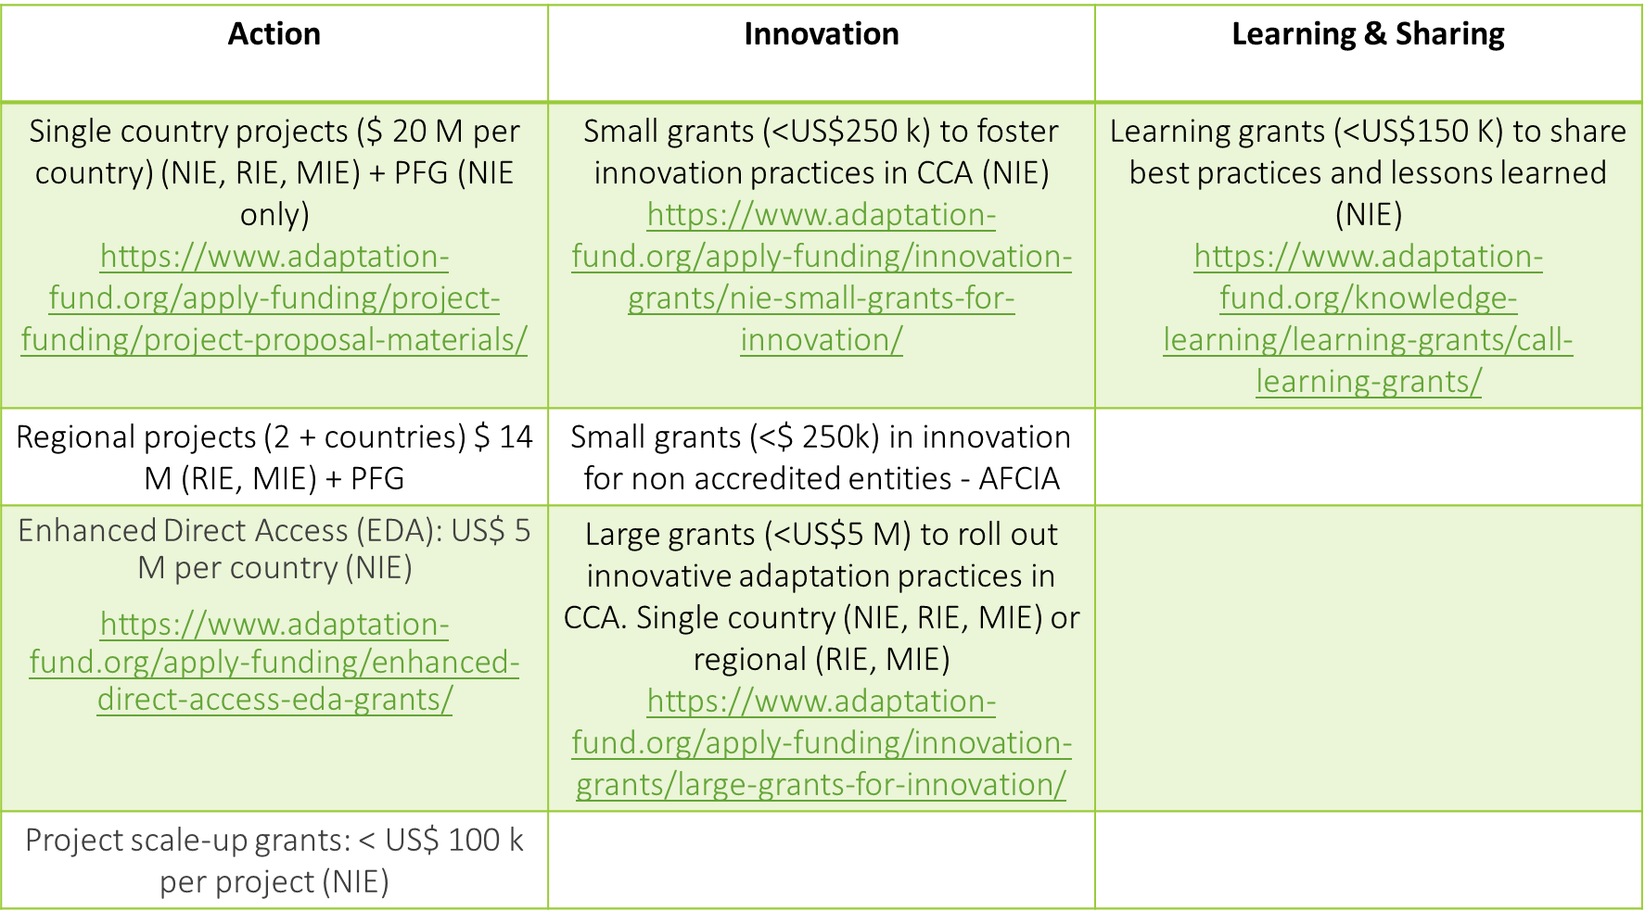
Funding opportunities

Slide 3
Project cycle
1. Project identification
3. Technical review by the AFB secretariat
4. Review by the Project and Programme Review Committee
5. Decision-making by the AFB
6. Contracting by the AFB
7. Project implementation
2. Submission of the project or programme proposal
8. Monitoring /Reporting by the Implementing Entity

Slide 4
Key documents and references
OPG-Annex 5 (review sheets/criteria , details of what needs to go in each section – the basis for how we undertake the review)
Instructions for preparing a request for project funding for EDA (to complement OPG Annex 5)
Environmental and Social Policy
Guidance document for Implementing Entities on compliance with the Adaptation Fund Environmental and Social Policy
Gender Policy and Action Plan of the Adaptation Fund (amended in March 2021)
Guidance document for Implementing Entities on compliance with the Adaptation Fund Gender Policy
https://www.adaptation-fund.org/documents-publications/operational-policies-guidelines/
https://www.adaptation-fund.org/apply-funding/enhanced-direct-access-eda-grants/

Slide 5
Eligibility – Letter of Endorsement
Please double check if the letter is signed by the correct DA (Check the AF website) and make sure it is still valid.
If the DA has changed, it is important to formally communicate this to the AF Secretariat! The letter should come from the Minister or similarly ranked government official (cabinet level or an ambassador).
In future review cycles, you are encouraged to send the LOEs well ahead of the proposal to ensure it is acceptable.

Slide 6
PROJECT JUSTIFICATION project supports concrete adaptation actions
Coherent Rationale: the suitability of activities in responding to the threats posed by future CC and on the use of EDA as a modality to address the adaptation issues.
  Likely climate scenarios in the country and target area
  Clarity on the environmental, social and economic climate change impacts
  The activities are suited to addressing the climate change impacts identified (why you chose these activities and not others)
  Activities will lead to substantial tangible outcomes (please be clear about these)
The activities align with the project’s overall goal and objectives ensuring the cohesion of the components among themselves – a good logical framework

Slide 7
Project justification
EDA RATIONALE
Project components should articulate the characteristics of the EDA model with description of locally led adaptation solutions
Presence of sub-project which could be USPs.
  Importance of USPs alignment with project objectives and with the Fund’s SRF.
  Type, sector, size and geographic locations of potential USPs should be fully described as far as possible.
Demonstrate that the adaptation measures proposed through the EDA are adequate for the identified climate threats.
Arrangements for technical assistance, monitoring and oversight of activities
Review and decision-making process for funding requests made by beneficiaries at sub-national level
Capacity building to support communities and structures at sub-national level to manage and report on funds

Slide 8
economic, social and environmental benefits, in compliance with ESP and GP
Information on the expected beneficiaries of the project, with particular reference to the equitable distribution of benefits to vulnerable communities, households, and individuals
In areas where marginalized and vulnerable groups and indigenous communities have been identified, outline particular benefits provided by the project to those groups
Outline benefits in all three areas: economic, social and environmental
Quantify the estimated benefits whenever possible
Highlight how you have integrated information resulting from the initial gender analysis to respond to the different needs, capabilities, roles and knowledge resources of women and men.

Slide 9
duplication of project with other funding sources
Identify all relevant potentially overlapping projects / programmes, and state lack of overlap / complementarity in a logical manner
Clearly outine linkages and synergies with all relevant potentially overlapping projects, avoiding evasive wording
Include areas of overlap and complementarity
Show how you have integrated lessons from the earlier initiatives during the project design, learning from their problems/mistakes
Outline any framework for coordination with complementary projects during implementation

Slide 10
Stakeholder consultations in compliance with ESP and GP
The consultative process is comprehensive and gender-responsive and involved all direct and indirect stakeholders of the project, including vulnerable groups
Outline all the stakeholders involved in the consultation process in the proposal with attention to minority groups, marginalized and vulnerable groups, and indigenous people in the target areas, where relevant
Include a report documenting the consultative process and contains
  a) the list of stakeholders already consulted (principles of choice, role ascription, date of consultation),
  b) a description of the consultation techniques (tailored specifically per target group),
  c) the key consultation findings (in particular suggestions and concerns raised)
Specify how the results of the consultative process are reflected in the project design, including consultation on safeguards process and outcomes

Slide 11
financing justification and full cost of adaptation reasoning
Demonstrate that the project activities are relevant in addressing its adaptation objectives and that, taken solely, without additional funding from other donors, they will help achieve these objectives
If project has co-financing, the Adaptation Fund project should be able to deliver its outcomes and outputs regardless of the success of the other project(s)
Activities that, taken out of context, could be considered “business-as-usual” development should be justified in the context of achieving the adaptation goals of the project.

Slide 12
alignment with AF’s results framework
The project includes a results framework which specifies the alignment with Adaptation Fund revised strategic results framework adopted in 2019
(https://www.adaptation-fund.org/wp-content/uploads/2019/10/Adaptation-Fund-Strategic-Results-Framework-Amended-in-March-2019-2.pdf)

Slide 13
the sustainability of the project
Outline how the adaptation benefits achieved by the project can be:
          sustained after its end and
          enable replication and scaling up with other funds after its end.
Explains the arrangements through which this would be achieved, taking into account:
          sustainability and maintenance of any infrastructure or installations to be developed,
          policies and governance arrangements to be developed and implemented,
          knowledge to be generated, management,
          other capacity to be improved, etc.
Address all key areas of sustainability, including but not limited to economic, social, environmental, institutional, and financial.

Slide 14
environmental and social risks, in compliance with the ESP and GP
Identify all potential environmental and social impacts and risks.
State the category in which the screening process has classified the project. (Category A, B or C). Please also ensure that these categories reflect AF ESP and not your organization’s.
Provide a checklist, indicating which environmental and social impacts and risks have been identified (for each ESP principle) and provide justification of the risk identification findings.
For the identified risk, carry out an environmental and social impact assessment
Include sufficient supporting documentation (annexes) including a gender assessment and action plan report.

Slide 15
Gender Policy - Requirements
2. PROJECT PROPSAL REQUIREMENTS | CONCEPT STAGE | FULL PROPOSAL STAGE
Initial Gender Assessment | ✓
Full Gender Assessment |  | ✓
Gender-Responsive Indicators |  | ✓
Gender-Responsive Implementation & Monitoring Programs |  | ✓
Preliminary gender equal consultation | ✓
Comprehensive gender equal consultation |  | ✓
Implement a fair and transparent Grievance Mechanism |  | ✓

Slide 16
Concept and Full Proposal ESP Requirements
Project Proposal (OPG Annex 5) IE will demonstrate and document the following: | Concept Proposal | Full Proposal
JUSTIFICATION
II.B. Economic, social and environmental benefits; Avoidance/mitigation of adverse impacts. | ✓ | ✓
II.E. Compliance with relevant national technical standards | ✓ | ✓
II.H. Consultative process | ✓ | ✓
II.K. Environmental and social impacts and risks | ✓ | ✓
III. IMPLEMENTATION ARRANGEMENTS
III.C. Environmental & Social risk management measures |  | ✓
III. D. Monitoring and evaluation program, budget |  | ✓
III.E. Results framework including milestones, targets, & indicators |  | ✓

Slide 17
IE Fees/ Execution costs, budget
Ensure that the figures add up across all budget tables – total amount requested, vs. components table vs. budget vs. Disbursement table.
The figures are rounded to a whole number (i.e. no decimals),
The Project Execution Cost is below 12% of the total budget (including fee)
The management fee (“IE fee”) is below 10% of the total budget before fee
In case of Implementing Entity serving as the Executing Entity, the limit for execution is 1.5%. The justifications must be provided, as this arrangement can be approved only on an exceptional basis.

Slide 18
IE Eligibility
Various cases where accreditation expires before the Board meeting, or the entity is in the re-accreditation process
Please ensure your re-accreditation is started well in advance if you plan to submit a proposal.

Slide 19
EDA Implementation arrangements
Description of decision-making structure at local level and institutional levels involved, providing evidence for locally led adaptation;
Describe roles and responsibilities of IE and EE(s) or other organizations/stakeholders involved in the project;
Continued capacity building + multi-stakeholder engagement approach
Process to identify, screen and address environmental and social risks should be described

Slide 20
Compliance with ESP/GP– Implementation arrangements (ESMP)
Identify adequate and credible measures to manage the impacts for all environmental and social risks that have been identified in section II, and the corresponding impacts that have been assessed
ESMP should contain/include:
  clearly allocated roles and responsibilities for its implementation
  opportunities for consultation and adaptive management
  credible budget provisions, as needed, for the implementation of the ESMP
Outline the arrangements for the IE to supervise executing entities for implementation of ESMP
Include clear monitoring and evaluation arrangements for ESP compliance
Include an accessible and meaningful grievance mechanism in place, mentioning all parts of the grievance process, including where grievances can be addressed

Slide 21
results framework
The results framework includes realistic, quantified expected results with indicators and targets that are gender responsive and disaggregated by sex as appropriate.
Include a table showing the linkage between project objectives and outcomes to the Fund level outcome and outputs (refer to the revised 2019 AF’s result framework)
The project result framework must include at least the core impact indicator “Number of beneficiaries including estimations for direct and indirect beneficiaries”.
A second core indicator must be added if the project includes activities targeting the areas identified in AF results framework, namely (1) Early Warning System; (2) Assets Produced, Developed; (3) Improved, or Strengthened; (4) Increased income, or avoided decrease in income or (5) Natural Assets Protected or Rehabilitated.

Slide 22
How can the Secretariat Help?
Your feedback on challenging sections or areas is helpful to us to see what additional guidance or training can be provided
If some aspects of the initial technical review is unclear, you can request to schedule a call with the secretariat and lead reviewer to clarify certain points.

Slide 23
Thank you!

