Slide 1

Operational Policies
and
Guidelines
of the Adaptation Fund
April 23-25
Apia, Samoa

Slide 2
The Adaptation Fund
An innovative financial mechanism:
Governing body: equitable and balanced representation of Kyoto Protocol Parties
New funding source: international levy
Direct access to AF resources for eligible countries

Slide 3
Resources
Proceeds from monetized CERs: US$168.3M
Annex-I parties contributions:
  Spain €45M, Monaco €10k, Germany €10M, Sweden SEK200M, Switzerland CHF 3M
  Pledges: Australia AU$ 15M, Brussels Capital Region €1M
Funds allocated by March 16, 2012: US$ 115.7M
Current Funding Availability: US$ 140
Estimated funds available by end-2012:
  Medium estimate US$ 204M (low: 187M;
  high: 223M)
Notes:
Estimated funds available figure is based on AFB/EFC.8/7, Table 5, line 16 (“Potential resources”).

Slide 4
Institutional Arrangements
Secretariat: GEF on an interim basis
Trustee: World Bank on an interim basis
KP Parties discussed a review of the interim institutional arrangements in CMP7 (December 2011) and decided to complete the review in CMP8
CMP
Secretariat (GEF interim basis)
AFB
Trustee (World Bank interim basis)

Slide 5
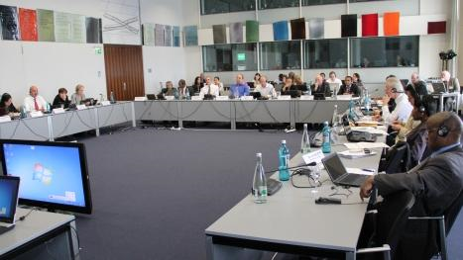
Governing Body: the AF Board
Composed of 16 members and alternate members representing:
  5 UN regions
  LDCs
  SIDS
  Annex I Parties
  Non-Annex I Parties
Equitable and balanced representation of Kyoto Protocol Parties
Legal capacity: Germany 2011
Notes:
The Board is composed of 16 members and their alternate members representing Parties, formally elected at a session of the CMP as follows:
Two representatives from each of the five UN regional groups;
One representative of the small island developing states;
One representative of the least developed country Parties;
Two other representatives from Annex I Parties; and
Two other representatives from non-Annex I parties.
Two years term, once renewable

Slide 6
Mandate
The Adaptation Fund:
  assist developing country Parties to the Kyoto Protocol that are particularly vulnerable to the adverse effects of climate change in meeting the costs of adaptation
  finance concrete adaptation projects and programmes that are country driven and are based on the needs, views and priorities of eligible Parties

Slide 7
Strategic Priorities
To finance concrete adaptation projects and programmes that:
  take place in developing country Parties that are Parties to the Kyoto Protocol (Decision 10/CP.7)
  are country driven and are based on the needs, views and priorities of eligible Parties (1/CMP.3)
  take into account, inter alia, national sustainable development strategies, poverty reduction strategies, NCs, NAPAs and other relevant
  instruments, where they exist (5/CMP.2)

Slide 8
Strategic Priorities
The Adaptation Fund:
  Should finance projects/programmes with particular emphasis on the most vulnerable communities;
  In developing projects and programmes to be funded under the Adaptation Fund, eligible Parties should consider information included in reports from the IPCC and information generated under the Nairobi work programme on impacts, vulnerability and adaptation to climate change.

Slide 9
Key Decisions
Adoption of the following key strategic decisions:
Prioritization of the direct access modality
Cap on maximum level of funding for MIEs → 50% cumulative funding decisions
Option of a project formulation grant for NIE proponents → $30k

Slide 10
Access Modalities
The AF provides the following access modalities:
Direct access
Multilateral access modality
Regional access modality
(to be elaborated further in Session 2)

Slide 11
Designated Authorities
Institutional background:
Each Party shall designate and communicate to the secretariat the authority that will represent the government of such Party in its relations with the Board and its secretariat.
The Designated Authority shall be an officer within the Party’s government administration.
The communication to the secretariat shall be made in writing and signed by either a Minister, an authority at cabinet level, or the Ambassador of the Party.

Slide 12
Designated Authorities (cont.)
The main responsibility of the Designated Authority is the endorsement on behalf of the national government of:
  accreditation applications as National Implementing Entities submitted by national entities;
  accreditation applications as Regional or Sub-regional Implementing Entities submitted by regional or sub-regional entities; and
  projects and programmes proposed by the implementing entities, either national, regional, subregional, or multilateral.
Identification of an appropriate NIE candidate

Slide 13
Designated Authority (DA) is:
The Government focal point towards the Adaptation Fund Board / AFB Secretariat
Responsible for endorsing the use of selected implementation modality
  NIE, MIE or RIE?
  Which organization is the most suitable?
  If NIE, which organization best meets criteria for applying accreditation?

Slide 14
Designated Authority (DA) is:
Responsible for endorsing each project/ programme submitted for AF funding from the country
  Understanding of the needs and priorities
  Knowledge of adaptation-related and sector strategies and policies
  Understanding of other adaptation activities taking place (avoidance of duplication)

Slide 15
Designated Authority (DA) is:
Responsible for observing project/programme during implementation
  Reviewing mid-term report
  Ensuring that government continues to endorse
    The Implementing Entity
    The project or programme being implemented
Eligible to call off project implementation if it ceases to endorse the IE or the project

Slide 16
Designated Authority (DA) is:
A person, not an institution
  Clarity on authority
Specifically appointed to this task
  Not automatically through other focal point roles, such as DNA, GEF Focal Point, etc.
Has to bear sufficient authority at the government level to perform this function.

Slide 17
Appointment of DA
The Adaptation Fund Board on April 8, 2010 sent out letters to all eligible countries requesting them to appoint DAs.
The communication to the secretariat shall be made in writing and signed by either a Minister, an authority at cabinet level, or the Ambassador of the Party.

Slide 18
When to appoint a DA?
Even if there is no active plan to have an AF project in the country, having a DA appointed ensures that the country can readily endorse national/regional implementing entities and project ideas
Deciding on DA may take some time
If no project / accreditation application, no additional burden to DA

Slide 19
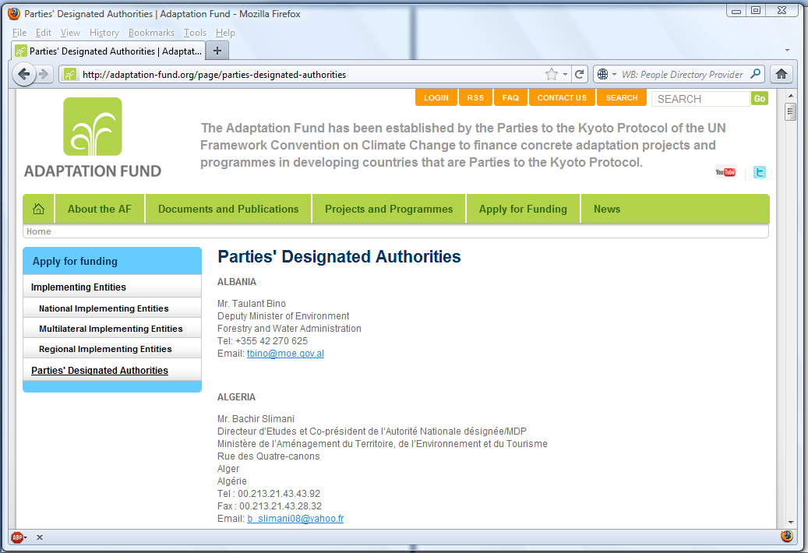
DAs Listed on AF website

Slide 20
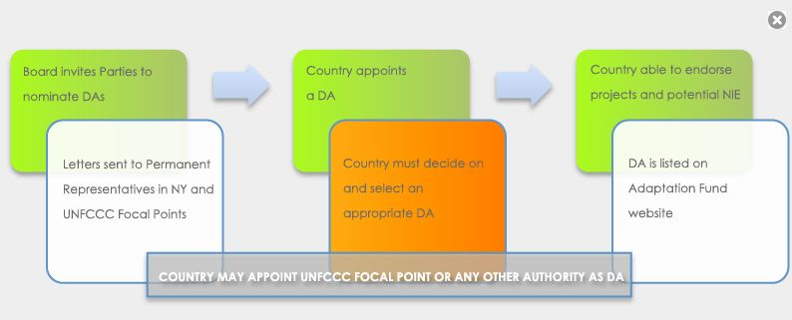
DA appointment process
Note: More information in the NIE Accreditation Toolkit

Slide 21
Identification of NIEs: Observations
Some countries have reported difficulties in establishing a robust process for undertaking selection of appropriate NIEs
In some other cases, the Fiduciary Standards were not given adequate consideration during the selection process
Inadequate due diligence when reviewing existing institutional capacity of the potential NIEs.
Focus some times is primarily on handling international donor/loan funds with low priority on project management capabilities.

Slide 22
NIE Role
Para 27 of the Operational Policies and Guidelines for parties to access resources from the Adaption Fund clearly defines the role of NIEs as below:
The NIEs will bear full responsibility for the overall management of the project and programmes
The NIEs will bear all the financial, monitoring and reporting responsibilities

Slide 23
Selecting a potential NIE
Selection should be through a defined process and not just a one off decision
Designated Authority (DA) needs to play a key role throughout the process

Slide 24
Suggested Process
DA to set up a Selection Committee (SC) (e.g. 2 or 3 persons)
Based on the requirements of the Fiduciary Standard the SC should identify a few potential NIEs.
Based on preliminary assessment develop a shortlist of 2 or 3 suitable entities
Undertake due diligence of the shortlisted entities
Identify gaps relating to the Fiduciary Standards for the selected entities

Slide 25
Process …… contd
Examine potential of each entity to bridge the gaps
Select most appropriate entity
Work with entity to fulfill the gaps
Work with entity to complete accreditation application and supporting documentation
Verify final application before submission to the Adaptation Fund

Slide 26
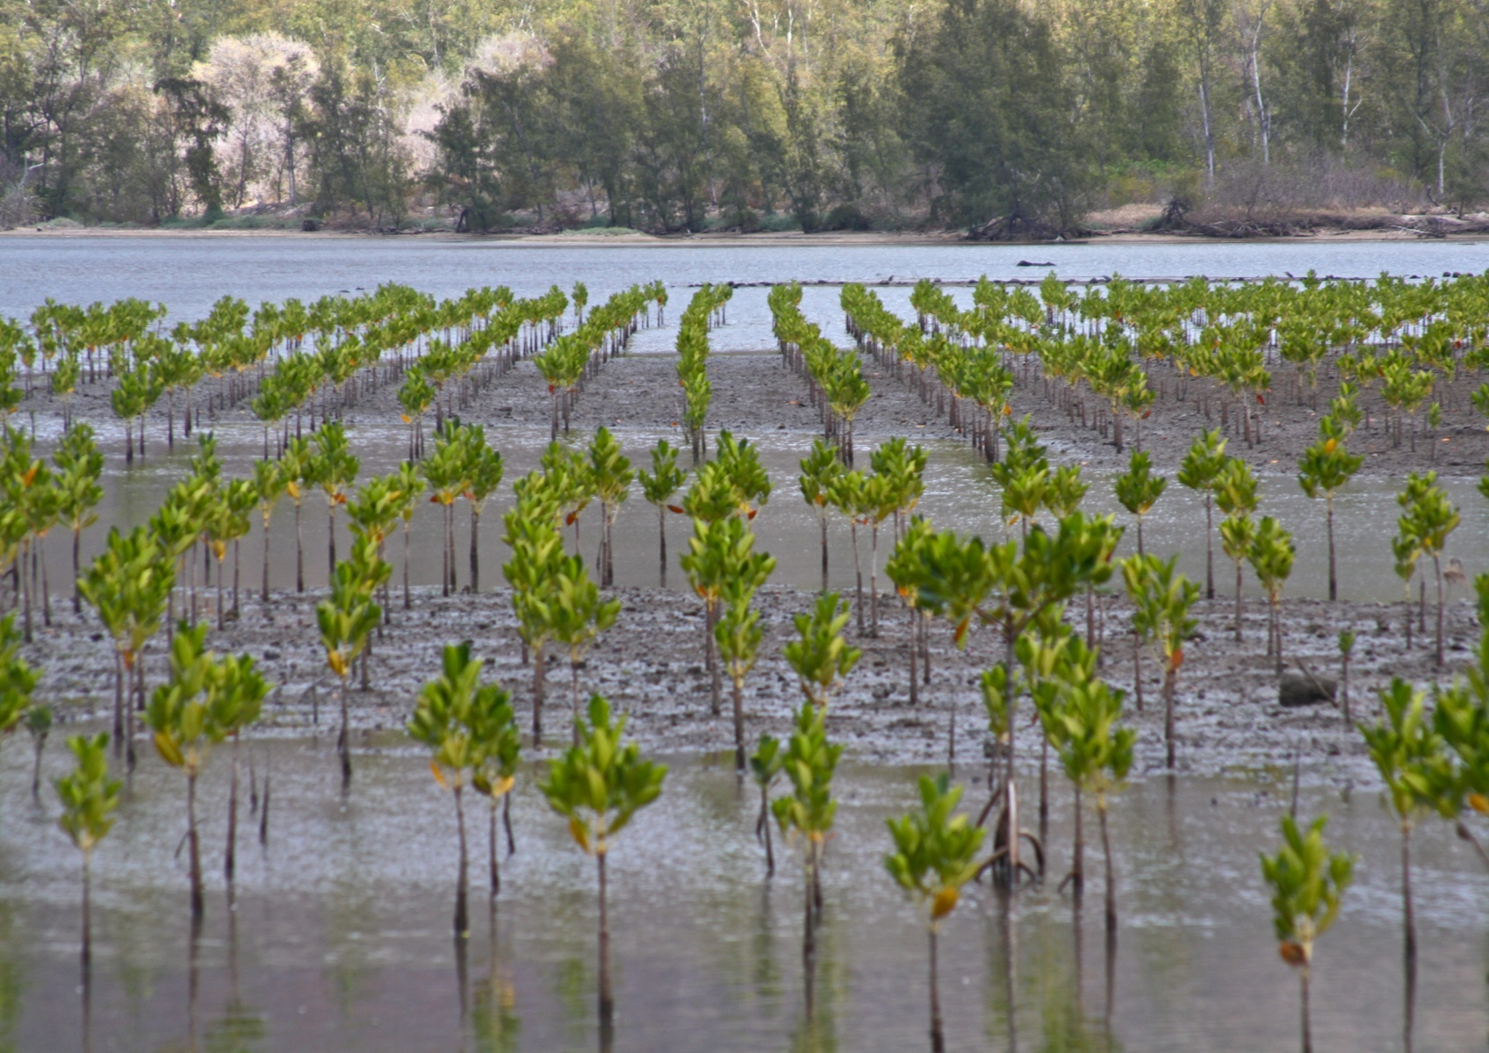
Thank you!

