Slide 1
Stakeholder Engagement and Grievance Mechanisms for Project-Affected Communities
Shaza Zeinelabdin
Social development specialist, IFC
July 29, 2015
Notes:
I understand that this morning, there was a break out session on consultation whereby a number of key challenges were highlighted by yourselves; a lot of the points that you have highlighted resonated with myself as we tend to come across them frequently in our projects. So this afternoon, we delve a little deeper into the question of what makes a good stakeholder engagement program?

Slide 2
Defining Stakeholder engagement
What does good stakeholder engagement mean to you?
“Stakeholder engagement is the basis for building strong, constructive, and responsive relationships that are essential for the successful management of a project’s environmental and social impacts”
Notes:
We’ve seen from our experiences globally that when Project sponsors are able to engage well with affected communities, this brings tremendous value to both sides in terms of building social acceptance & support for the project, BUT when it’s not done well, problems often arise.
And yet stakeholder engagement continues to be an area where many of our clients still struggle to get it right. If I may pause for a minute and ask to audience “ What does good stakeholder engagement mean to you”?
ICE Breaker. .. Will ask the Q to the audience
In broad terms, pro-active engagement enhances a project’s development impact, proponent’s local standing and overall “brand” value (social license to operate) and provides a defense against negative press, costly community action and complaints.

Slide 3
Level Of Risk Drives Level of Effort
Public Consultation
OTHER INTERESTED STAKEHOLDERS
Disclosure
ADVERSELY IMPACTED PERSONS
Active Engagement
Information Sharing
Negotiation
SIGNIFICANTLY IMPACTED PERSONS
Informed Participation
Notes:
One of the first questions we get from project proponents when we talk to them about SE is is “who do we have to talk to and how much time is this going to take?” Our experience has shown that it is most effective to determine the level of risk to the broad range of stakeholders who may be affected by the project or have an interest in it. The level of risk will determine the level of effort in terms of SE - So you start from a broader universe (with general sharing of information) and narrow the intensity so that the bulk of ones efforts focus on those who are most at risk.

Slide 4
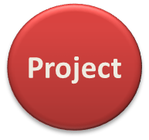
Where and how to begin
Local
government /
Mayors
General
Public
Buyers /
Customers
National
Government
Agencies
Traditional
Authorities
Affected
Communities
Civil Societies
Investors
Settlers/
Encroachers
Illegal settlers
Community
Enterprises /
CBOs
Media
Employees
from
communities
Service
Providers
Notes:
So let’s look at this in the context of a project - stakeholder landscape can be complex in a context that is characterized by Challenging business climate
Difficult and ever-changing Political environment; Complicated social context, characterized by land conflicts and politicization of the land issue; Multiple issues and stakeholders with competing interests and agendas. Or it may be less complex but there are a number of stakeholders that need to be analyzed and prioritized
stakeholder mapping exercise - the first step was to identify the broad range of stakeholders who might be interested in or affected by the project
And the second step was to PRIORITZE them according to the level of risk and impact.
Land Acquisition
Land rights and land use conflicts
Indigenous Peoples
Supply Chain
Poverty and Livelihoods
Deforestation
Shifting Political Dynamics
Benefits Sharing
Illegal logging
Climate Change
Illegal settlers

Slide 5
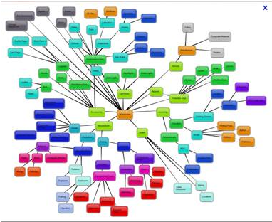
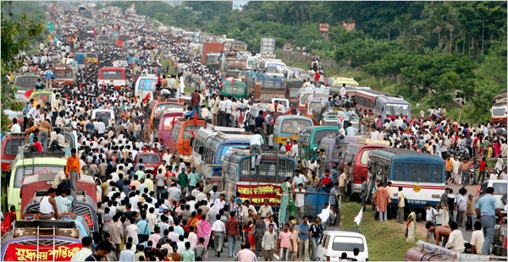
Stakeholder mapping
Identify/locate all potential stakeholders
Understand their “stake”
How project can affect them / how they can affect the project
Who influences whom?
Prioritize engagement efforts
Notes:
Stakeholder Mapping is an essential tool and process that encourages the physical identification of the universe of stakeholders and their individual interests relative to the project– who they are, where they are located, what are their interests (do they stand to gain or lose from the project), and this starts to help prioritize the Project Proponent’s engagement efforts from a risk perspective (which we talked about a few minutes ago)
(Ask Audience) – Have you been involved in any stakeholder mapping exercise? Do you think it was useful?

Slide 6
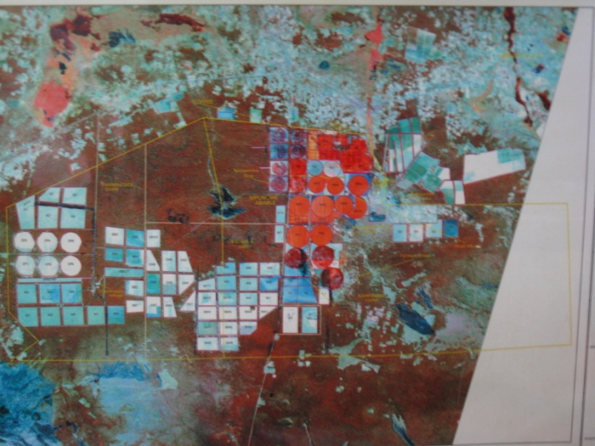
Some Commonly Used Tools for Stakeholder Mapping
Impact Zone Mapping
Venn Diagram
Notes:
Types of mapping may include “impact zone mapping” where you essentially overlay the project’s design components and their anticipated impacts over a map of stakeholder groups in the area to determine the “severity” of impacts on some groups relative to others as a way of informing to the client’s engagement strategy.
Another way of “mapping” stakeholders is through a Venn Diagram, which highlights areas of convergence of interests among stakeholders that can inform the development of a stakeholder engagement strategy. This is a relatively simple diagram compared to the complexity of the situations we encounter.

Slide 7
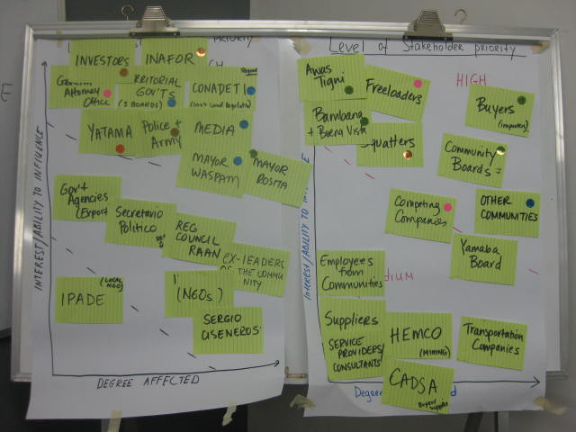
Some Commonly Used Tools for Stakeholder Mapping
How to keep happy people happy and turn unhappy ones into project supporters?
Influence (high, medium, low)
Impact (high, medium, low)
Support (positive, neutral, negative)
Notes:
Then there’s the old school method with flip charts and sticky notes
This is an Impact-Influence Grid to help rank stakeholder priority
On one axis, Influence - Who can affect the business? (High, med, low)
On the other axis, Impact – Who is affected by the project? )High medium low_
Using color coding to indicate What is their position vis-à-vis the company? (supportive, neutral, opposed?)
This starts to make clear the level of engagement for each group
So in other words, if you have a high priority stakeholder group who is against the project, this is job #1.
Overall, the goal is to keep the happy stakeholders happy

Slide 8
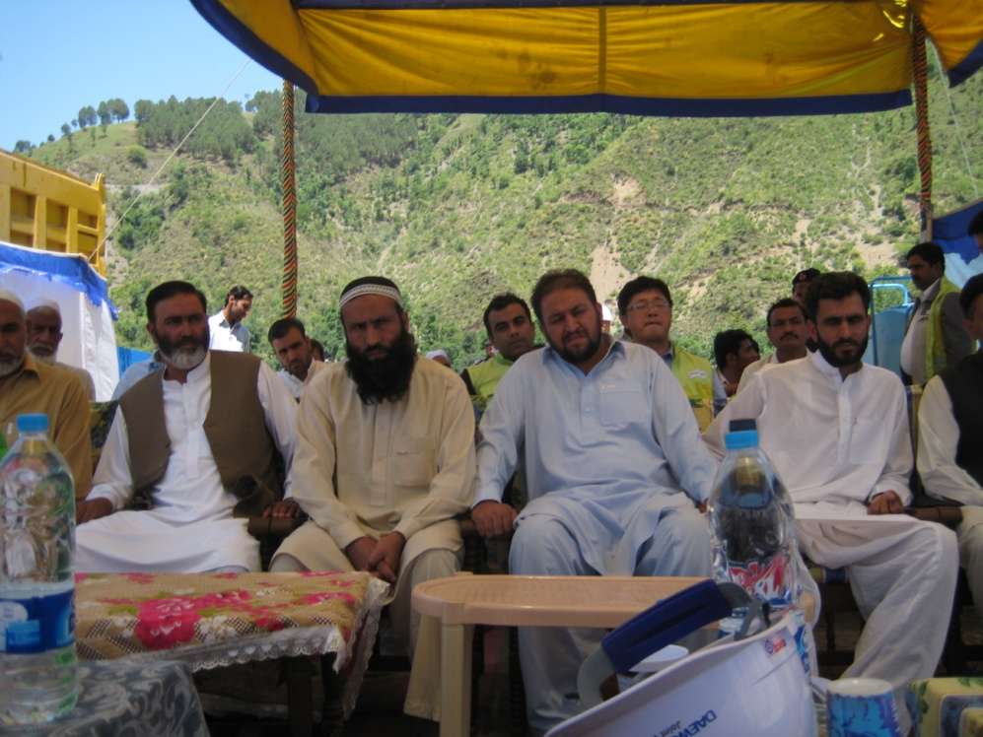
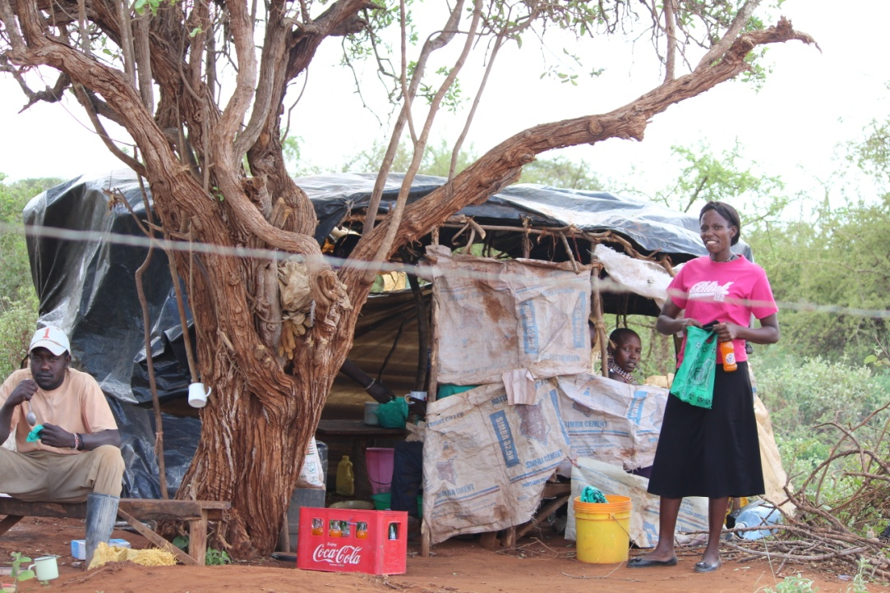
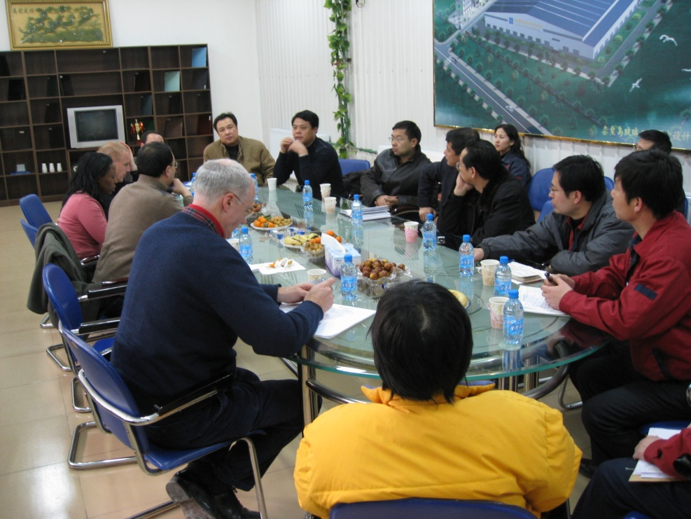
Stakeholder Types
Primary Stakeholders – directly affected
Secondary Stakeholders – indirectly affected
Influencing Stakeholders
Sub-groups – within each of the above categories
Notes:
Here is one typology of stakeholders - one way of looking at stakeholder groups.
What mapping emphasizes is: the physical location of these groups relative to project impacts
and the relationships between/among groups that can be leveraged to improve a client’s engagement with stakeholders
And prioritize which stakeholders’ interests are important to the success and sustainability of a project.
Good stakeholder mapping should also identify sub-groups within stakeholder categories such as the “community”. This could be women, men, fisherman, farmers, youth – and identify their specific issues/ interests, how they might be differentially impacted and how engagement might need to be tailored to meet their specific needs.
Example: ERC Refinery in Egypt, client discovered there was a high level of illiteracy among the women in the surrounding villages so they engaged a local NGO to read the project information to them and facilitate discussion.

Slide 9
Sample Stakeholder Mapping Table
STAKEHOLDER GROUPS | Degree of Influence on Project Outcomes (H/M/L) | Degree Impacted by Project (H/M/L) | Position vs. Project -Supportive -Neutral -Opposed | How will We Engage this Group? - Issues -Methods
Government Agencies
Affected Communities Sub-groups: Fishing Villages; Indigenous groups; Women; Elders; Youth; Religious Minorities, etc.
Neighboring Communities
Trucking Contractors
Business owners
Illegal Settlers
NGOs
Tribal Chiefs
Politicians or Religious Leaders
This information should be used to prioritize the stakeholders and level of effort, as well as tailor consultation and information dissemination to the needs and interests of different groups.

Slide 10
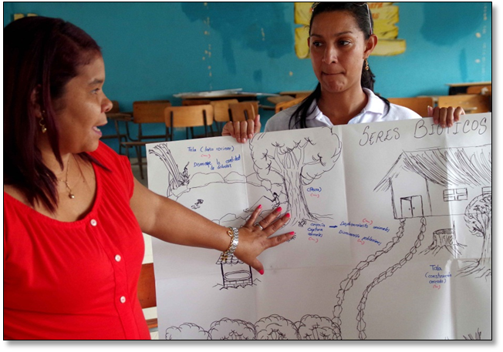
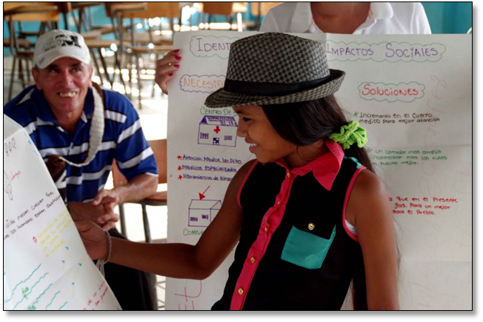
What is “Meaningful” Consultation?
Informed
Interactive (Two-way engagement)
Inclusive
Iterative
Influences the decision-making process
Incorporates access to a Grievance Mechanism
Notes:
One hears a lot these days that consultation should be “meaningful”. Has anyone heard this phrase “meaningful consultation?”
So what is the meaning of meaningful consultation? Any ideas? (What qualities would you expect?)
Let’s go through each of these in more detail….

Slide 11
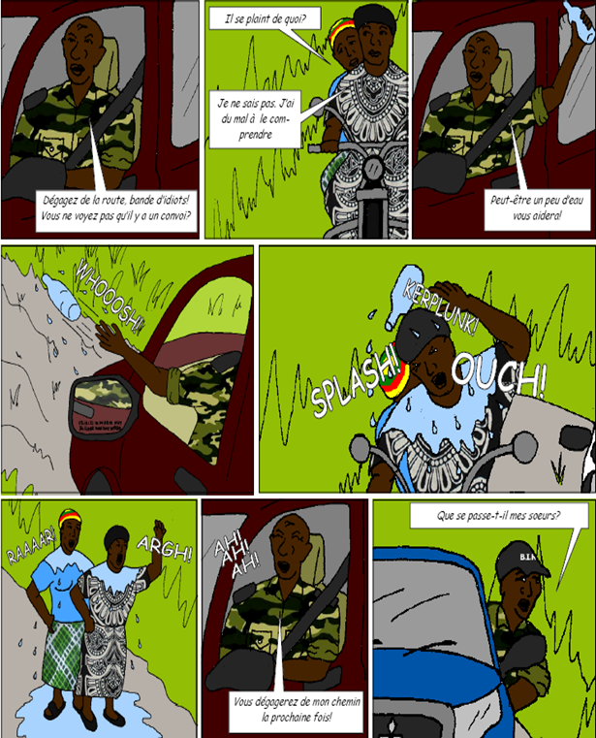
Informed
Sufficient time – information in advance
Substantive – full description of project
Understandable – in non-technical terms, Local language, Format they can understand
Accessible – convenient access to information
Notes:
If communities are to feel informed when they are meeting with a company or government officials, what might they need?
Time – they need to be given enough time ahead of any meeting to review and prepare and discuss. I know that this was raised as key challenge this morning during the break out session. What we see is that often times, the consultation process begins later in the project cycle, good practice is to involve the stakeholders as early as the concept stage to gauge support of opposition and identify issues early on and take into consideration during the decision making process.
Details – They need enough details to really understand what is being proposed / implications
Understandable format– Instead of giving local people a 500 page technical environmental document to read, a company in Cameroon produced a comic book to explain project impacts to communities. This particular scene has to do with risks related to bad behavior by security guards. The comic book turned out to be extremely popular & was a very effective way to raise awareness about the project. Children were reading it to their parents.
So understanding who is the audience, and making the information meaningful for them is very important.
Does anyone have a good example of this they’d like to share?

Slide 12
Inclusive
Recognize and accommodate unequal power relationships
Views of both men & women
Consider sub-groups (minorities, youth, elders)
Vulnerable groups who may be unwilling or unable to express themselves in a large public meeting
“Verify” community representation
Notes:
What does it mean to make a consultation process inclusive? What type of considerations should we think about?
This is a photo from an IFC project where the client reported that they had a very successful public consultation and 100s of people attended. But what do you notice about this picture?;
Being inclusive means paying attention to who is in the room and who is speaking, but also to who is not in the room or why they may not speaking up in public.
In this type of situation, what might you do to try and make its process more inclusive? Any ideas?
(separate meetings with women; focus groups; organize committees with diverse representation)

Slide 13
Iterative (ongoing) Engagement
A “one-off” public meeting
(often the only regulatory requirement for environmental licensing)
is usually insufficient for achieving meaningful engagement.
Notes:
The one-off public meeting (shown here) that is often the statutory requirement for environmental licensing is seldom a satisfactory, or meaningful, engagement of stakeholders. It is often removed from the project location, dominated by representatives of households or vocal groups within the community, or those who stand to gain the most or the least from the project.
Some communities, or sub-groups within those communities, may need multiple engagements to enable them to understand the full impact of a project and what it means for them. Indigenous groups may need time to reach an understanding and an acceptance of a project through there unique systems of deliberation and consensus building.

Slide 14
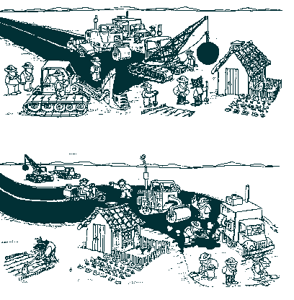
Influences Decision-making
Project design & implementation
Impact mitigation
Project benefits
Demonstrated incorporation of stakeholder views in the decision-making process
Notes:
Perhaps the biggest test of whether a consultation process is “meaningful” is whether the Project Proponent actually takes stakeholder concerns and ideas into account in its decision-making about the project.
Now this doesn’t mean that a company can or should do everything a community asks. But it does mean that as a result of consultation and dialogue, there have been certain changes, adjustments, compromises – perhaps on both sides.
Does anyone have examples of where the consultation process has positively influenced the project?

Slide 15
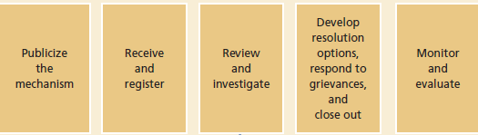
Grievance Mechanisms – Process Steps
Multiple access points
Awareness-raising about the GM
Systematic tracking (logs & databases)
Seeking feedback (users and non-users)
Engaging communities in design of GM
Notes:
Finally I want to mention grievance mechanisms which are an important component of meaningful engagement because it gives people a way to have their complaints or concerns about the project heard and addressed.
For a Project Proponent, a GM should be seen as an “early warning” system to identify and address problems before they can escalate into bigger issues.
This slide outlines some of the key steps of the process:
First, making sure people know about the GM and how to use it (hotline # advertised on billboard; grievance officer passes on business cards)
Second, have a clear system in place for receiving and recording complaints (usually through a complaints log or database); ensuring they are properly reviewed; and communicating the proposed resolution to the complainant in a timely manner
And then following up to make sure the agreed solution is implemented & people are generally satisfied

Slide 16
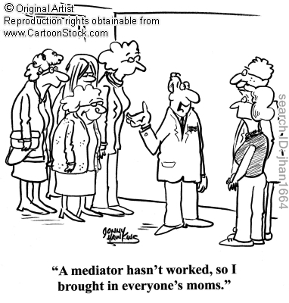
Different Categories of Grievances Require Different responses
Different Mechanisms
Internal Mechanisms
Tri-partite Model
Independent Mediator
In Low Trust Contexts
Third Party Verification Model
(NGO as “witness”)
Joint fact finding
Participatory Monitoring
Notes:
But not all grievances are the same. Some might be more serious than others, or the context might be one of poor relationships between the Project Proponents and local communities, where the level of trust is low.
So the type of mechanism used needs to fit the situation. For example, a contractor running over someone’s chicken should be something that can be easily resolved at the project level.
But in a situation where large numbers of people are claiming their land was historically taken without compensation – this may require a more formal process, that may go beyond the project to resolve, and involve representation from gov’t and communities.
And where agreement cannot be reached, we have lots of examples where using an independent mediator has been successful.
In low trust environments where people do not trust the validity of the information (environmental studies) or the government’s land records, what we’ve seen work is measures designed to build credibility and create greater transparency.
For example having a third party (such as an NGO or legal advisor) present when people are signing land agreements to make sure they truly understand their rights and are not doing so under coercion.
Last example is on joint fact finding, especially around land issues, where official records are poor or disputed and the only way to go forward is to take a step backward and create a process where communities become part of helping the generate the information & creating a shared understanding of events among stakeholders.

Slide 17
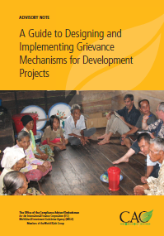
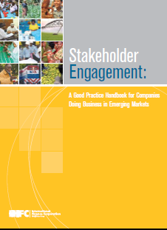
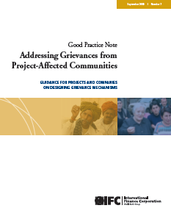
Guidance on Stakeholder Engagement and Grievance Mechanisms
CAO: A Guide to Designing and Implementing Grievance Mechanisms for Development Projects
IFC: Stakeholder Engagement: A Good Practice Handbook for Companies Doing Business in Emerging Markets
IFC: Good Practice Note: Addressing Grievances from Project Affected Communities

Slide 18
Thank You!

