Slide 1
FINANCE AND ECONOMIC MANAGEMENT
GOVERNMENT OF THE COOK ISLANDS
PO Box 120, Rarotonga, Cook Islands
Telephone + 682 22878 ♦ Facsimile + 682 23877
EMAIL cifinsec@mfem.gov.ck ♦ http://www.mfem.gov.ck
Cook Islands Adaptation Fund Project and NIE update

Slide 2
Agenda
Introduction
Cook Island – Quick overview
Project background
Project Objectives
NIE background and process

Slide 3
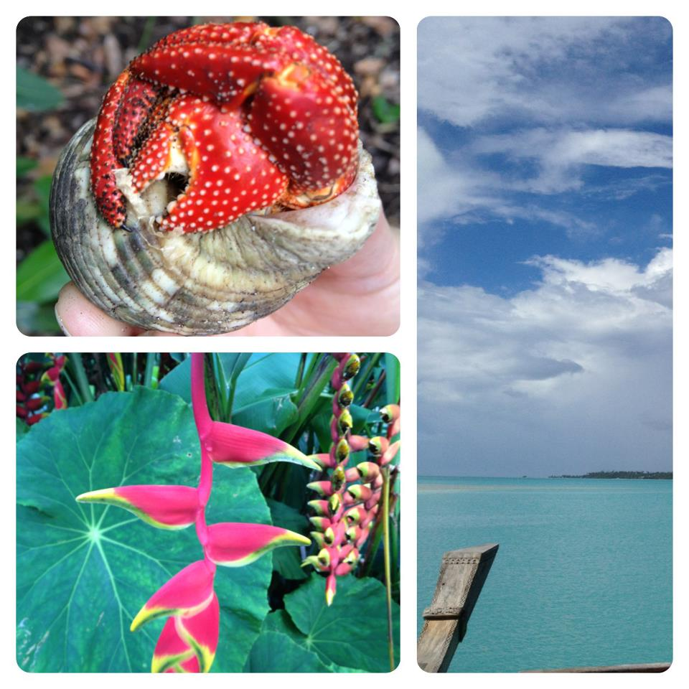

Slide 4
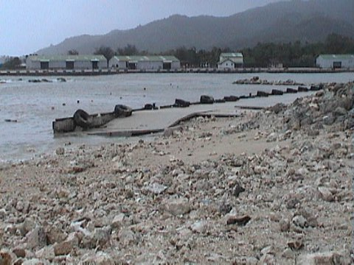

Slide 5
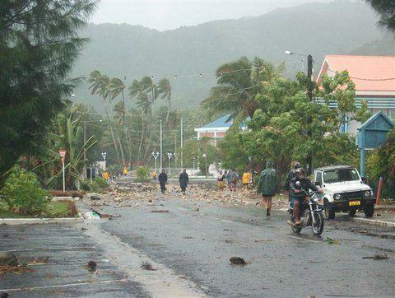
Notes:
Avarua after the cyclone

Slide 6
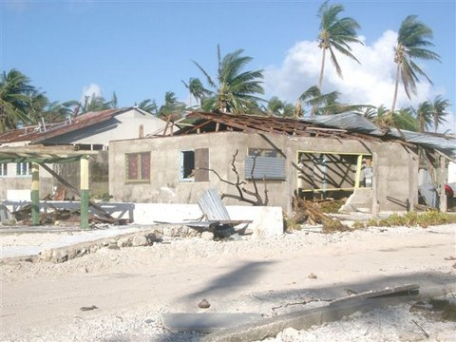
Notes:
Pukapuka

Slide 7
Partnership approach

Slide 8
Cook Islands – UNDP Proposal Formulation Consultations
Objective
To obtain inputs and guidance from stakeholders related to formulating a project designed to enhance the resilience of communities in the Cook Islands through integrated climate change adaptation and disaster risk management interventions.

Slide 9
Cook Islands Project
Strengthening the Resilience of our Islands and our Communities to Climate Change (SRIC - CC)
Akamatutu’anga i te iti tangata no te tuatau manakokore ia e te taui’anga reva

Slide 10
Programme Objective
To strengthen the ability of all Cook Island communities and the public service to make informed decisions and manage anticipated climate change driven pressures (including extreme events) in a pro-active, integrated and strategic manner.

Slide 11
Objectives cont...
The Programme will also contribute to all outcomes listed within the 2 objectives of the Adaptation Fund Strategic Results Framework and corresponds particularly to the following higher order fund-level outputs:
Output 1.1. Risk and vulnerability assessments conducted and updated at national level;
Output 1.2 Targeted population groups covered by adequate risk reduction systems;
Output 1.3 Targeted population groups participating in adaptation and risk reduction awareness activities; and
Output 2.2 Vulnerable physical, natural and social assets strengthened in response to climate change impacts, including variability.
output 2.4. Targeted individual and community livelihood strategies strengthened in relation to climate change impacts, including variability
5 year programme of work

Slide 12
Practical application
To implement the Joint National Action Plan JNAP) for Disaster Risk Reduction and Climate Change Adaptation
To reduce climate change related risks in the Pa Enua, and especially at community level

Slide 13
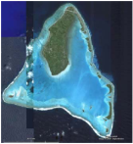
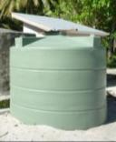
AF proposal - an opportunity to further develop and implement part of the DRM-CCA JNAP:
National capacity: integrate DRM-CCA into sectoral policies and plans, climate early warning system
Island capacity: integrate DRM-CCA into island-level development processes
Implement on-the-ground measures: coastal management, agriculture, water, health
Create programme management and delivery capacity that can attract further funding – because the AF funds will not be enough to cover all CCA-DRM needs

Slide 14
Programme Structure
Community-engagement in vulnerability assessment, adaptation planning and awareness
USD 785,000
Integrated community-based DRM-CCA measures
USD 3,215,000
Institutional strengthening for DRR-CCA-NAP implementation
USD 500,000
Programme support:
Nationally Executed:
NES, MoE, MMR, MOIP, MoH, MoA, OPM
NGOs
Island, Vaka Councils
Project Management
(National Executing Agency)
USD 460,000
total budget
USD 5,381,600
Implementing Agency Fee
(UNDP)
USD 421,600

Slide 15
Formulation process/timeline - Original:
Aug-Sept 2010 -Scoping mission, NCCCT meeting, initial consultations
Sept 2010 - Initial concept submitted for Cabinet approval:
Oct 2010 - Project concept submitted to AF:
Dec 2010 - Concept approved by AF Board at Cancun UNFCCC COP
Febr 28-4 March 2011DRR-CCA Planning week and related consultations
June 2011 Final stakeholder meeting:
July 2011 full proposal to be submitted to AF Secretariat
Sept. 2011 AF Board meeting
November 2011 – starting at earliest
UPDATED:
Final plan was approval in December 2011(resubmission required)
March 2011 AFB signed off UNDP as an MIE
April – planning (AWP, Project office)
June – Inception workshop

Slide 16
NIE Process
Interest established in pursuing Adaptation Funding
Discussion/decision about NIE readiness back in 2010
Designated Authority chosen (MFAI)
Project concept/project proposal in conjunction with UNDP
MIE status for UNDP showed us direct access needed to be an avenue for us moving forward
UNDP NY assessment & report completed
Workshop commitment
Report on actions we need to take to ensure readiness for NIE application process

Slide 17
NIE process cont...
UNDP NY & Samoa completed in-country visit to:
Elaborate and clarify the NIE accreditation application requirements
Facilitate and conduct a capacity assessment of MFEM on the AF’s accreditation requirements
Provide advice on the development of a capacity development strategy and action plan

