Slide 1
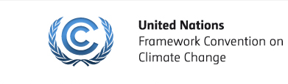
The Accreditation Process
April 23-25
Apia, Samoa

Slide 2
Access modalities
Direct Access Modality
Eligible Parties can submit their projects/programmes directly to the AFB through an accredited National Implementing Entity (NIE).
Multilateral Access Modality
  Parties can submit their proposals through an accredited Multilateral Implementing Entity (MIE).
  Regional Access Modality
  A group of Parties may also nominate regional and sub-regional entities (RIE) as implementing entities.

Slide 3
Access modalities (2)
NIE, RIE and MIE shall:
Meet the fiduciary standards established by the AFB:
  Financial management and integrity
  Institutional capacity
  Transparency, self-investigative powers and anti-corruption measures
Bear full responsibility for the overall management of the projects and programmes; and
Carry out financial, monitoring and reporting responsibilities.

Slide 4
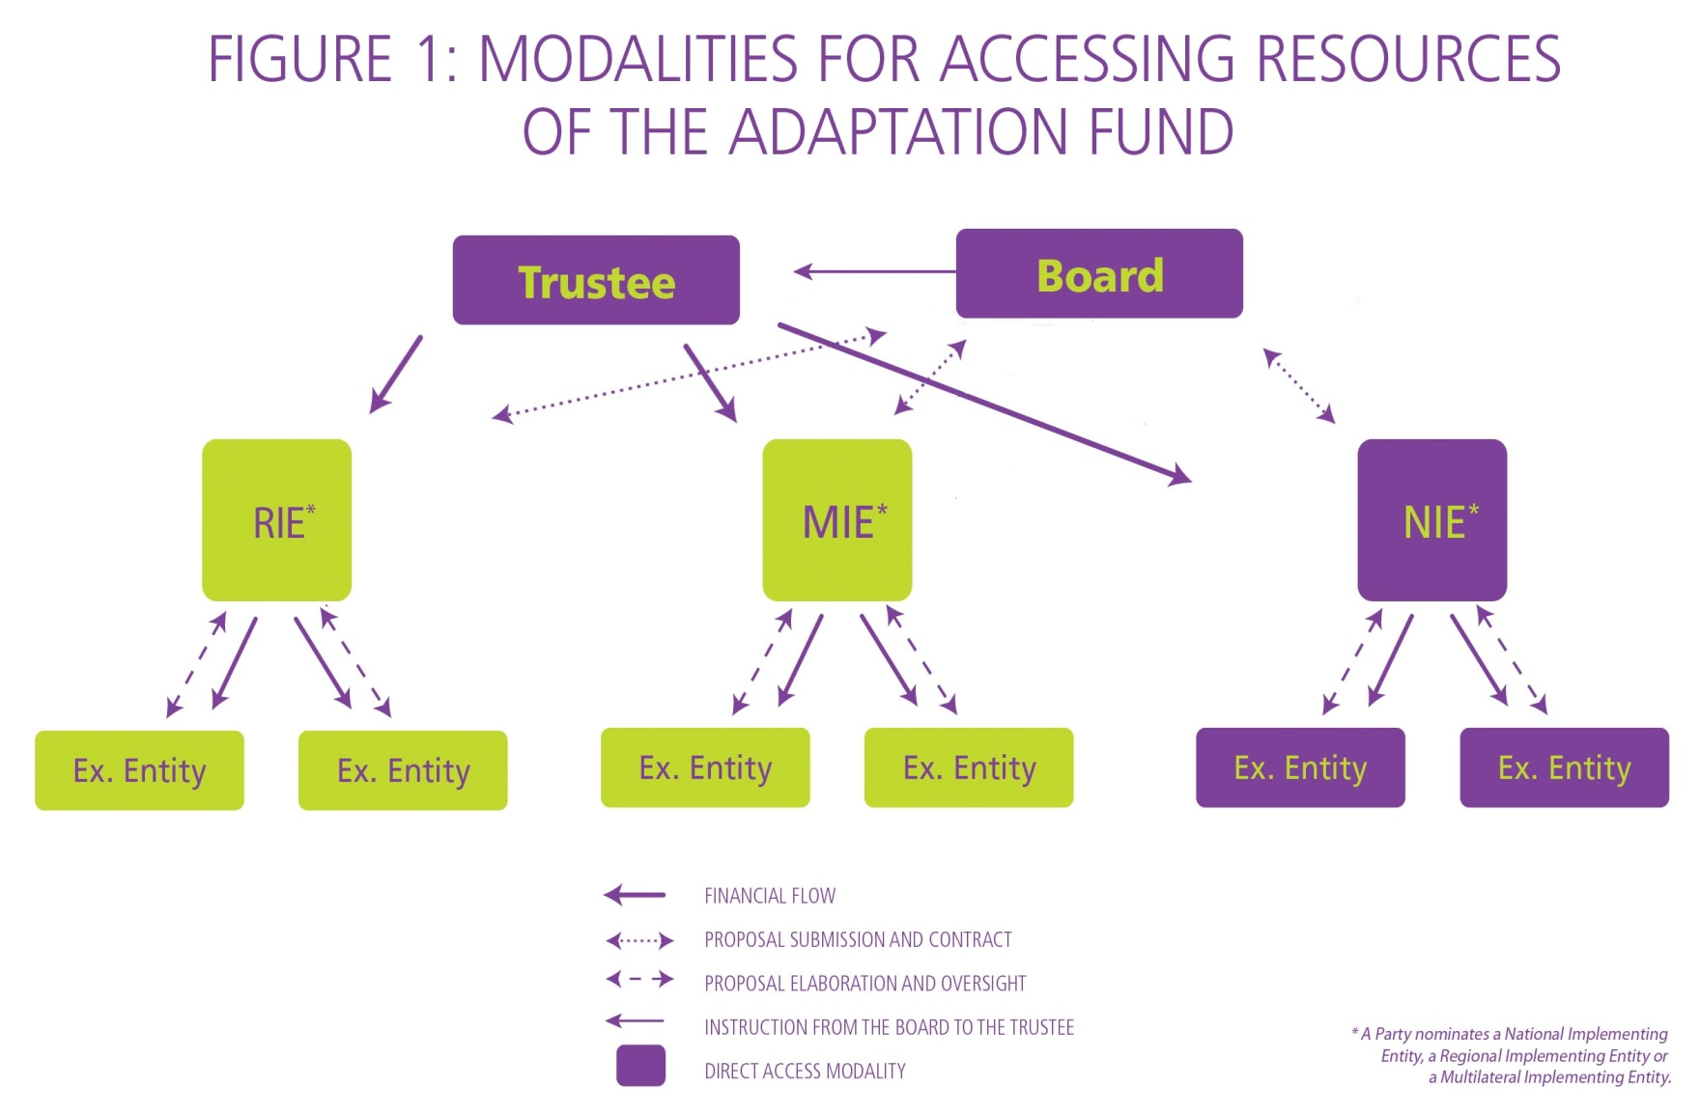
Access modalities

Slide 5
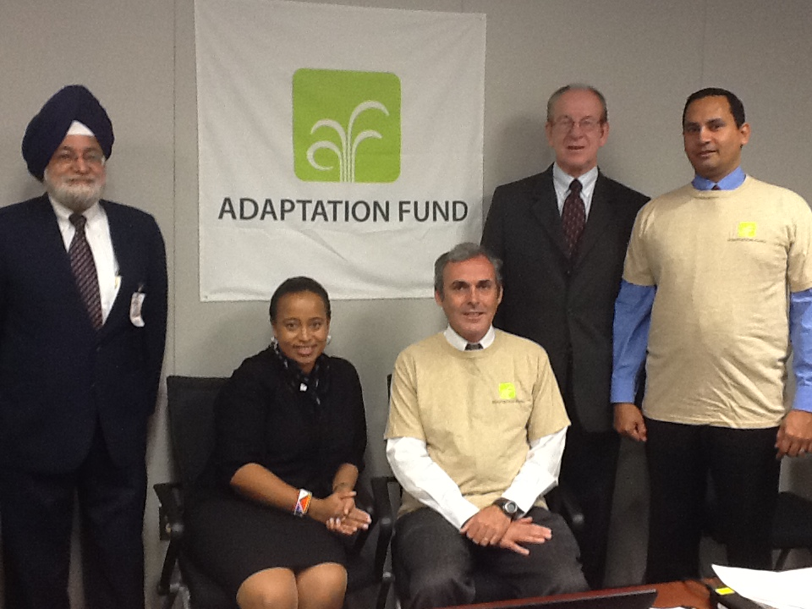
Accreditation Panel

Slide 6
Why Direct Access?
Advantages:
  Empower developing countries to manage their own funds following their own priorities
  Swifter inception and implementation to meet the immediate needs of vulnerable countries
  Retain more funds within the country
  Recognize the potential of strong institutions in developing countries
  Improve institutional and operational processes thru acc.
Is the process cumbersome?
  The AF has made it a priority to streamline its procedures. This is the fundamental premise of the Fund
  The Panel works with applicants. It is not an antagonistic process

Slide 7
What is accreditation?
To check and certify an organization’s capabilities for carrying out the required tasks for meeting the defined goals
Required tasks include maintenance of accounts and preparation of financial statements, provisions for external and internal audit, procurement, project management and creating and maintaining an ethical and corruption-free environment
The goal is to successfully complete the projects within planned budget and time and also meet the objectives outlined in the project document

Slide 8
Verifying capabilities
Does the organization have appropriate processes and systems defined and documented to undertake the tasks and achieve the stated objectives? (refer previous slide)
Does the organization have adequate checks and balances to monitor, control and report on the activities?
Does the organization have adequate competence at various levels for implementing the processes and systems effectively and efficiently?

Slide 9
Criteria for Accreditation
The organization should be able to demonstrate/showcase capabilities in terms of policies/framework and give adequate evidence of experience in effectively carrying out the activities required

Slide 10
Access modalities: the Accreditation Process
Step 0: The government appoints a Designated Authority. The DA must endorse the accreditation application of Implementing Entity and all IE project/programme proposals.
Step 1: Submit application:
  Description of how the organization meets the specific required capabilities
  Attachment of supporting documentation
Step 2: Accreditation Panel Reviews Application.
Step 3: Panel can request additional information/clarification from organization.
  Might suggest to Board that an on-site visit is required
  Might suggest that technical support needs to be provided to an applicant to improve its capacity in order to attain accreditation
Step 4: Panel makes recommendation to AF Board.
Step 5: AF Board makes final decision on accreditation of entity

Slide 11
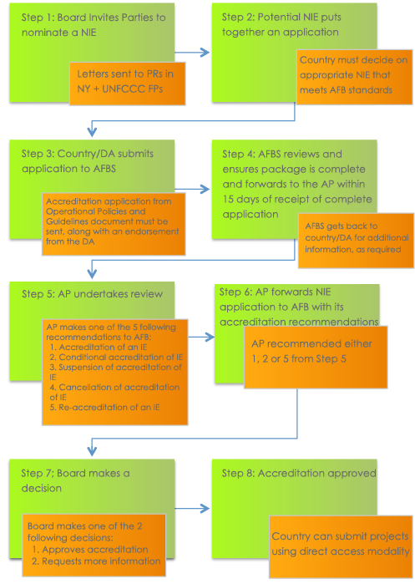

Slide 12
Access modalities:
Implementing Entities
11 National Implementing Entities accredited:
  Centre de Suivi Ecologique (Senegal)
  Planning Institute of Jamaica (Jamaica)
  Agencia Nacional de Investigación e Innovación (Uruguay)
  Fonds national pour l'environnement (Benin)
  South African National Institute for Biodiversity (South Africa)
  Protected Areas Conservation Trust (Belize)
  Ministry of Natural Resources (Rwanda)
  Ministry of Planning and International Cooperation (Jordan)
  National Environment Management Authority (Kenya)
  Instituto Mexicano de Tecnologia del Agua (Mexico)
  Unidad para el Cambio Rural (Argentina)
1 Regional Implementing Entity
    Banque Ouest Africaine de Développement
10 Multilateral Implementing Entities accredited:
  The World Bank, ADB, AfDB, IADB, UNDP, UNEP, IFAD, WFP, WMO, UNESCO
Swift accreditation process: can be done in 3 months

