Slide 1
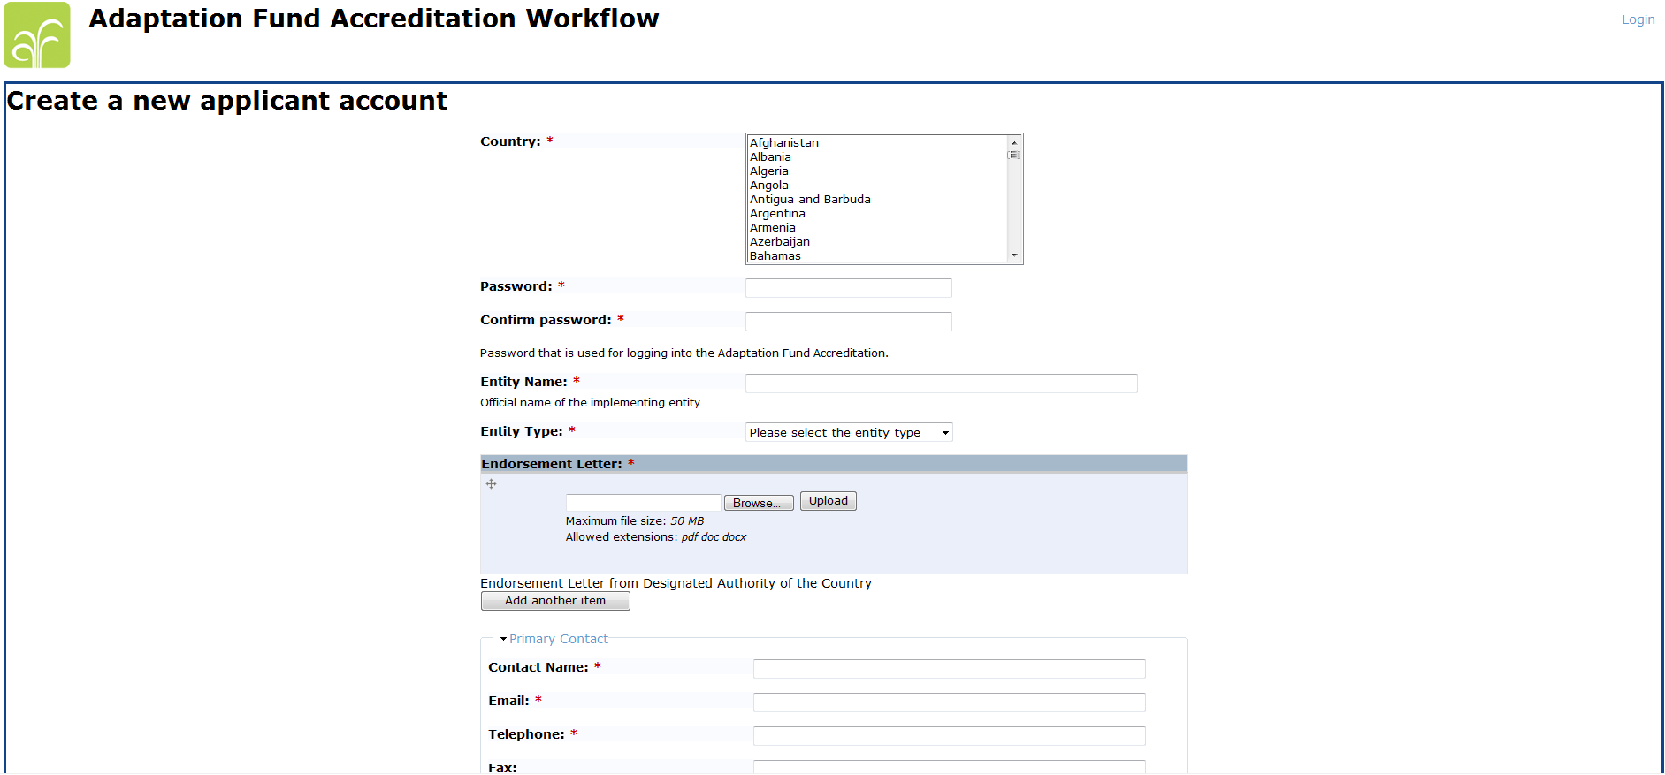
Application Form – Registering as user
DA should provide contact details (especially email) of the applicant entity.
The secretariat will send the link to the registration form above to this contact.
The contact person at the identified NIE candidate should fill in this form to create a user name and be able to login into the system.

Slide 2
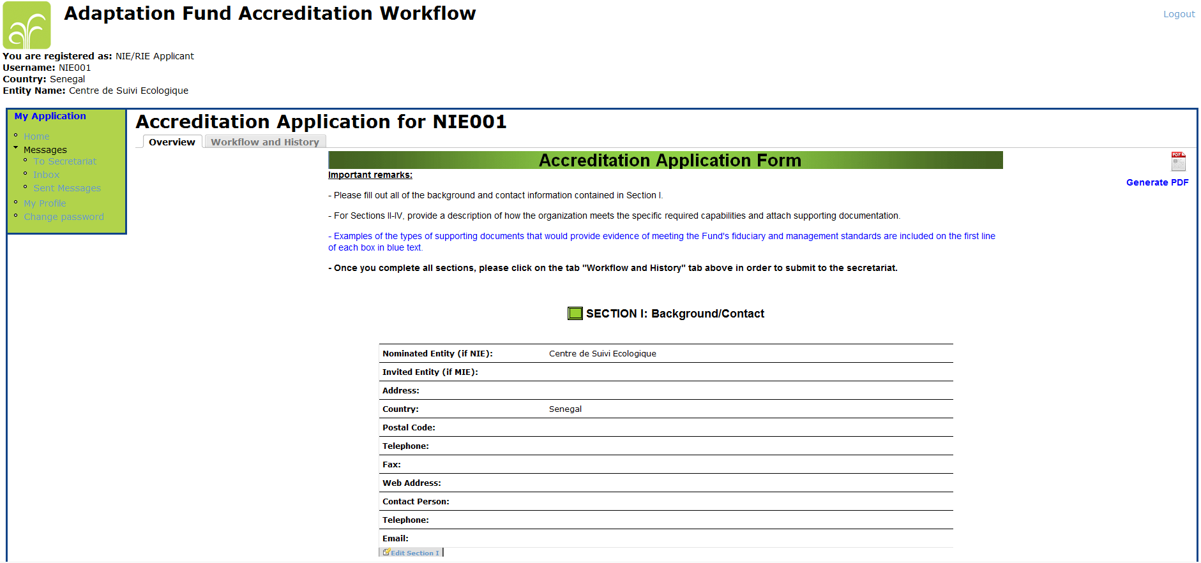
Application Form – Section I
Data should be entered by clicking here

Slide 3
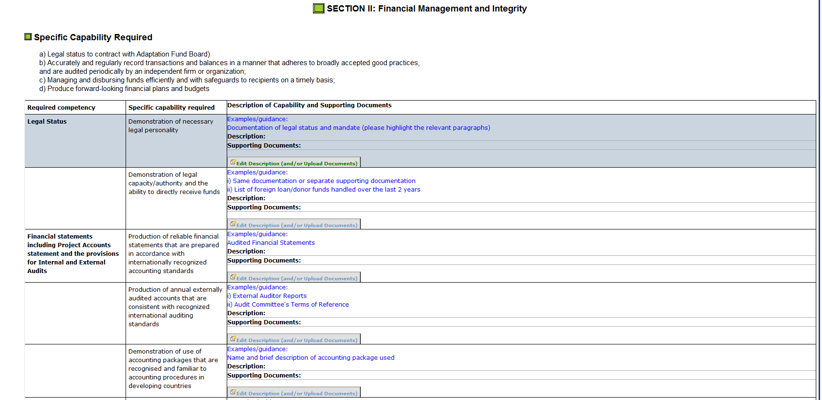
Application Form – Section II, III and IV
User should click on “Edit Description”

Slide 4
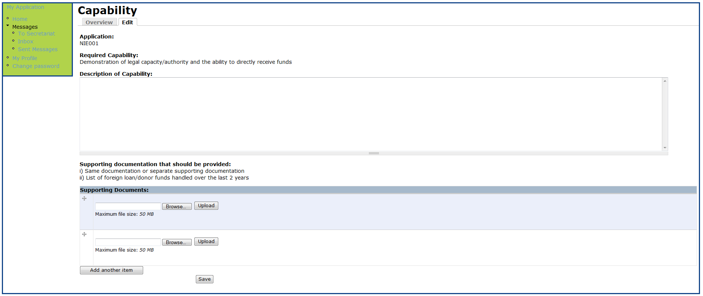
Application Form – Section II, III and IV – Editing description
Description of how the entity meets this particular capability should be entered in this text box.
Supporting documents providing evidence of this capability should be uploaded here.
All changes should be saved by clicking on this button

Slide 5
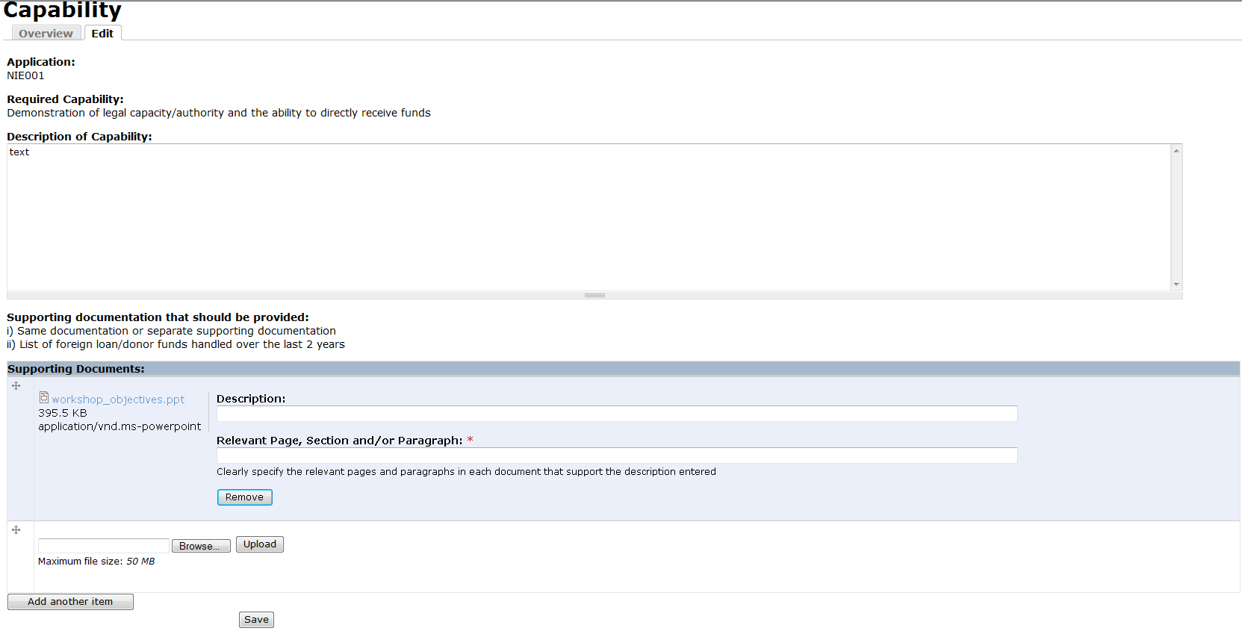
Application Form – Section II, III and IV – Editing description
Once uploaded, the system will ask for a short description of the supporting document (e.g. Law No. XYZ establishing the entity and mandate).
The user should also specify the page, paragraph or section that are relevant for the demonstration of the capability.

Slide 6
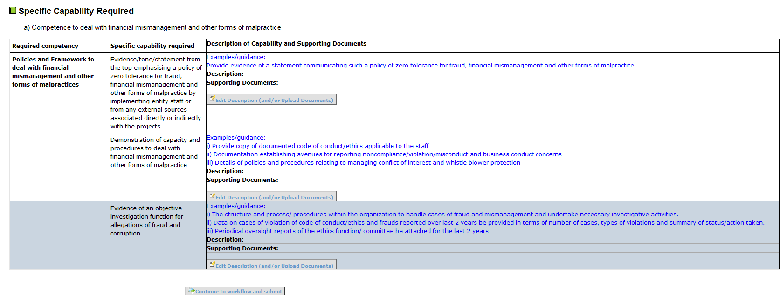
Application Form – Submitting the application
Once completed, the form can be submitted by clicking on the button “Continue to workflow and submit” at the bottom of the page.

Slide 7
Application Form – Submitting the application
This will bring the user to this screen, where any comment to the secretariat can be entered here in the text box.
…and finally, the application can be submitted by clicking here

Slide 8
Thank you! To receive login credentials, DA should please email: secretariat@adaptation-fund.org

