Slide 1

AF Project Cycle
and Approval Process
Manila, the Philippines
19-21 March 2012

Slide 2

Financing criteria
Funding provided on full adaptation costs basis of projects and programmes to address the adverse effects of climate change
AF will finance projects/programmes whose principal and explicit aim is to adapt and increase climate resilience
Projects/programmes have to be concrete: discussion on definition on-going

Slide 3
Financing criteria (2)
Accommodation of different country circumstances: no prescribed sectors or approaches
Focus on vulnerable communities
All projects/programmes must include a knowledge component
Temporary country cap: USD 10 million
Temporary cap for MIE share of funds: 50%

Slide 4
Prerequisites for proposing project
Recipient country/countries eligibility
Proposed by an accredited Implementing Entity (NIE / RIE / MIE)
Proposal and access modality endorsed by the Designated Authority (DA)
Country/ies did not receive funds up to country cap
Proposal has to meet project review criteria

Slide 5
Financing Windows
Parties may undertake adaptation activities under the following categories:
  Small-size projects and programmes (proposals requesting up to $1 million); and
  Regular projects and programmes (proposals requesting over $1million).

Slide 6
Project/Programme Proposals
For projects/programmes larger than USD 1M, a choice of a one step (full proposal) or two step process (concept approval and project/programme document)
For small-scale projects (below USD 1M) one-step process
NIE proponents can get Project Formulation Grant for developing endorsed concepts to full proposals
Deadline for proposals 9 weeks before AFB meetings

Slide 7
Project Concept Required Content
All concept content areas also apply to fully-developed project documents
  more information is required at that stage
Country Eligibility
  Country should be party to the Kyoto Protocol
  Country should be a developing country particularly vulnerable to the adverse effects of climate change (all non-Annex I countries qualify)

Slide 8
Project Concept Required Content (2)
Project Justification
  The project endorsed by the government through its Designated Authority
  The project / programme supports concrete adaptation actions to assist the country in addressing the adverse effects of climate change and builds in climate change resilience: description of activities

Slide 9
Project Concept Required Content (3)
Project Justification (continued)
  The project / programme provides economic, social and environmental benefits, with particular reference to the most vulnerable communities, including gender considerations
  Cost-effectiveness of the project / programme: comparison to other possible interventions

Slide 10
Project Concept Required Content (4)
Project Justification (continued)
  The project / programme consistence with national sustainable development strategies, national development plans, poverty reduction strategies, national communications or adaptation programs of action, and other relevant instruments
  The project / programme meets the relevant national technical standards: EIA, building codes

Slide 11
Project Concept Required Content (5)
Project Justification (continued)
  The project does not duplicate / overlap with activities funded through other funding sources
  The project / programme has a learning and knowledge management component to capture and feedback lessons
  The project / programme has been developed through a consultative process involving all stakeholders, including vulnerable communities
  and women

Slide 12
Project Concept Required Content (6)
Project Justification (continued)
  The project / programme provides justification for the funding requested on the basis of the full cost of adaptation
  The project / programme aligned with the AF results framework
  The sustainability of the project/programme outcomes taken into account when designing the project

Slide 13
Full Proposal Additional Content
Implementation Arrangements
  Adequate arrangements for project management
  Measures for financial and project risk management
  Arrangements for monitoring and evaluation clearly defined, including a budgeted M&E plan
  A project results framework included. Relevant targets and indicators disaggregated
  by gender

Slide 14
Full Proposal Additional Content (2)
Information accrued during project development
  Results of consultative process with stakeholders
  Results of preparatory assessments, if any
  More detailed information on all technical and operational aspects of the project
Disbursement schedule
Relevant additional documents as annexes

Slide 15
Provisions on project budget
The requested project funding must be within the cap of the country: currently USD 10 M
The Implementing Entity management fee must be at or below 8.5 per cent of the total project/ programme budget before the fee
The project/programme execution costs must be at or below 9.5 per cent of the total project/ programme budget before the fee

Slide 16
Important steps in project development
Acquiring adequate information about the adaptation challenge and other factors
Ensuring alignment with national strategies and plans
Avoiding overlap with other similar projects
Ensuring alignment with AF results framework
Adequate consultations with vulnerable communities and women (for full proposal)

Slide 17
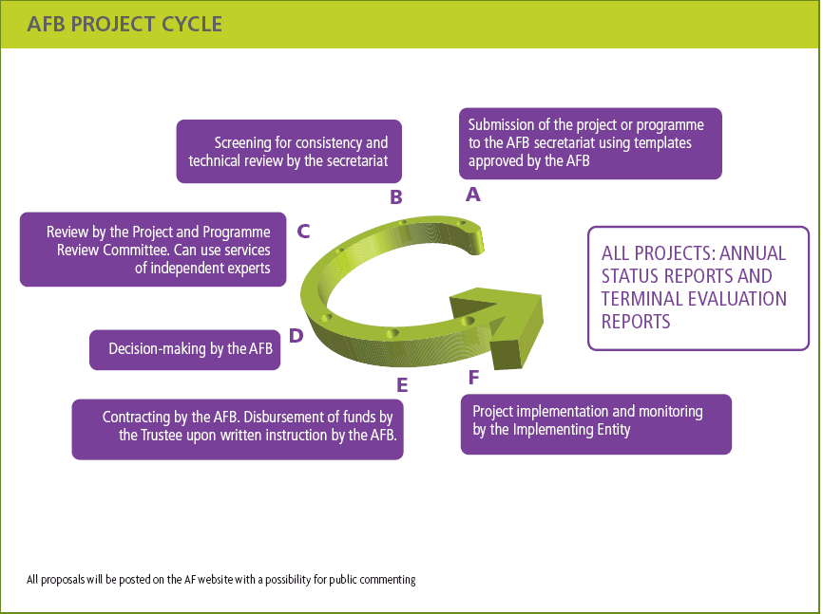

Slide 18
Key Decisions
Adoption of the following strategic decisions:
Results Based Management (RBM) and Strategic Results Framework
M & E framework and guidelines for final assessment
Strategic framework for knowledge management
Project Formulation Grant

Slide 19
Transfer of Funds
Project/Programme Formulation Grants (PFG)
  NIEs (only) may submit a request for a PFG together with together with a concept. A PFG can only be awarded when a project/programme concept is presented and endorsed.
Project/programme funds are committed upon the approval of the proposal. Once the legal agreement is signed, the Trustee will transfer funds on the written instruction of the Board. Funds are transferred in tranches based on the disbursement schedule with time bound milestones submitted with the fully developed proposal
The Board may require a progress review from the Implementing Entity prior to each tranche transfer ( or to suspend transfer of funds)

Slide 20
AF Results Framework

Slide 21
AF Results Framework (2)

Slide 22
Alignment with AF results framework: example

Slide 23
Project Reporting Process
Report Type | Frequency | Responsibility
Project/Programme Inception Report | Start of project/programme | Implementing Entity
Project/Programme Performance Report (PPR) | Yearly, rolling basis | Implementing Entity
Project/Programme Mid-term/Terminal Evaluations | Mid-term/End of project/programme | Implementing Entity
Audited financial statement | Once, end of project | Implementing Entity
Adaptation Fund Annual Performance Report (AFAPR) | Yearly, fiscal year | AFB secretariat
Adaptation Fund Evaluation Report | Yearly, fiscal year | AFB independent evaluation function

Slide 24
The Adaptation Fund Project Portfolio
Africa
Senegal
Eritrea
Madagascar
Mauritius
Tanzania
Asia
Maldives
Mongolia
Pakistan
Turkmenistan
Eastern Europe
Georgia
Latin America and Caribbean
Uruguay
Ecuador
Honduras
Nicaragua
Pacific
Cook Islands
Samoa
Solomon Islands
Also: 10 endorsed project concepts

Slide 25
The Adaptation Fund Project Portfolio

Slide 26
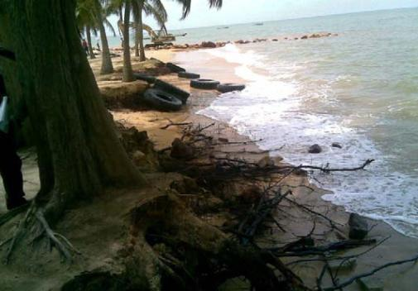
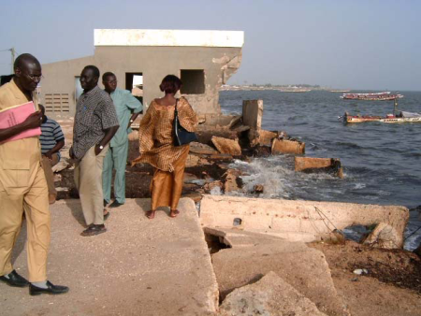
ANALYSIS OF CURRENT PORTFOLIO AND PIPELINE

Slide 27
36 project/programme proposals
From June 2010 to September 2011, 32 concepts and 18 full proposals submitted;
Small-size projects and programmes window has never been used
 | Endorsed concepts | Concepts endorsed at first submission | Approved proposals | Proposals approved at first submission
Number | 22 | 17 | 11 | 7
Total number submitted | 32 |  | 18
% of total submitted | 65 | 50 | 61 | 39
% of total endorsed/ approved | - | 77 | - | 64

Slide 28
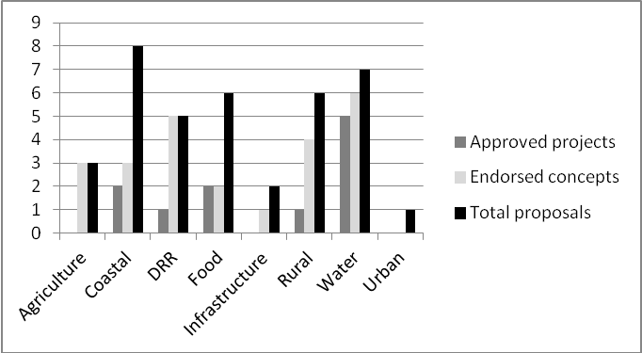
Variety of sectors

Slide 29
Proposals by Implementing Entity

Slide 30
Distribution by region

Slide 31
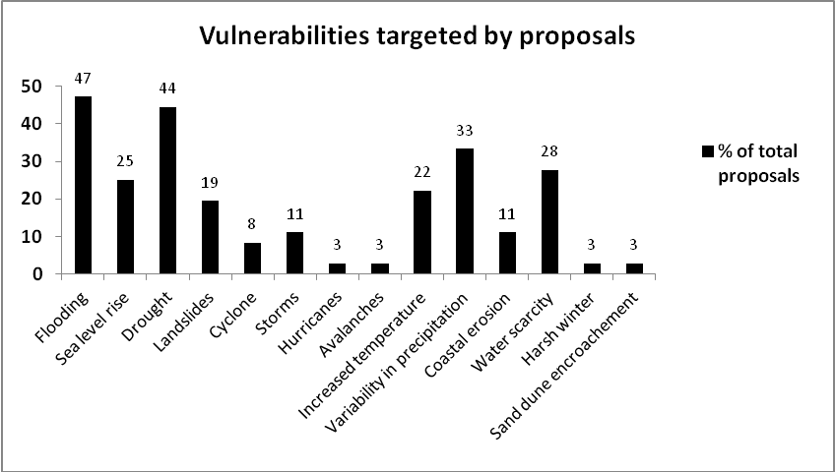
Vulnerabilities identified

Slide 32
Review criteria with the most issues during the review process
Does the project / programme support concrete adaptation actions?
Is the project / programme cost-effective?
Does the project / programme provide economic, social and environmental benefits, with particular reference to the most vulnerable communities, including gender considerations?
Is there duplication of project with other funding sources?
Does the project / programme meet the relevant national technical standards, where applicable?
Has a consultative process taken place, and has it involved all key stakeholders, and vulnerable groups, including gender considerations?

Slide 33
Common issues related to “concreteness” criterion
Lack of cohesion among the components of the project/programme,
Difficulty of distinguishing between an adaptation project and a “business-as-usual” development project and, related to that issue,
Non-climatic barriers to achieving the project objective that would not be taken into account and finally
Proposed adaptation measures not being suited or adequate for the identified climate threats.
Notes:
Hence, it is clear that this criterion, beyond looking at whether the project/programme will implement “concrete” adaptation actions, has allowed the secretariat reviewers to assess the overall project/programme design and its link with adaptation, to evaluate whether its activities align with the project/programme level goal and objectives and finally, to assess the cohesion of the components among themselves. Also, before the criterion on “sustainability” was included in the list of criteria, it was assessed under the “concreteness” criterion as well.

Slide 34
LESSONS LEARNED
Approval/endorsement rate is consistent with the strategic priorities of AF (swift processes and disbursements): 60-65%
Full proposals submitted through the two-step process are more likely to get approved than one-step;
More guidance is needed on:
  How to determine the concrete adaptation actions that are needed when designing the project/programmes,
  How to evaluate the cost effectiveness,
  The use of relevant national technical standards by the project and
  How to handle the consultation process when preparing the proposal.

Slide 35
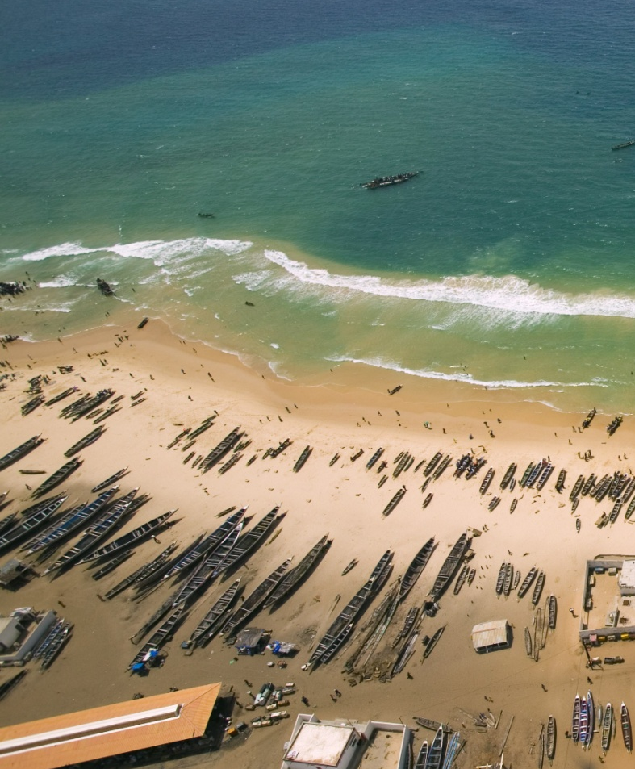
LESSONS LEARNED (2)
NIEs have a very low share of the proposals submitted;
  More NIEs are being accredited;
  Accreditation Toolkit;
  Cap of 50% on MIEs.
UNDP = 63% of all proposals submitted;
  Only 4 out of 9 MIEs have submitted proposals: lack of experience, interest, or willingness to give NIEs their chance?
  Need for more guidance on AF projects/programmes review criteria?

