Slide 1
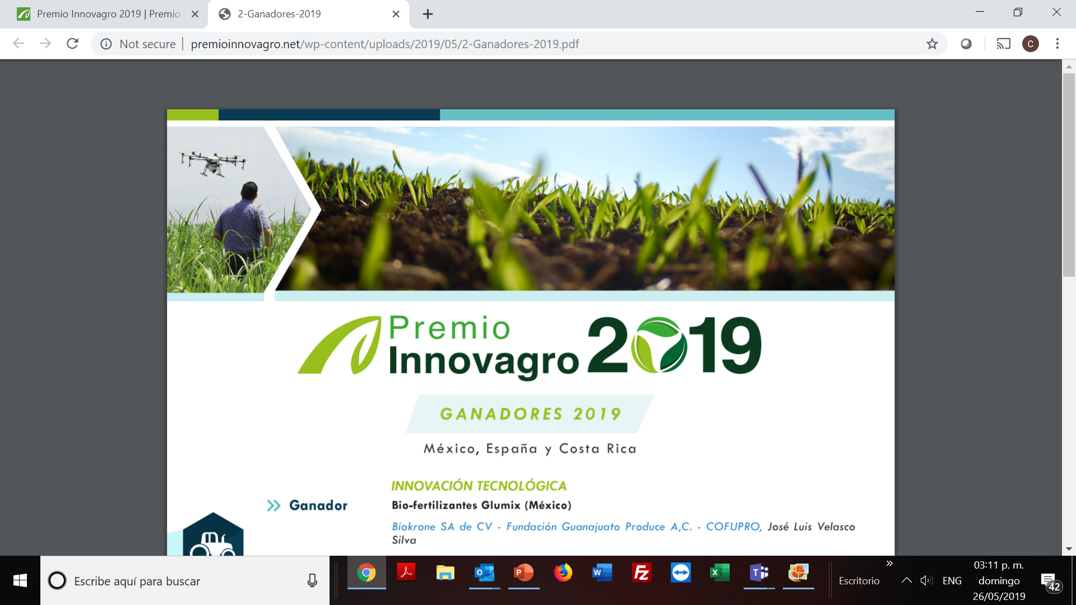
Draft Charter
Community of Practice for Direct Access Entities
General Overview

Slide 2
Draft Charter
General Aspects
Living document
Provides guidelines which Direct Access Entities (DAEs) and community members agree
ground rules, expectations and the purpose for the group’s existence
contains information and key points needed to develop a successful community of practice

Slide 3
Purpose
Provide an avenue for knowledge exchange, learning and experience sharing, collaboration and peer support within the community of national implementing entities (NIEs) and DAEs involved in the programming of climate change adaptation and mitigation finance, so as to increase the effectiveness of entities in accessing resources and implementing adaptation and mitigation projects and programmes through direct access

Slide 4
Specific objectives
Scope
Development of an online platform for experience sharing;
Development of a capacity building, with a focus on direct access (through accreditation), project development, and monitoring and evaluation of projects;
Support for bilateral cooperation between DAEs, or between DAEs and future accredited entities.
Accredited NIEs of the Adaptation Fund and DAEs of the Green Climate Fund (GCF) that are eligible to access adaptation and mitigation finance directly from both the Funds.

Slide 5
Ground Rules for Engagement
Participation of members is voluntary
Members will participate to the fullest extent possible
Participation and collaboration are used to overcome challenges that are priorities in climate adaptation and mitigation funding modalities and project/programme implementation best practice;
Members agree to be respectful
Members will uphold a high level of integrity.
Members are willing to openly share and be transparent.
Challenges, lessons learned and successes are shared openly
Members strive to create an environment of trust and to foster insightful, non-threatening discussion of ideas and experiences;
Membership and topics reflect issues of interest and of relevance to NIEs/DAEs

Slide 6
Individual and Organizational Benefits
Individual
Continue to learn and develop professionally;
Access expertise from peers;
Increase communication with peers;
Increase productivity and quality of work;
Network to keep up to date with current trends, technology, innovations and best practice in adaptation and mitigation projects/programmes;
Develop a sense of professional identity;
Enhance professional reputation.
Organizational
Facilitating a cost effective avenue for retrieving information;
Reducing the time and effort it takes to learn new content on specific relevant topics;
Enhancing the provision of and access to South-South peer support for climate change adaptation and mitigation;
Improving knowledge sharing and distribution;
Enabling innovation;
Building alliances;
Enhancing access to the resources of climate funds.

Slide 7
Key Deliverables
CPDAE launch message or circular;
A signed Community of Practice Charter;
An action plan (sustainability plan) with key deliverables
Coordination and Communication Strategy;
Contact details of community members;
Online collaboration tool (e.g. a group email, a website that includes member profiles, discussion forum such as the World Bank C4Dev platform, resource library, calendar of events, etc.)
Annual meetings;
Discussion groups;
Links to presentations by community members;
Best practices and successful cases.
Development of an online platform for experience sharing
Capacity building and training of trainers programmes with training modules

Slide 8
Membership
All members of the community of practice are encouraged to sign the member signature page in Annex I to this charter
Participation as a member on the online platform for the community of practice will be by invitation and exclusive to persons registered with the NIEs/DAEs.
Entry of New Members
Accredited NIEs of the Adaptation Fund and DAEs of the Green Climate Fund of other climate funds,
Signing of the charter by an NIE/DAE.
New members may be admitted to the community through the invitation and/or referral of an existing community member or request by the non-member made in writing, to the CPDAE management committee.

Slide 9
Structural Design
Overseeing access and use of the online platform
Receiving and addressing requests for membership to the CPDAE and online platform for the CPDAE;
Encouraging and promoting discussion on the CPDAE online platform;
Planning and arranging face to face meetings of the CPDAE, e.g. on the margins of other global climate change events/meetings;
Suggest ideas for future specific activities by the CPDAE in consultation with members;
Make announcements and provide information regarding the CPDAE operations, activities and management to members;
Oversee review and amendment to the draft charter as necessary.
Committee

Slide 10
Stakeholder Responsible | Approach | Output | Outcome
NIE/DAE members of community of practice or dedicated NIE/DAE subgroup, | Agreement on Community of Practice areas of collaboration, tools and management roles | Management support systems and tools created and identified Roles and responsibilities of members agreed upon Online platform structured according to agreed areas of collaboration | Enabling environment for a successful community of practice created Management roles identified
Members of community of practice | Open discussions describing the benefits, responsibilities, risk, constraints and challenges to implementing a community of practice | Socialization of community of practice concept | Socialization/ a successfully functioning community showing benefits of membership to NIEs/DAEs and external parties.
 | Charter: created and socialized, take in feedback and educate members on charter and community of practice | First draft of community charter developed Identify changes needed to charter | Communication tools chosen Revised version of charter signed by members
 | Collaboration online community of practice members | set up roles, creating sub groups, facilitating discussions, encouraging knowledge sharing | Community of practice members begin taking ownership
Members of community of practice | Community of practice specific gathering or collaboration | Site visits, in person knowledge sharing continued online support | Identifying expertise, good practices, creating knowledge products, tools or publications
Adaptation Fund Board Secretariat, GCF Secretariat, Members of COP | Establish a framework for the assessment of the CPDAE effectiveness on a regular basis | Measure output, ROI on community of practice | Identify opportunities and challenges Make adjustments

