Slide 1
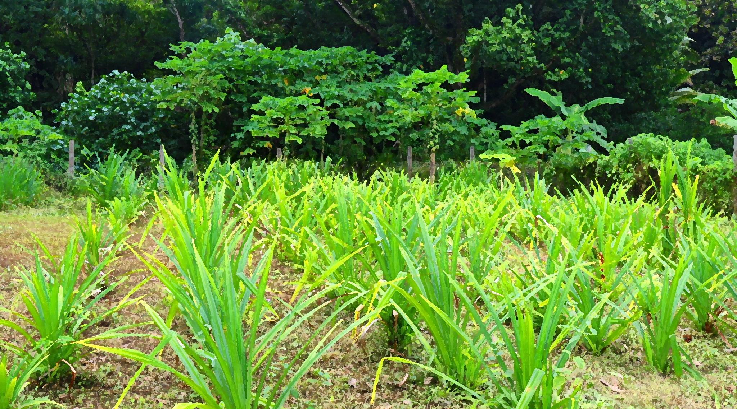


Innovation Small Grants
Training Module 1
Innovation

Slide 2
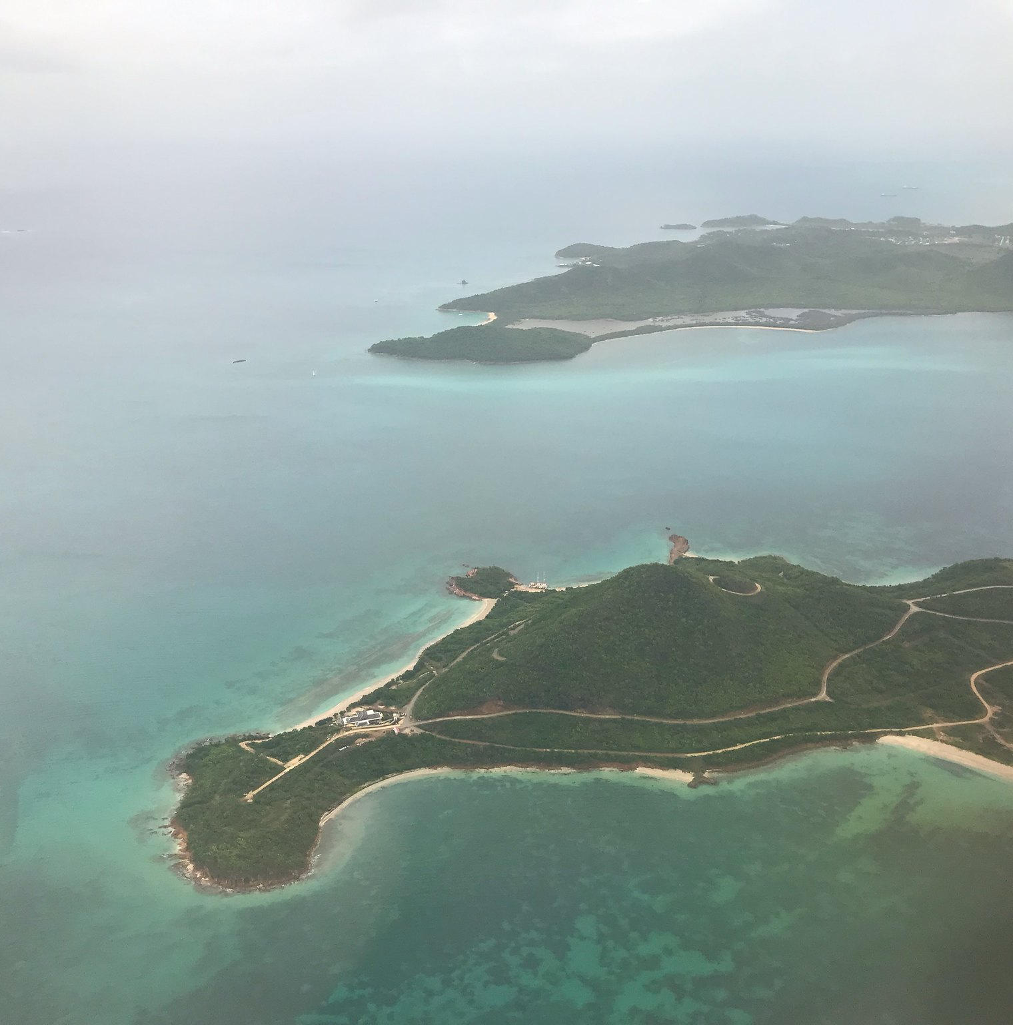



Aims and Objectives
Aim
To learn about innovation, and different approaches to innovation
Module 1
Learning objectives
Learn how to describe innovation
Learn about the stages of innovation
Know how to take first steps in designing an innovation small grant proposal

Slide 3
Outline
Section 1
Definitions of innovation
Section 2
Innovation pathways

Slide 4
Training Module 1
Section 1
Definitions of innovation

Slide 5




What is Innovation?
Innovation as the application of physical tools, processes, knowledge and skills with the aim of building resilience and adapting to climate change
Innovation as the renewing, advancing or changing the way things are done
Innovation as the process of translating an idea or invention into a valuable good or service

Slide 6
Innovation small grants
Test, evaluate, roll out and scale up innovative adaptation practices, products and technologies.
NIE
250k
New innovations encouraged and accelerated.
Development of innovative adaptation practices, tools and technologies encouraged and accelerated
Evidence base generated.
Evidence of effective, efficient adaptation practices, products and technologies generated as a basis for implementing entities and other funds to assess scaling up

Slide 7
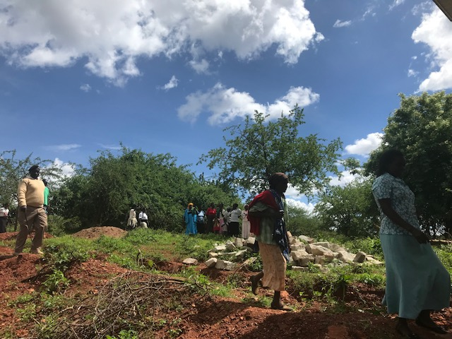

Some different types of innovation
Transformational or disruptive change
E.g. repurposing land areas and creating novel incomes
Low tech revival
E.g. Traditional or ingenious tools repurposed
Application of something new to add value
E.g bringing in an existing technology and adapting it to a new location
Process or social developments and changes
E.g. new policy

Slide 8
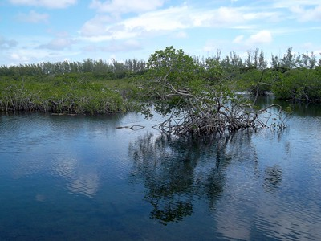

Examples of innovation
Rehabilitation of ecosystems and agriculture
Novel technology in challenging environments
New knowledge to support smallholder production
      Rehabilitate plant life
      Encouraging biodiversity and
      improve soil fertility
      Increase livelihoods
      Training on best practices
      Preserve low access locations
      Monitor the region and
      collect data
      Potential for indigenous collaborations
      Support micro-finance
      Support biodiversity
      Introduce novel methods and build capabilities
      Increase livelihoods
      Strengthen smallholders

Slide 9
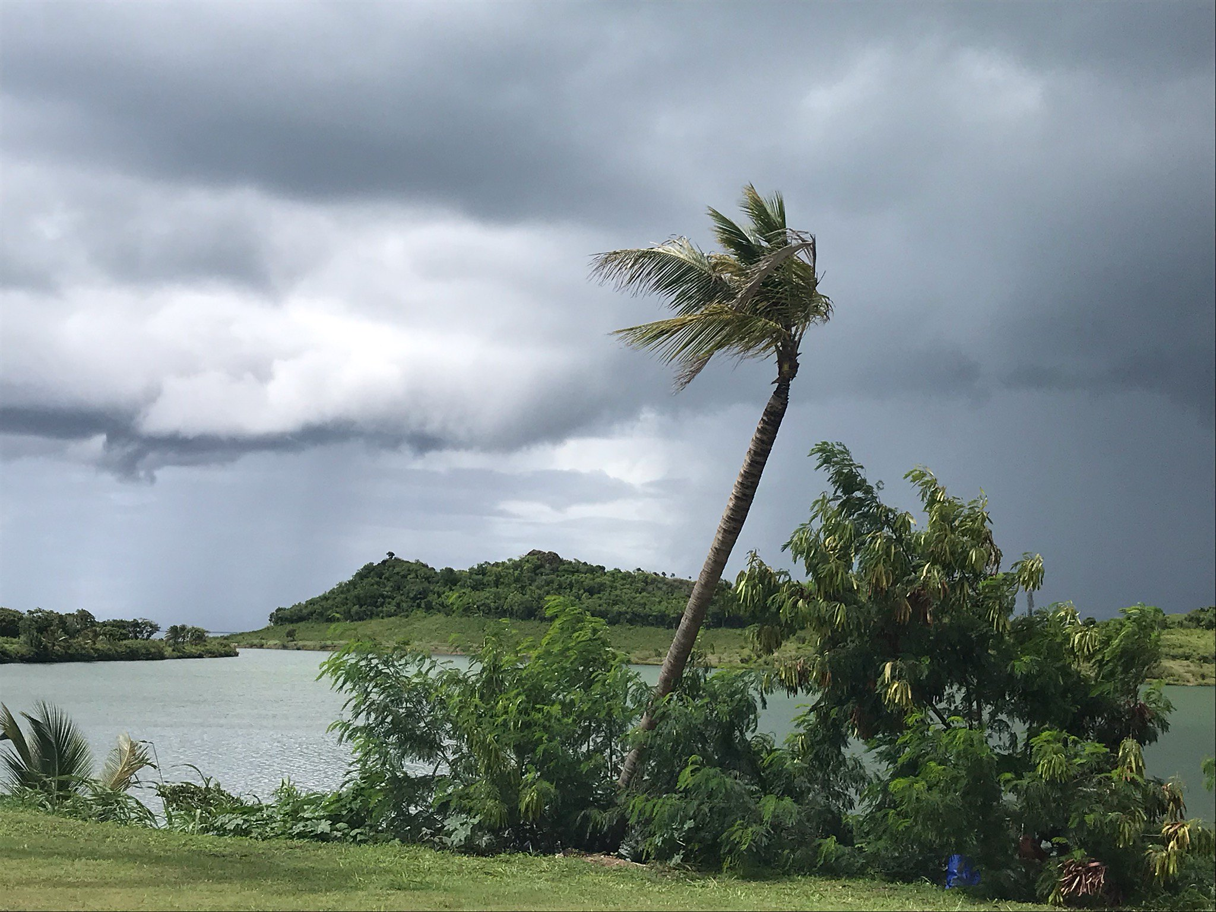
Learning review
QUIZ
Innovation is:
A technology or process applied to my location
A technology or process adapted to my location
Training 1, Section 1

Slide 10
Learning recap
Innovation is
renewing, advancing or changing the way things are done
Types of innovation
Innovation is diverse, and includes but is not limited to:
Disruptive
Adaptive
Revival
Social process
Training 1, Section 1

Slide 11
Training Module 1
Section 2
Innovation pathways

Slide 12
What is an innovation pathway?
Testing cycles
Learning cycles
Innovation is an on going process of scoping, testing, learning, and scaling.

Slide 13
An innovation pathway
Identify adaptation challenges
Scale to other areas / applications
Design and develop innovation
Embed and normalize locally
National / international scaling
Test
Engage
Learn
Create new solutions
Explore problems
Pilot and demonstrate
Build portfolios
Seek existing innovations
Diffuse innovation to target area
Look for solutions
Innovate wider systems

Slide 14
Learning recap
Testing cycles
Innovation as a pathway
Stage 1: Identify, seek, ideate
Stage 2: Test, engage, learn, adapt
Stage 3: Scale, develop, share, normalize
Learning cycles
Training 1, Section 2

Slide 15
Activity
Create a stakeholder tree
Your challenge is the tree trunk
The roots are the people, organizations, and communities affected by the challenge
The branches are the people organizations, and communities who are working in the challenge area.
Those working in the challenge area
Your challenge
Create a stakeholder tree
Populate your tree with all stakeholders associated with your challenge. Remember to think broadly including:
Indigenous groups, women, youth, vulnerable communities, and minority groups
As well as government, NGOs, charities, corporates and other organizations
Those affected by the challenge area
Training 1, Section 2

Slide 16
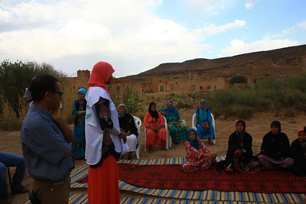
Next steps
Create a stakeholder tree
Your challenge is the tree trunk
The roots are the people, organizations, and communities affected by the challenge
The branches are the people organizations, and communities who are working in the challenge area.
Take Module 2:
The innovation small grants application training
Or go directly to the website and start the application:
https://www.adaptation-fund.org/apply-funding/innovation-grants/
Training 1, Section 2

Slide 17
COMPLETE
Training Module 1
Innovation pathways

