Slide 1
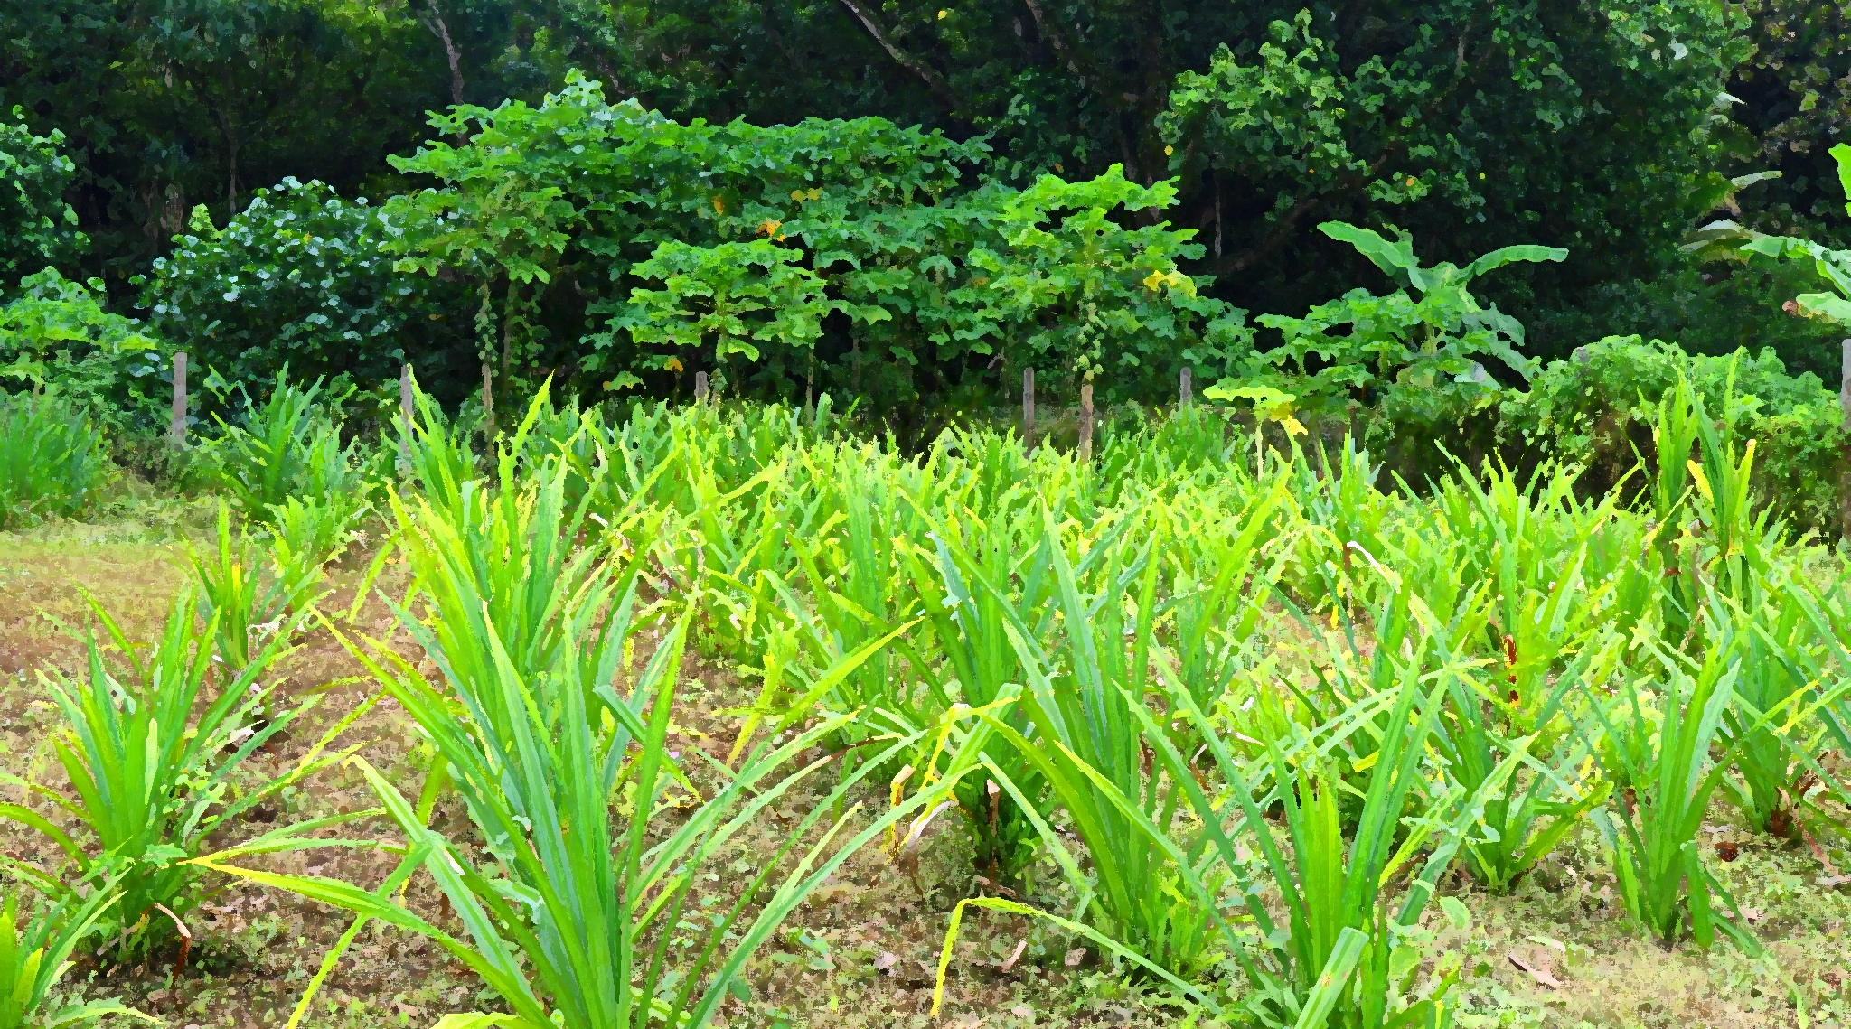


Innovation Small Grants
Training Module 2
Innovation small grant applications

Slide 2
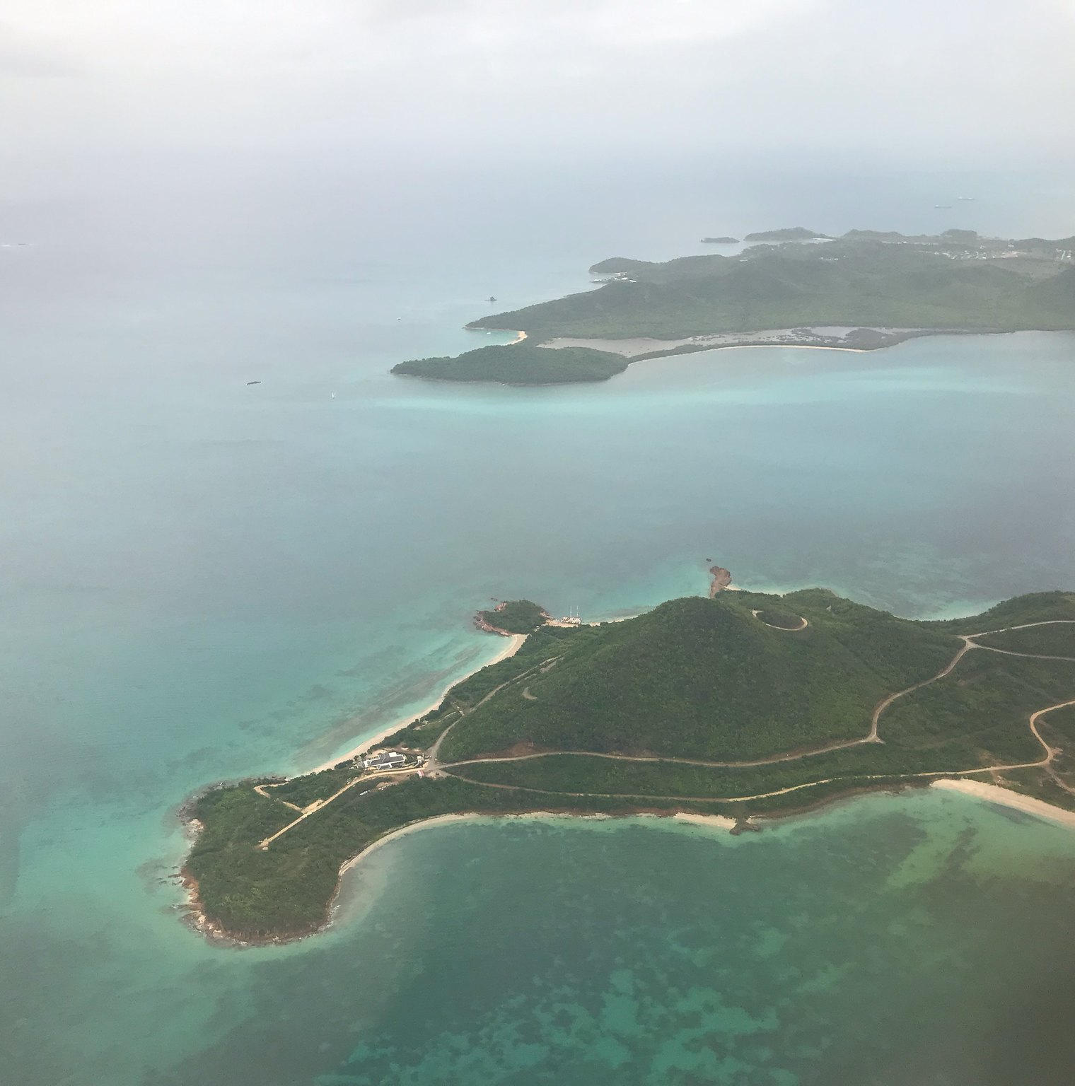



Aims and objectives
Aim
To learn how to complete the innovation small grant application form.
Module 2
Learning objectives
How to develop a strong application for the innovation small grants
How to approach each part of the application form

Slide 3
Outline
Section 1
Navigating the website and finding resources
Section 2
Developing a strong application

Slide 4
Training Module 2
Section 1
Navigating the website

Slide 5


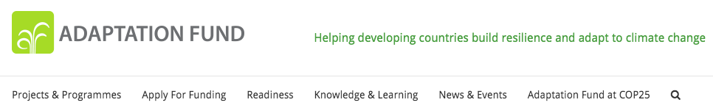
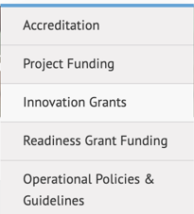
Navigating the website
https://www.adaptation-fund.org/
Apply for Funding

Slide 6
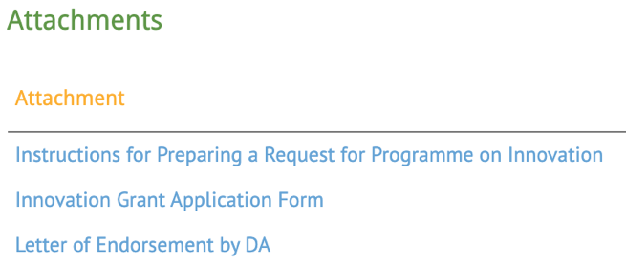
Navigating the website
www.adaptation-fund.org/apply-funding/innovation-grants/

Slide 7
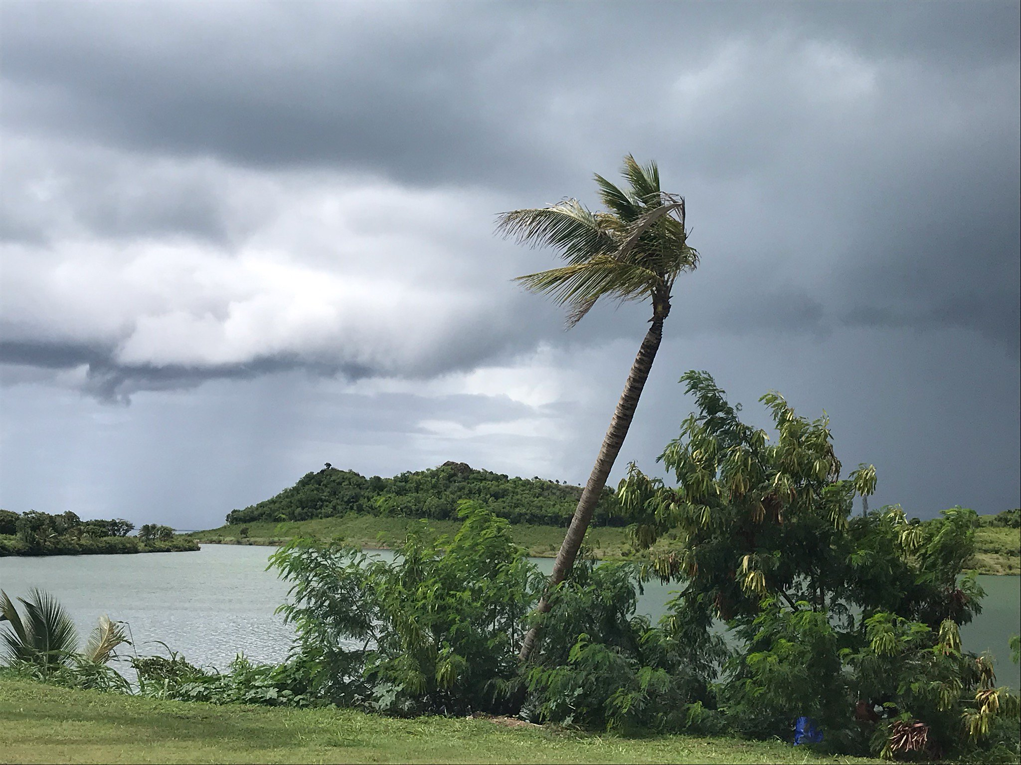
Learning review
Try it now
Go to
    www.adaptation-fund.org
    Download the documents
Training 2, Section 1

Slide 8
Training Module 2
Section 2
Writing your application

Slide 9


The application form
PART I
Project information
PART II
Project justification
PART III
Implementation
Introduce the project
Describe the solution
What is your adaptation challenge?
5 sections
3 to 4 pages
What is your innovative adaptation solution?
7 sections
6 pages total
Define your capacity
How will you deliver the project successfully?
6 sections
4 pages total
PART IV
Endorsement and certification
2 section, 1 page total

Slide 10
In detail: Part I
PART I
Project information
  Link to PART II,
  Section C: Innovation
  Link to PART II,
  Section A: Components
Country
Title
Implementing entity
Executing entities
Financing requested
Project background and context
Project objectives
Project components and financing
Projected calendar
Basic information
Describe your climate adaptation challenge
What will you achieve?
Actions taken
Changes delivered
List each component, and its cost
Dates: Start, end, evaluation

Slide 11
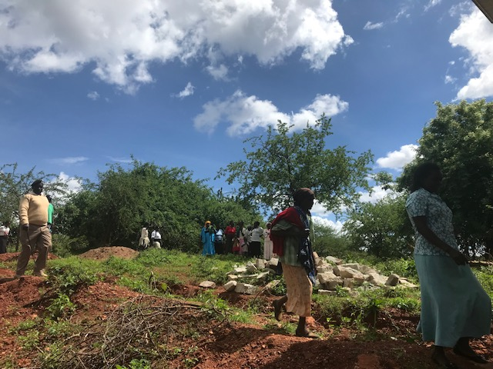
Example: Natural farming in India
Challenges faced:
Chemical fertilizers and pesticides
Land deterioration
Water mismanagement
Training and capacity building
Pilot natural farming
Knowledge capture and sharing
Development of cooperatives
India
Resilient agriculture
India NIE
Executing entities list
US$250,000
Country
Title
Implementing entity
Executing entities
Financing requested
Project background and context
Project objectives
Project components and financing
Projected calendar
Project start
Project end Evaluation
Revitalize agricultural practices
Implement new farming methods
Generate awareness

Slide 12
Learning review
PART I
Project information
Part I of the application is the
background information on your project.
Task
What is the
adaptation challenge
in your area?
Country
Title
Implementing entity
Executing entities
Financing requested
Project background and context
Project objectives
Project components and financing
Projected calendar

Slide 13
In detail: Part II
A
Components
Use the list of components from PART I
For each component describe how it:
  Increases adaptation and resilience
  Decreases vulnerability
PART II
Project justification
A
A
B
Benefits
D
List the benefits of the project
Economic
Social
Environmental
Engagement and empowerment of vulnerable communities
B
B
F
C
Innovation
E
Describe the the innovation process
Describe the innovation learning and potential for future scaling
C
G
C

Slide 14
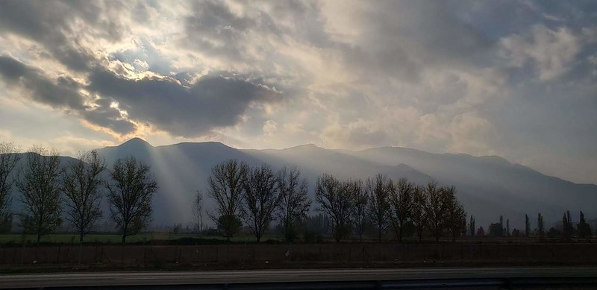
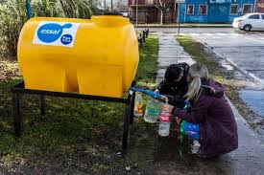
Example: Urban water points in Chile
      Adaptation to drought through water
      management
      Improve urban water distribution
      Promote Innovation
      Water access, skilled community
A
Components
    Water resilience, community livelihoods, women in markets, community learning.
B
Benefits
Competition for ideas
Pilot studies
Learning from novel water stations
Engagement
C
Innovation

Slide 15
Learning review
Tell the story of your innovation, and how it has a positive impact
MAKE A START
List how your innovation will benefit:
      Marginalized and Vulnerable Groups
      Gender Equality and Women’s Empowerment
      Indigenous Peoples
      Protection of Natural Habitats
      Conservation of Biological Diversity
      Climate Change Adaptation
G
Justification
PART II
Project justification
PART II
Project justification
A
A
A
Components
D
B
Benefits
E
Knowledge management
B
B
F
D
Standards
F
Risks
E
C
G
C
Innovation
C

Slide 16
In detail: Part II
PART II
Project justification
D
Standards
List all:
Standards
Policies
Related to the project
A
D
D
B
F
F
Risks
F
  Risk assessment:
  Cumulative
  Social
E
Environment
High impact
Other
C
G

Slide 17
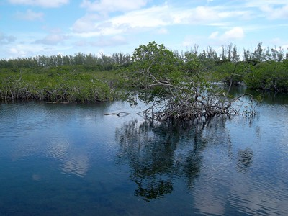
Example: Thermo solar desalination in Dominican Republic
      The project describes its alignment to the following plans and policies:
      The National Development Strategy
      The National Environment Policy
      The National Climate Change Policy
      The Provincial Development Plan
      The Plan National for adaptation to Climate Conditions Dominican Republic
      The Environmental and Social Policy of the Adaptation Fund
D
Standards
      Risk assessment included:
      Compliance with the law
      Access and equity
      Marginalized and vulnerable groups
      Human rights
F
Risks

Slide 18
Learning review
MAKE A START
Create a risk table for your project
Describe how your project adheres to standards and avoids risk
PART II
Project justification
E
Knowledge management
D
Standards
A
F
Risks
D
D
B
F
F
F
Risks
E
C
G

Slide 19
In detail: Part II
PART II
Project justification
E
Knowledge management
Capture learning
Share learning
Innovation works with learning loops:
Try, learn, innovate
A
D
B
F
G
Justification
What would happen without this project?
What will happen with this project in place?
E
E
C
G
G

Slide 20
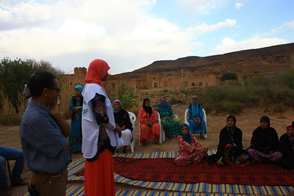
Example: Development of oasis zones in Morocco
    A combination of:
      learning by doing
      learning by seeing
      Building local knowledge through reports and a new water council
    Building national knowledge with seminars
E
Knowledge management
      Oasis zones face
      marginalisation and drought
      With funding areas can be
      sensitively revitalised.
G
Justification

Slide 21
Learning review
MAKE A START
List the learning opportunities presented by your innovation
Explain how you, and others,
will learn from the project
PART II
Project justification
PART II
Project justification
E
Knowledge management
A
D
B
F
G
Justification
D
Standards
E
E
C
G
G

Slide 22
In detail: Part III
PART III
Implementation arrangements
A
Implementation arrangements
F
Disbursement schedule
Detail:
How you deliver
How you monitor
Describe:
Your results
AF alignment
Detail:
Your total budget
How it will be spent
B
Monitoring and evaluation
C
Results
framework
D
Results framework alignment
E
Budget

Slide 23
Examples
1. Create an organizational chart
PART III
Implementation arrangements
A
Implementation arrangements
F
Disbursement schedule
Project management board
2. Describe the role of the NIE
3. List who provides each execution service
NIE: Name of responsible
B
Monitoring and evaluation
Execution service: Name
Execution service: Name
C
Results
framework
D
Results framework alignment
E
Budget
4. Who will be in charge of monitoring and evaluation?
5. What are the outputs: Monitoring plan. Status reports. Audit reports

Slide 24
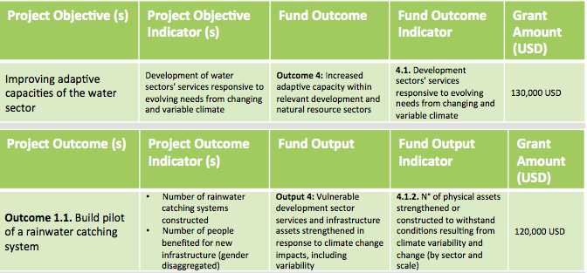
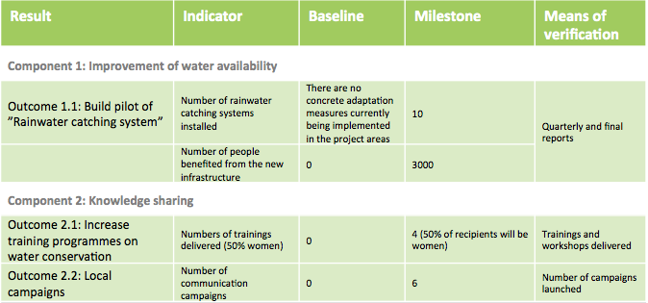
Examples
★
Outcome 8
Strategic Results Framework
Indicator
Milestones
Means of verification
Results
Baseline
PART III
Implementation arrangements
A
Implementation arrangements
F
Disbursement schedule
B
Monitoring and evaluation
C
Results
framework
D
Results framework alignment
E
Budget

Slide 25
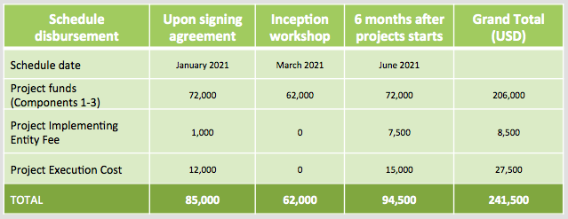
Examples
Timeline of activities
PART III
Implementation arrangements
A
Implementation arrangements
Disbursement of funds across time
F
Disbursement schedule
B
Monitoring and evaluation
The proposal should include a budget
The budget presentation style is open
Breakdown costs to activity level
D
Results framework alignment
C
Results
framework
E
Budget

Slide 26
Learning review
PART III
Implementation arrangements
A
Implementation arrangements
Standard project implementation details
F
Disbursement schedule
Delivery and monitoring
Results
Budget
B
Monitoring and evaluation
C
Results
framework
D
Results framework alignment
E
Budget

Slide 27
In detail: Part IV
PART IV
Endorsement by government and certification by the Implementing Entity
GOVERNMENT ENDORSEMENT
Name
Position
Ministry
Date
IMPLEMENTING ENTITY CERTIFICATION
Coordinator name and signature
Date
Contact person’s name, telephone number and email address

Slide 28
Innovation small grants
Experiment
Adapt
Transform

Slide 29
Action
Try it now
Go to
    www.adaptation-fund.org
    Start the application
Training 2, Section 2

Slide 30
COMPLETE
Training Module 2
Innovation small grant applications

