Slide 1
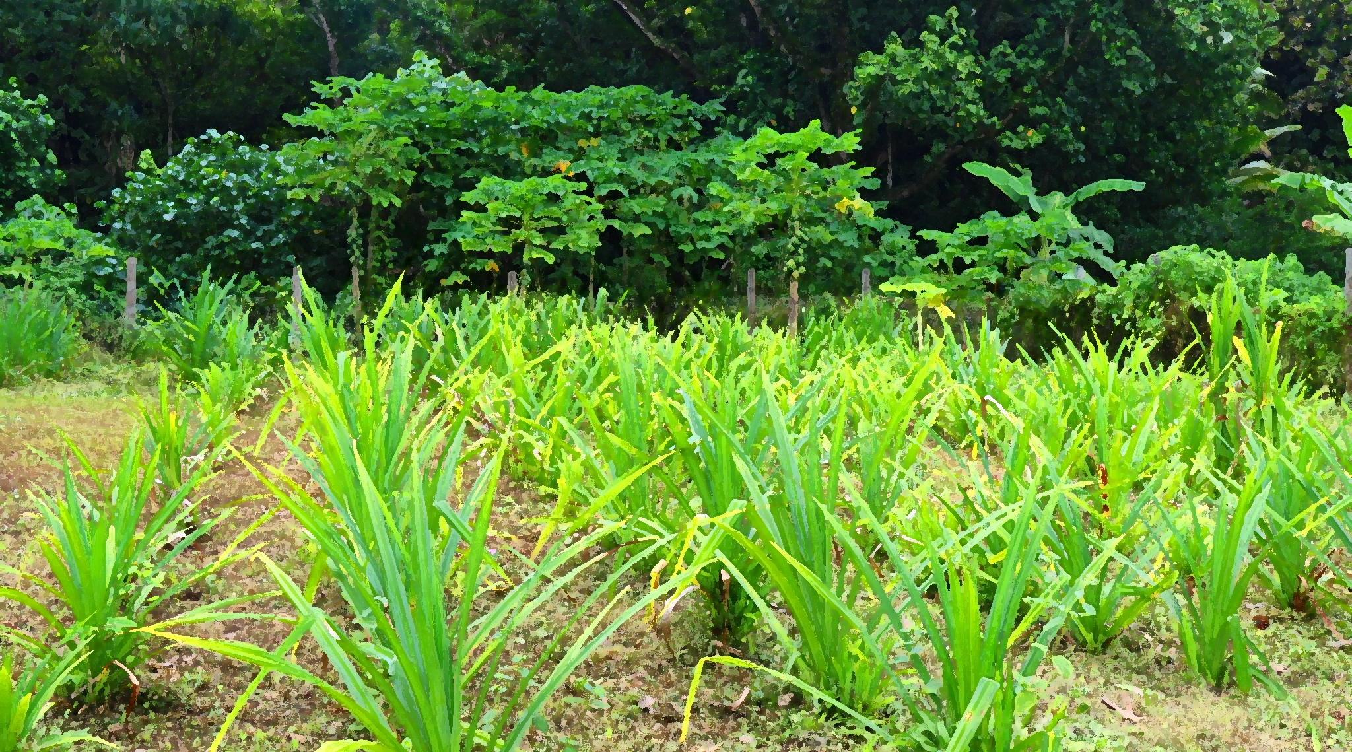

Innovation at the Adaptation Fund
Funding windows through
the Innovation Facility

Slide 2
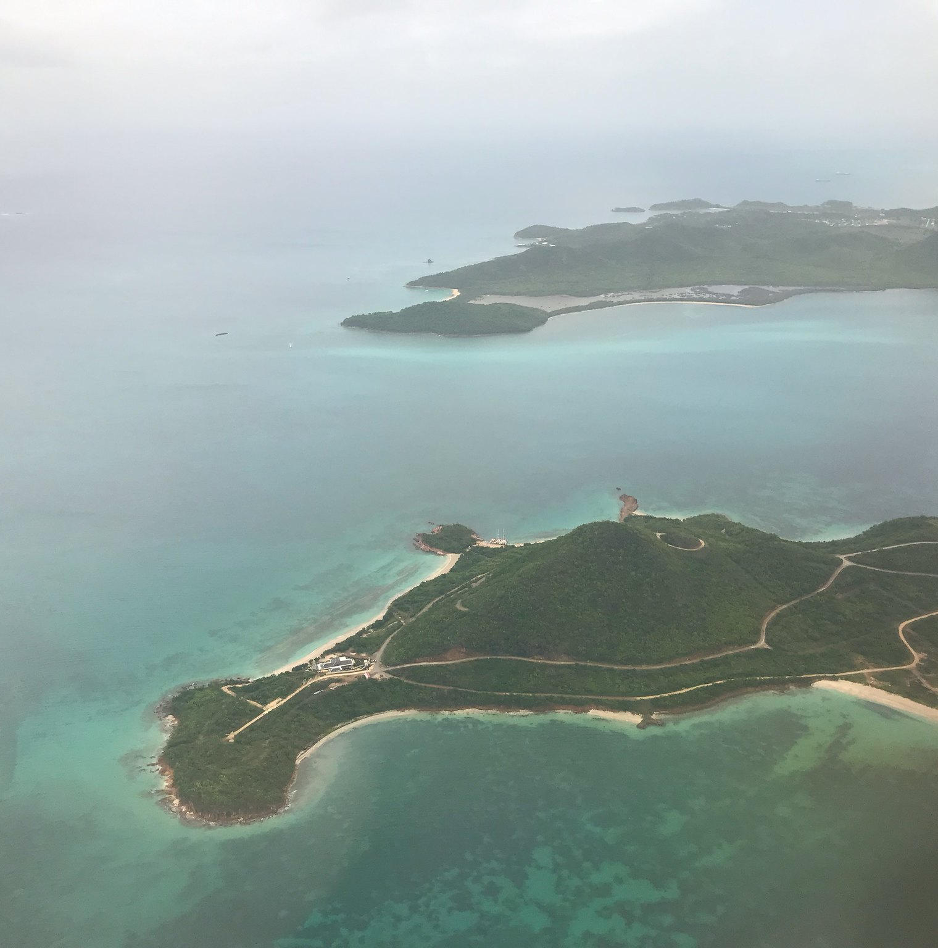



Outline
Innovation Facility
Background
Definition of innovation
Funding windows
Small grants for innovation
AFCIA programme
Large innovation projects
Awarded Projects
Chile
Armenia

Slide 3
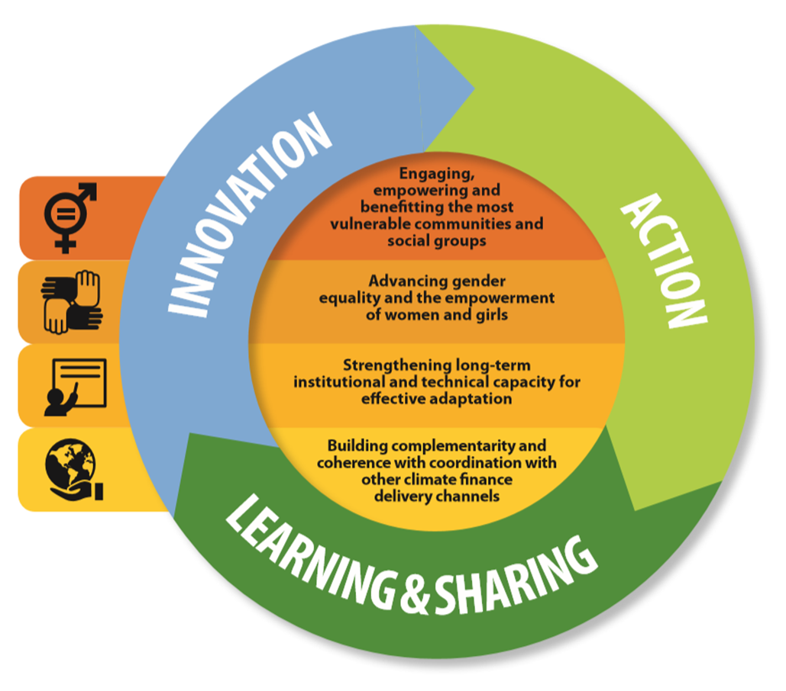
Innovation as a Strategic Focus for Adaptation
The Adaptation Fund’s Medium-Term Strategy established the Innovation Facility
An Innovation Facility dedicated to:
Roll out successful innovations;
Scale up viable innovations;
Encourage and accelerate innovations; and
Generate evidence of effective and efficient innovation in adaptation.
Notes:
Presentation #1 The Adaptation Fund’s Innovation Facility - Saliha

Slide 4




What is Innovation?
Understood as the creating, testing, deployment or diffusion of new, adapted or improved adaptation solutions
Developed contextually and with the inclusion of the communities most vulnerable to climate change
Emphasis on iterative deployment where change, learning, and new information are embraced

Slide 5
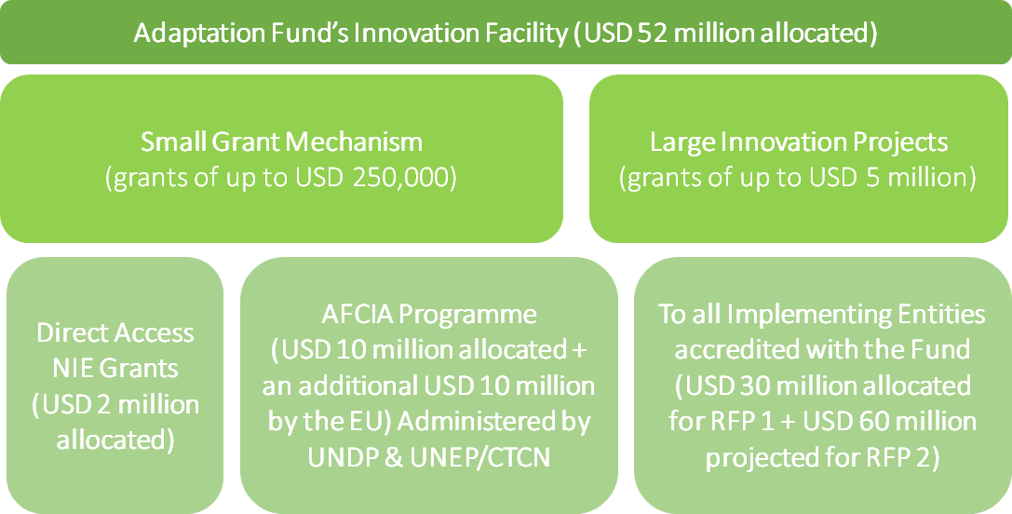
Adaptation Fund’s Innovation Funding Opportunities
Notes:
Presentation #1 The Adaptation Fund’s Innovation Facility - Saliha
The Facility offers two types of innovation grants:
1. Small Grant Mechanism to develop and/or test innovative products and technologies. Small grants (up to US$ 250,000) will be awarded to vulnerable developing countries through two routes:
i. directly through the Fund’s accredited National Implementing Entities (NIE); and;
ii. through a Multilateral Implementing Entity (MIE) Aggregator Mechanism to other entities (organizations, groups, associations, institutions, businesses, agencies, NGOs, youth and other vulnerable groups, and others) that are not accredited with the Fund.
The NIE Innovation Small Grants were launched at the 24th session of the Conference of the Parties to the UNFCCC (COP24) in December 2018 with two objectives, as defined in the Medium-Term Strategy:
New innovations encouraged and accelerated through the development of innovative adaptation practices, tools and technologies; and
Evidence base generated of effective solutions as a basis for scaling up.
The first two proposals for Chile and Armenia have been approved by the Board in October 2019. Three more proposals are currently under review.
The MIE Aggregator Mechanism was launched at COP25 in December 2019. The US$10 million programme will be implemented by UNDP and UNEP together with the Climate Technology Centre and Network (CTCN) to administer US$5 million of small innovation grants respectively.
Large Grant Mechanism (grants up to US$ 5 million) will be available to all Implementing Entities accredited with the Fund to roll out innovative adaptation practives, tools and technologies that have demonstrated success to new counties/regions or to scale up innovations that have demonstrated viability at a small scale. The large grant mechanism is due to be launched at COP26.

Slide 6
Adaptation Fund’s Innovation Funding Opportunities
Small grants
Max. US$ 250,000
Accredited
NIEs
To encourage & accelerate innovation
To generate evidence based
}
Outside of country and regional CAP
Large projects
Max. US$ 5 Million
Accredited
NIEs, MIEs and RIEs
To roll out successful innovation
To scale up innovations
PFGs available to support application process
AFCIA
Max. US$ 250,000
Not-for-profit, Civil Society Organisations, Business Members, Community Based Organizations
To encourage & accelerate innovation
To generate evidence based
Administered by UNDP and UNEP/CTCN

Slide 7






Thematic areas
Disaster Risk Reduction
Nature-based solutions
Coastal management
Agriculture
Water resources
Management
Forests and Land Use
Rural development
Food Security
Social innovation
Urban
adaptation
Advancement of gender equality
Enhancement of cultural heritage
Focus on communities
Inclusion of youth
Innovative adaptation financing

Slide 8

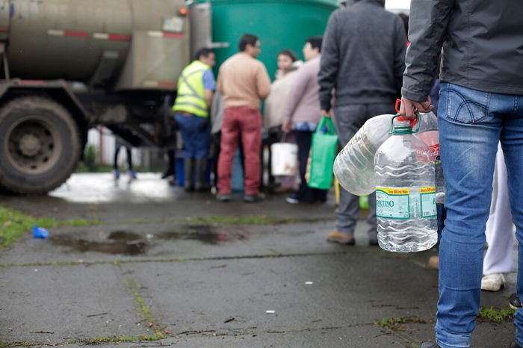
Chile: Water management
To improve safe access to water under emergency situations by sourcing the most appropriate and cost-efficient existing solutions under a competitive system.
Develop urban points for water distribution
Awareness campaign, sensitizing future users on a more sustainable use of water and a better management under shortages.
Innovation Features:
Crowdsourced through an open design contest
Adaptable and replicable
USD 230,000

Slide 9


Why is Innovation Important?- Chile’s Case
Crowdsourced Proposal
  Awareness
  Competitive
Replicable
  CPDA
Mental & Physical Insecurity
Cost-effective & Accessible
Project: Improving water access in emergency situations in a vulnerable province of Valparaiso.
Slide by: Violeta Leiva – ex-Program Manager at AGCID

Slide 10

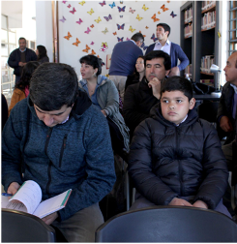
Armenia: Youth
To educate new generations of environmentally cultured young change-makers (with particular focus on climate adaptation) in developing countries, through design and introduction of replicable and sustainable digital education solution for high school students.
Innovation Features:
Gamified digital solution
Online contest
USD 231,250

Slide 11
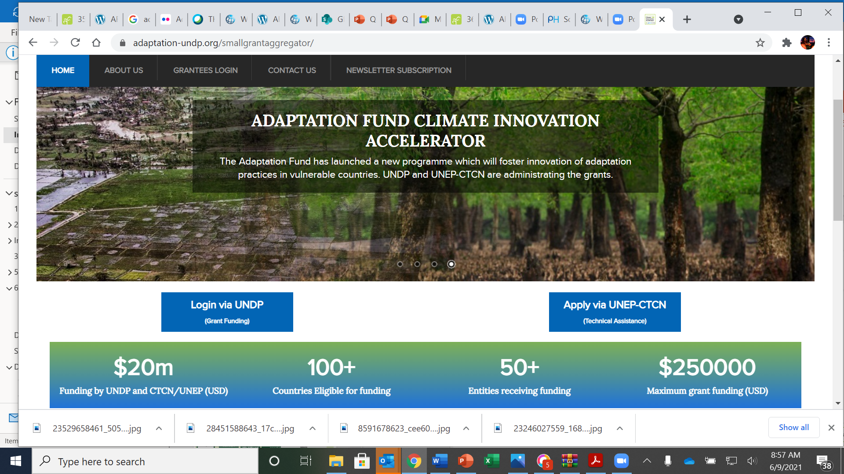

Slide 12
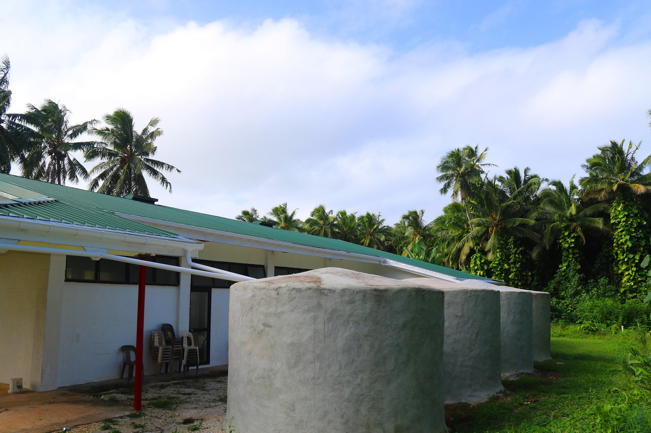
Large Grants for Innovation
Objective: Successful innovations rolled out. Innovative adaptation practices, tools and technologies that have demonstrated success in one country spread to new countries/regions;
Viable innovations scaled up. Innovative adaptation practices, tools and technologies that have demonstrated viability at a small scale piloted at larger scales.
  Main features:
  At least 6 projects of up to US$ 5 million each to NIEs, RIEs and MIEs
  Setasides: US$ 30 M 2021; US$ 60 M 2022 (exp.)
  Submission deadlines, review process, implementation modalities similar to single-country and regional projects and programmes
  PFG: $30 K for NIEs for single country; RIE and MIE for regional
The origin of large innovation grants and their main features
Notes:
Medium Term Strategy was adopted by the Adaptation Fund Board (the Board) in its thirtieth meeting, and specifically the establishment of a dedicated Innovation Facility in order to (a) roll out successful innovations; (b) scale up viable innovations; (c) encourage and accelerate innovations; and, (d) generate evidence of effective and efficient innovation in adaptation; which would include support via large grants of up to $5 million as well as small grants of up to $250,000.

Slide 13
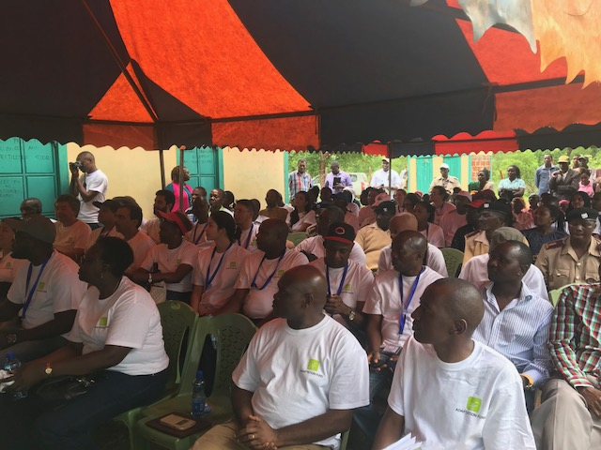
Next steps & opportunities
Free online training for accessing Small Grants for Innovation
The 1st Call for Large Innovation Projects welcomes proposals for consideration at 37th Board meeting, October, 2021
Upcoming policy developments: updates from recent Board meetings
Under the Innovation Facility
Notes:
Presentation #1 The Adaptation Fund’s Innovation Facility - Saliha

Slide 14
Updates from recent Board Meetings
Creation of a Task Force
Composed of Board members representing developing and developed countries. To further define and elaborate on the Fund’s vision for innovation, including review criteria, and risk appetite.
Development and approval of new criteria to evaluate large innovation projects within the Fund.
Adoption of a Vision and Mision for innovation within the Fund as a way towards a more concrete understanding of how the Board pursues innovation through programming.
AFB/B.36/8
Elements under development:
Result-based management

Slide 15
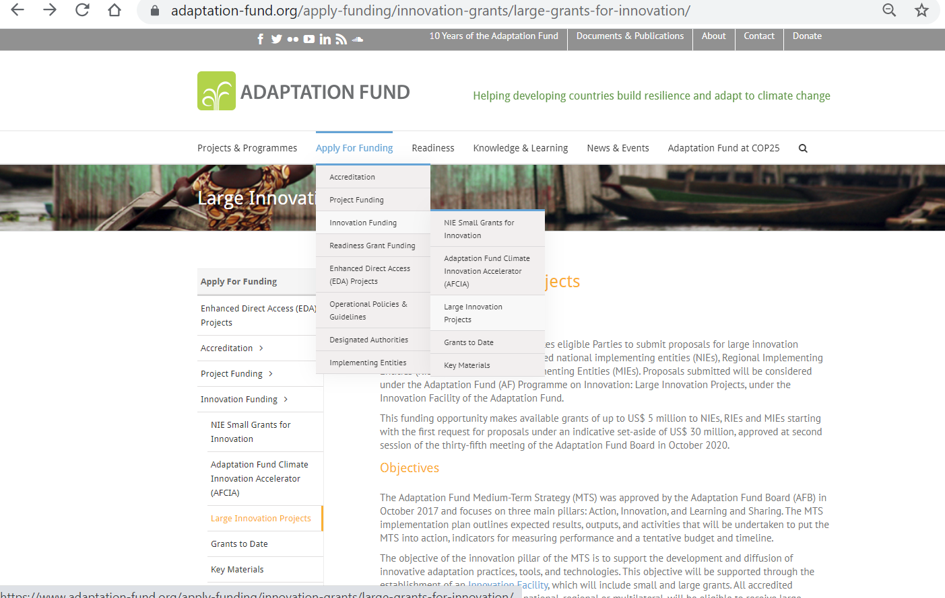

Slide 16
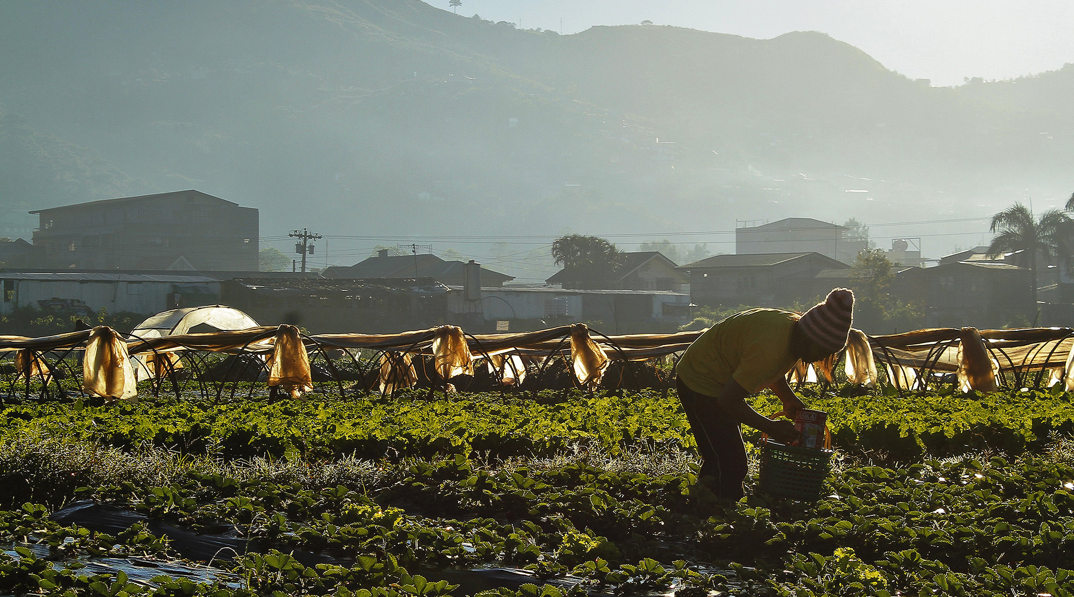





Thank You
Innovation Team at the Adaptation Fund
Saliha Dobardzic
sdobardzic@adaptation-fund.org
Alyssa Gomes
agomes3@adaptation-fund.org
Claudia Lasprilla Pina
clasprillapina@adaptation-fund.org
www.adaptation-fund.org

