Slide 1








Marianella Feoli
mfeoli@fundecooperacion.org
Fundecooperación para el Desarrollo Sostenible
Notes:
Falta logo adapta2+ y cambiar el logo del mag viejo por el nuevo

Slide 2








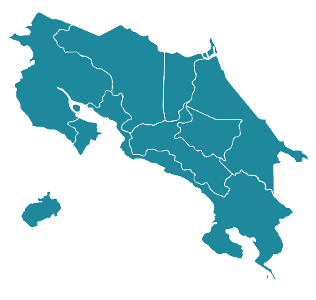

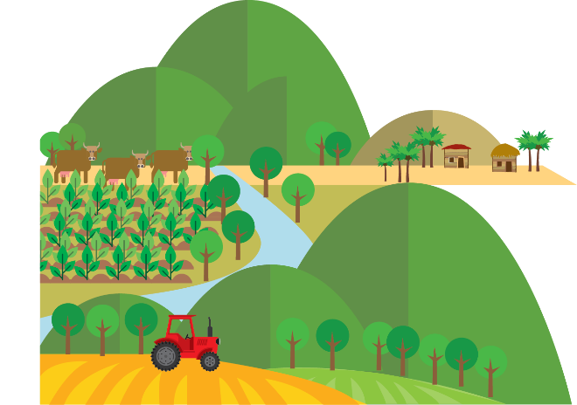


Financed by
National Implementing Entity
Sectors
Enhanced Direct Access
40+ Executing Entities
100+ community lead organizations
Water Resources
Agriculture
Coastlines
Execution Period:
2015 - 2022
Strategic Partners: MAG, MINAE, INTA, CRUSA, INS, IMN, AyA, ARESEP, Associations, Internactional Cooperation Agencies, Productive Cooperatives, Universities, Non Gubernamental Organizations, etc.
Notes:
National Implementing Entity
Agriculture, Water Resources and Coastlines
Execution Period: 2015-2022
Strategic Partners:
Zonas. quitar el cuadro y tal vez marcar las zonas en el mapa?
Grant Amount: $10.000.000
Counterpart: $6.500.000

Slide 3

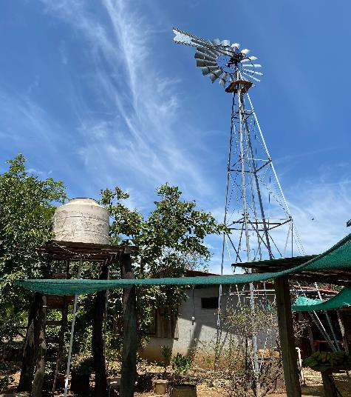
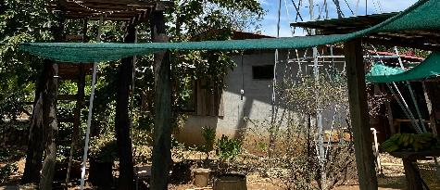
Challenges/strategies when implementing LLA
Good identification and construction of adaptation opportunities
Capacity building for local organisations
Local adaptation knowledge – relevance of support from the NIE.
Access to low-cost adaptation technologies.
Facilitate/strengthen technical support for implementation.
Bottom-up + Top- down approach

Slide 4
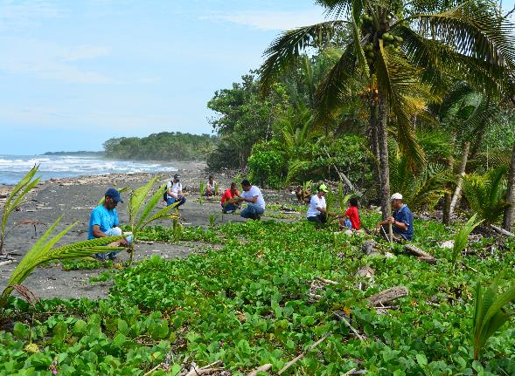
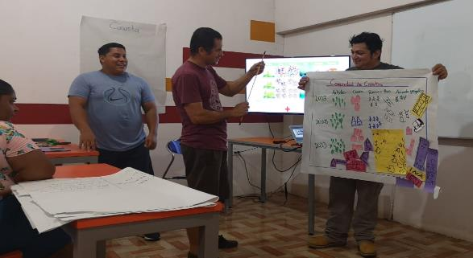
Common threads of success
Local organisation with capacity, credibility and strong roots in the community
Effective collaboration among stakeholders. Be inclusive, take time to build trust, understanding and collaboration.
Good and effective communication
Economic and social analysis of the adaptation actions in order to promote replicability

Slide 5

8 principles for LLA
(2) Addressing structural inequalities faced by women, youth, children, disabled, displaced, Indigenous Peoples & marginalised ethnic groups
(1) Devolving decision making to the lowest appropriate level
(3) Providing patient & predictable funding that can be accessed more easily
(4) Investing in local capabilities to leave an institutional legacy
(5) Building a robust understanding of climate risk & uncertainty
(6) Flexible programming & learning
(7) Ensure transparency & accountability
(8) Collaborative action & investment

Slide 6
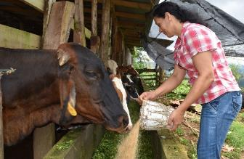
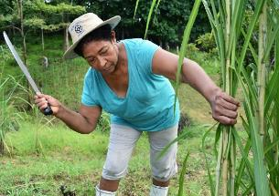
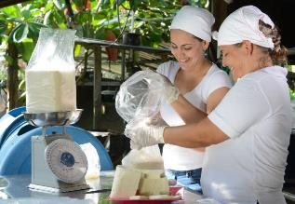
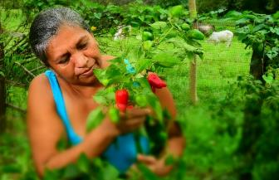
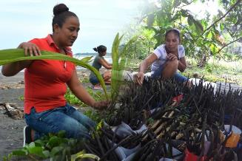
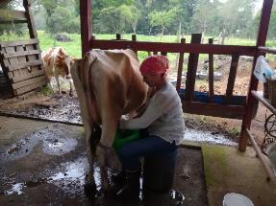
Proper adaptation measures + sinergy + capacity building + appropriate finance = more scaling up, better local ownership
#SomosFunde

Slide 7







Increasing resilience and reducing vulnerability on critical sectors.
Financed by

