Slide 1
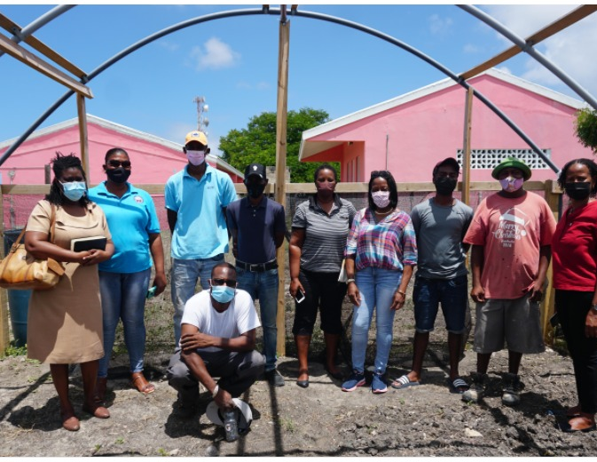
LOCAL-LED ADAPTATION IN ANTIGUA AND BARBUDA
“An integrated approach to physical adaptation and community resilience in Antigua and Barbuda’s northwest McKinnon’s watershed”
Rashauna Adams-Matthew
Environmental Social Safeguard and Gender Officer (Department of Environment

Slide 2
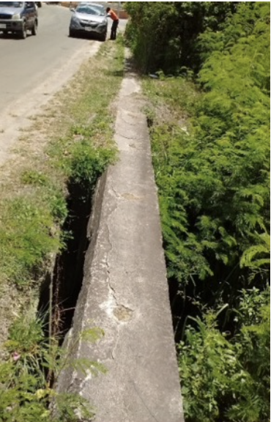
IMPACTS OF CLIMATE CHANGE EVENTS ON THE YORKS AND THE MCKINNONS COMMUNITY

Slide 3




PROJECT DESCRIPTION
COMPONENT 1: Upgrade Drainage and Waterways to meet projected climate change impacts
COMPONENT 3: Adaptation Mainstreaming and Capacity-Building in NGOs and Community Groups to sustain project interventions
COMPONENT 2: Resolving Loans for Homes in McKinnon’s Watershed To Meet New Adaptation Guidelines in the Building Code and Physical Plan
COST- EFFECTIVE ADAPTATION MEASURES THROUGH THE IMPLEMENTING OF ADAPTATION IN THE ENVIRONMENT AND IN THE COMMUNITY, BUILDING BOTH NATURAL AND SOCIAL ADAPTIVE CAPACITY AT THE SAME TIME.

Slide 4
LOCAL LED-ACTION
Through the project, The Department of Environment has provided support for community shelters, most of which are faith-based organisations to increase the resilience and comfort of hurricane shelters, taking into account the accommodation of women, children, the disabled and other vulnerable groups
In order to maintain the physical interventions of the AF project, the DOE will be launching a programme through Component 3 of the AF project which will provide financial support to existing and aspiring local entrepreneurs in the area of landscaping, to maintain the waterway as well as implement public awareness campaigns in the community to promote reporting of littering along the waterway

Slide 5
EXPECTED RESULTS
Increased sense of comfort and security as residents are able to stay at shelters within their own community
Increased capacity and resilience of community shelters to increased climate events
Increased access for persons whose access has traditionally been compromised due to issues involving disability, age, sex, medical condition, etc
Increased community ownership of waterway interventions through the empowerment of local businesses to maintain interventions
Creation of advocacy for community value and health, while also focusing on encouraging anti-littering practices.
Increased livelihood opportunities for local small and medium businesses
Promotion of green energy through the support of local small and medium businesses

