Slide 1
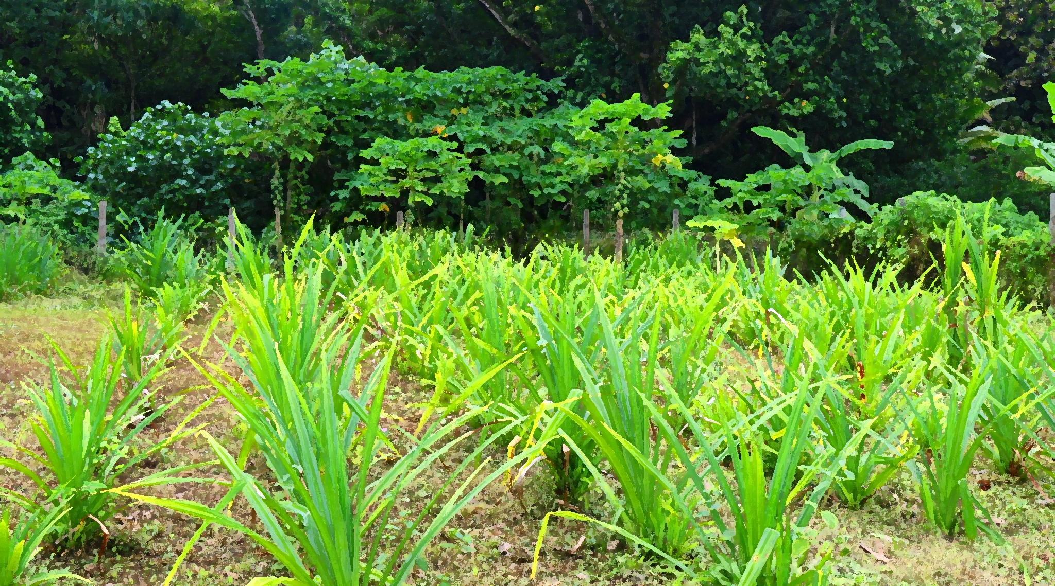

Strategic Overview of AF Innovation
Priorities
Innovation Facility

Slide 2
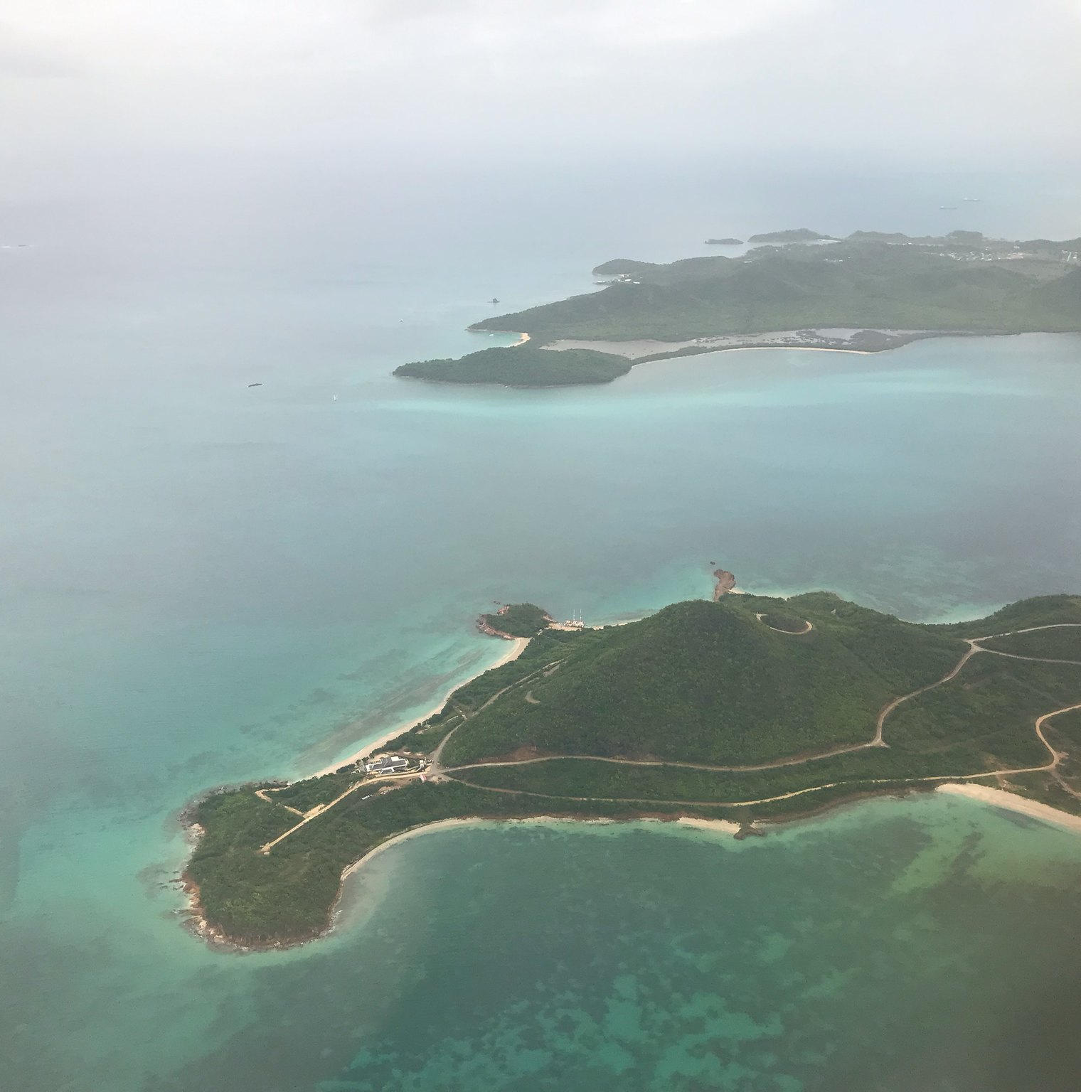



Outline
Innovation Facility
Background
Definition of innovation
Funding windows
Small grants for innovation
AFCIA programme
Large innovation projects
How to apply
Application process
Key materials

Slide 3
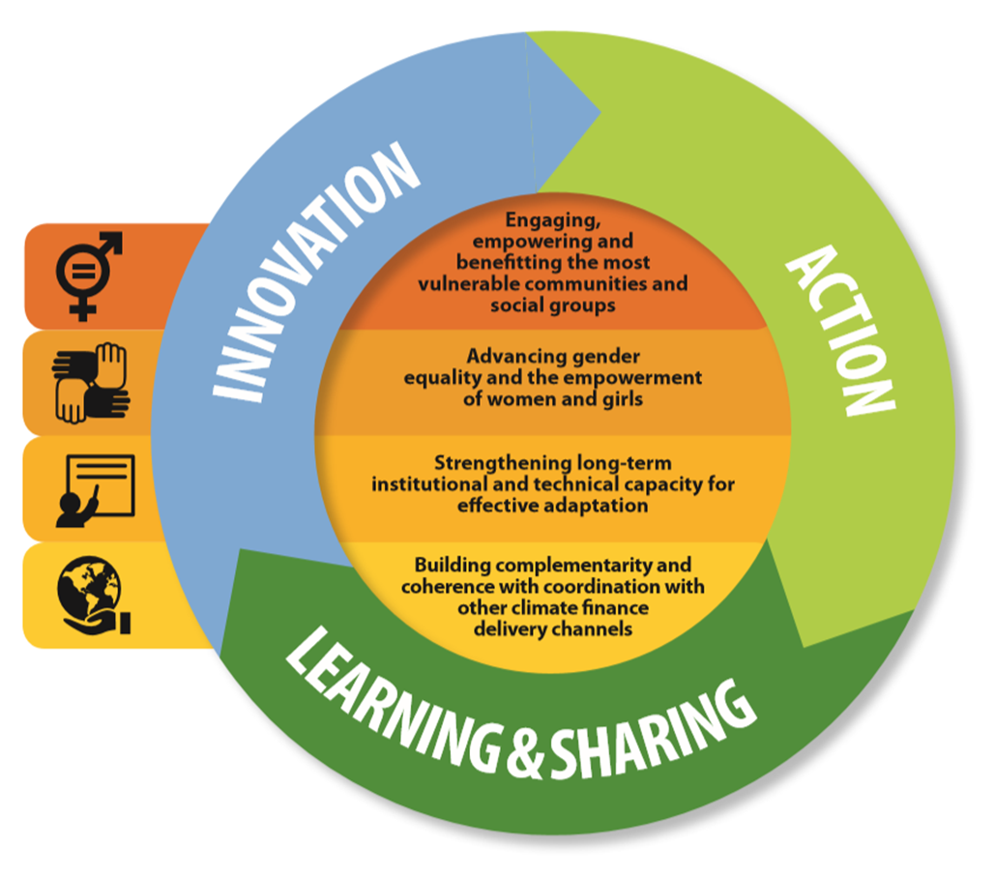
Innovation as a Strategic Focus for Adaptation
The Adaptation Fund’s Medium-Term Strategy established the Innovation Facility
An Innovation Facility dedicated to:
Roll out successful innovations;
Scale up viable innovations;
Encourage and accelerate innovations; and
Generate evidence of effective and efficient innovation in adaptation.
Notes:
Presentation #1 The Adaptation Fund’s Innovation Facility - Saliha

Slide 4
Background- The Adaptation Fund’s Pillars
Based on the Medium Term Strategy 2018-2022
ACTION
INNOVATION
LEARNING AND SHARING
Support eligible countries to undertake high quality adaptation projects and programmes consistent with their priority needs, goals and strategies.
Support the development and diffusion of innovative adaptation practices, tools, and technologies for effective, long-term adaptation to climate change accelerated, encouraged and enabled.
Practical knowledge about effective adaptation activities and financing modalities generated and communicated to actors around the world.

Slide 5





Background – Innovation Pillar
Innovation at its core
Medium-Term Strategy 2018-2022
Paris Climate Agreement
Vulnerable communities
Funding windows
Direct access and Enhanced Direct access
New services, such as the Readiness Programme
To accelerate, encourage and enable innovation
Critical for an effective global response to climate change
To help them adapt to climate change
Innovation Small Grants,
Innovation Large Grants &
AFCIA

Slide 6




What is Innovation?
Understood as the creating, testing, deployment or diffusion of new, adapted or improved adaptation solutions
Developed contextually and with the inclusion of the communities most vulnerable to climate change
Emphasis on iterative deployment where change, learning, and new information are embraced

Slide 7
Adaptation Fund’s Innovation Funding Opportunities
Adaptation Fund’s Innovation Facility (USD 52 million allocated)
Small Grant Mechanism
(grants of up to USD 250,000)
Large Innovation Projects
(grants of up to USD 5 million)
Direct Access
NIE Grants (USD 2 million allocated + USD 4 projected for RFP 2)
AFCIA Programme
(USD 10 million allocated + an additional EUR 10 million by the EU) Administered by UNDP & UNEP/CTCN
To all Implementing Entities accredited with the Fund
(USD 30 million allocated for RFP 1 + USD 60 million projected for RFP 2)
Notes:
Presentation #1 The Adaptation Fund’s Innovation Facility - Saliha
The Facility offers two types of innovation grants:
1. Small Grant Mechanism to develop and/or test innovative products and technologies. Small grants (up to US$ 250,000) will be awarded to vulnerable developing countries through two routes:
i. directly through the Fund’s accredited National Implementing Entities (NIE); and;
ii. through a Multilateral Implementing Entity (MIE) Aggregator Mechanism to other entities (organizations, groups, associations, institutions, businesses, agencies, NGOs, youth and other vulnerable groups, and others) that are not accredited with the Fund.
The NIE Innovation Small Grants were launched at the 24th session of the Conference of the Parties to the UNFCCC (COP24) in December 2018 with two objectives, as defined in the Medium-Term Strategy:
New innovations encouraged and accelerated through the development of innovative adaptation practices, tools and technologies; and
Evidence base generated of effective solutions as a basis for scaling up.
The first two proposals for Chile and Armenia have been approved by the Board in October 2019. Three more proposals are currently under review.
The MIE Aggregator Mechanism was launched at COP25 in December 2019. The US$10 million programme will be implemented by UNDP and UNEP together with the Climate Technology Centre and Network (CTCN) to administer US$5 million of small innovation grants respectively.
Large Grant Mechanism (grants up to US$ 5 million) will be available to all Implementing Entities accredited with the Fund to roll out innovative adaptation practices, tools and technologies that have demonstrated success to new counties/regions or to scale up innovations that have demonstrated viability at a small scale. The large grant mechanism is due to be launched at COP26.

Slide 8
Adaptation Fund’s Innovation Funding Opportunities
Small grants
Max. US$ 250,000
Accredited
NIEs
To encourage & accelerate innovation
To generate evidence based
}
Outside of country and regional CAP
Large projects
Max. US$ 5 Million
Accredited
NIEs, MIEs and RIEs
To roll out successful innovation
To scale up innovations
PFGs available to support application process
Not-for-profit, Civil Society Organisations, Business Members, Community Based Organizations
To encourage & accelerate innovation
To generate evidence based
Administered by UNDP and UNEP/CTCN
AFCIA
Max. US$ 250,000
  AFCIA CONTACTS
  UNDP
  Mr. Charles Yu
  Investment Appraisal Specialist
  Email: chongguang.yu@undp.org
  UNEP-CTCN
  Mr. Clara Landeiro
  CTCN Regional Manager for Asia and the Pacific
  Email: clara.landeiro@un.org

Slide 9















Thematic areas
Disaster Risk Reduction
Nature-based solutions
Coastal management
Agriculture
Water resources
Management
Forests and Land Use
Rural development
Food Security
Social innovation
Urban
adaptation
Advancement of gender equality
Enhancement of cultural heritage
Focus on communities
Inclusion of youth
Innovative adaptation financing

Slide 10
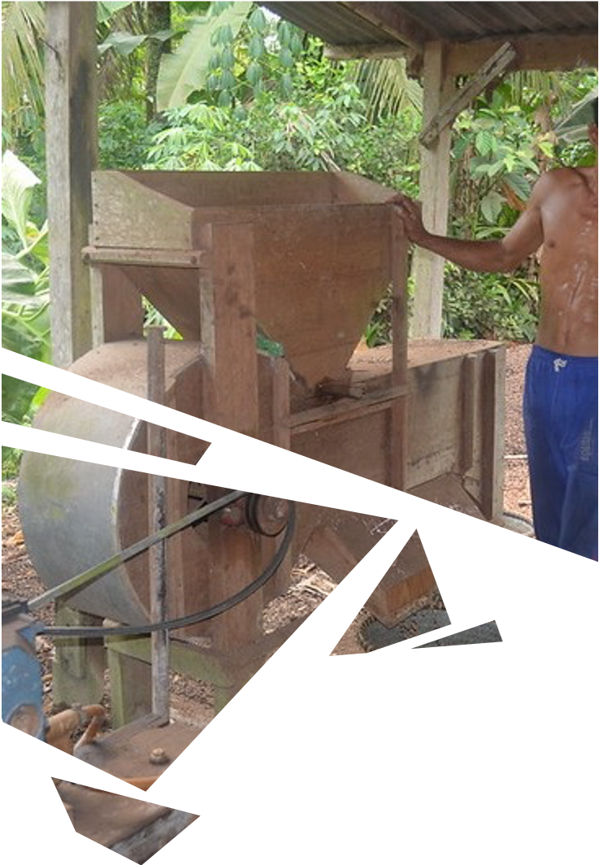



Indicators on innovation
Strategic Results Framework amended in March 2019. Consists of impact level results, with associated core indicators, outcomes and outputs, and indicators associated with the outcomes and outputs
Outcome 8 is focused specifically on innovation, which aligns with the MTS Innovation Strategic Focus
It is foreseeable that the objectives and indicators for innovation will need to be periodically revisited and potentially refined

Slide 11
Specific indicators on innovation
Performance Indicator | Definition | Measurement | Note
Number of innovations supported | New, adapted or improved adaptation solutions, developed contextually and with the inclusion of the communities most vulnerable to climate change, to enable those communities to become more resilient to climate change. Innovation solutions may include approaches, technologies and mechanisms. | Number of innovations | This replaces Indicator 8.1
Number of innovators supported | Persons who can introduce an innovation. | Number of innovators, disaggregated by gender (male/female) and youth status (youth/non-youth) | This is a new indicator, disaggregated in line with the innovation programme’s effort to promote gender equality and youth inclusion.
Number of partnerships leveraged | Exchange of goods or services or ideas, consultations and assistance (that could be in form of technical assistance, funds, in-kind contributions and other) between grantee and a stakeholder (for example, contributor, recipient governments, accredited Implementing Entities, the AF NGO Network and other civil society stakeholders, as well as other relevant stakeholders, including unconventional actors.) | Number of partnerships | This is a new indicator in line with the definition and vision on innovation adopted by the Board that includes stakeholder engagement on innovation
Number of “learning and sharing” initiatives | Number of learning and sharing initiatives undertaken, including communication initiatives. This can include studies and reports, lessons-learned events and workshops, articles, broadcasts, social media. This can also include any “change, learning and new information” initiatives that support iterative deployment of the innovation, and can take innovation projects and programmes in different directions. | Number of “learning and sharing” initiatives | This indicator complements indicator 8.2. It also strengthens the link between learning-and-sharing pillar and innovation pillar.
Number of applicants to innovation calls under the project or programme | Number of individuals or organizations that submit an application to an innovation competition or challenge. | Number of applicants | This is a new indicator that would serve the MIE aggregator programmes (AFCIA), and any large or small innovation projects that include innovation competitions.

Slide 12




5 Awarded Small Innovation Projects
Eastern Europe
1 project, US$230,000
Asia-Pacific
1 project, US$250,000
Latin America & Caribbean
3 projects, US$730,000

Slide 13

Key documents
Options for further Defining Innovation in Adaptation Projects and Programmes AFB/PPRC.26.b/17
Further Clarification of Vision and Definition of Innovation under the Adaptation Fund: Analysis of Relevant Elements and Guidance on Review Criteria AFB/B.36/8
Specific Objectives and Indicators for the Innovation Aspects of Projects and Programmes AFB/B.37/6

Slide 14
Accessing AF Innovation Grants
Application Process

Slide 15
Innovation Projects
Experimenting
Adapting
Transforming

Slide 16
Adaptation Fund’s Innovation Funding Opportunities
Small grants
Max. US$ 250,000
Accredited
NIEs
To encourage & accelerate innovation
To generate evidence based
}
Outside of country and regional CAP
Large projects
Max. US$ 5 Million
Accredited
NIEs, MIEs and RIEs
To roll out successful innovation
To scale up innovations
PFGs available to support application process
Not-for-profit, Civil Society Organisations, Business Members, Community Based Organizations
To encourage & accelerate innovation
To generate evidence based
Administered by UNDP and UNEP/CTCN
AFCIA
Max. US$ 250,000
  AFCIA CONTACTS
  UNDP
  Mr. Charles Yu
  Investment Appraisal Specialist
  Email: chongguang.yu@undp.org
  UNEP-CTCN
  Mr. Clara Landeiro
  CTCN Regional Manager for Asia and the Pacific
  Email: clara.landeiro@un.org

Slide 17
Indicators on innovation
Strategic Results Framework amended in March 2019. Consists of impact level results, with associated core indicators, outcomes and outputs, and indicators associated with the outcomes and outputs
Outcome 8 is focused specifically on innovation, which aligns with the MTS Innovation Strategic Focus
It is foreseeable that the objectives and indicators for innovation will need to be periodically revisited and potentially refined

Slide 18
Specific indicators on innovation
Performance Indicator | Definition | Measurement | Note
Number of innovations supported | New, adapted or improved adaptation solutions, developed contextually and with the inclusion of the communities most vulnerable to climate change, to enable those communities to become more resilient to climate change. Innovation solutions may include approaches, technologies and mechanisms. | Number of innovations | This replaces Indicator 8.1
Number of innovators supported | Persons who can introduce an innovation. | Number of innovators, disaggregated by gender (male/female) and youth status (youth/non-youth) | This is a new indicator, disaggregated in line with the innovation programme’s effort to promote gender equality and youth inclusion.
Number of partnerships leveraged | Exchange of goods or services or ideas, consultations and assistance (that could be in form of technical assistance, funds, in-kind contributions and other) between grantee and a stakeholder (for example, contributor, recipient governments, accredited Implementing Entities, the AF NGO Network and other civil society stakeholders, as well as other relevant stakeholders, including unconventional actors.) | Number of partnerships | This is a new indicator in line with the definition and vision on innovation adopted by the Board that includes stakeholder engagement on innovation
Number of “learning and sharing” initiatives | Number of learning and sharing initiatives undertaken, including communication initiatives. This can include studies and reports, lessons-learned events and workshops, articles, broadcasts, social media. This can also include any “change, learning and new information” initiatives that support iterative deployment of the innovation, and can take innovation projects and programmes in different directions. | Number of “learning and sharing” initiatives | This indicator complements indicator 8.2. It also strengthens the link between learning-and-sharing pillar and innovation pillar.
Number of applicants to innovation calls under the project or programme | Number of individuals or organizations that submit an application to an innovation competition or challenge. | Number of applicants | This is a new indicator that would serve the MIE aggregator programmes (AFCIA), and any large or small innovation projects that include innovation competitions.

Slide 19

How to apply
https://www.adaptation-fund.org/

Slide 20


How to apply
Download and complete the provided application form
Attach a signed letter of endorsement by the Designated Authority
Send completed application to the Adaptation Fund
The call for innovation grants opens twice a year for consideration at the bi-annual board meetings and follows the project cycle submission process. After review by the secretariat comments can be addressed by the IE and the proposal resubmitted.

Slide 21
The application form
PART I
Project information
PART II
Project justification
PART III
Implementation
Introduce the project
Describe the solution
What is your adaptation challenge?
What is your innovative adaptation solution?
Define your capacity
How will you deliver the project successfully?
PART IV
Endorsement and certification

Slide 22
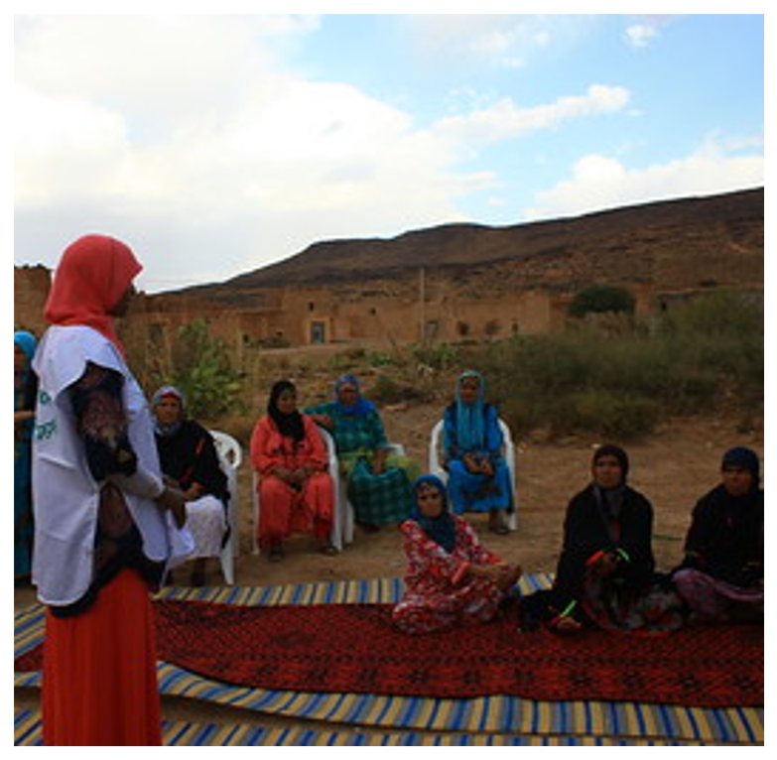
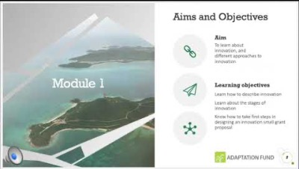
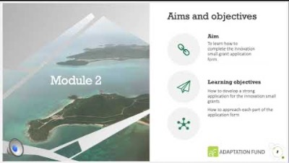
Key materials
Free on-line training on the understanding of innovation
Free online training on the Innovation Small Grant application
Application sample for Innovation Small Grants

Slide 23
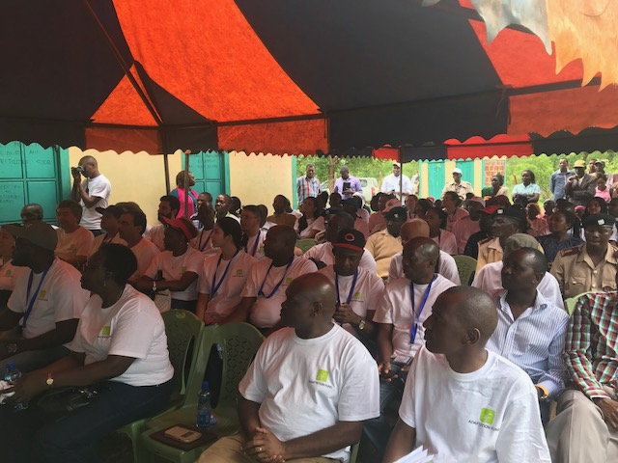
Upcoming opportunities
Small Innovation Grants and Large Innovation Projects are open to receive proposals for the AFB38 Board meeting. Deadline is January 10, 2022 at 18:00 (Washington DC time). Proposals may be submitted as early as January 3, 2022.
Under the Innovation Facility

Slide 24
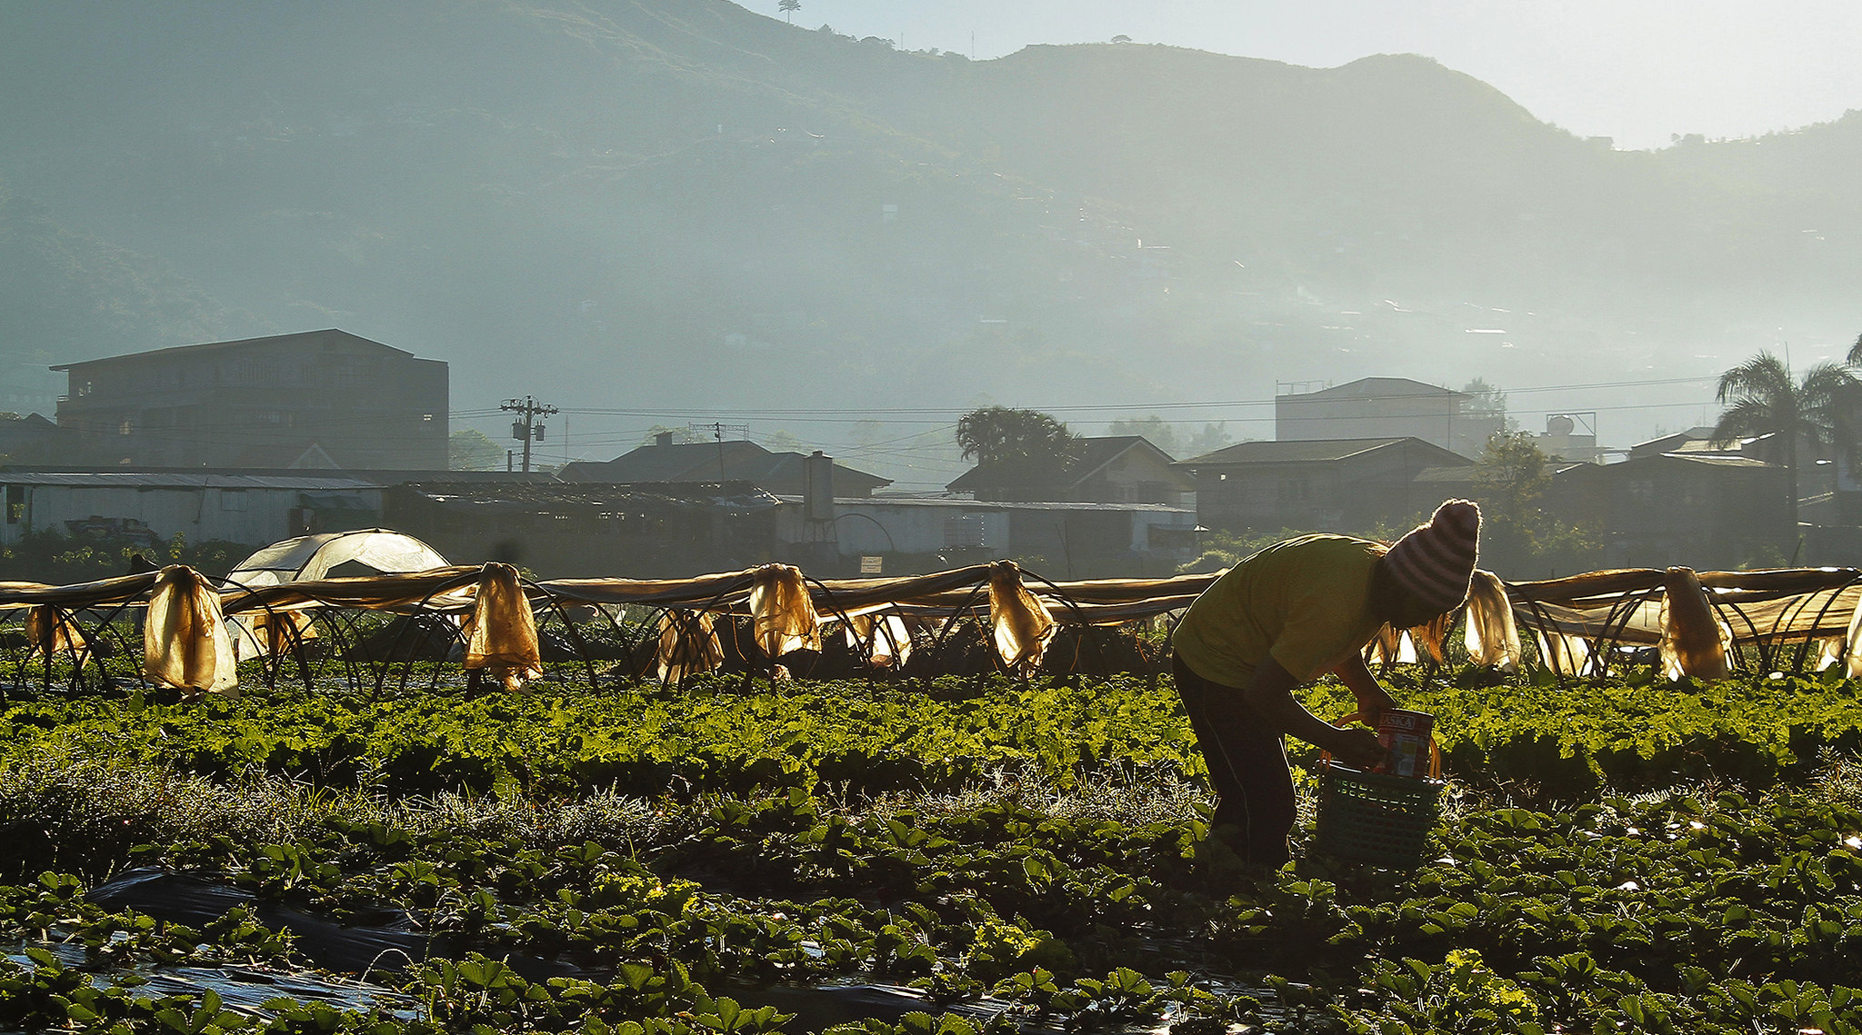





Thank You
Innovation Team at the Adaptation Fund
Saliha Dobardzic
sdobardzic@adaptation-fund.org
Alyssa Gomes
agomes3@adaptation-fund.org
Claudia Lasprilla Pina
clasprillapina@adaptation-fund.org
www.adaptation-fund.org

