Slide 1

AF Side Event COP26 Glasgow
============================
“Community Adaptation For Forest-Food Based Management in Saddang Watershed Ecosystem in South Sulawesi-INDONESIA”
Laode M Syarif, Ph.D
Executive Director

Slide 2

Identifying core areas, enhance action and cooperation to address disaster and climate risk.
Accelerate action to combat climate change-related disaster risk: institutional reforms, system changes and policies.
Improve Public Private Partnership to provide integrated and robust adaptation and mitigation activities.
Identify critical climate threats that require urgent action (e.g. food security, financial shocks, trade, infrastructure, water-related and security threats).
Building resilience and adapting to climate change at multiple levels and with a range of stakeholders from different sectors (more effective policies, risk management systems and response capacities at national level will need to be equally matched by investments at local levels, particularly in communities and for people who are most vulnerable to the impact of climate change).
Promote cooperation on adaptation, in order to maximize its effectiveness.
Approaches

Slide 3
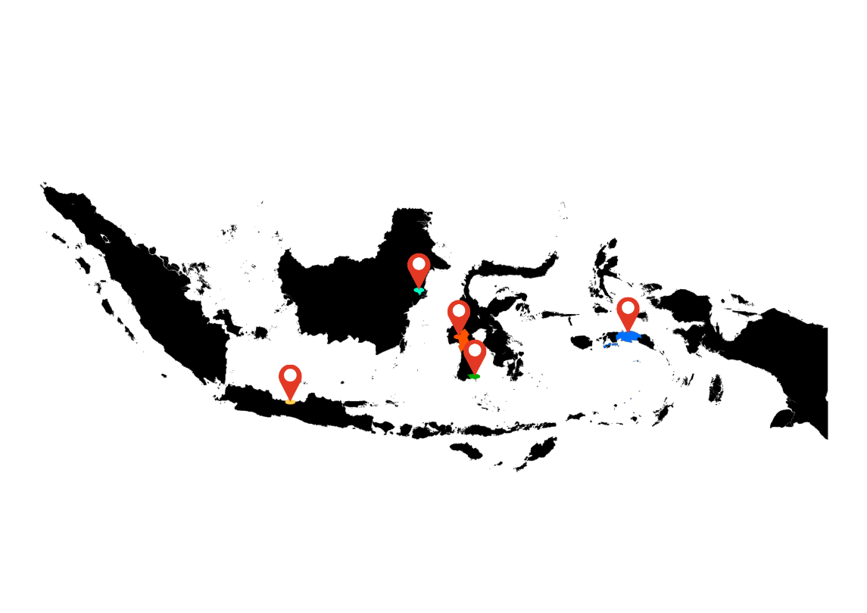
AF PROJECTs in Indonesia
EMBRACING THE SUN:
Redefining Public Space as a Solution for the Effects of
Global Climate Change in Indonesia's Urban Areas
Community Adaptation for
Forest-Food Based Management in Saddang Watershed
Enhancing the Adaptation Capability of Coastal Community
in Facing the Impacts of Climate Change in Negeri (Village) Asilulu,
Ureng and Lima of Leihitu District Maluku Tengah Regency Maluku Province
Safekeeping-Surviving-Sustaining towards Resilience:
3S Approach to Build Coastal City Resilience to
Climate Change Impacts and Natural Disasters
in Pekalongan City, Central Java Province
Adapting to Climate Change through Sustainable Integrated
Watershed Governance in Indigenous People of Ammatoa Kajang
Customary Area in Bulukumba Regency, South Sulawesi Province, Indonesia
3

Slide 4
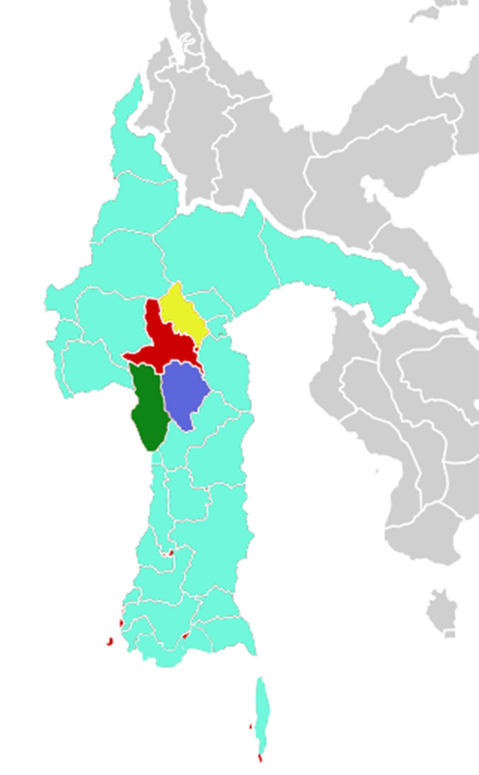
Community Resilience: SADDANG experience
Covering 4 Regencies of South Sulawesi Province:
Pinrang, Enrekang, Toraja, and North Toraja
Approach
Strengthened Social Forestry through encouraging forest food in the upstream of Saddang Watershed
Improved coastal governance and carrying capacity in support of climate change adaptation action downstream of Saddang Watershed
Strengthened institutional system and capacity to reduce climate risk including socio-economic and environmental degradation
Strengthened capacity and support of the parties through knowledge management

Slide 5
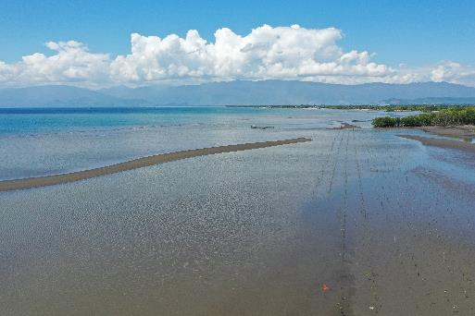
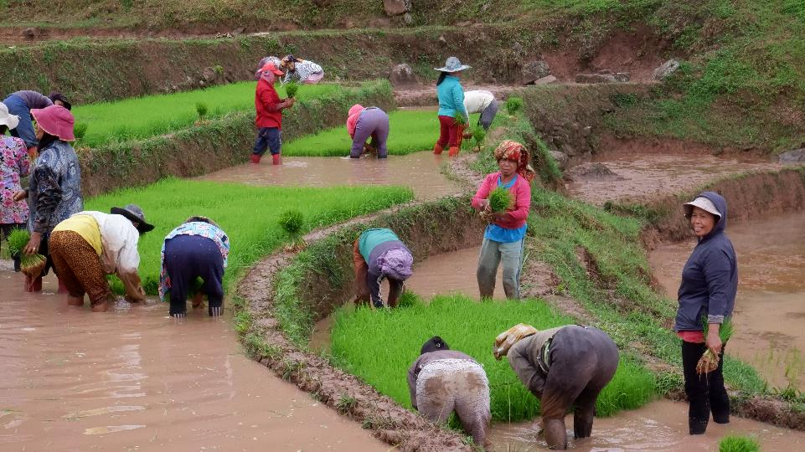
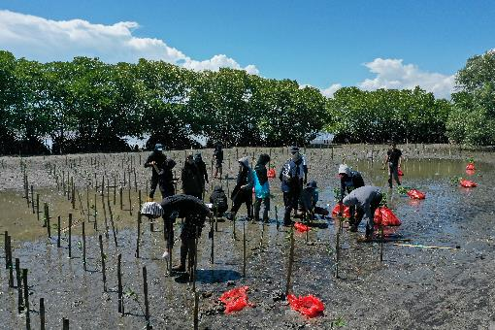
A Few Promising Progress
Saddang river
Mangrove planting in
Pinrang Regency
Rice Farmers in Enrekang Regency,
South Sulawesi

Slide 6
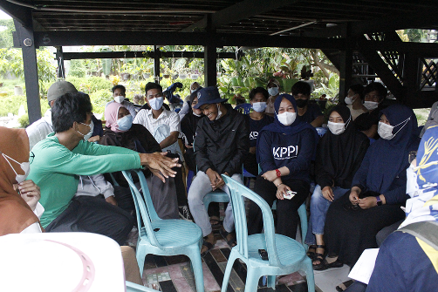
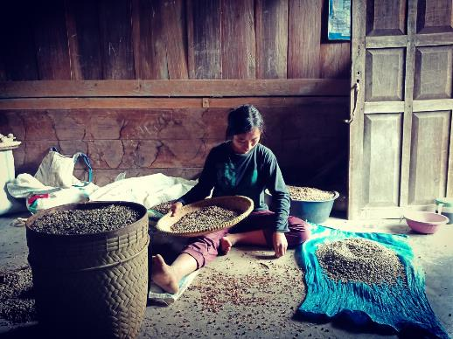
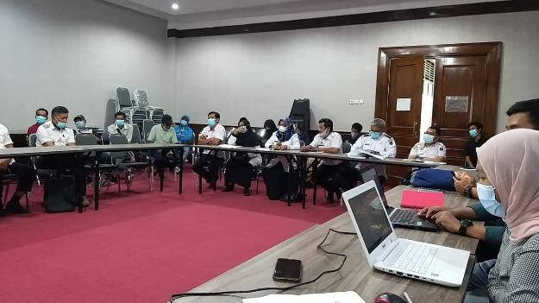
Government and People Enthusiasm
Establishment of Youth Group on Climate Change (KPPI)
Assistance to women groups in developing small scale home industry
Advocacy to CLIMATE CHANGE POLICY at Regency Level

Slide 7
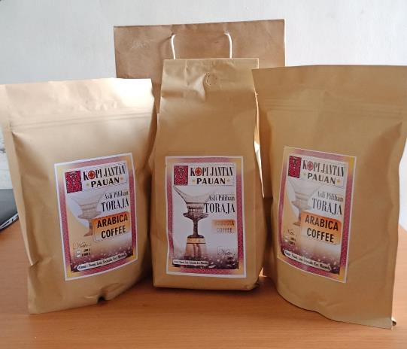
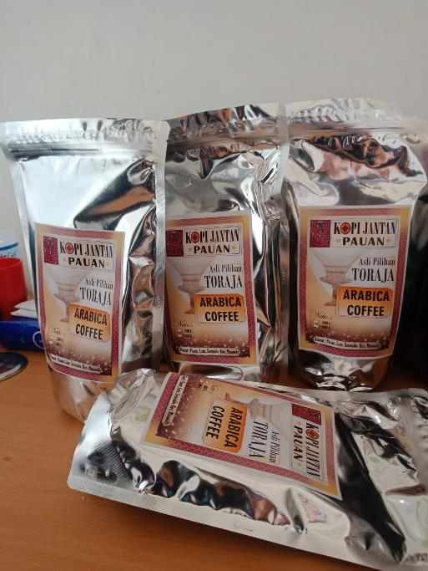

ENCOURAGING Agroforestry Products
Palm sugar
Toraja Arabica Coffee

Slide 8
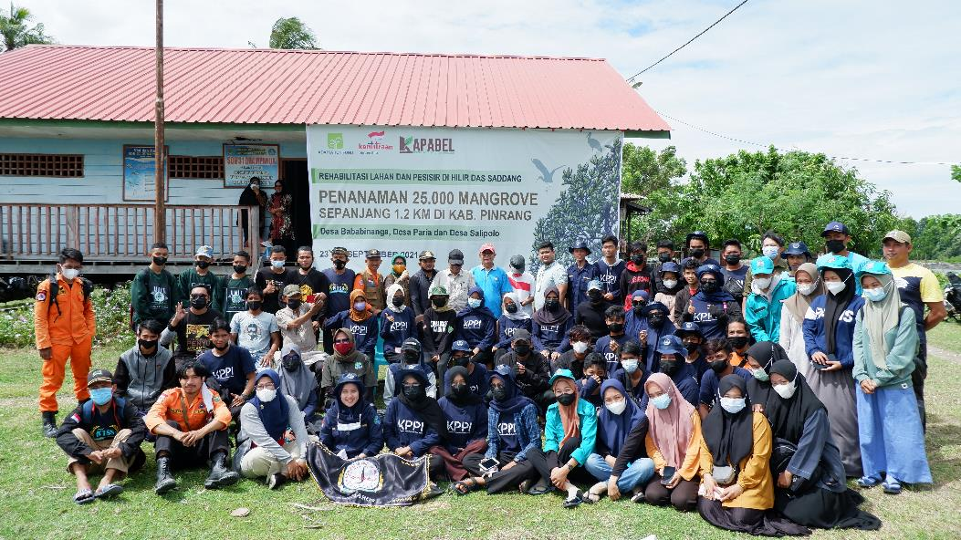
Terima kasih // Thank You

