Slide 1
Readiness Package: Access and Application
Enhanced Direct Access Workshop in Costa Rica
22 June 2022
Ishani Debnath: Readiness Consultant, Adaptation Fund Board Secretariat

Slide 2
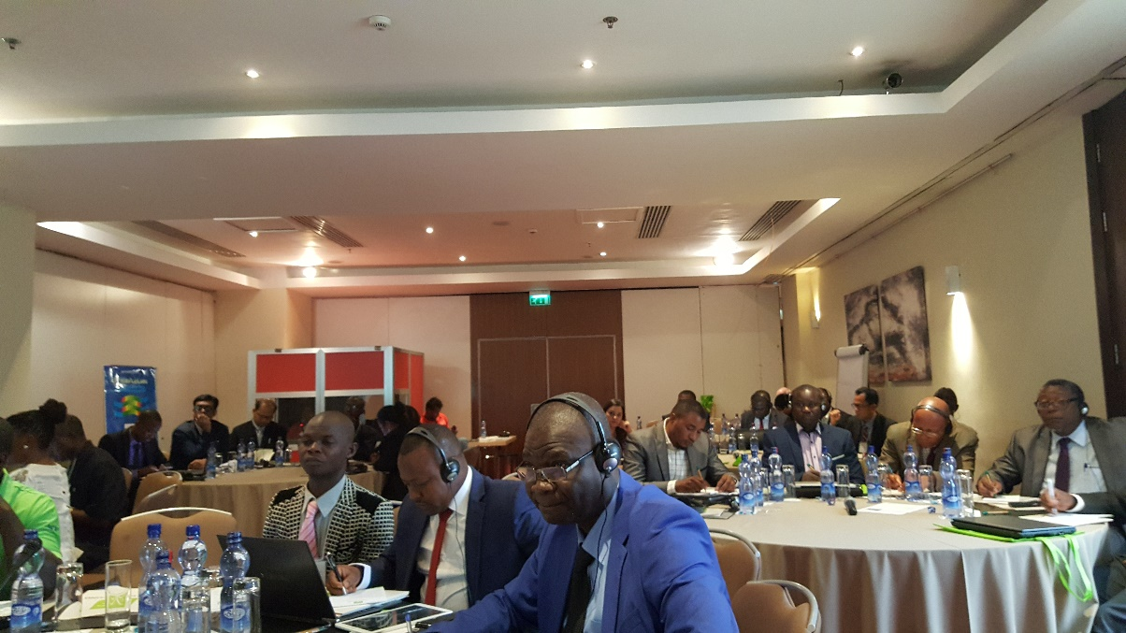
The Readiness Package Grant
Approved at AFB 29, March 2017
OBJECTIVE
Provide enhanced support for accreditation
Employing a suite of tools to advance the delivery of climate finance through Direct Access
Enable recruitment of fiduciary guidance and other experts
Shorten the length of time to achieve accreditation
The Readiness Package Grant is available for accreditation of NIEs only, up to a maximum of US$ 150,000 per NIE.

Slide 3
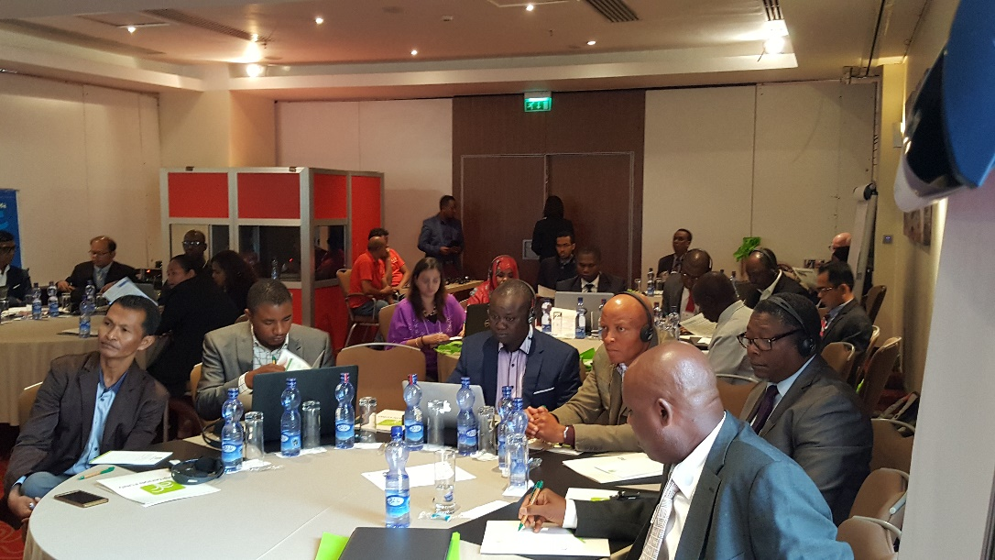
The Readiness Package Grant
The grant continues to support South-South Cooperation (SSC) through a more comprehensive suit of tools.
Following a decision by the Board at AFB26, March 2021, countries may accredit 2 NIEs, and the readiness package grant is US $150K per NIE.

Slide 4
Eligibility to Receive Accreditation Support
All developing country Parties to the Kyoto Protocol and Paris Agreement under the UNFCCC that wish to have an NIE accredited with the Fund are eligible to receive the Readiness Package grant.
You are eligible even if you previously accessed the SSC grant
It is available as a once off grant per NIE

Slide 5
Eligibility to Provide Intermediary Services
The NIE intermediary should have tangible achievements with the Fund in programming adaptation finance through the preparation and implementation of concrete adaptation projects and programmes
All NIE intermediaries have to meet the following eligibility criteria:
must currently have an “Accredited” status with the Adaptation Fund;
must have experience advising or organizing support relevant to accreditation or capacity building to institutions, organizations or other entities in developing countries at the national, sub-national or local level to receive climate finance for adaptation projects and programmes;
must have experience implementing a concrete Adaptation Fund project or programme and have submitted at least one project performance report (PPR), hence demonstrating commitment to adhere to the fund’s fiduciary standards, operational policies and guidelines

Slide 6
Eligible Activities for Funding
Support in one or more of the following:
Support to the DA to nominate a suitable NIE candidate
In-country support by the intermediary to an NIE candidate for the preparation of an application for accreditation.
Technical support through experts to develop and/or put in place policies, procedures and other institutional arrangements to support the accreditation process with the Fund.
Organization of local, national or regional consultations/workshops to assist in the preparation of applications for accreditations from several NIE candidates.
Following consultations between the intermediary and NIE candidate

Slide 7
Application Form

Slide 10
The window for the Readiness Package Grant proposal is open from 1 February to 31 March and from 1 July to 31 August every year. Applications should be sent to afbsec@adaptation-fund.org and carbon copy to idebnath@adaptation-fund.org and fmadziwa@adaptation-fund.org.

