Slide 1
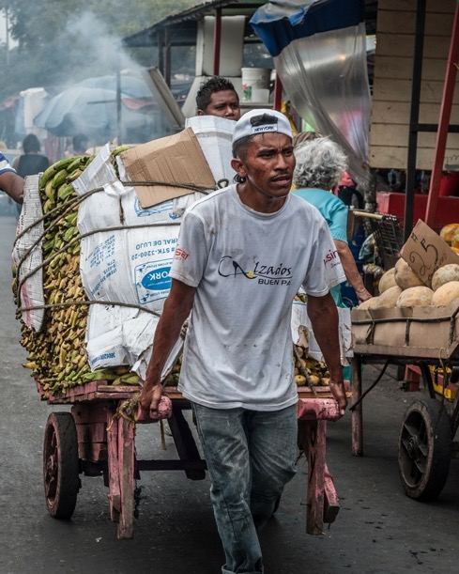
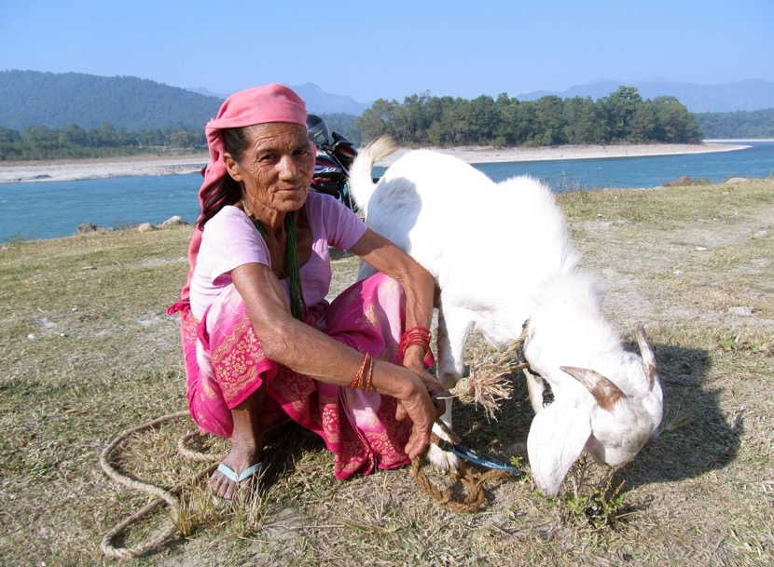
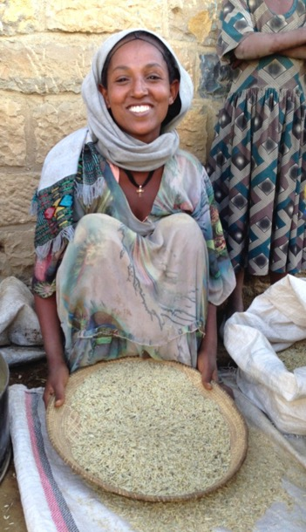
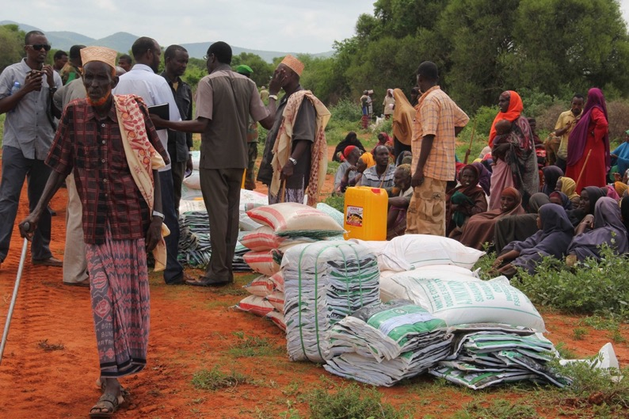
Evaluating projects Ex post & Emerging sustainability and resilience
Jindra Cekan, PhD. (Valuing Voices), Meg Spearman and Caroline Holo
MONTH 2022
Training material Part 1

Slide 2
Survey
Before we start….
Please take the following survey and tell us about your expectations for the training:
https://survey.zohopublic.com/zs/UvD77Z

Slide 3
Introduction
The AF-TERG and the evaluation team
The Adaptation Fund (AF) The Technical Evaluation
Reference Group of the AF
The Adaptation Fund was established to finance concrete adaptation projects and programmes in developing countries that are parties to the Kyoto Protocol and are particularly vulnerable to the adverse effects of climate change.
The Fund is supervised and managed by the Adaptation Fund Board (AFB). It now serves the Paris Agreement.
The AF-TERG is an independent evaluation advisory group, accountable to the Board, established to ensure the independent implementation of the Fund’s evaluation framework.
Specifically, the TERG provides an:
evaluation function,
advisory function, and
oversight function

Slide 4
Introduction
AF-TERG team for ex post evaluations
Susan Legro Caroline Holo Jindra Cekan, PhD. Meg Spearman

Slide 5
Introduction
Ex post evaluation process overview at the Adaptation Fund
STEPS CONTENT
PART 1
PREPARATION (slide deck 1)
AF team intro, Preparatory training,
Data consulted, Theories of Change / Sustainability drafted, Outcome(s) chosen
Inception report drafted
PART 2
DESIGN (slide deck 2)
Drafting of evaluation approach,
Training for fieldwork – data collection methods selection, overview of data analysis tools
Inception report finalized
PART 3
EXECUTION
Evaluation fieldwork & findings analysis
with support of AF-TERG consultants,
Evaluation report,
Sharing of results and dissemination
Notes:
NB: Part 3 is *not* a training slide deck

Slide 6
PART 1
Preparation for the Ex post Evaluation
Project selection for ex post evaluations
Understanding ex post evaluations
Sustainability and resilience frameworks
Preparatory work for fieldwork

Slide 7
Part 1: Preparation for the ex post evaluation
Objective and expectations: what will you learn?
OBJECTIVES OF PART 1:
Learn from national evaluators and implementing entities about their project/ program
Build on evaluator’s capacities to draft a theory of change and theory of sustainability
Advise on outputs/ outcomes/ impacts selection/ methods for the co-creation process
Help national stakeholders understand sustainability/ resilience broadly and how to evaluate them to help them learn for their planning/programming
CONTENTS OF PART 1:
1.1
PROJECT SELECTION FOR EX POST
UNDERSTANDING EX POST EVALUATIONS
SUSTAINABILITY AND RESILIENCE ANALYSIS FRAMEWORKS
PREPARATION FOR THE EX POST/FIELDWORK
1.2
1.3
1.4

Slide 8
1.1- Project selection for ex post evaluation
Contents
Selection framework for project eligibility
Overview of project and selection criteria

Slide 9
Project selection for ex post evaluations
Selection framework to determine projects eligible for ex post evaluation
CRITERIA
FUNNEL
A1
A2
A3
A4
B1
B2
B3
Ex post inadvisable
NO
A1 Timing
A2 Methodological feasibility
evaluating sustainability ex post
A3 Safe evaluation
A4 Financial and technical
feasibility and organizational
commitment (field consulted)
B1 Diversity of stakeholders
and/or implementing entity
B2 Variety of geography
B3 Variety in (cross)sector
Project
Ex post possible,
but with issues
MAYBE
Portfolio
Ex post feasible, recommended
GO
FIVE SHORTLISTED PROJECTS
FINAL SELECTION OF Next ex posts
Notes:
MS – NEED TO NOTE: how many were eligible (closed 3-5 years ago this FY), how many were short listed, how many selected per year, and that the prior year’s shortlisted ones may be likely to end up on the subsequent year’s list
Note: In 2021, 20 of 100 (closed) projects were eligible (from 2010 to 2019) for this assessment overall
The project selection or screening process for ex post evaluability has a two-layered structure with two types of criteria: mandatory (project evaluability) and optional (purposive portfolio sampling):
Mandatory: Examining elements of project evaluability (Type A criteria) can help determine whether quality, sufficient, and relevant data, as well as favourable timing, commitment, and interest of IEs are all in place for supporting a successful ex post analysis.
Optional: The sampling of the portfolio (Type B criteria) will aim to reflect the (multi/cross-) sectoral and geographic variety of interventions. Concurrently, it will seek project characteristics that might lend themselves to a more robust ex post evaluation and a more accurate overview of the contributions of the Fund. These are optional in Phase one given the small pool of completed projects.
Projects are rated first by mandatory type A criteria (ex post) then by optional type B criteria (Fund portfolio) with the idea of a screening funnel. Each criterion is assessed against a “stoplight scale” to rank projects (Green: ex post feasible; Orange: ex post possible but with issues; Red: ex post inadvisable).
Sources: Stoplight Evaluability approach adapted from RIE by Save the Children Ethiopia and draws on Valuing Voices’ Ex post evaluability, AF’s Phase 0 Ex post research and evaluability assessment and Secretariat input.
RIE: https://resourcecentre.savethechildren.net/library/retrospective-impact-evaluation-scoping-guide
ex post evaluability: https://valuingvoices.com/wp-content/uploads/2017/08/Valuing-Voices-Checklists.pdf

Slide 10
Project selection for ex-post evaluations
Argentina NIE (UPCR) project analyses: overview of selection criteria
Criteria ratings
NO
a) project closure: Dec 2018 (4 years ago)
b) duration: 5 years (2013-2018)
c) final evaluation: Jan-May 2019 (3 years ago)
d) seasonality: field work between July and August – match ’23
e) Project/ Data quality: mix of outputs and outcomes, stronger on assets
f) Diversity: First NIE, another Latin American ex-post, Agriculture
A3: Unsafe evaluation (covid-19)
MAYBE
A2 data quality re: precise outcomes
A2 ownership (NIE)
GO
A1 timing
A2 project quality & methods
A2 sustainability planning & exit & scaleup including resources, partnerships, capacities
B1 NIE (org diversity)
Possible dual- project Capacities evaluation with IBRD Project
Argentina Phase 2 New | IBRD w/Min Env & Sust Dev* | 2015 - 2019 | Rural Dev/ Land Mgmt capacities | Mar 20 | Aug-19 > Sep-19 March 20 completed | Argentina | Only output focused, e.g. # of trainings, #of visitors to website IEWS & municipal planning also AF important. But ‘adaptation practices’ & participatory sustainability strategy are interesting | IBRD is new MIE but Arg NIE meets B criteria better; FE is in Spanish so used PCR. Capacities eval is new to AF ex-posts.
UNKNOWN
A3: Monitored ESG risks
10

Slide 11
1.2- Understanding ex post evaluations
Contents
What are ex post evaluations?
Defining sustainability and resilience
What will you evaluate at ex post?
What will you learn from ex post evaluations?

Slide 12
Understanding ex post evaluations
What is co-creation?
This ex post evaluation follows a
Co-creation process
Define the purpose, scope and initial design of
the post-project evaluation
Determine data availability and quality, learning priorities and identify outcomes to evaluate
Identify best methods to evaluate outcome sustainability and resilience
Understand conditions for the field work country pilots
(site selection, stakeholders, logistics)
Notes:
Discussion ideas/prompts:
In what ways does evaluation practice support participation?
Have you ever been a part of a cooperative or collective evaluation process ? Please describe it.
Who do you see as the main partners/co-creators for these ex post evaluations?
Who do you see as the main audience/recipients of the lessons learned and other reports contents?

Slide 13
Understanding ex post evaluations
[AF-TERG framework] What will you evaluate at ex post?
The ex post framework focuses on aspects of both sustainability of outcomes and of climate resilience to answer the following overarching questions:
1
Have the project outcomes/impact(s) been sustained since project completion?
Why? If not, why not? What, if anything, emerged?
2
Are the sustained project outcomes/impact(s) climate-resilient?
How? In what ways? What does the outcome do in relation to climate disturbances?
All that is sustained may not be resilient to climate disturbances, and all that may be resilient to climate disturbances may not be sustained!
Notes:
WE NEED TO EMPHASIZE THAT OUR EVALS ARE FOR LEARNING PURPOSES
Once we have our project selected…. What do we want to consider?
Discussion questions:
- What does sustainability mean? How have you seen it demonstrated? How do you measure it?
- What does climate - resilience mean? How have you seen it demonstrated? How do you measure it?
NB: we will come back to the concepts of sustainability and resilience in greater detail.

Slide 14
Understanding ex post evaluations
What is ex post evaluation?
The OECD DAC defines ex post as an
“evaluation of a development intervention after it has been completed.”
It adds that “the intention is to identify the factors of success or failure,
to assess the sustainability of results and impacts,
and to draw conclusions that may inform other interventions”.
EX POST EVALUATION FOCUSES ON SUSTAINABILITY
Notes:
Citation: https://www.oecd.org/officialdocuments/publicdisplaydocumentpdf/?cote=DCD/DAC/EV(2022)2&docLanguage=en (2022)
Verbatim: “ex post evaluation Evaluation of an intervention after it has been completed. Note: An ex post evaluation may be undertaken directly following or some time after the intervention. The intention is to identify the factors of success or failure, to assess the sustainability of results and impacts, and to draw conclusions that may inform other interventions.”

Slide 15
Understanding ex post evaluations
Why evaluate ex post?
“At exit it is impossible to verify how much the project will contribute to sustainability… but many assume full success and full attribution to the project.” - John Mayne, evaluator
Translation: The sustainability analysis and sustainability ratings found in many multilateral final evaluations are untested and unproven.
Also: We cannot attribute results to only our project, but we can evaluate contribution to sustainability… and evaluate what emerged from local/national efforts to sustain results.

Slide 16
Understanding ex post evaluations
On what results level will ex post evaluations focus?
Ex posts ideally track high-level long-term impacts (what did we want to change for years), especially for climate adaptation where effects can be traced 3-5 years +
The Adaptation Fund desired impact to trace is:
“Adaptive capacity enhanced, resilience strengthened and the vulnerability of people, livelihoods and ecosystems to climate change reduced.”
Impact (s)
Emerging outcomes from local efforts (not the project) are important to trace ex post
Outcomes
Outcomes (what did we want to achieve) generated from assets (tangible gains, benefits) and capacities (resources, capabilities) that can be evaluated for sustainability
Outputs (what did we deliver) are normally not evaluated ex post as they are preconditions for results, but outcome links can be re-created
Outputs
In the Ecuador and Samoa pilot ex posts, the final evaluation data was mostly about outputs, so outcomes were re-created
Activities
Inputs
Ex post evaluation & M&E pyramid
Notes:
Notes: This is another way of thinking of the results chain (above slide) and what we can examine in ex post with data available.
NB: NEED TO EXPLAIN WHAT “RECREATING” OUTCOMES MEANS.
WORKSHEET: Need a flier on terminology/cheat sheet on the different terms in different funds/for different donors

Slide 17
Understanding ex post evaluations
What are we looking for?
ADAPTATION FUND DESIRED IMPACT:
Adaptive capacity enhanced,
resilience strengthened and
the vulnerability of people, livelihoods and ecosystems to climate change reduced
EVALUATING ADAPTATION FUND PROJECTS ALSO MEANS LOOKING AT CLIMATE RESILIENCE
Notes:
JICA conducts ex post evaluations 2-3 years after each project completion
They are the only donor to have done over 2500 ex post evaluations; most donors have done very few.
JICA feeds back the ex post evaluation results, lessons learned and recommendation to the future and on-going projects.
Also JICA publishes the evaluation results, ratings, and the third-party opinions for public accountability.
To enhance the objectivity of the evaluations, JBIC obtains third-party opinion by asking to verify the evaluation results for each project ex post evaluation from experts in developing countries.
Sources: https://www.jica.go.jp/english/our_work/evaluation/oda_loan/post/2006/pdf/other03.pdf & https://www.jica.go.jp/english/our_work/evaluation/oda_loan/post/2006/pdf/other04.pdf

Slide 18
Understanding ex post evaluations
Linking sustainability and resilience: Decreasing Vulnerability
Vulnerability is structural; if an outcome has been sustained, it is because it was valued or relevant to reducing vulnerability
Vulnerability is multi-dimensional; social, economic/financial, and cultural, but also environmental (including climate and other external disturbances)
Most of climate change adaptation is tied to broader unmet development needs
Adaptation Example: Infrastructure
Ownership
NB: Refer to upcoming slide on relevance in climate change adaptation vs relevance in sustainability.
Notes:
Source: US Climate Resilience Toolkit https://toolkit.climate.gov/tool/vulnerability-assessment-scoring-tool-vast
NB: This circle diagram is for TRANSPORTATION ASSETS
Source: CCVI https://storymaps.arcgis.com/stories/e45fb304d10b4917b6adb0d5bf11dac5
NOTES: CLIMATE vulnerability is only ONE TYPE of vulnerability! Most vulnerability is tied to development, not climate alone.

Slide 19
Understanding ex post evaluations
[AF-TERG framework] What will you evaluate at ex post?
ADAPTATION PROJECT
OUTCOME
OUTCOME
OUTCOME
You will evaluate one or more OUTCOMES of your project (not the entire project)
[assets and/or capacities]
SUSTAINABILITY
Vulnerability
&
Relevance
RESILIENCE
LEARNING

Slide 20
Understanding ex post evaluations
What will you evaluate at ex post?
Legend:
What you will evaluate
Sustainability =
Did it last?
≠ did it work?
What you will NOT evaluate
Effectiveness
Did it work?
Did the project achieve the
desired objectives/ outcomes?
Was the intervention based on knowledge and research to improve the likelihood of success?
Sustainability and unanticipated / emerging effects
Are the project’s effects lasting?
Are the intervention strategies and outcomes (still) desirable?
ex post analysis shows what was sustained (or not), by whom and why. This can illuminate relevance but not efficiency
Resources / inputs
Activities & Outputs
Outcomes
Effects/ Intermediate States
Post project outcomes / Impacts
Efficiency
Was it efficient?
What was the relationship between the project’s inputs and outputs?
Could resources have been better used?
*
Effects/IS
Was the project worthwhile?
Does it have merit?
Some short-term impacts can be traced, longer-term level impacts can be discovered w/ complex data or longer time
Relevance
Did the project intervention address the right issues?
←←Contextual and external factors outside project boundaries that may have influenced the project trajectory→→
Notes:
Sources: Adapted from WHO manual 2019 for the Adaptation Fund Phase 1, 2021
Mention the OECD DAC criteria – people keep trying to evaluate the effectiveness and efficiency
https://www.oecd.org/dac/evaluation/daccriteriaforevaluatingdevelopmentassistance.htm
To look at sustainability and resilience - - - - First we need to break down the results framework into parts and explore what we can learn about the project’s results in ex post based on the data we have.
Possible Discussion Qs (based on this and prior slide):
What do you notice about terminology (this is WHO)?
What are some questions to you DO expect to be able to answer in ex post? Why? With what data?
What are some questions (you might want to answer but) you do NOT expect to be able to answer in ex post? Why not?

Slide 21
Understanding ex post evaluations
What will you evaluate at ex post?
*
Relevance
Did the project intervention address the right issues?
What relevance means for sustainability
What relevance means for adaptation
Outcomes achieved e.g.:
feed into national or sector-level climate change strategy objectives
address the needs of the most vulnerable people and/or address climate-vulnerable sectors
reduce exposure to or impact from climate disturbances
improve quality of and/or access to climate information for decision-making
Key participants, persons and groups involved or affected by the outcome achieved are engaged and invested in its continuation
Ex post focuses on learning what does/ doesn’t last, and why, and then examines relevance.
Using OECD/DAC + sustainability thinking, relevance is: ‘did the intervention address (fund, design, implement) the right issues… that could be sustained?’
If results were not sustained, why not, and what can be learned?
Ex posts look for sustainability disincentives in the very funding/design, e.g. food aid subsidies
Notes:
NB on resilience: these are POSSIBLE ways to see relevance reflected in the ‘adaptation’ outcome.

Slide 22
Understanding ex post evaluations
Learning and main expectations from ex post project evaluations
Main lessons from past ex post evaluations, to be expected:
There are always positive and negative lessons from all project evaluated; not all activities are typically sustained, but all results can be learned from;
Questions of why some results lasted in some places over others can illuminate differences in context, design, implementation, M&E or exit;
Some outputs/outcomes could be sustained differently than originally conceived, given differed resources/ capacities etc.; this has important future design implications, especially for scaling up ‘success’ that can be differently defined;
There can be emerging outcomes that came from local efforts (not through the project) to sustain results through different design and implementation. These especially can help inform future project design and funding.
Questions:
What would you expect to learn from an ex post evaluation?
Have you ever learned anything from a particular ex post evaluation? Do you recall? Who funded/conducted it?
Can you think of examples of lessons learned from an ex post evaluation? How they were used?
Notes:
Discussion Question ideas:
What would you expect to learn from an ex post evaluation?
Have you ever learned anything from a particular ex post evaluation? Do you recall? Who funded/conducted it?
Can you think of examples of any of these in the slide?

Slide 23
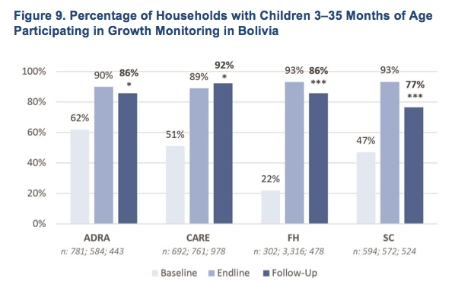
Understanding ex post evaluations
What ex post evaluations can tell: example of mixed outcomes
Mixed (Typical) outcomes on child health
USAID, 2 years ex post 2016
Percentage of households with children 3-35 months of age participating in growth monitoring:
Decreased child health via growth monitoring from end line by only 4-16% (ADRA, FH, SC)
Improved child health via growth monitoring by 3% (CARE)
Notes:
Source: ADRA, CARE, FH, Save the Children Bolivia USAID Exit Strategies, 4-country study, Tufts Friedman School of Nutrition and FHI/360 ’16

Slide 24
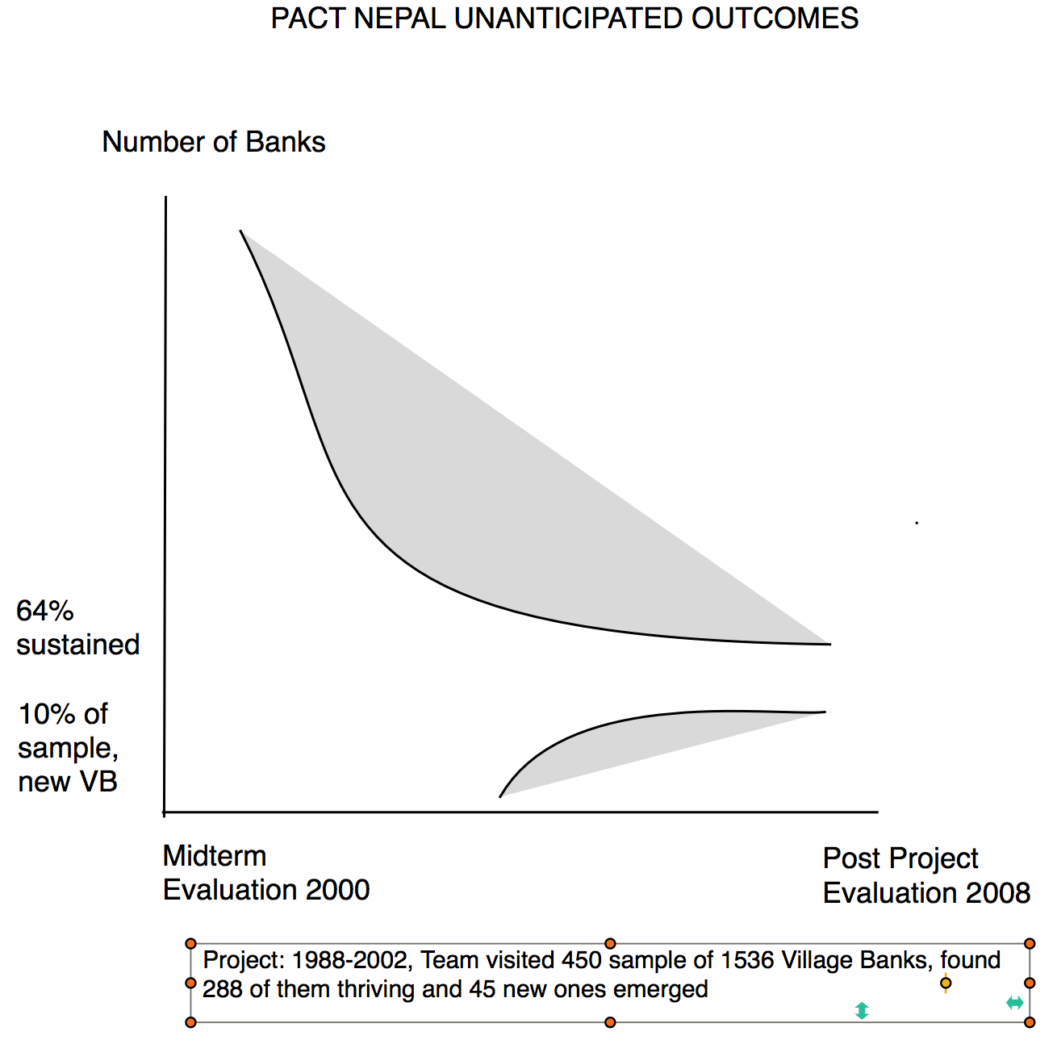
Understanding ex post evaluations
What ex post evaluations can tell: example of unanticipated outcomes
Mixed Results with Unexpected Positive Results in Village Savings and Empowerment
PACT WORTH Nepal, 2008
Only 2/3 banks were sustained…
Yet 10% were new village banks formed post-closure in communities by word of mouth or self-help training
(Note: No baseline or final, only since midterm, project was replicated in 12 countries)
Notes:
See ex posts: https://valuingvoices.com/catalysts-2/

Slide 25
Stretch and drink break
Questions? Comments?

Slide 26
1.3- Sustainability and resilience analysis frameworks
Contents
Quick overview of sustainability analysis
Quick overview of resilience analysis

Slide 27
Ex post evaluation and sustainability
Analyzing sustainability through the sustainability framework
Programming Relevance
Ownership
Human, social, economic shocks and stresses
Risk Management Strategy
Sustained (?) Outcome(s)
Economic, Political, Human/Social, and Natural Capital
Resources
Selected Outcome(s)
Sustainability plan, Ratings, and Exit Strategy
Climate Shocks and Stresses
Partnerships
Sustainability Assumptions, e.g. Trajectories in systems
Emerging (?) Outcome(s)
Adaptive Management
Capacities
CONTEXT
Backdrop of the strategy and results
STRATEGY
Supporting sustainability throughout implementation
CONDITIONS OF SUSTAINABILITY
Conditions fostering sustainability
DISTURBANCES
Endured by the outcome(s)
YOU WILL USE THE ENTIRE SUTAINABILITY FRAMEWORK (ALL 4 COMPONENTS) AS PART OF THE EX POST EVALUATION TO UNDERSTAND HOW THE OUTCOME(S) IS/ARE (NOT) SUSTAINED
LIKELIHOOD OF SUSTAINABILITY
VERIFICATION OF SUSTAINABILITY
Notes:
Notes on preparation leading to OUTCOME SELECTION and THEN using the sustainability framework:
Data availability and data quality;
Organizational considerations,
methodological considerations,
choice of projects, sites, timing; data

Slide 28
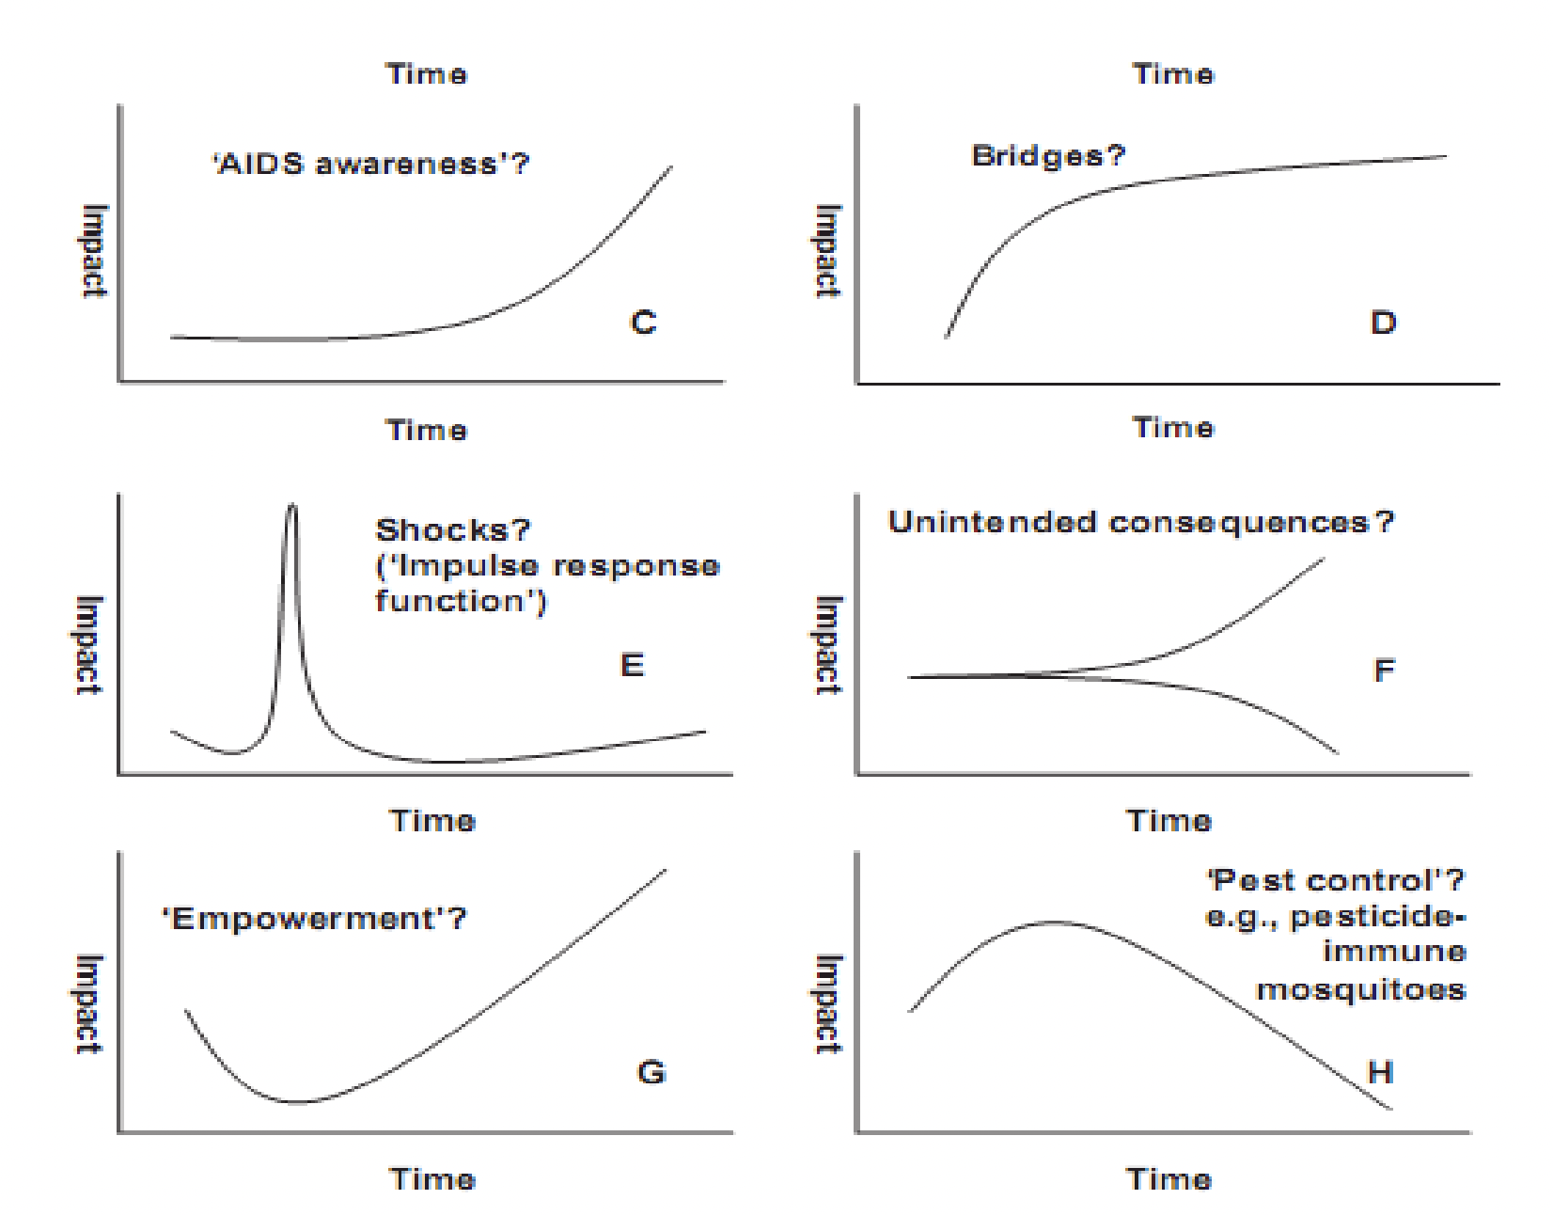
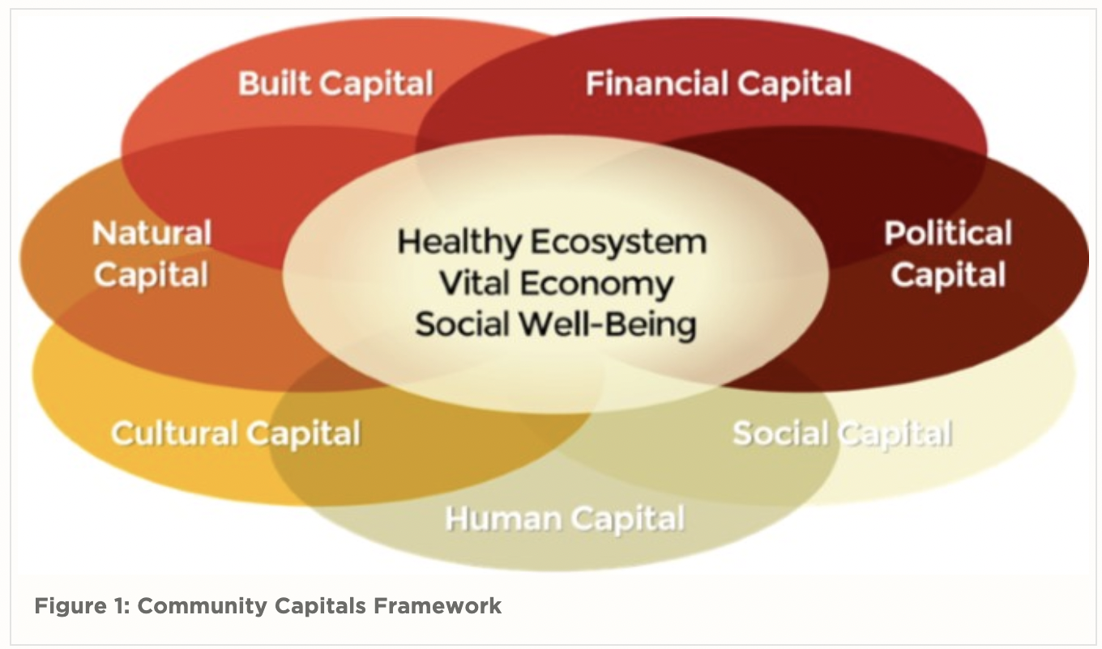
Ex post evaluation and sustainability
CONTEXT
Backdrop of the strategy and results
Context: Capital and Trajectories
Types of Capital
Types of Trajectories
Notes:
Community Capital: https://agecon.unl.edu/cornhusker-economics/2015/community-capitals-framework
Trajectories source; http://evaluationontario.ca/wp-content/uploads/2012/11/Sanjeev-Sridharan-Understanding-and-Evaluating-Complex-Programs.pdf
NOTES:
Capitals: Sustainability rests on all the capitals - we are dealing with all these vulnerabilities - the project changes the vulnerability from high to decrease it so that those capitals are stronger - with the project, we are improving all the capitals, and all of these capitals are either the source of vulnerability or what projects are trying to change, and as a result, sustainably changes
Trajectories: when you look at the graphics, you see that things can get better or worse - over time, there are trajectories developing but we can't assume that the trajectories will be positive

Slide 29
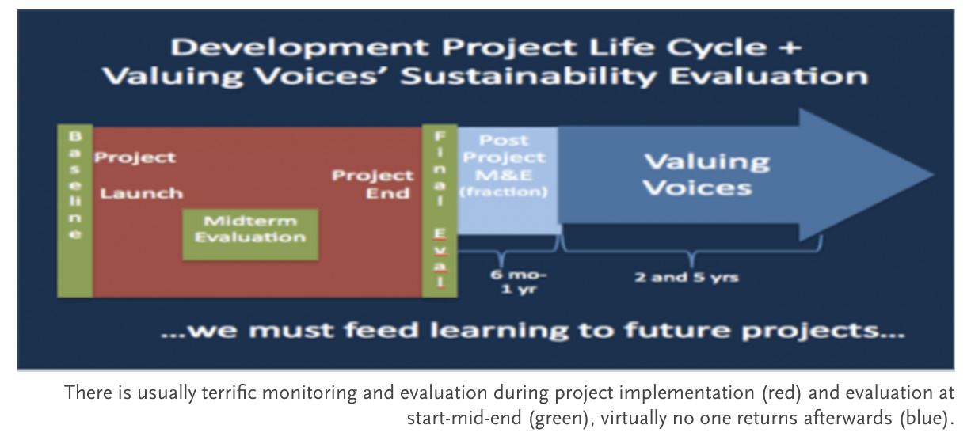
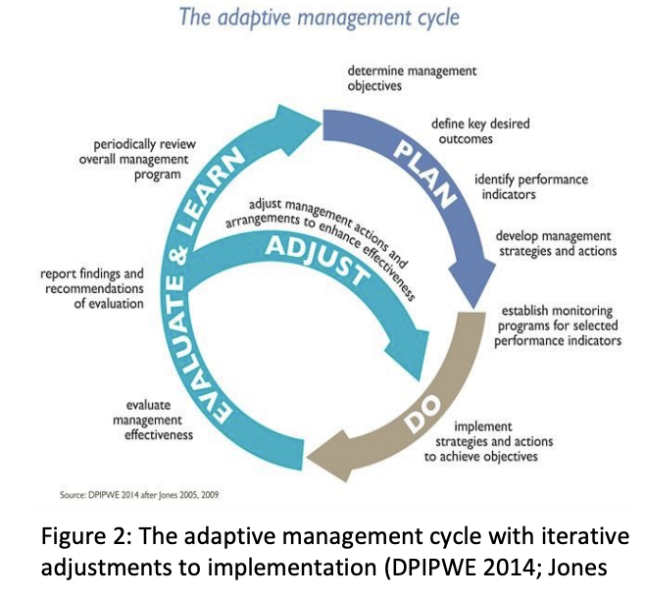
Ex post evaluation and sustainability
STRATEGY
Supporting sustainability throughout implementation
Strategy: Relevance, Strategy, Sustainability & Risk Management plans, Adaptive Management
As the OECD relevance criteria states: “The extent to which the intervention objectives and design respond to beneficiaries’, global, country, and partner/institution needs, policies, and priorities, and continue to do so if circumstances change.”
“Although people’s own efforts, initiative, and responsibility are essential to manage risk, ‘their success, in terms of resilience and prosperity, will be limited without a supportive environment.’
To ensure risk management is at the center of development planning.”
29
Notes:
Sources:
OECD Evaluation Criteria: https://www.oecd.org/dac/evaluation/revised-evaluation-criteria-dec-2019.pdf
Risk: https://www.worldbank.org/en/news/feature/2013/10/06/Managing-risk-for-development-From-crisis-fighting-to-systematic-risk-management
Sustainability: https://ssir.org/articles/entry/when_funders_move_on
Adaptive mgmt.: https://www.betterevaluation.org/sites/default/files/MandE_for_Adaptive_Management_WP2_What_Is_AM_%26_how_does_it_work_202009.pdf
NOTES:
relevance: is the outcome still relevant, even if the government does not provide resources, etc; check if outcome is still relevant so people maintain it
sustainability plans: Unless you do sustainability planning for the long-tern, then the outcome is far less likely to be sustained
risk management : risk mgt is at the center of development planning - if they don't plan and mitigate risks, the results won't be sustained
sustainability ratings: if the project says " very likely to be sustained because involvement of local partners", then if it is verified, it is more likely that the project is sustained
adaptative management: once you learn, you circle back - if you adapt, it is far more likely for the outcome to be sustained – indications of adaptive management will make an outcome far more likely to be sustained; looking at adaptive management actions can show how did it work out during the sustainability evaluation

Slide 30
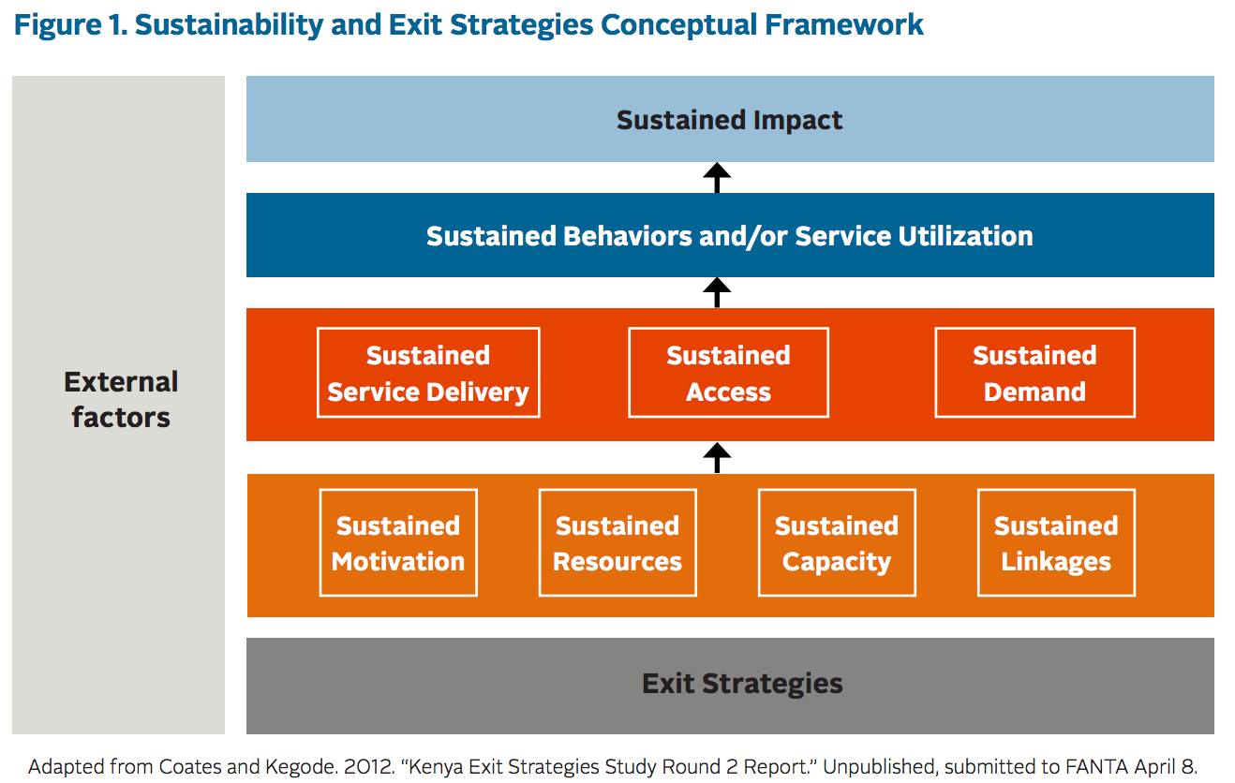
Ex post evaluation and sustainability
CONDITIONS OF SUSTAINABILITY
Conditions fostering sustainability
Conditions: Ownership, Resources, Capacity, Partnership
YOU WILL ANALYZE ALL FOUR CONDITIONS - OWNERSHIP, RESOURCES, CAPACITIES, AND PARTNERSHIP - IN ORDER TO UNDERSTAND AND EVALUATE SUSTAINABILITY
Ownership
Sustained motivation; who benefits from the sustained results enough to sustain it locally? Who is using it/demanding it?
Resources
How are the sustained results being resourced? Are these financial, in-kind, technical, and/or other resources?
Capacity
What are the necessary knowledge and skills to be transferred to local/national stakeholder partners to sustain the results? How will new entrants be trained to continue sector change?
Sustained Ownership
Sustained Partnerships
Ownership
Ownership
Partnerships
Partnerships
What continued project knowledge, and skills from which stakeholder partners, are needed to sustain the results? What local contracting with direct and indirect partners are needed?
Notes:
Source: Tufts/ FHI 360 (2016)

Slide 31
Ex post evaluation and sustainability
DISTURBANCES
Endured by the outcome(s)
Disturbances: Shocks and Stresses (climate and non-climate)
Notes:
Source: WFP Anticipatory actions: https://docs.wfp.org/api/documents/WFP-0000110236/download/
NOTES:
Projects designed to address vulnerabilities – for how long? How well did the project strengthen capacities to withstand shocks?

Slide 32
Ex post evaluation and sustainability
Outcome(s)
Outcomes: (Un?) Sustained & Emerging (?)
Emerging outcome examples:
Ownership & Resources:
Participants valued the health clinic built by the project and sustained it by introducing community tithing to cover costs and incentives to comply (CRS/Niger)
Niger health clinic
Partnerships & Capacity:
Members of Village Banks offered trainings in Village Banks for sale in distant home areas (Pact/Nepal)
= project outcomes
= sustained outcome
Notes:
Source: Graphic: https://www.naceweb.org/diversity-equity-and-inclusion/best-practices/emerging-trends-could-threaten-equitable-outcomes-for-marginalized-students/
Examples: https://www.pactworld.org/features/rural-nepal-pact-using-integrated-development-break-povertys-grip

Slide 33
Ex post evaluation and resilience
Defining resilience in the context of Climate Change Adaptation
“Resilience” to both the sudden and long-term effects of climate change can be described as a high-level goal of climate change adaptation.
Successful adaptation means the structures and functions critical to life are less affected by climate-related disturbances, and/or these disturbances are less impactful.
DISTURBANCES: acute shocks (e.g. a cyclone, flood event) or chronic stresses (e.g. gradual crop loss from temperature rise, sea level rise).
Affect… …Are affected by
STRUCTURES:
*a literal, physical asset (forest, storm wall, evacuation shelter, etc.),
*a figurative asset like an institution or set of practices (local government, economy, early warning system).
FUNCTIONS:
ability to serve a particular need or purpose (generate income, attend school, be safe and secure).
Notes:
Transition – now we have a sustained outcome and we want to know how it reflects resilience

Slide 34
Ex post evaluation and resilience
Applying the resilience framework
Continual
Transformation Resilience Resistance
Natural systems
*Structures
*Functions
Climate information Use
At scale
Sustained Outcome
Climate disturbances
Diverse
NEXUS
Climate Vulnerability Reduction
Emerging Outcome
Flexible
Human systems
*Structures
*Functions
Redundant
YOU WILL USE THE ENTIRE RESILIENCE FRAMEWORK (ALL 5 COMPONENTS) AS PART OF THE EX POST EVALUATION TO UNDERSTAND HOW THE OUTCOME(S) IS/ARE (NOT) RESILIENT
DISTURBANCES
Addressed by the sustained outcome
SYSTEMS
The larger context of the strategy and results
ADAPTATION
How assets and capacities are used
CHARACTERISTICS
What characteristics the outcomes exhibit
R-R-T
Resistance – Resilience – Transformation

Slide 35
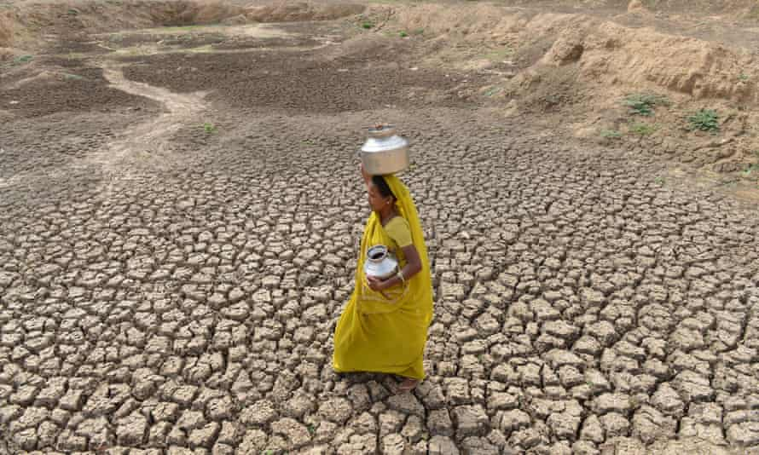
Ex post evaluation and resilience
DISTURBANCES
Addressed by the sustained outcome
Disturbances: Climate stresses and shocks
EXAMPLE - Outcome: Improve food security for drought prone region
Climate change stresses
Gradual and/or cyclical changes in:
Temperature
Rainfall, rainfall patterns
Sea level (rise)
Related stresses: Temperature rise, decreased rainfall, shortened and delayed wet season
Related effects: depleted soils, crop loss, shorter growing season, stunted crop growth, low yields
Climate change shocks
Sudden ((un)expected) events:
Hurricane or Typhoon
Tornado
Flood
Storm Surge
Seasonal Drought
Related shocks: periodic drought, floods
Related effects: topsoil loss, landslides, crop loss
Notes:
This could also be a PHYSICAL MAP like a community or other local-unit vulnerability mapping exercise, aka hazard map or risk map. See next slide
Photo credit: https://www.theguardian.com/global-development-professionals-network/2015/jun/12/decade-of-drought-a-global-tour-of-seven-recent-water-crises

Slide 36
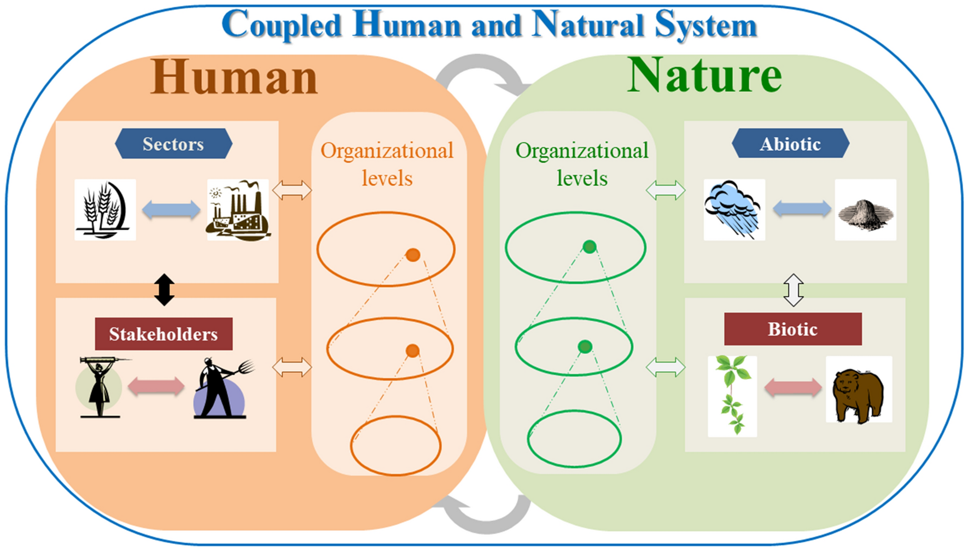
Ex post evaluation and resilience
SYSTEMS
The larger context of the strategy and results
Systems: Human, Natural, Nexus
e.g.
Institutions
Policies
Infrastructure
e.g.
River basin
Forest/ protected area
Wetlands
Nexus
e.g.
Practices
Skills
Notes:
Source: Liu, et.al. 2021.
Nexus is the interface or relationship between the human and natural systems – “HOW” they are coupled
Organizational levels = increasing complexity and scale as you go up; interface is different at different scales
We talk about SYSTEMS so that we can talk about STRCUTURES AND FUNCTIONS, so that we can talk about RRT

Slide 37
Ex post evaluation and resilience
ADAPTATION
How assets and capacities are used
Adaptation: Climate Vulnerability, Climate Information
Various Assets & Capacities are used to reduce vulnerability and adapt to climate change.
How are they used? They are used to:
Reduce climate vulnerability
Reduce exposure
Reduce sensitivity
Increase adaptive capacity
Capacities
Improve climate information & Learning
Availability
Use/uptake
Accessibility
Quality
Relevance
Including…
Notes:
ASSETS AND CAPACITIES developed/built by the sustained outcome are now tested for whether they are being used specifically for CLIMATE CHANGE purposes – reducing CLIMATE vulnerability and enabling improved climate information
WHY DOES INFORMATION MATTER? Assets and capacities are great but unless there’s continual information sharing, and opportunity to adjust assets and capacities to NEW needs/challenges/understandings of risks and disturbances, then the assets and capacities become irrelevant

Slide 38
Ex post evaluation and resilience
CHARACTERISTICS
What characteristics the outcomes exhibit
Resilience Characteristics
Continual
At scale
Diverse
Flexible
Redundant
Feedback loops; continually receive and provide relevant information/substance
Sufficient time and space for systems to maintain or modify structures and functions
Complexity of actors reliant on /supporting one another for success or survival
Dynamic in approaches and strategy, around an equilibrium
Duplicate or back up systems, paths, means, or options when another fails
Notes:
This could also be a PHYSICAL MAP like a community or other local-unit vulnerability mapping exercise, aka hazard map or risk map. See next slide
Photo credit: https://www.theguardian.com/global-development-professionals-network/2015/jun/12/decade-of-drought-a-global-tour-of-seven-recent-water-crises

Slide 39
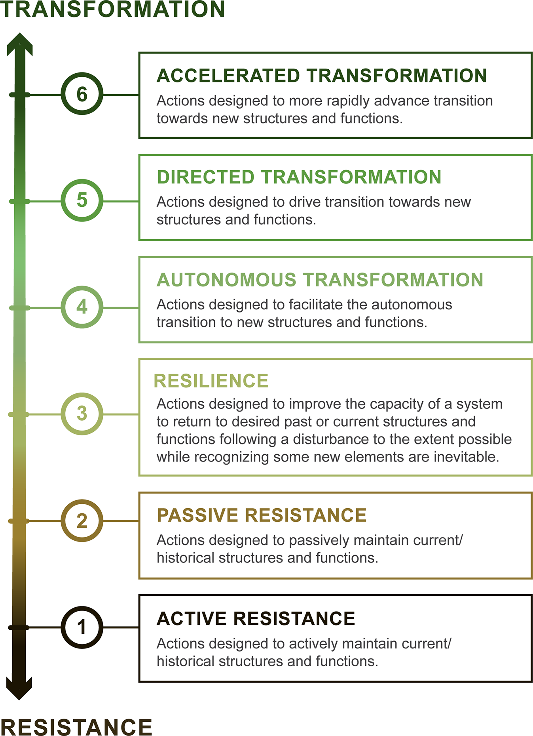
Ex post evaluation and resilience
R-R-T
Resistance – Resilience – Transformation
Evaluating resilience : R-R-T Typology
Overhaul of structures and functions (S&F)
4-6 New S&F
Directed transition toward new S&F
Undirected transition toward new S&F
Improve system capacity to keep current or past S&F
1-3
Old S&F
Passive maintenance of S&F
Active maintenance of S&F
Notes:
Notes:
- This is a TYPOLOGY. Meaning, everyone should NOT be aiming for transformation. It’s a way of describing the strategy taken for managing climate disturbances.
The distinction between directed and autonomous is one of SPEED.
Source: https://www.nature.com/articles/s42003-020-01556-2

Slide 40
Stretch and drink break
Questions? Comments?

Slide 41
1.4- Preparatory work for ex post evaluation
Contents
Step 1: Project documentation review
Step 2: Theory of Change
Step 3: Revise ToC into Theory of Sustainability
Step 4: Outcome(s) selection for ex post evaluation
>> What do we want to see in the Inception report?

Slide 42
Ex post pilots: preparatory work for field work
Objective and expectations: what will you do?
At the end of this training, you will be expected to do the following
STEPS OF PART 1 (OUTPUTS):
1
Inventory and analysis of project data availability and quality at hand
2
(Re-) creation of Theory of Change
Draft inception report /
plan for ex post
3
Identification of factors affecting sustainability for Theory of Sustainability
4
Outcome selection
AF-TERG feedback
Notes:
AT THE END OF PART 1:
Evaluator: Conducts analysis of the AF data at hand, creates a Theory of Change/ assumptions about Sustainability with the MIE/NIE and proposes short inception report/plan for the ex post evaluation
AF Team: Provides feedback and training before final inception and fieldwork planning

Slide 43
Ex post pilots: preparatory work for field work
STEP 1: project documentation review
BEFORE GOING TO THE FIELD, THE IE AND EVALUATOR SHOULD GATHER AND REVIEW THE PROJECT’S SECONDARY DATA DOCUMENTATION (MANDATORY)
DATA GATHERING. The following documents will be consulted to provide background on the project :
Project Proposal/Project Document
Mid-Term Evaluation and other assessments
Monitoring and Results Reports
Final Evaluation
Baseline Report & other Technical Reports
Documented knowledge change
Partnerships
Partnerships
Notes:
Follows with Q&A and a brief break – anyone who hasn’t already taken the
Adapted from https://valuingvoices.com/building-the-evidence-base-for-post-project-evaluation-a-report-to-the-faster-forward-fund/
FULL TEXT (STAR = WORKSHEET)
Project Proposal:
Project context (institutions, partners, climate conditions, etc);
Planned targets and indicators, theory of change
Mid-Term Evaluation and other Monitoring and Results Reports:
Vulnerability Assessment Mapping
Results and analysis on measured targets & indicators
Final Evaluation:
Sustainability analysis and ratings
Qualitative and quantitative data of outputs & outcome
List of project outputs: Assets/ Infrastructure created
An endline survey or review, endline sampling, methodology and survey design for statistical comparison
Benchmarking, exit, handover for exit readiness, and access to data for reidentification of participants
Baseline Report & other Technical Reports:
Climate shocks and stresses and assumptions about them
Documented knowledge change: proof of capacities gained

Slide 44
Ex post pilots: preparatory work for field work
STEP 1: project documentation review
What will the project documentation review tell us?
AVAILABILITY OF DATA
- Sufficient information on results (outcomes, impacts)
QUALITY OF DATA
- Surveys/participants, disaggregation, etc
CONDITIONS FOR SUSTAINABILITY
Partnerships, capacities, resources, ownership
SUSTAINABILITY PROJECTIONS
Ratings, projections, etc.
*
Notes:
See slide 27 for conditions for sustainability
FULL TEXT -
AVAILABILITY OF DATA:
- Is there enough data to inform an evaluation of outcomes, impact, and/or other changes?
QUALITY OF DATA:
Is the data sufficiently disaggregated? (by geography, sex, direct/indirect involvement, etc)
Are sampling frames, and survey and participant lists retained?
CONDITIONS FOR SUSTAINABILITY
What were the ownership, resources, capacity, and partnership conditions for sustainability identified at project completion in the final evaluation?
SUSTAINABILITY PROJECTIONS
What are the sustainability ratings and sustainability projections at project completion?

Slide 45
Ex post pilots: preparatory work for field work
*
STEP 1: project documentation review /identifying sustainability ratings
During data gathering, you might find categories of sustainability ratings in the final evaluation. The former Guidelines for final evaluations required assessing the likelihood of sustainability of outcomes and provide a rating for the following risks and assumptions to sustainability:
Financial and economic
Socio-political
Institutional framework and governance
Environmental
Uncertainties on climate change Impacts
Example: Final evaluation of Tanzania
YOU WILL IDENTIFY SUSTAINABILITY RATINGS AND PROJECTIONS IN THE FINAL EVALUATION REPORT AND TEST WHETHER THEY HOLD TRUE AT EX POST
Design your fieldwork to test final evaluation sustainability projections/ratings

Slide 46
Ex post pilots: preparatory work for field work
STEP 1: project documentation review /identifying sustainability ratings
Example of identified projected sustainability to verify in the FORECCSA project:
“The expected outcomes of the two components of the FORECCSA project have been achieved satisfactorily:
-increase awareness of communities in managing climate change risks and
-enhance their ability to adapt and respond to the impacts of climate change
This allows to foresee a high probability that these communities will maintain what has been achieved.”
To check in the field:
Confirm awareness of climate change risks prior to intervention vs level at project closure;
Document climate shocks and corresponding (absence of) community and household adaptations and responses after project closure

Slide 47
Ex post pilots: preparatory work for field work
STEP 2: Revisit the Theory of Change
YOU WILL NEED TO UNDERSTAND THE PROJECT LOGIC AND ASSUMPTIONS ABOUT SUSTAINABILITY IN ORDER TO CONDUCT THE EX POST EVALUATION
If the project has a Theory of Change,
Ensure project Impact = Adaptation Fund’s Impact
Identify the assets and capacities developed by the project outcomes
Determine whether outcomes and outputs were monitored
Find the most robust – thorough, verifiable, etc - data from among the assets-related outcomes and capacities- related outcomes
Ensure data is available from the TE/at project completion
Examine underlying assumptions and impact drivers related to the intervention logic
If the project does not have a Theory of Change,
Recreate a Theory of Change by identifying the project logic and the results chain
Go through the steps above
Partnerships
Belize example
Notes:
WE WILL VISIT THIS IN MORE DEPTH LATER DOWN
Adapted from https://valuingvoices.com/building-the-evidence-base-for-post-project-evaluation-a-report-to-the-faster-forward-fund/

Slide 48
Revisiting the ToC: Belize Example
Drivers: Project validates and builds on baseline; prioritizes investments in precursor activities that drive parallel processes in support of incremental results.
Drivers: Project secures technical capacity; employs
adaptive implementation strategies; supports policy & regulatory processes; ensures due diligence in
alternative livelihoods; evaluates BCC success.
Drivers: Project assertively engages project partners in establishing the basis for sustaining and up-scaling outcomes in support of CC adaptation measures; systematic monitoring of outcomes; systematization of results and lessons learnt.
Components/ Activities
Intermediate Results (Outputs)
Outcomes
Intermediate States
Project Objective (Impact)
Component 1: Improving the Protection Regime of Marine and Coastal Ecosystems
1.1 The target MPAs are effectively managed as recorded by the Management Effectiveness Tracking Tool
1.0 MPAs & replenishment zones expanded and secured in strategically selected locations
IS1: Effective public policies and regulatory framework leading to improved adaptive management response in support of ICZM; coastal resources restored; reduced user conflicts in coastal zone; and accountability improved
1.2 At least 3 restored coral sites, with resilient varieties grown in coral nurseries (with each site measuring 300 m2)
Priority ecosystem based marine conservation and climate adaptation measures implemented to strengthen the climate resilience of the Belize barrier reef system
2.0 Coastal zones effectively managed
IS2: Sustainable livelihoods lead to reduce stresses on coastal resources and behaviour change leading to voluntary compliance by coastal resource users and public advocacy for ICZM.
1.3 Coastal developments adhering to the development guidelines of the ICZM Plan
Component 2: Promotion of
viable alternative livelihoods
for affected users of the reef
2.1 Alternative livelihoods Subprojects developed
3.0 Livelihoods of affected users of the reef diversified
2.2 Persons participating in training based on training needs assessment and 30% of trainees are women;
IS3: Adaptation measures in support of increased resilience are quantifiable and are being quantified to demonstrate impact on resilience.
Component 3: Raising
awareness and building
local capacity
3.1 Behavior change comms campaigns conducted at all the target fishing communities
4.0 The value of marine conservation and impacts of CC are understood
Assumptions: Enabling legislative framework facilitates project activities; Organizations have the capacity to execute MCCAP counterpart responsibilities; lessons from previous alternative livelihoods attempts are given due consideration; efficient procurement processes; baseline indicators are relevant and robust, and performance indicators are realistic and achievable
Assumptions: Stakeholders support expansion of replenishment zones; policy makers embrace project objectives and processes; ICZMP implementation can be effectively measured; methods used in coral restoration are sound; alternative livelihoods go beyond training and startup and are market-driven; BCC is target and audience-driven
Assumptions: Replenishment zones produce intended CCA results; there is tangible evidence of effective coastal zone management and adherence to ICZM Plan; resilient corals are growing well; there is evidence of meaningful supplementary income to fishing households from alternative livelihoods, coupled to reduce violation and infractions to no-fishing zones of MPAs
Notes:
NB: activities through outputs are about the ACCOUNTABILITY of the project… but in ex post we are FOCUSED ON LEARNING ABOUT OUTCOMES (whether/how they were sustained, whether they were useful etc and their resilience in relation to climate disturbances)
DISCUSSION ICON in upper right – prompt to stop for a talk on this and next two slides
Example questions:
What are your experiences with TOCs? Have you ever made one? Used one?
What do you notice about results terminology between different donors/organizations?
Why is it important to note/name/identify assumptions and impact drivers? What are they for? (transition to next slide)

Slide 49
Revisiting the ToC: Belize Example (identifying assets/ capacities)
Drivers: Project validates and builds on baseline; prioritizes investments in precursor activities that drive parallel processes in support of incremental results.
Drivers: Project secures technical capacity; employs
adaptive implementation strategies; supports policy & regulatory processes; ensures due diligence in
alternative livelihoods; evaluates BCC success.
Drivers: Project assertively engages project partners in establishing the basis for sustaining and up-scaling outcomes in support of CC adaptation measures; systematic monitoring of outcomes; systematization of results and lessons learnt.
Components/ Activities
Intermediate Results
Outcomes
Intermediate States
Project Objective (Impact)
Outputs
Component 1: Improving the Protection Regime of Marine and Coastal Ecosystems
1.1 The target MPAs are effectively managed as recorded by the Management Effectiveness Tracking Tool
1.0 MPAs & replenishment zones expanded and secured in strategically selected locations
IS1: Effective public policies and regulatory framework leading to improved adaptive management response in support of ICZM; coastal resources restored; reduced user conflicts in coastal zone; and accountability improved
Assets (infrastructure):
Belize
Objective 1.1: Marine protected areas (MPA) coverage increased to 20.2% of the Belize’s territorial sea
Objective 1.3: Km of coastline under protection
Objective 1.3: National surface of mangroves (ha)
Intermediate outcome 1.3: At least 3 restored coral sites, with resilient varieties grown in coral nurseries (with each site measuring 300 m2)
assets
1.2 At least 3 restored coral sites, with resilient varieties grown in coral nurseries (with each site measuring 300 m2)
Priority ecosystem based marine conservation and climate adaptation measures implemented to strengthen the climate resilience of the Belize barrier reef system
Adaptation Fund’s desired impact to trace: “Adaptive capacity enhanced, resilience strengthened and the vulnerability of people, livelihoods and ecosystems to climate change reduced.”
2.0 Coastal zones effectively managed
IS2: Sustainable livelihoods lead to reduce stresses on coastal resources and behaviour change leading to voluntary compliance by coastal resource users and public advocacy for ICZM.
1.3 Coastal developments adhering to the development guidelines of the ICZM Plan
Component 2: Promotion of
viable alternative livelihoods
for affected users of the reef
2.1 Alternative livelihoods Subprojects developed
3.0 Livelihoods of affected users of the reef diversified
2.2 Persons participating in training based on training needs assessment and 30% of trainees are women;
IS3: Adaptation measures in support of increased resilience are quantifiable and are being quantified to demonstrate impact on resilience.
capacities
Component 3: Raising
awareness and building
local capacity
3.1 Behavior change comms campaigns conducted at all the target fishing communities
4.0 The value of marine conservation and impacts of CC are understood
Assumptions: Enabling legislative framework facilitates project activities; Organizations have the capacity to execute MCCAP counterpart responsibilities; lessons from previous alternative livelihoods attempts are given due consideration; efficient procurement processes; baseline indicators are relevant and robust, and performance indicators are realistic and achievable
Assumptions: Stakeholders support expansion of replenishment zones; policy makers embrace project objectives and processes; ICZMP implementation can be effectively measured; methods used in coral restoration are sound; alternative livelihoods go beyond training and startup and are market-driven; BCC is target and audience-driven
Assumptions: Replenishment zones produce intended CCA results; there is tangible evidence of effective coastal zone management and adherence to ICZM Plan; resilient corals are growing well; there is evidence of meaningful supplementary income to fishing households from alternative livelihoods, coupled to reduce violation and infractions to no-fishing zones of MPAs
49
Notes:
Once we have a sense of what is measurable (Assets? Capacities?) … we can think about how to measure them.
Discussion questions:
What do we mean by assets?
What do we mean by capacities?
How do we trace an asset or a capacity to its relevant outcome?

Slide 50
Ex post pilots: preparatory work for field work
STEP 3: Revise Theory of Change into a Theory of Sustainability
Create an anticipated Theory of Sustainability post project for specific outputs & outcomes:
With regards to assets and capacities: Identify assumptions about anticipated drivers and barriers to sustainability at ex post for each asset or capacity identified in project documentation
= IDENTIFY = what is expected to still be functioning based on findings from terminal evaluation and initial discussions with IE/EE?
With regards to general sustainability: Identify what drivers and barriers are expected to affect whether results last, including stakeholders’ engagement, and update by accounting for events in-country since closure (e.g. climate, economy, government)
With regards to climate disturbances: identify assumptions of the ToC in relation to climate shocks and stresses in project documentation, and gather evidence on their veracity; identify any missing assumptions

Slide 51
Revise the ToC: Belize Example (assumptions and drivers)
Drivers: Project validates and builds on baseline; prioritizes investments in precursor activities that drive parallel processes in support of incremental results.
Drivers: Project secures technical capacity; employs
adaptive implementation strategies; supports policy & regulatory processes; ensures due diligence in
alternative livelihoods; evaluates BCC success.
Drivers: Project assertively engages project partners in establishing the basis for sustaining and up-scaling outcomes in support of CC adaptation measures; systematic monitoring of outcomes; systematization of results and lessons learnt.
Components/ Activities
Intermediate Results (Outputs)
Outcomes
Intermediate States
Project Objective (Impact)
Component 1: Improving the Protection Regime of Marine and Coastal Ecosystems
1.1 The target MPAs are effectively managed as recorded by the Management Effectiveness Tracking Tool
1.0 MPAs & replenishment zones expanded and secured in strategically selected locations
IS1: Effective public policies and regulatory framework leading to improved adaptive management response in support of ICZM; coastal resources restored; reduced user conflicts in coastal zone; and accountability improved
1.2 At least 3 restored coral sites, with resilient varieties grown in coral nurseries (with each site measuring 300 m2)
Priority ecosystem based marine conservation and climate adaptation measures implemented to strengthen the climate resilience of the Belize barrier reef system
2.0 Coastal zones effectively managed
IS2: Sustainable livelihoods lead to reduce stresses on coastal resources and behaviour change leading to voluntary compliance by coastal resource users and public advocacy for ICZM.
1.3 Coastal developments adhering to the development guidelines of the ICZM Plan
Component 2: Promotion of
viable alternative livelihoods
for affected users of the reef
2.1 Alternative livelihoods Subprojects developed
3.0 Livelihoods of affected users of the reef diversified
2.2 Persons participating in training based on training needs assessment and 30% of trainees are women;
IS3: Adaptation measures in support of increased resilience are quantifiable and are being quantified to demonstrate impact on resilience.
Component 3: Raising
awareness and building
local capacity
3.1 Behavior change comms campaigns conducted at all the target fishing communities
4.0 The value of marine conservation and impacts of CC are understood
Assumptions: Enabling legislative framework facilitates project activities; Organizations have the capacity to execute MCCAP counterpart responsibilities; lessons from previous alternative livelihoods attempts are given due consideration; efficient procurement processes; baseline indicators are relevant and robust, and performance indicators are realistic and achievable
Assumptions: Stakeholders support expansion of replenishment zones; policy makers embrace project objectives and processes; ICZMP implementation can be effectively measured; methods used in coral restoration are sound; alternative livelihoods go beyond training and startup and are market-driven; BCC is target and audience-driven
Assumptions: Replenishment zones produce intended CCA results; there is tangible evidence of effective coastal zone management and adherence to ICZM Plan; resilient corals are growing well; there is evidence of meaningful supplementary income to fishing households from alternative livelihoods, coupled to reduce violation and infractions to no-fishing zones of MPAs
Notes:
What’s the difference between an assumption and an impact driver? A barrier? (hint: both are believed to affect the project, but no one can control assumptions/context, whereas you do/can have say in an impact driver)
Why is it important to note/name/identify assumptions? What are they for?
Why is it important to note/name/identify impact drivers? What are they for? (transition to next slide)

Slide 52
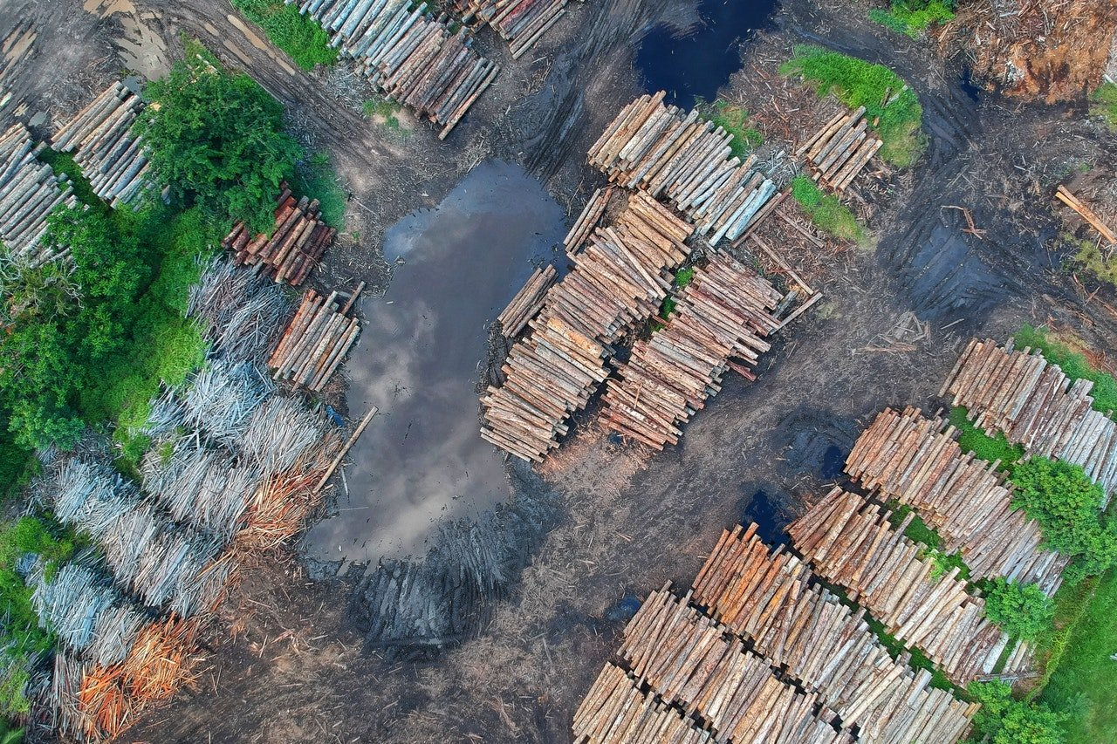
Ex post pilots: preparatory work for field work
STEP 3: Revise Theory of Change into a Theory of Sustainability
Identify underlying assumptions about climate shocks (Ecuador example)
Environmental and uncertainty of climate change impact risks | Moderately Probable
The main environmental risks faced by areas of FORECCSA project are derived from global warming, environmental contamination, destruction of forests, diversification, floods, affectation of water sources, greenhouse effect, and decreased biodiversity.
e.g.
use of chemical products in flower companies
decrease in water volume and loss of topsoil due to poor agricultural practices
Source: Evaluation of sustainability from the final evaluation of the Ecuador project
Notes:
The evaluation of sustainability refers to the analysis of risk factors that could have incidence in the permanence or consolidation of the outcomes and the Project’s expected impact. Risks about climate change impacts can give an idea of how well would socio-ecological (human and natural) systems withstand climate disturbances?
172. Specific environmental risks were identified at intervened parishes. Among them is the success of flower activities for export at Pedro Moncayo and Cayambe in Pichincha, bananas and cacao at El Oro, and mining in Azuay. The indiscriminate use of chemical products in flower companies, with evident affectation to the health of workers anddeterioration of ground quality and aerial fumigations, especially in banana plantations, are negative environmental impacts which together with the attraction of these activities for the beneficiary population, as detailed below, affect the continuity of FORECCSA’s outcomes.
173. Another risk that was identified in intervened territories is related to a decrease in water volume. Strong winds during certain times of the year were identified in Pichincha and the loss of the topsoil due to poor agricultural practices and freezes and plagues in Loja which risk permanence of family gardens. Training programs and technical assistance offered especially by MAG in territories can mitigate these negative factors.
174. Greater availability of timely and trustworthy information for decision making is a factor that reduces uncertainty about the effects of climate change. Important contributions were made by the Project, among which are vulnerability studies that include indicators related to climate change threats, a vulnerability analysis with emphasis in food securityin the Jubones River Basin, and the assembly of meteorological stations.
175. In addition to the Project’s direct contribution to reduce uncertainty of climate change effects, other instances have developed initiatives that reduce that risk, among which stand out forecasts of scenarios until 2100 made by the MAE and the INAMHI and the information system presented recently to the MAE during the Third National Communication on Climate Change.
176. Rating: By analyzing the above difficulties and attenuating circumstances, it was considered there are environmental and uncertainty risks that could affect sustainability of FORECCSA’s outcomes and the probability of future affection was estimated as Moderately Probable.

Slide 53
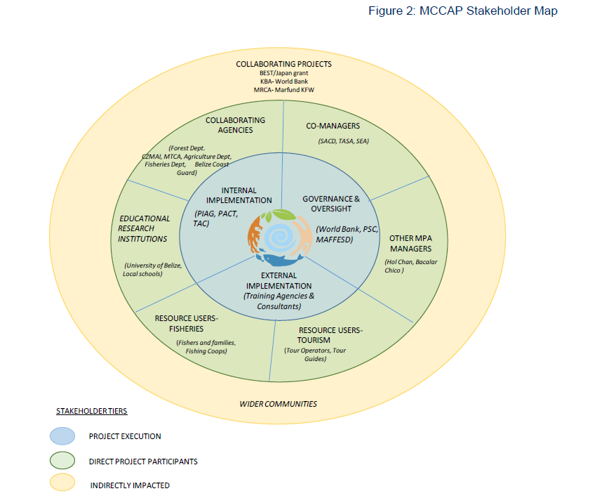
Ex post pilots: preparatory work for field work
STEP 3: Revise Theory of Change into a Theory of Sustainability
Identify sustainability assumptions: Map out who should be talked to and test assumptions of sustainability
Sustainability prospect is (-) because assumption of no resources
INVOLVEMENT
10
Stake holder
Example
Stake -holder
s
s
Stake -holder
Stake -holder
stk
Sustainability prospect is (+) bec. assumption of benefits from MPA for users
Stake -holder
-5 +5
AGAINST FOR
Belize project stakeholder map
Which stakeholders are likely to make things last (+) or not (-)?
Notes:
Insert a + or – near the stakeholders, insert text box - who is going to make things last?

Slide 54
Ex post pilots: preparatory work for field work
STEP 3: Revise Theory of Change into a Theory of Sustainability
Identify sustainability assumptions:
Understand who is expected to positively sustain results/ or harm them since exit
>>> Draw a stakeholder map of organizations likely to sustain the results
including partnerships, resources, and capacities to be sustained, how design & exit enabled this (e.g. who took over implementation ex post?)
capacity and commitment and structure of institutions assuming responsibility post project and relationships of those locally implementing.
what conditions/inputs internal to the project implementation that were assumed
at exit changed since closure?
Notes:
Discussion questions:
What kind of stakeholder mapping have you done and where was it in the project cycle?
How was it useful? What were you able to examine or decide as a result of the mapping exercise?
What is the relationship between the sustainability rating and the stakeholder mapping?

Slide 55
Ex post pilots: preparatory work for field work
STEP 4: Select the outcome(s) you will evaluate
REMINDER: you will evaluate one or more outcome(s)
(not all outcomes of the project)
OUTCOME SELECTION
How?
(what will you consider for outcome selection?)
1
Interest and learning priorities of stakeholders (co-creation process)
Quality of data
Sustainability at exit or prospects of sustainability (e.g. Sustainability ratings and assumptions)
2
3

Slide 56
Ex post pilots: preparatory work for field work
STEP 4: Select the outcome(s) you will evaluate
1
Interest and learning priorities of stakeholders
>> Discuss purpose and usability to choose evaluated outcome(s) with key stakeholders
Reminder of ex post evaluation questions: sustainability & relevance… and resilience
Stakeholders' expectations and pre-evaluation questions :
What are the learning priorities for the implementing entity? National stakeholders?
What other things could be learned from the evaluation? How?
How will the evaluation process & findings be used and by whom?
Who will use the eval. data in the future and how will that influence retention & dissemination, from local levels to international?
Other interests or lessons learned for current or future programming?

Slide 57
Ex post pilots: preparatory work for field work
STEP 4: Select the outcome(s) you will evaluate
2
Review quality of outcomes/outputs to give priority to measurable ones
Consider the following distinctions for the review:
Planned outcomes (targets)
vs
Actual outcomes
Strong outcomes (measurable outputs)
vs
Weak outcomes (outputs not measured/missing data)
Verify achievement, sustainability
and risks
Give priority to measurable outcomes/outputs
Examples from the project:
Measurable outcomes: ….
Weak outcomes: ….

Slide 58
Ex post pilots: preparatory work for field work
STEP 4: Select the outcome(s) you will evaluate
2
Review quality of outcomes/outputs to understand the ability to evaluate change and impact
Planned output (targets) | Actual outputs | Actual outcomes? | Impact
XXX | XX | XX
Adaptation Fund’s desired impact to trace: “Adaptive capacity enhanced, resilience strengthened and the vulnerability of people, livelihoods and ecosystems to climate change reduced.”
RESULTS FRAMEWORK
FINAL EVALUATION
FINAL EVALUATION
EX POST EVALUATION
How well was this output measured at final evaluation?
What outputs are strong enough to be able to create a causal relationship to outcomes (& re-evaluate)?
What is the quality of this output?
Is this output measurable?
Link with outcomes ToC to
THEORY OF SUSTAINABILITY
Notes:
>>> Discuss quality of outputs/ outcomes data for assets and capacities and ability to evaluate outcomes (which outcomes link to impact)

Slide 59
Ex post pilots: preparatory work for field work
STEP 4: Select the outcome(s) you will evaluate
3
Use sustainability prospects for outcome selection
Sustainability ratings
Expected sustained outcomes at ex post are identified (to verify)
Use the sustainability ratings and assumptions to understand the sustainability prospects about your outcomes.
Sustainability drivers
ASSUMPTIONS
Sustainability barriers
Remember: you want to select an outcome identified as sustained/ sustainable in the final evaluation !

Slide 60
Stretch and drink break
Questions? Comments?

Slide 61
Ex post pilots: preparatory work for field work
Next steps
First:
Evaluator undergoes extensive desk review and consultation
Evaluator develops draft Theories of Change/Theory of Sustainability with AF team after national stakeholder consultations, highlighting assets vs capacities, and strength of arguments for what outputs/outcomes can (or cannot) be evaluated
Evaluator develops draft evaluation inception report, shares with AF Team for review/feedback
Then….
Evaluator undergoes Part 2 training with AF team for deeper-dive on considerations for fieldwork, evaluation methods, and data analysis in relation to sustainability and resilience
Evaluator finalizes inception report, then begins fieldwork planning: site selection, logistics support planned, and fieldwork leading to final report done

Slide 62
Ex post pilots: preparatory work for field work
What do we want to see in the draft inception report?
1
Overall approach of the evaluation (conceptual model, evaluation questions):
PROJECT BACKGROUND
DATA AVAILABILITY
SUSTAINABILITY PROJECTIONS
OUTCOME SELECTION
DRAFT REPORT
Notes:
FULL TEXT
PROJECT BACKGROUND
Quick project description
Map of activities implementation
Important field/context considerations (geographical, climatic, economic, social)
DATA AVAILABILITY
List of project documents available
Inventory of M&E data available
Analysis of data quality for each project outcome/ outputs
SUSTAINABILITY PROJECTIONS
Project theory of change (available or recreated) inc. assumptions and drivers linked to sustainability and resilience
Identified conditions for sustainability and list of relevant sustainability ratings
OUTCOME SELECTION
Suggested outcome based on data availability and IE learning preferences
Rationale for outcome selection
Rationale for site selection based on suggested outcome

Slide 63
Ex post pilots: preparatory work for field work
What do we want to see in the draft inception report?
2
DATA COLLECTION STRATEGY
DATA ANALYSIS STRATEGY
ANNEXES
DRAFT REPORT**
**only if information already available
FINAL REPORT
Notes:
FULL TEXT
DATA COLLECTION STRATEGY
Key data sources that will be selected to inform the answer to each evaluation question
Discussion on data analysis methods to be used to answer each evaluation question and their limitations
Sampling approach, including area and population to be represented, rationale for selection, and limitations of the sample.
DATA ANALYSIS STRATEGY
Risks and limitations that may undermine the reliability and validity of results, and proposed mitigation strategies for each.
How gender analysis will be integrated into the evaluation design
ANNEXES
Summarized evaluation methodology in a matrix that contains for each evaluation question: measure(s) or indicator(s), data collection method(s), data source, sampling approach, and data analysis method(s).
Timeline showing the key evaluation phases (e.g., data collection, data analysis, and reporting) and specific deliverables and milestones.

Slide 64
Ex post pilots: preparatory work for field work
What do we want to see in the draft inception report? [summary]
DRAFT IR REPORT (END OF PART 1)
FINALISED IR REPORT (END OF PART 2)
Overall approach of the evaluation (conceptual model, evaluation questions)
PROJECT BACKGROUND
Quick project description
Map of activities implementation
Important field/context considerations (geographical, climatic, economic, social)
DATA AVAILABILITY
List of project documents available
Inventory of M&E data available
Analysis of data quality for each project outcome/ outputs
SUSTAINABILITY PROJECTIONS
Project theory of change (available or recreated) inc. assumptions and drivers linked to sustainability and resilience
Identified conditions of sustainability
List of relevant sustainability ratings
OUTCOME SELECTION
Suggested outcome based on data availability and IE learning preferences
Rationale for outcome selection
Rationale for site selection based on suggested outcome
DATA COLLECTION STRATEGY
Key data sources that will be selected to inform the answer to each evaluation question
Discussion on data analysis methods to be used to answer each evaluation question and their limitations
Sampling approach, including area and population to be represented, rationale for selection, and limitations of the sample.
DATA ANALYSIS STRATEGY
Risks and limitations that may undermine the reliability and validity of results, and proposed mitigation strategies for each.
How gender analysis will be integrated into the evaluation design
ANNEXES
Summarized evaluation methodology in a matrix that contains for each evaluation question: measure(s) or indicator(s), data collection method(s), data source, sampling approach, and data analysis method(s).
Timeline showing the key evaluation phases (e.g., data collection, data analysis, and reporting) and specific deliverables and milestones.

Slide 65
See you soon!
Questions? Comments?
to Part 2….

Slide 66
What’s next?
Part 2 – Designing the ex post evaluation
Considerations for fieldwork
Data collection
Data Analysis - Sustainability
Data Analysis - Resilience

Slide 67
Survey
Before you go….
Please take the following quick survey: here
What was most surprising?
What was unclear?
What else do we need to know?
If you wish, you can also verify your understanding of today’s session by taking this small quiz
Link to quiz 1

