Slide 1
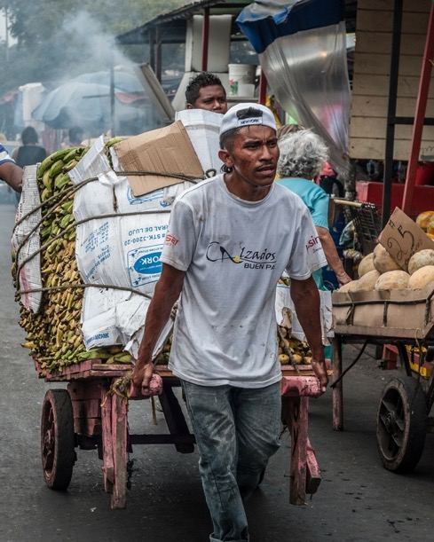
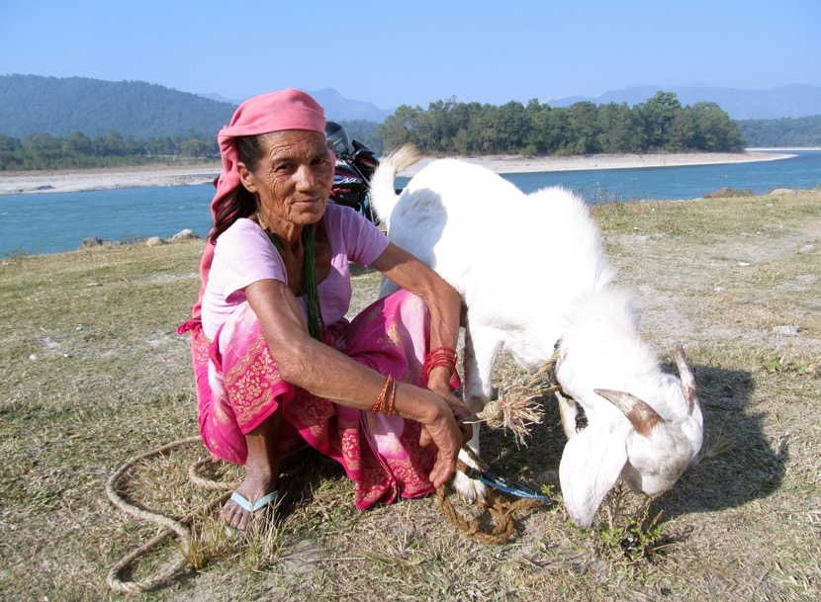
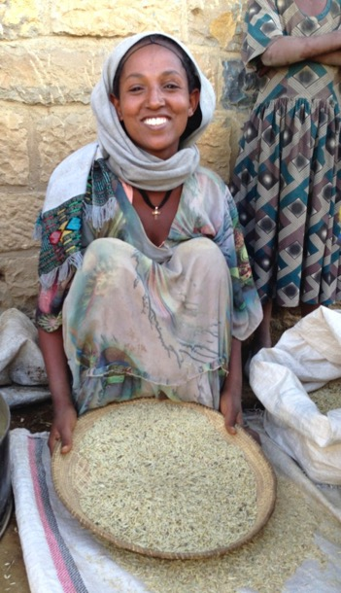
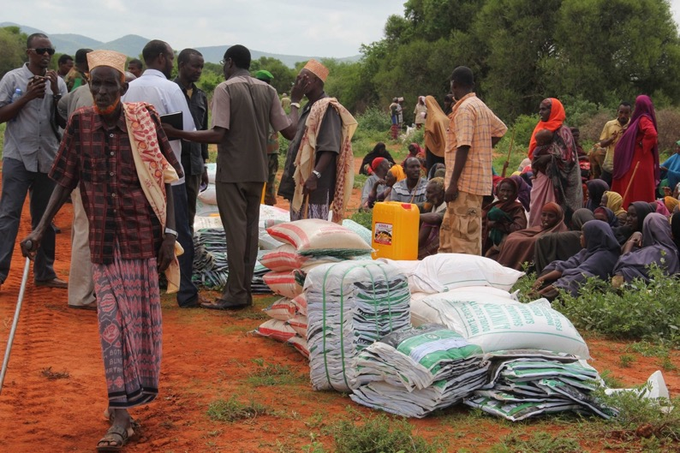
Evaluating projects ex-post & Emerging sustainability and resilience
Jindra Cekan, PhD. (Valuing Voices), Meg Spearman and Caroline Holo
June 2022
Training material Part 2

Slide 2
Introduction
Ex post evaluation process overview at the Adaptation Fund
STEPS CONTENT
PART 1
PREPARATION (slide deck 1)
AF team intro, Preparatory training,
Data consulted, Theories of Change / Sustainability drafted, Outcome(s) chosen
Inception report drafted
PART 2
DESIGN (slide deck 2)
Drafting of evaluation approach,
Training for fieldwork – data collection methods selection, overview of data analysis tools
Inception report finalized
PART 3
EXECUTION
Evaluation fieldwork & findings analysis
with support of AF-TERG consultants,
Evaluation report,
Sharing of results and dissemination
Notes:
NB: Part 3 is *not* a training slide deck

Slide 3
PART 2
Design of the ex-post evaluation
Considerations for fieldwork
Data collection methods
Data analysis - sustainability
Data analysis - resilience

Slide 4
Part 2: Design of the ex-post evaluation
Objective and expectations: what will you learn?
OBJECTIVES OF PART 2:
Inform the evaluator’s initial evaluation approaches
Train on data collection methods/ approaches selectively based on methods knowledge/ rigor proposed
Train on data analysis tools to understand sustainability and resilience better
CONTENTS OF PART 2:
2.1
CONSIDERATIONS FOR FIELDWORK
DATA COLLECTION : METHODS A LA CARTE
DATA ANALYSIS : SUSTAINABILITY TOOLS
DATA ANALYSIS: RESILIENCE TOOLS
2.2
2.3
2.4

Slide 5
2.1- Considerations for fieldwork
Contents
Site selection
Evaluation questions
Institutional buy-in
Ex post timetable

Slide 6
Considerations for fieldwork: process for ex post evaluations
Water
Example: Ecuador
2. Food security
Irrigation
Consumption
Small livestock
Agriculture
Agroforestry
Best outcome data
Mapping: Range of stakeholders as informants
Mapping vulnerability and shocks that affect the participants
e.g. droughts vs. rainfall
Mapping activities e.g. isolatability or intensity of other projects
Mapping: Project activities by location;
and number of villages
Multiple sectors needed to achieve impact?
e.g. irrigation and agriculture for food security
Leads to fieldwork
METHODS
Purposive or random sampling

Slide 7
Considerations for fieldwork
Site selection for ex post evaluations
NGO2
Mapping project activities helps narrowing down the possibilities for site selection.
A
NGO1
Mapping concentration and isolatability - Where is the project area and where were the activities located?
A
A
A
A
A
A
A
A
A
Identify the concentration of activities.
The concentration shows where you should go
A
NGO1
A
NGO2
NGO1
NGO2
NGO3
A
NGO3
Show the isolatability of AF project (with regards to other organizations implementing projects in the area)

Slide 8
Considerations for fieldwork
Setting up your research questions
Field work (1) : possible questions to understand barriers and drivers of sustainability
How widely ‘owned’ were the activities/ outputs-outcomes to be sustained? By whom?
How did resources, capacities and partnerships get sustained?
How did the output/ outcome change as a result?
How well was the project handed over to local actors or other implementers/ donors/ partners?
What shifts in power relationships happened? How did the intervention change the power relations more widely e.g. gender, generational, systemic/ organizational?
Did men, women, rich and poor experience the results differently?
What recommendations from the project’s final evaluation and subsequent studies were implemented and did they affect sustainability?
Are there lessons for other projects’ design, implementation, timeframe, handover & exit?
Partnerships
What other questions came from the co-creation process?
Notes:
THINK ABOUT BARRIERS AND DRIVERS

Slide 9
Considerations for fieldwork
Setting up your research questions
Fieldwork (2) : possible questions to explore for the evaluation
What is still functioning, how well at ex-post and regarding resilience categories & RRT? Why or why not?
What conditions/inputs during project implementation were assumed at exit changed since closure?
What unexpected outcomes arose?
Why would results last (or not)/ for how long)?
How do implementing partners on the project see the long-term outcomes? Emerging ones?
How have sustained outcomes affected and been affected by underlying socio-ecological systems (climate resilience)?
What external shocks affected the participants, partners, natural system, wider country?
How to plan for resilience better?
Partnerships
Stakeholders to decide: Are all these ex-post questions a priority for the project and its stakeholders?

Slide 10
Considerations for fieldwork
Institutional buy-in & learning
Before going to the field, the IE and evaluator should make sure there is preparation on logistics
Additional considerations of logistics and staffing:
Multi-sectoral team
Select a multi-sectoral team, women/men, diff. sectoral and language expertise, translator(s) if needed
Distances to sites
Consider distances to sites given funding and timing, consider vulnerability to climate change
Fieldwork logistics
Plan logistics hotels, plan visits with communities, clear funding/ perdiem with national partners
Former project staff
We suggest at least one former staff member from the project accompany us to the field for introductions and context both qualitative and quantitative phases.
Partnerships
Debrief logistics
Plan debrief logistics in each region including site, invitees, dates
Notes:
We suggest at least one former staff member from the project accompany us to the field for introductions and context both qualitative and quantitative phases. This will ensure local courtesies are addressed and that introductions to all stakeholders are made. The staffer would not be expected to be present for any of the data gathering activities (to ensure respondents could be unbiased), but would add value during evening debriefs to provide context
Source: adapted from WHO manual 2019 & CFIOR manual

Slide 11
Considerations for fieldwork
Ex-post evaluation timetable - to confirm
Date | Task
Week 0 | Co-creation process where stakeholders agree on what will be evaluated, what benefits will come from the ex-post evaluation, what is needed logistically (data, fieldwork) & for learning
Week 1 | Virtual briefing with AF team with consultant on approach on Eval Qs to be answered, confirm expectations of final process and product, and training on ex-post and resilience
Week 2 | Field team out to the local area(s): Fieldwork 8 days (day 1 and 8 travel days) 2 Qualitative SEIE tools, e.g. Community RRA tools/ transect walk, FGD, analysis on 1st site or or use CA tools ; repeat in 2nd site, in addition of counterfactual village(s) using Outcome Harvesting, then analysis and triangulation by partner interviews in each area at district level including draft writeup
Week 2-3 | District debriefs and partner input with consolidation of qual data to shape quantitative survey. Debrief on qual findings to stakeholders, with input on outstanding questions to be answered
Week 3 | Consultant submits draft survey instrument to AF for feedback
Week 3 | Survey put on tablet and consultant trains enumerators and launch survey
Week 4 | Survey results sent to analysis team
Week 4 | Writing and draft report submission
Week 5 | Debrief with AF and
Week 5 | Final report submitted to INGO and learning products drafted and shared

Slide 12
Stretch and drink break
Questions? Comments?

Slide 13
2- Data collection: process and methods
Contents
Ex post evaluation process for sustainability and resilience
Methods a la carte

Slide 14
Data collection
Ex post evaluation process: tracing sustainability and resilience
Output
sustainability
Actual output*
IMPACT
Vulnerability
&
Relevance
Actual outcome*
Actual output*
resilience
Output
* This diagram is oversimplified because normally many outputs lead to an outcome and many outcomes (from various actors) lead to impact
Notes:
Impact can be thought of as having elements of sustainability and elements of resilience; but they are not interchangeable. Something can be resilient (for a time) without being sustained, and something can be sustained but not (climate) resilient.
IN THIS EXERCISE (ex post evaluation of AF projects) WE’RE LOOKING AT WHAT ELEMENTS OF RESILIENCE CAN BE FOUND IN THE SUSTAINED OUTCOMES AT EX POST.

Slide 15
Data collection
Ex post evaluation process: tracing sustainability and resilience
Planned output | Actual outputs | Actual outcomes? | Impact
XXX | XX | XX
Link with outcomes / IS from
THEORY OF SUSTAINABILITY
RISKS TO SUSTAINABILITY
Determine the actual outcomes and proof of outputs leading to outcomes from :
- the information provided in the results framework
- the information provided in the final evaluation reports and other reports
- the theory of sustainability previously developed (planned outcomes and IS)
Check sustainability at ex-post evaluation of outputs/ outcomes to impacts or not and why?
Check resilience of outputs/ outcomes by looking at their use, and the characteristics they exhibit at ex-post
Check shocks and risks to know whether the outcome/impact was resilient to (and sustained after) shocks/ disturbances
Something on vulnerability and relevance of the outcome here?? OR NOT necessary
Check progress to ultimate impact: “Adaptive capacity enhanced, resilience strengthened and the vulnerability
of people, livelihoods and ecosystems to climate change reduced.”
1
disturbances
R-R-T scale
2
3
4
5
6

Slide 16
Data collection
Ex post evaluation process: tracing sustainability and resilience
Planned output | Actual outputs | Actual outcomes? | Impact
XXX | XX | XX
Link with outcomes / IS from
THEORY OF SUSTAINABILITY
RISKS TO SUSTAINABILITY
disturbances
Determine the actual outcomes and proof of outputs leading to outcomes from:
- the information provided in the results framework
- the information provided in the final evaluation reports and other reports
- the theory of sustainability previously developed (planned outcomes and IS)
Check sustainability at ex-post evaluation of outputs/ outcomes to impacts or not and why?
Check shocks and risks to know whether the outcome/impact was resilient to shocks/ disturbances
Check progress to ultimate impact: “Adaptive capacity enhanced, resilience strengthened and the vulnerability of people, livelihoods and ecosystems to climate change reduced.”
1
R-R-T scale
2
3
4

Slide 17
Data collection
Process for ex-post project evaluation & learning
Is there good quantitative / qualitative sectoral outcomes, impacts data?
yes
Compare % to which outputs, outcome(s), or impact(s) sustained
Probe for why/why not with all informant groups
Probe for causes: From project? From concurrent or subsequent external stakeholders? From community innovation? Something else?
no
Triangulate with a range of stakeholders & data sources including debriefs locally
Characteristics of Resilience? Threatened by lack of resilience?
Can data be recreated through project docs? Recall interviews/ survey with stakeholders (who? use mapping)?
yes
Consider counterfactuals for contribution
Disseminate findings back to all stakeholders
no
Partnerships
May not be evaluable
What emerged in terms of processes and new outcomes/ impacts? Why?
Source: Valuing Voices Sustained and Emerging Impacts Evaluation
Notes:
Source: Valuing Voices Sustained and Emerging Impacts Evaluation

Slide 18
Data collection
Methods available for the ex post evaluation fieldwork
There is an array of possible methods to collect data for ex post evaluation.
Methods used depends on the project context, the outcome chosen, and
project previous data availability and quality
Sustained and Emerging Impact Evaluation (SEIE)
Contribution Analysis
Seasonal Calendar
Timelines of major events
Venn diagram with maps
Activities mapping
Rankings and Matrices
Transect walks
Focus Group Discussion
Quantitative surveys
Most significant change
Outcome Harvesting
Carroll’s methods??
METHODS USED FOR DATA COLLECTION ARE CUSTOMIZED TO YOUR EX POST EVALUATION

Slide 19
Data collection
Methods available for the ex post evaluation fieldwork
Methods can tell us different things about the sustainability and resilience of our outcome:
Example: water reservoirs in Ecuador | What is assessed during the fieldwork with the tools?
DATA COLLECTION TOOLS | Sustainability of outcome | Climate resilience of outcome
Desk information | Maintenance budgets | Characteristics of resilience
Historical calendar of shocks | Shocks before and after the project – how it affected the outcome
Maps | Who benefits from water ? | Scale of natural systems affected by irrigation
Activities mapping | Comparison with / without project | Impact of shocks before/ after project
Rankings | Access and use the most/ least | Least/ most affected by shock
Transect walk | Triangulation + check visible impact | Comparison before/ after in driest areas
Interviews: KII FGD | Understand maintenance, use, access, impacts, benefits, distribution of benefits | Understand impact of shocks, vulnerability to climate change, change imputed to project
triangulation
IT IS RECOMMENDED TO MAP OUT THE OBJECTIVE OF YOUR TOOLS BEFORE GOING TO THE FIELD

Slide 20
Data collection
Method deep dive: XXXXX
[Placeholder for “deep dive slides” about methods (customized slides)]

Slide 21
Data collection
Method deep dive: XXXXX
[Placeholder for “deep dive slides” about methods (customized slides)]

Slide 22
2.3- Data analysis – sustainability tools
Contents
Verify the Theory of Sustainability
inc. revisiting assumptions, stakeholder mapping, etc
Discuss Conditions for Sustainability
e.g. resources, capacities, etc- and how to evaluate pre- and during field work
Mapping shocks affecting sustainability
e.g. local, regional, national, and international shocks; as well as climate disturbances
Emerging outcomes

Slide 23
Data analysis – sustainability tools
Recap: Analyzing sustainability through the sustainability framework
Programming Relevance
Ownership
Human, social, economic shocks and stresses
Risk Management Strategy
Sustained (?) Outcome(s)
Economic, Political, Human/Social, and Natural Capital
Resources
Selected Outcome(s)
Sustainability plan, Ratings, and Exit Strategy
Climate Shocks and Stresses
Partnerships
Sustainability Assumptions, e.g. Trajectories in systems
Emerging (?) Outcome(s)
Adaptive Management
Capacities
CONTEXT
Backdrop of the strategy and results
STRATEGY
Supporting sustainability throughout implementation
CONDITIONS OF SUSTAINABILITY
Conditions fostering sustainability
DISTURBANCES
Endured by the outcome(s)
LIKELIHOOD OF SUSTAINABILITY
VERIFICATION OF SUSTAINABILITY
Notes:
Notes on preparation leading to OUTCOME SELECTION and THEN using the sustainability framework:
Data availability and data quality;
Organizational considerations,
methodological considerations,
choice of projects, sites, timing; data

Slide 24
Data analysis – sustainability tools
Verify the Theory of Sustainability by testing assumptions in the field
What will the Theory of Sustainability tell us?
During the fieldwork:
Check whether assumptions were true/false/missing
Check whether impact drivers have held up/were irrelevant/turned to barriers
Revisit any project exit-readiness and benchmarking for sustainability assumptions about partners, e.g. how well were ex-post plans developed and/or executed? What were plans for continuation of activities and/or follow-on support, replication, scale-up, other?
Revisit any project assumptions about shocks (environmental, economic, political etc)
Revisit any natural system barriers (e.g. ecological limits) or human systems barriers (e.g. dependent on rainfall for agriculture) as well as assumptions that current climate change is challenging
YOU WILL CHECK WHETHER DRIVERS AND ASSUMPTIONS AFFECTING SUSTAINABILITY WERE TRUE IN ORDER TO UNDERSTAND WHY OUTCOMES DID OR DID NOT LAST

Slide 25
Data analysis – sustainability tools
Verify the Theory of Sustainability by testing assumptions in the field
What information from the desk review and initial discussions with the EE and IE can be gathered?
What assumptions about these factors can be tested in the field?
Known/considered risks to sustainability, as stated in the Terminal Evaluation, e.g.:
Financial
Political
Socio-political
Socio-economic
Institutional
Specific risks to communities/ beneficiaries
Environmental risks
...
Presence of factors enabling sustainability at project closing (and beyond), e.g.:
Local ownership/uptake and continued use of project strategies
Follow-on financing (resources)
Partnerships/alliances formed
New policy/revised policy
Leadership buy-in
Capacities sustained
…..
Example types of underlying assumptions to be tested in the field:
Risk levels: Were (climate and non-climate) projections accurate?
Project design/approach: Did the project strategy play out as planned? Why or why not?
Engagement/involvement: Did the stakeholders fulfill expected roles?
Political climate: Did leadership stay interested? Were policies helping or hindering sustainability?
…

Slide 26
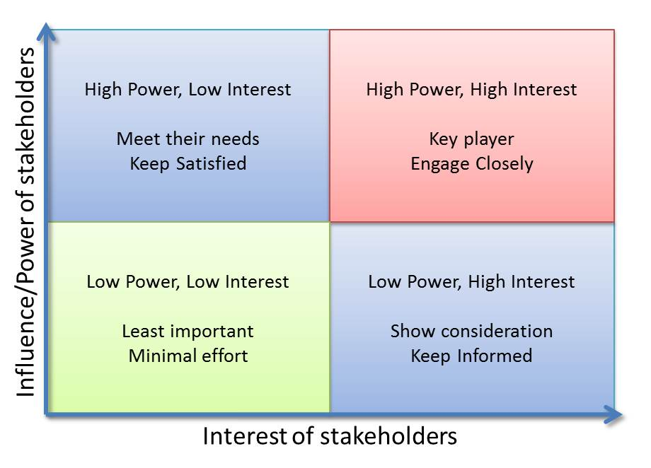
Data analysis – sustainability tools
Verify the Theory of Sustainability with the Stakeholder analysis tool
Who are the key stakeholders who influenced or who were influenced by the project outcomes?
What are their respective levels of interest in the goals of the project?
What are their respective levels of influence or power (relative to other stakeholders) in affecting the goals of the project?
Notes:
Steps: work your way through the questions on the left; then think about where the stakeholders fit into the quadrants on the right
Notes: Lower left is for “MONITORING” not really “least important,” especially if you can move them to another quadrant
REFERENCES:
- UNDP - “ICA – institutional and contextual analysis”
https://www.undp.org/content/dam/2030agenda/Publications/INSTITUTIONAL%20AND%20CONTEXT%20ANALYSIS%2021%20March%202017%20CLEAN.pdf
- Meaningful stakeholder engagement (consortia)
https://publications.iadb.org/publications/english/document/Meaningful_Stakeholder_Engagement_A_Joint_Publication_of_the_MFI_Working_Group_on_Environmental_and_Social_Standards_en.pdf
- Another way to do it (in a matrix)
http://changingminds.org/disciplines/change_management/stakeholder_change/stakeholder_mapping.htm
Source image: https://projectizing.com/stakeholders-analysis-powerinfluence-interest-matrix/

Slide 27
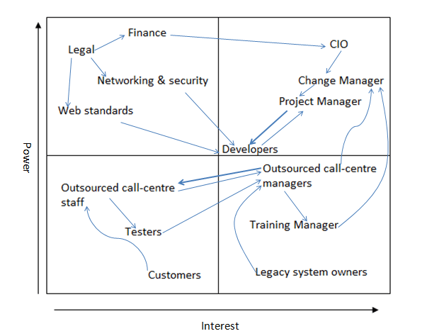
Data analysis – sustainability tools
Stakeholder analysis tool - example
Explore whether identified stakeholders were engaged by the project, and how/in what ways;
Were they engaged in alignment with their quadrant?
Did any stakeholders change quadrants? When? Why?
Have (new) key stakeholders emerged since project closing?
Assess whether stakeholders have changed quadrants since project closing and why
Examine how did (a lack of) understanding interest and influence dynamics (during or after the project) influence the sustainability of outcomes
Notes:
Image example:
For a Customer Relationship Management (CRM) software implementation project
Stakeholders included are those that bought the software
Blue lines = INFLUENCE LINES between actors; who influences whom
Can also map (separately) what kind of interests that have – political, economic/financial, sociological, technical etc.
Purpose: Draw a stakeholder analysis map for project closing if possible and compare to now/at time of ex post evaluation.
Step 1: Reconstruct a stakeholder analysis from desk review.
Step 2: Develop a stakeholder analysis with country counterparts and THEN compare with the desk review version (don’t offer the desk review version up front because it will influence inputs).
Step 3. Revise the stakeholder analysis (based on desk review) with the stakeholder/country counterpart one; verify with fieldwork.
Step 4: Determine what’s changed since project closing, how the relationships between power and interests have affected (and will continue to affect) sustainability; were any stakeholders missing? Were any moved from one quadrant to another and why? What implications does it have for sustainability of results and/or future impacts?
Source image: https://www.stakeholdermap.com/stakeholder-analysis/stakeholder-analysis-example.html

Slide 28
Data analysis – sustainability tools
Reminder: Four possible conditions for sustainability
YOU WILL HAVE TO ANALYZE OWNERSHIP, RESOURCES, CAPACITIES, AND PARTNERSHIP TO UNDERSTAND SUSTAINABILITY
Ownership
Sustained motivation; who benefits from the intervention enough to sustain it locally?
Who is using it/ demanding it?
Resources
How is the intervention being resourced to be sustained? Are these financial, in-kind, technical or other resources?
Capacity
What are the necessary project knowledge and skills to be transferred to national stakeholder partners to sustain the intervention? How will training be sustained for specific sectoral behavior change among new entrants onward?
Ownership
Partnerships
What continued project knowledge and skills from which stakeholder partners are needed to sustain the intervention? What local contracting with direct and indirect partners are needed to sustain project operations?

Slide 29
Data analysis – sustainability tools
Discuss conditions of sustainability – fill in relevant rows
Sustainability assessment | Findings (desk review) – likelihood of sustainability | Findings (emerging from fieldwork) – verification
Ownership Sustained motivation; who benefits from the intervention enough to sustain it locally? Who is using it/ demanding it?
Resources How is the intervention being resourced to be sustained? Are these financial, in-kind, technical, or other?
Capacities What are the necessary project knowledge and skills to be transferred to national stakeholder partner? How will training be sustained for specific sectoral behavior change among new entrants onward?
Partnership What continued project knowledge and skills are needed from which stakeholder partners? What local contracting with direct and indirect partners are needed to sustain project operations?
YOU WILL HAVE TO FILL IN THIS TABLE WHEN DOING YOUR SUSTAINABILITY ANALYSIS
Notes:
Next slides will focus on the encircled steps

Slide 30
Data analysis – sustainability tools
Discuss conditions of sustainability – fill in relevant rows
Sustainability assessment | Findings (desk review + emerging from fieldwork)
Ownership Sustained motivation; who benefits from the intervention enough to sustain it locally? Who is using it/ demanding it?
Resources How is the intervention being resourced to be sustained? Are these financial, in-kind, technical, or other?
Capacities What are the necessary project knowledge and skills to be transferred to national stakeholder partner? How will training be sustained for specific sectoral behavior change among new entrants onward?
Partnership What continued project knowledge and skills are needed from which stakeholder partners? What local contracting with direct and indirect partners are needed to sustain project operations?
YOU WILL HAVE TO FILL IN THIS TABLE WHEN DOING YOUR SUSTAINABILITY ANALYSIS
Notes:
Next slides will focus on the encircled steps

Slide 31
Data analysis – sustainability tools
Using sustainability conditions to understand likelihood of sustainability - example
(donor perspective – likelihood of sustainability )
The final evaluation of the FORECCSA project projected a very positive sustainability rating.
Ex-post evaluations test such sustainability ratings, e.g.
CAPACITIES
“The fact that most beneficiaries, especially women, have been trained in food security,
have started to have their own orchard products
and have modified their diet forming a habit,
is another factor that guarantees permanence of FORECCSA’s achievements.”
OWNERSHIP &
RESOURCES
SUSTAINABILITY PROJECTION
Note: No Partnerships were found in the sustainability rating
YOU WILL VERIFY THIS SUSTAINABILITY PROJECTION FROM THE FINAL EVALUATION BY LOOKING AT OWNERSHIP, CAPACITIES, RESOURCES, AND PARTNERSHIPS
Notes:
Note: For this projection, in the field, you will have to confirm sustainability of orchards production, and subsequent income increase levels and self-consumption of garden products.

Slide 32
Data analysis – sustainability tools
Using sustainability to verify sustainability - examples
(Emerging ex-post findings – field verification of sustainability)
Examples of conditions for emerging sustainability
Ownership: Participants valued health clinic built by the project and sustained it by introducing community tithing to cover costs (CRS/Niger)
Resources & Capacities: A food security project improved assets and income but better water access led to surprising decreases in gender violence (LWR/ Niger)
Partnerships & Ownership: Members of Village Banks offered trainings in VB for sale in other, home areas (Pact/Nepal)
Ownership & Resources: A Tanzanian grape value-chain project expanded youth participation and land-use (although unclear land has good carrying-capacity over the long future)
Ownership
Partnerships
Notes:
Sources: Valuing Voices study for CRS/ Niger, 2016, Cekan for LWR 2008, PACT/ Nepal 2013
DISCUSSION Qs:
Can you think of examples of the sustainability conditions in your own work?
Do you think some conditions are more important than others for certain projects? Why or why not?
Have you ever noted a project that was sustained without one or more of these conditions? How or why was it sustained?
Do you ever see mentions of these conditions in sustainability ratings? Do you see them in sustainability plants/project documentation?
Can you think of an example of either (Q above)?

Slide 33
Data analysis – sustainability tools
Using sustainability to verify sustainability : example of infrastructure assessment
Check what can affect the sustainability of infrastructure
For supply systems:
Management/ functioning Boards – do they still exist? how do they function?
Access to supply – do people pay their bills? does the fee limit access for the more vulnerable? was that already the case or did inequality of access worsen?
Maintenance - are there enough funds for maintenance?
Service - what is the level of service eg. water / electricity 24/7 or specific hours? is the service seasonal e.g. a road is harder to pass in rainy season?
Demand – did the infrastructure satisfy an existing demand, does it replace and alternate supply, or did it develop new demand?
For soft infrastructure:
Capacity – was there any training, capacity development and staffing to maintain use
Maintenance – is there any payment scheme, ownership, etc
Partnerships
Resources
Partnerships
MEG- your __?
MEG- your Redundancy?
Ownership & Capacities
Notes:
Context for infrastructural sustainability:
Did the infrastructure satisfy an existing demand, does it replace and alternate supply, or did it develop new demand? (Very important!) I have often seen that provision of electricity or a new road results in new demand. That means people still use the old road, they still charge a battery in town, they still use the old generator… they just add to their existing use, they grow their consumption. That has an environmental impact in itself.
Sustainability of soft infrastructure can negatively impact the sustainability of hard infrastructure.

Slide 34
Data analysis – sustainability tools
Mapping shocks to sustainability
YOU WILL MAP LOCAL, REGIONAL, NATIONAL, AND INTERNATIONAL SHOCKS THAT CAN/ HAVE AFFECTED SUSTAINABILITY (E.G. POLICY, ECONOMY, SECURITY) PRE AND POST CLOSURE BY SITE
what external shocks linked to climate vulnerability and resilience affected the participants, partners, natural system, wider country?
describe the viability of the local ecosystem and describe how it has changed since the project’s end. Why?
What other external shocks affected the previously cited stakeholders?

Slide 35
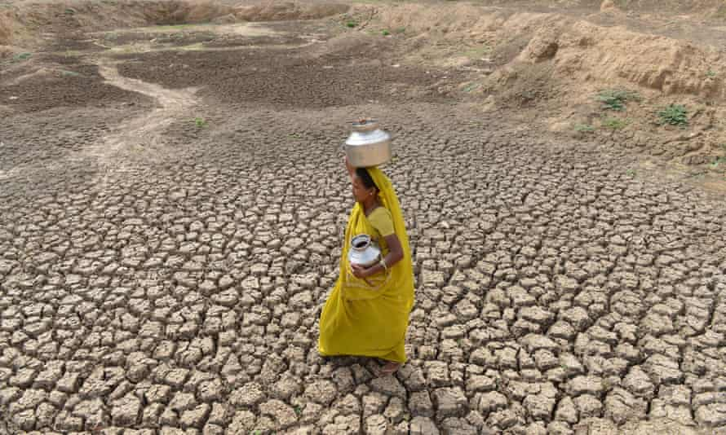
Data analysis – sustainability tools
Mapping climate stresses and shocks – example list
EXAMPLE - Outcome: Improve food security for drought prone region
Climate change stresses
Gradual and/or cyclical changes in:
Temperature
Rainfall, rainfall patterns
Sea level (rise)
Related stresses: Temperature rise, decreased rainfall, shortened and delayed wet season
Related effects: depleted soils, crop loss, shorter growing season, stunted crop growth, low yields
Climate change shocks
Sudden ((un)expected) events:
Hurricane or Typhoon
Tornado
Flood
Storm Surge
Seasonal Drought
Related shocks: periodic drought, floods
Related effects: topsoil loss, landslides, crop loss
Notes:
This could also be a PHYSICAL MAP like a community or other local-unit vulnerability mapping exercise, aka hazard map or risk map. See next slide
Photo credit: https://www.theguardian.com/global-development-professionals-network/2015/jun/12/decade-of-drought-a-global-tour-of-seven-recent-water-crises

Slide 36
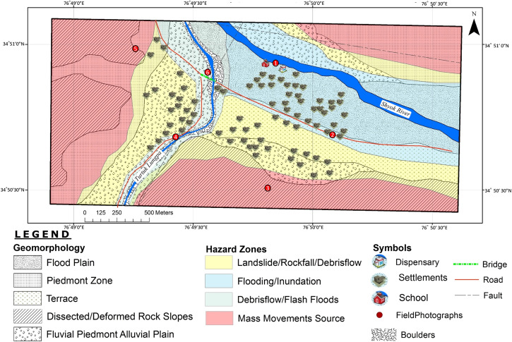
Data analysis – sustainability tools
Mapping climate stresses and shocks – example diagram
Notes:
Aka HAZARD MAP or vulnerability map.
First one: the geographic overview of risks in the valley
Second two: Community people – Turtuk, July 2017
Credit: https://www.sciencedirect.com/science/article/pii/S2212420919300093

Slide 37
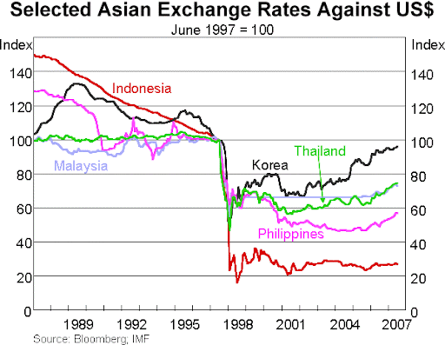
Data analysis – sustainability tools
Mapping other (non-climate) external stresses and shocks
Global Shocks
Exchange rate
Trade policies
Price hike/ drop of commodity
…
National Shocks
Coup or political unrest
Earthquake
Inflation
…
Local Shocks
Flood
Landslide
Violence/Gang Activity
…
Asian Financial Crisis (1997)
Notes:
Image: https://www.rba.gov.au/speeches/2007/sp-gov-180707.html

Slide 38
Data analysis – sustainability tools
Uncovering emerging outcomes
[Placeholder] = do we have a slide on emerging outcomes?
Notes:
Source image: JICA Fiji
Hard (physical, remote) eg seawalls (physical, human maintained). Examples include transport, energy (production vs. distribution), waste (incl. wastewater), communications, water (production vs. distribution), buildings, etc.
But what was displaced ex-post, e.g. What is the environmental impact of the use of infrastructure. Road and electricity grid extensions are closely related to deforestation as example. Opening a road will result in more charcoal production and supply to the towns it links to. This also links to a question on climate resilience; while the infrastructure could be climate resilient, does the infrastructure itself generate shocks and stresses?! Eg. a road leads to deforestation, deforestation leads to an increased risk of landslides. A sea wall might lead to water behind the sea wall not having tides anymore, impacting wild life and thus livelihoods.
Issues of infrastructure withstanding climate shocks and climate-resilience; have there been any shocks or stresses and how have these impacted the infrastructure?
E.g. A tidal wave did not damage the sea wall, but it did destroy most of the boats, those people now have no income, no money to pay their water / electricity bills, sit on the maintenance group, etc.

Slide 39
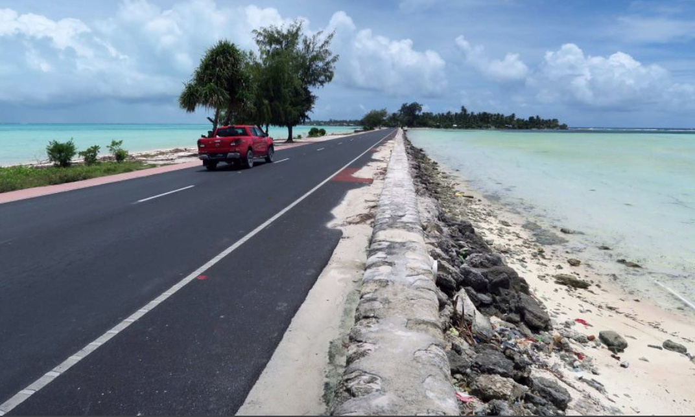
Data analysis – sustainability tools
Uncovering emerging outcomes: example of infrastructure assessment
Negative externalities e.g. Displacement of people
Environmental impact of the use of infrastructure e.g. Road and electricity grid extensions are closely related to deforestation. Opening a road will result in more charcoal production and supply to the towns it links to
Although climate resilient, does the infrastructure generate shocks and stresses?
e.g. a road leads to deforestation, deforestation leads to an increased risk of landslides. e.g. a sea wall might lead to water behind the sea wall not having tides anymore, impacting wildlife and thus livelihoods.
Do not forget to check unintended impacts
maladaptation
Notes:
Source image: JICA Fiji
Hard (physical, remote) eg seawalls (physical, human maintained). Examples include transport, energy (production vs. distribution), waste (incl. wastewater), communications, water (production vs. distribution), buildings, etc.
But what was displaced ex-post, e.g. What is the environmental impact of the use of infrastructure. Road and electricity grid extensions are closely related to deforestation as example. Opening a road will result in more charcoal production and supply to the towns it links to. This also links to a question on climate resilience; while the infrastructure could be climate resilient, does the infrastructure itself generate shocks and stresses?! Eg. a road leads to deforestation, deforestation leads to an increased risk of landslides. A sea wall might lead to water behind the sea wall not having tides anymore, impacting wild life and thus livelihoods.
Issues of infrastructure withstanding climate shocks and climate-resilience; have there been any shocks or stresses and how have these impacted the infrastructure?
E.g. A tidal wave did not damage the sea wall, but it did destroy most of the boats, those people now have no income, no money to pay their water / electricity bills, sit on the maintenance group, etc.

Slide 40
Data analysis – sustainability tools
Reviewing sustainability of assets: example of infrastructure assessment
Check aspects of sustainability by verifying data availability on :
For road & water infrastructure:
evaluate maintenance and impact
Operations and maintenance (control and repairs)
Maintenance budget (amounts & availability or disbursement) or prevention of damage from shocks
‘Climate proofing definition & measures’ for roads
Staff training on maintenance
Long-term monitoring of quality
e.g. Monitoring coastal sedimentation/ flood protection/ escape routes
e.g. Monitoring of IWS water supply and quality
Impact on livelihoods e.g. tourism, farming, access to social services
For evaluation of capacity to withstand climate shocks:
evaluate restoration capacity or prevention
If shock:
Budget allocation for repairs and maintenance
Extent of damage after shock
Evidence of relocation
Recovery to previous conditions
If no shock:
Budget for prevention
Materials used e.g. sustained quality of wave breakers
Planning for end-of-life of material
Notes:
.

Slide 41
Data analysis – sustainability tools
Reviewing sustainability of assets: example of infrastructure assessment
Sustained Impact Conditions Checklist for infrastructure
Resources - How is infrastructure being maintained? does it generate income or resources for anyone?
Partnerships and local ownership - Who benefits from it being there? Who is using it/demanding it?
Capacity building - What behavioral changes or policy changes have happened or are possible thanks to it? What priorities are changed? What new info or other benefits came out of it?
Emerging sustainability - What modifications or changes are needed or were made locally to make it more useful or used?
Evaluation of risks - What is the risk management plan? What other systems rely on this infrastructure? are there liabilities?
Impacts - Is the structure still standing (and expected to based on engineering inputs/expert analysis)?

Slide 42
Data analysis – sustainability tools
TIP: Tracing sustainability if you do not have measured outcomes in your project
Planned output | Actual output | Actual outcome?
140km coastline and riparian streams introduced with resilient shoreline and flood protection measures, including vegetation planting in at least 60 km coast and 50 km of riparian streams, and beach replenishment techniques applied in at least 2 sites and 10 Km coastline | The Vaiala Seawall (0,66 km) and the Saleia Rock Wall (1 km) were both completed
 | Barely 3 km out of the planned 10 km of the new road for Salimu/Musumusu were constructed to protect critical sections of the access road prone to coastal erosion
 | Replanting coverage was equivalent to 18.9 hectares covering 14 sites
assets
Data linking to actual outcomes: Seawall construction is having mixed results on tourism: it allows the protection of touristic infrastructures, but it also contributes to sandy beach destruction, reducing tourism
Component 2
Planned outcome TOS: Increased protection of the road from coastal erosion
Data linking to actual outcome: Replanting has a positive environmental impact with the limitation of erosion, flooding and preservation of biodiversity
RISKS: need to replenish/repair
wave breakers after storm surges
RISKS: possible acceleration of sandy beach removal, contributing to ecosystem damage.
Planned outcome TOS: Alleviation of flooding of main roads and properties during heavy rain
1. Identify examples in the final evaluation that help you make a link with the outcome and intermediate states from the ToS
2. Check actual outcomes of seawall construction and replanting
3. Check data on risks in order to know if the outcome was sustained
e.g. is there beach erosion, is the infrastructure weak?
IS2: Infrastructure to manage impacts induced by climate change and variability on shoreline, water supply, and road access are strengthened and can endure climate shocks

Slide 43
3.4- Data analysis – resilience tools
Contents
Analyzing adaptation – climate information use and climate vulnerability reduction
Explore ways in which the outcomes exhibit resilience characteristics
Place the overall outcome strategy into a typology of RRT (Resistance - Resilience - Transformation)
EXAMPLE 1: Reviewing resilience: infrastructure assessment
EXAMPLE 2: How can outcomes be analyzed for restoration, disaster risk management/reduction, etc?
2

Slide 44
Data analysis – resilience tools
Recap: Analyzing resilience through the resilience framework
Continual
Transformation Resilience Resistance
Natural systems
*Structures
*Functions
Climate information Use
At scale
Sustained Outcome
Climate disturbances
Diverse
NEXUS
Climate Vulnerability Reduction
Emerging Outcome
Flexible
Human systems
*Structures
*Functions
Redundant
DISTURBANCES
Addressed by the sustained outcome
SYSTEMS
The larger context of the strategy and results
ADAPTATION
How assets and capacities are used
CHARACTERISTICS
What characteristics the outcomes exhibit
R-R-T
Resistance – Resilience – Transformation

Slide 45
Data analysis – resilience tools
Analyzing adaptation – climate information use
[Placeholder]
Notes:
NOT all characteristics will be present in all projects/outcomes/outputs.

Slide 46
Data analysis – resilience tools
Analyzing adaptation – climate vulnerability reduction
[Placeholder]
Notes:
NOT all characteristics will be present in all projects/outcomes/outputs.

Slide 47
Data analysis – resilience tools
Explore characteristics of resilience
Resilience characteristics | Findings
Redundancy (Creating a duplicate or back-up system to support resilience to climate disturbances if/when one option fails)
Diversity (Reflecting a wide and deep variety of actors and inputs working toward common goals in complexity and climate resilience)
At Scale (Providing the temporal or spatial scale needed for natural and/or human systems to maintain or change their functions and/or structures in the face of climate disturbances)
Dynamism (flexibility) (Demonstrating flexibility – around an equilibrium – in approach and strategy towards reaching common objectives)
Continuous Feedback Loops (Providing or developing communication, and/or coordination to sustain results)
YOU WILL FILL IN THE RELEVANT CELL(S) WHEN DOING YOUR RESILIENCE ANALYSIS
Notes:
NOT all characteristics will be present in all projects/outcomes/outputs.

Slide 48
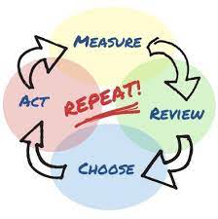
Data analysis – resilience tools
Explore characteristics of resilience – FEEDBACK LOOPS
Does anything about the project site reflect resilience characteristics?
Example Questions
E.g. What kinds of communication, and/or coordination has developed at this project site to sustain results?
Does information get to whomever needs it to respond to climate impacts at this project site? Is it done in a new or different way because of the project?
Examples
Coordination mechanism: Established and active cross-sector and representative national committee or group to facilitate long-term planning and short-term decision-making at the sector/sub-sector specific level
Open communication channels: Regular (multi) village level representative meetings around addressing specific local climate risks and corresponding response measures
Feedback loops
At scale
Diverse
Dynamic
Redundant

Slide 49
Data analysis – resilience tools
Explore characteristics of resilience – FEEDBACK LOOPS
Does anything about the project site reflect resilience characteristics?
Example questions to consider
EXAMPLE: Country/project
Samoa: “A large number of the most innovative communication activities started at the very end of the project, missing out opportunities to generate knowledge and lessons learned as well as to increase interest and CCA sensibility.” (FE)
How and in what ways were the final communication activities (that were sustained post-project) “innovative” ?
What decision-making was informed by information gathered and/or shared through these activities?
Feedback loops
What behavioral changes and resource allocation changes resulted from the communications?
At scale
Diverse
Dynamic
Redundant
Notes:
These questions are entirely illustrative. It’s up to the evaluator to decide which questions are most relevant given the site options and other considerations.

Slide 50
Data analysis – resilience tools
Explore characteristics of resilience – SCALE
Does anything about the project site reflect resilience characteristics?
Example Questions
Temporal scale: e.g. Did sufficient time pass in order to see desired results (especially for natural systems)? In what way(s) did the outcome change the speed responsiveness to climate disturbances at the project site?
Spatial scale: e.g. Is there a cluster of sites that together comprise of a substantial benefit at a regional or national scale? Did the project results change the impact of the climate disturbance?
Examples
Mangrove: Adequate time for restoration of a natural buffer to climate disturbances
Early warning system: Increased speed of (human) responsiveness to climate risks…
Afforestation: Area of restored natural resources is large enough to support ecosystem services
Storm surge (sea) wall: Hard infrastructure provides a physical buffer from a targeted climate disturbance…
Remember to consider both time and space
Feedback loops
At scale
Diverse
Dynamic
Redundant
Notes:
The only timeframe we can measure is what's happened since project closing, so that's all they can answer for, but of course they're looking toward the future as well; and it would depend on the replenishment rate of the natural asset, for example, to know the "timeframe" needed to pass to see the outcomes bear out.
The argument/logic: if something is big enough or lasts a long enough time, it’s more likely to be robust and/or adapted. Why?
Physical space – picture a thin mangrove vs a lush, wide one; physical space shapes behavior and how we think of scarcity for example
Temporal space – trees take time to grow, animals take time to adapt/adjust behavior and/or change habitat etc.; same goes for people

Slide 51
Data analysis – resilience tools
Explore characteristics of resilience – SCALE
Example questions to consider
EXAMPLES: Country/project
Belize: “75% of coastal developments adhering to the development guidelines” (FE)
Argentina: “Increased density of hydro-meteorological stations and rain meters.” (FE)
Are the targeted coastal developments in critical locations?
Is their combined size of the targeted areas enough to make an impact at a national level?
Are the locations of the new met stations and rain meters in places most affected by drought/floods etc?
Feedback loops
Is there evidence that the speed of responsiveness to climate events has improved?
At scale
Diverse
Dynamic
Redundant
Notes:
These questions are entirely illustrative. It’s up to the evaluator to decide which questions are most relevant given the site options and other considerations.

Slide 52
Data analysis – resilience tools
Explore characteristics of resilience – DIVERSITY
Does anything about the project site reflect resilience characteristics?
Example Questions
Human systems: e.g. Does the project site show inclusion for women and girls, disabled, poor, and/or other marginalized groups? Does the site reflect diversity or diversification in other ways?
Natural systems: e.g. Is ecological biodiversity a factor in sustaining results?
Examples
Engagement of marginalized groups in decision-making: People who are historically left out of decision-making positions now actively participate
Gender equity in leadership: Women and girls, non-binary and/or trans people have leadership roles
Ecological diversity: A wide variety of species with different niches that have co-evolved together are not threatened or endangered
Feedback loops
At scale
Diverse
Dynamic
Remember to consider both human diversity and biodiversity
Redundant

Slide 53
Data analysis – resilience tools
Explore characteristics of resilience – DIVERSITY
Example questions to consider
Is there evidence that these coral varieties are climate resilient at this site?
What critical (especially threatened, endangered) species’ habitat is at these sites?
EXAMPLES: Country/project
Beliz: “At least 3 restored coral sites, with resilient varieties grown in coral nurseries” (FE)
Ecuador: “Visible… diet diversification and the awareness about being able to feed better with their own production” (FE)
How are cultural norms around recipes and cooking affected - and perpetuated - as a result of dietary changes?
Feedback loops
What is the impact of diet diversification on food security?
At scale
Diverse
Dynamic
Remember to consider both human diversity and biodiversity
Redundant
Notes:
These questions are entirely illustrative. It’s up to the evaluator to decide which questions are most relevant given the site options and other considerations.

Slide 54
Data analysis – resilience tools
Explore characteristics of resilience – DYNAMISM
Does anything about the project site reflect resilience characteristics?
Examples
Coordination: Entities that are responsible for specific climate disturbance management are now sharing resources and information
Partnership: Active cooperation facilitating complex decision-making around common goals in relation to climate disturbances
Example Questions
e.g. What kinds of flexibility and adaptability are illustrated at this project site? How were these capacities demonstrated?
E.g. If one path/ strategy/ approach did not work was another tried? Why, or what triggered the change? By whom?
Feedback loops
At scale
Coral reefs are an example of a dynamic system
Diverse
Dynamic
Redundant

Slide 55
Data analysis – resilience tools
Explore characteristics of resilience – DYNAMISM
Example questions to consider
EXAMPLE: Country/project
Samoa: “25+ districts with coastal infrastructure management (CIM) Plans reviewed and updated with climate change risks fully integrated, through balanced involvement of men, women, and youth population.” (FE)
How are decision-making processes or actions regularly better informed as a result of the CIMS? For whom?
Are there new systems in place for reinforcing the gains in managing climate-integrated coastal infrastructure?
Feedback loops
At scale
Diverse
Dynamic
Redundant
Notes:
These questions are entirely illustrative. It’s up to the evaluator to decide which questions are most relevant given the site options and other considerations.

Slide 56
Data analysis – resilience tools
Explore characteristics of resilience – REDUNDANCY
Does anything about the project site reflect resilience characteristics?
Examples
Back-up systems: Two evacuation routes through different terrain in case one is closed off or damaged
Parallel or duplication of effort: An observer manually measures rainwater levels in addition to the hydro met station gauge
Example Questions
e.g. Are there duplicate systems or back-up systems involved in responding to a specific climate disturbance at this project site?
If one path, approach, or strategy fails, what are the other options available?
Feedback loops
At scale
Diverse
Dynamic
Redundant
Notes:
Diversity is different pieces/parts doing DIFFERENT functions (like predators vs fungus, for example) together to form some coherent whole, while duplication and repetition means they're serving the SAME functions (like all pollinators and all decomposers, for example).

Slide 57
Data analysis – resilience tools
Explore characteristics of resilience – REDUNDANCY
Example questions to consider
What specific functions does each of the natural resource assets provide in the context of climate disturbances?
EXAMPLE: Country/project
Mauritania: “Natural resource assets created, maintained or improved to withstand conditions resulting from climate variability and change; e.g. Tree plantings, water and soil conservation, defenses, and village plantations.” (FE)
What is the relationship between duplication of effort (e.g. multiple defenses in one place) and specific climate disturbances?
Do the functions overlap or repeat? To what extent?
Feedback loops
At scale
Diverse
Dynamic
Redundant
Notes:
These questions are entirely illustrative. It’s up to the evaluator to decide which questions are most relevant given the site options and other considerations.

Slide 58
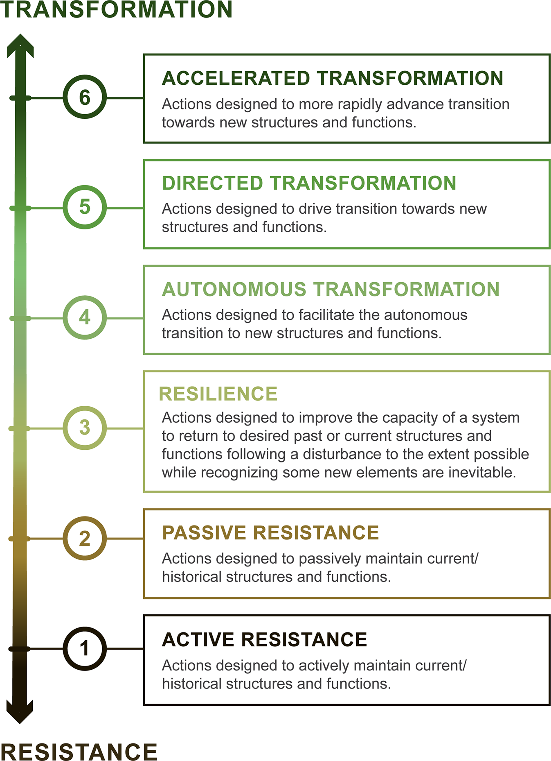
Data analysis – resilience tools
Evaluating resilience : R-R-T Typology
Overhaul of structures and functions (S&F)
4-6 New S&F
Directed transition toward new S&F
Undirected transition toward new S&F
Improve system capacity to keep current or past S&F
1-3
Old S&F
Passive maintenance of S&F
Active maintenance of S&F
Notes:
Notes:
- This is a TYPOLOGY. Meaning, everyone should NOT be aiming for transformation. It’s a way of describing the strategy taken for managing climate disturbances.
The distinction between directed and autonomous is one of SPEED.
Source: https://www.nature.com/articles/s42003-020-01556-2

Slide 59
Data analysis – resilience tools
Discuss R-R-T typology
Position on R-R-T Typology | Outcomes and Explanations
6 Accelerated Transformation: Actions designed to more rapidly advance transition towards new structures and functions
5 Directed Transformation: Actions designed to drive transition towards new structures and functions
4 Autonomous Transformation: Actions designed to facilitate the autonomous transition to new structures and functions
3 Resilience: Actions designed to improve the capacity of a system to return to desired past or current structures and functions following a disturbance to the extent possible while recognizing some new elements are inevitable
2 Passive Resistance: Actions designed to passively maintain current/ historical structures and functions
1 Active Resistance: Actions designed to actively maintain current/ historical structures and functions
YOU WILL FILL IN THE RELEVANT CELL(S) WHEN DOING YOUR RESILIENCE ANALYSIS
Notes:
Note: This typology represent strategies or approaches to climate change adaptation. This is a question of “Which resilience strategy did they primarily rely on with this outcome?” The evaluator needs to understand that the outcome(s) they focused on in ex post about will fall along this typology, usually in one or two places. NOT every strategy/approach will be used by every project.

Slide 60
Data analysis – resilience tools
Reviewing resilience: example of infrastructure assessment
Resilience Checklist
Disturbances – What climate shocks and stressors (disturbances) does this infrastructure resist? How have the disturbances changed since project closing?
Systems – In what systems does the infrastructure sit (human and natural)? What structures and functions does it fulfill in those systems?
Characteristics - What resilience characteristics does the infrastructure exhibit in the face of climate disturbances (feedback loops, redundancy, diversity etc.)? Are the characteristics locally valued?
Means and Actions – What activities and resources are being used to ensure the infrastructure continues to exhibit these resilience characteristics? In what ways and for how long?
Resistance – Resilience – Transformation – Where on the RRT typology does the sustained infrastructure outcome sit overall? To what extent did impacts influence/affect targeted systems?

Slide 61
Data analysis – resilience tools
Reviewing resilience: example of restoration, DRR projects, etc
EXAMPLE 2: How can outcomes be analyzed for restoration, disaster risk management/reduction, etc?

Slide 62
What’s next?
Field work and learning
Xxxxxxxxx

Slide 63
Survey
Before you go….
Please take the following quick survey: here
What was most surprising?
What was unclear?
What else do we need to know?
If you wish, you can also verify your understanding of today’s session by taking this small quiz
Link to quiz B

Slide 64
See you tomorrow!
Questions? Comments?

