Slide 1
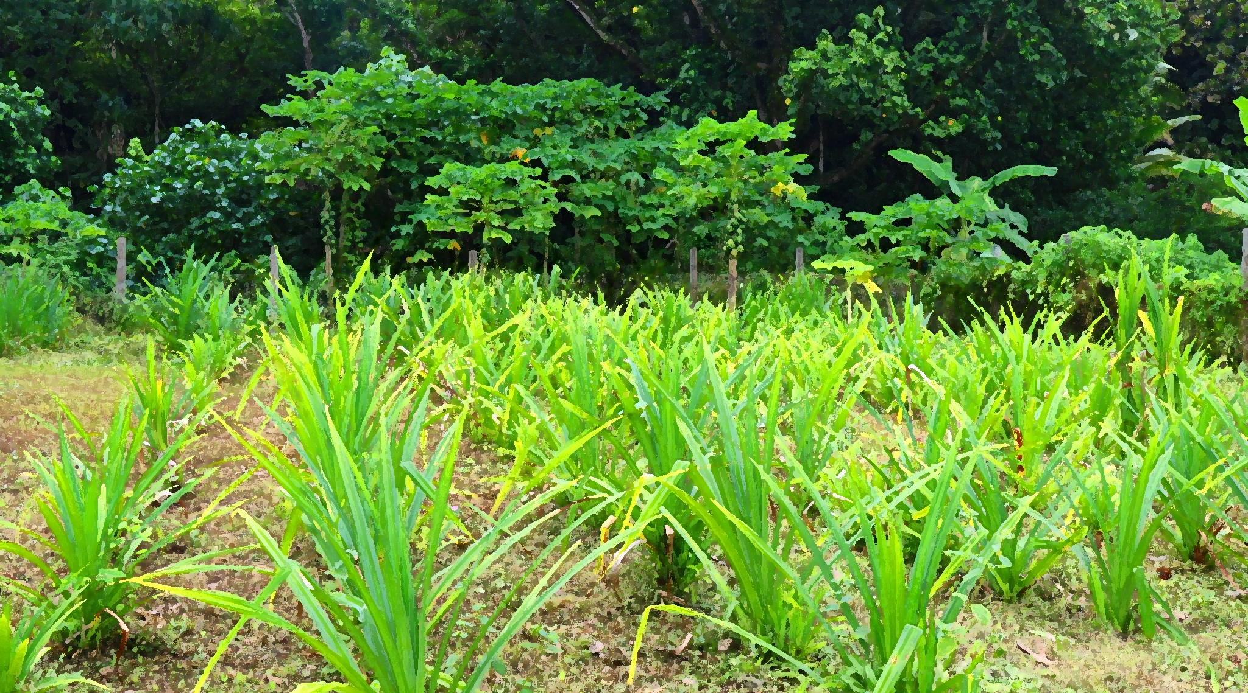
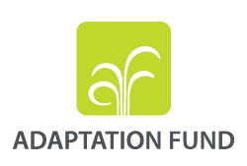
Adaptation Fund
Session: Opportunities for financing climate change adaptation in transboundary basins
Global Network of Basins Working on Climate Change Adaptation
May 26, 2023
Kalterine Shabani Vrenezi
Adaptation Fund Secretariat

Slide 2
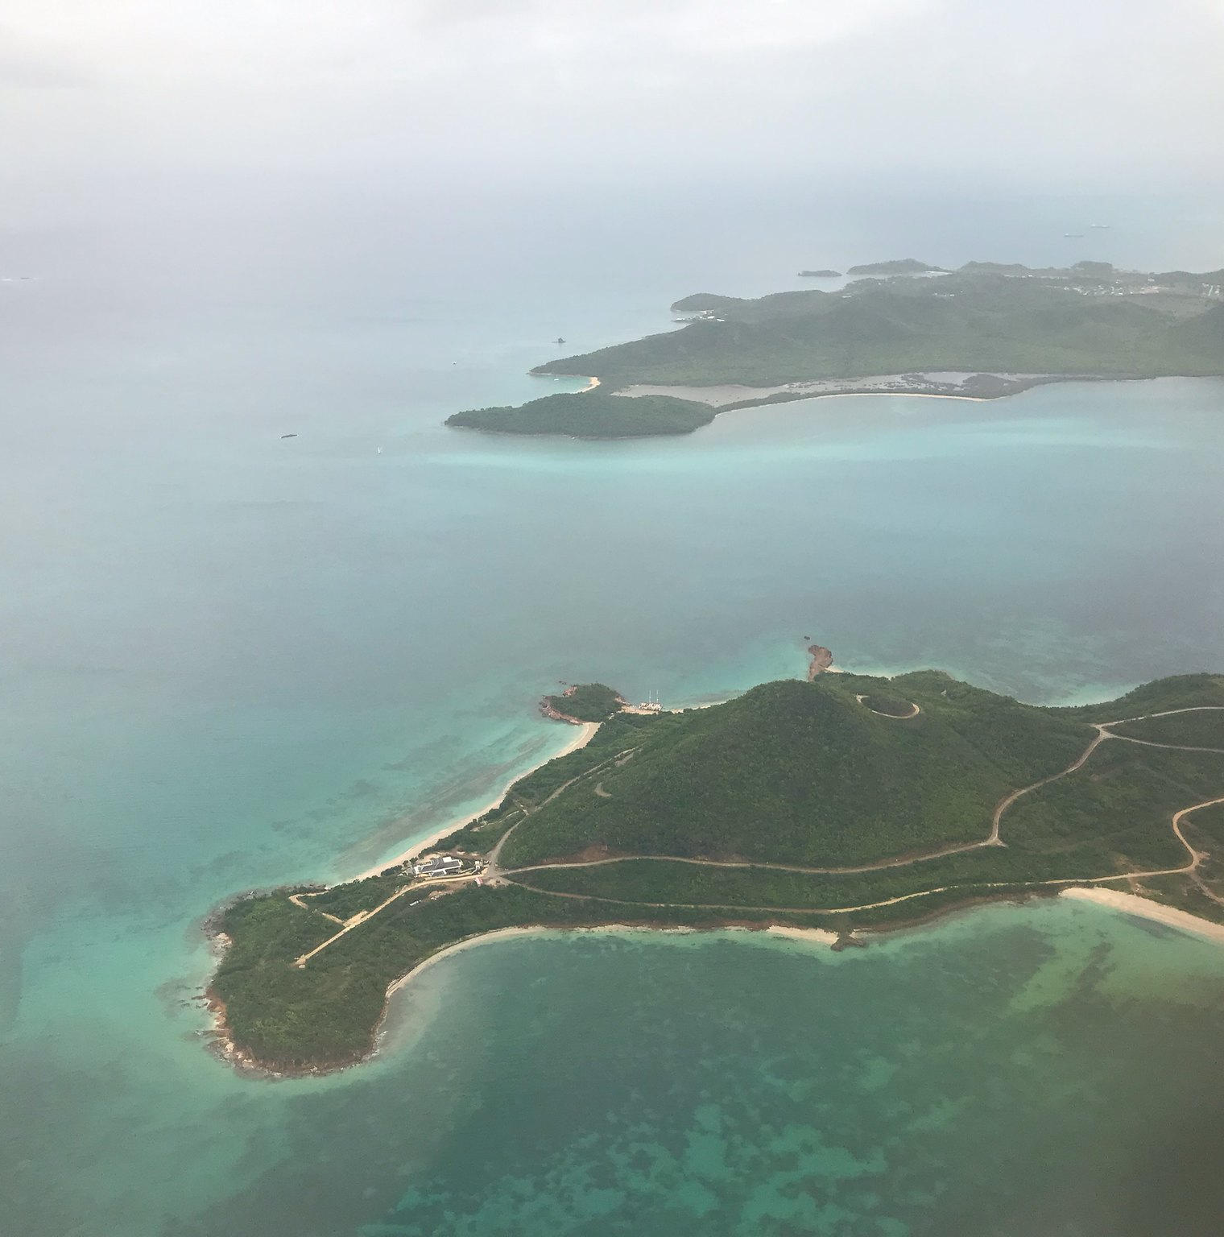



Adaptation Fund
Pioneered Direct Access – finances concrete Adaptation projects/programs
A total of 56 IE (34 NIEs, 14 MIEs, 8 RIEs)
US$1 billion portfolio in grant funding including US$205 million for transboundary projects/34 countries

Slide 3


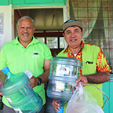

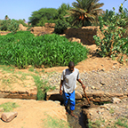
AF portfolio – Regional distribution to date
Eastern Europe
6 projects
$ 29.8 M
Asia Pacific
48 projects
Multi
$ 275.8 M
2 projects
$ 10 M
TOTAL PORTFOLIO
139 projects
Africa
$988.2 M
42 projects DA
5 projects EDA
32 projects
51 projects
Latin America & Caribbean
$ 271.1 M
$ 401.5 M

Slide 4
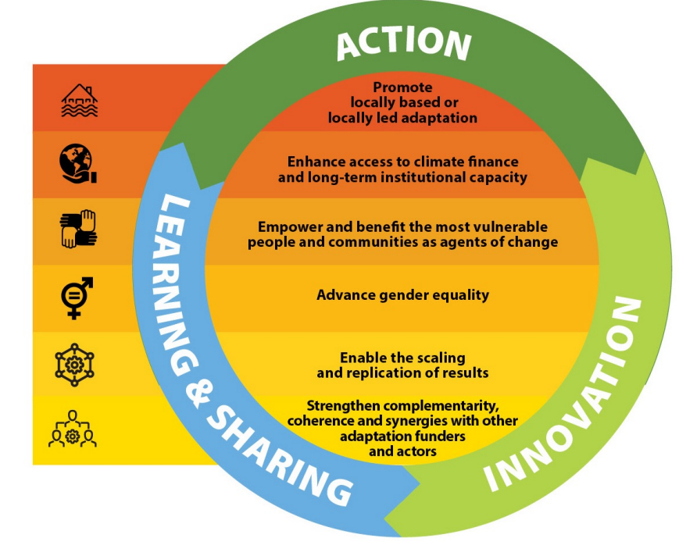
Medium-Term Strategy (2023-2027)
Adaptation in action
The new MTS was approved in 2022
Further builds on the Fund’s strategic pillars of Action, Innovation and Learning &Sharing.
Increased focus on strengthening synergies between pillars and adding other cross-cutting features
Foster locally led adaptation and scaling up Fund’s actions and results

Slide 5



AF funding opportunities (to be expanded with the new MTS 2023-2027)
Action | Innovation | Learning & Sharing
Single country projects ($ 20 M per country) (NIE, RIE, MIE) + Project formulation grants (NIE only) | Small grants (<US$250 k) to foster innovation practices in CCA (NIE) | Learning grants (<US$150 K) to share best practices and lessons learned (NIE)
Regional projects (2 + countries) $ 14 M (RIE, MIE) + PFG | Small grants (<$ 250k) in innovation for non accredited entities - AFCIA
Enhanced Direct Access (EDA): US$ 5 M per country (NIE) | Large grants (<US$5 M) to roll out innovative adaptation practices in CCA. Single country (NIE, RIE, MIE) or regional (RIE, MIE)
Project scale-up grants: < US$ 100 k per project (NIE)

Slide 6
AF Regional Window – ACCESS MODALITY
Pilot programme introduced in 2015 with at cap of $30 million
Up to $14 million and $100k PFG (project formulation grant) for regional project (2+ countries)
Implemented by MIE or RIE and endorsement by each DA of participating countries
Concrete adaptation actions in multiple sectors including including Transboundary Water Management, Enabling Environment, water security, Nature-Based Solutions, EBA, etc.
Total of US$219M under the regional window, or 20% total portfolio
Funding on basis of the full cost of adaptation (No co-financing required, addressing adaptation needs and co-benefits if any, no BAU)
Environmental, socio-economic benefits especially for the most vulnerable and gender considerations

Slide 7
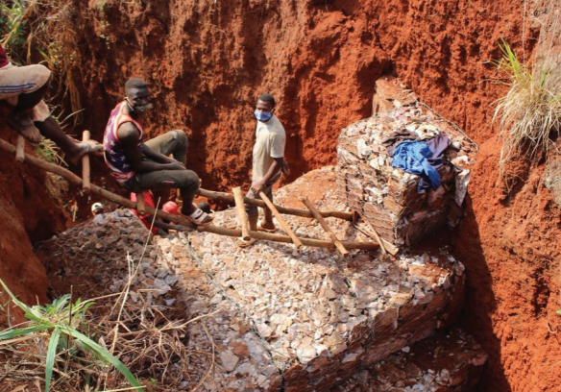
Adapting to Climate Change in Lake Victoria Basin (Burundi, Kenya, Rwanda, Tanzania, Uganda) - UN Environment Programme (US$ 5,000,000)
Case Study
Results:
Training provided on downscaling regional climate information to national, subnational and local levels and on delivery of climate information to local communities at selected project sites.
43 small-scale community-based projects that promote innovative approaches to climate change sites funded.
240 hectares of agricultural land rehabilitated through climate smart agriculture and agroforestry practices.
460 households in Burundi and Rwanda benefiting from climate smart water conservation practices.
1,644 households trained on climate change adaptation technologies.
Lessons Learned:
Seek consensus between authorities and other key stakeholders across partner countries.
Ensure project is based on high quality regional-level baseline information.
Incorporate a sustainability and transfer of knowledge plan
Project Components:
Improving regional management of a transboundary water catchment
Climate information dissemination
Regional approach to climate change adaptation in vulnerable communities
Community-based approaches to climate change adaptation
Knowledge management and learning

Slide 8
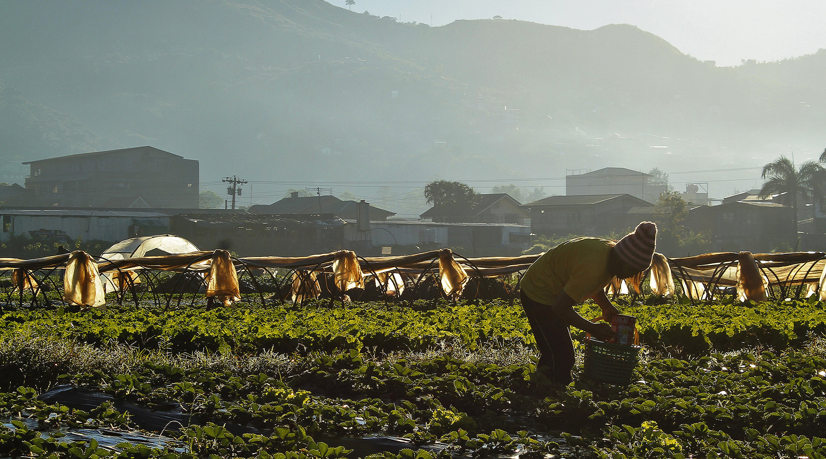
Thank You
Kalterine Shabani Vrenezi
kvrenezi@adaptation-fund.org
AF Website:
adaptation-fund.org
AF on Twitter:
https://twitter.com/adaptationfund

