Slide 1
Community of Practice of Direct Access Entities: Action Plan Implementation
Adaptation Fund Annual NIE Seminar
Dominican Republic
September 2023

Slide 2
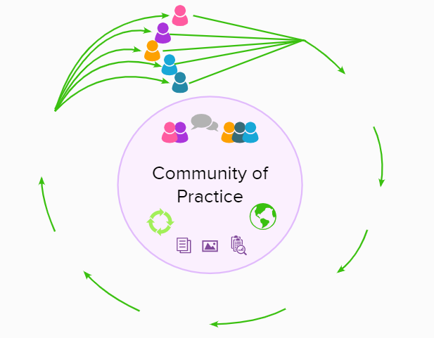
What is a Community of Practice
Spontaneously come together under a
Within each
Common Purpose
Implicitly held Knowledge
They build
Which becomes
Trust and Confidence
Collective Intelligence
In order to
Share Knowledge
Which creates
Share Practice
Play video
Thereby developing
Notes:
https://drive.google.com/file/d/1SUcnkG94vGkFC7PkTSxofMLVSruXzAbc/view?usp=drive_link

Slide 3
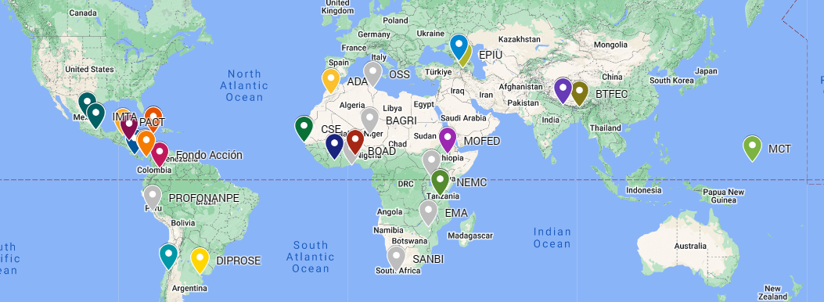
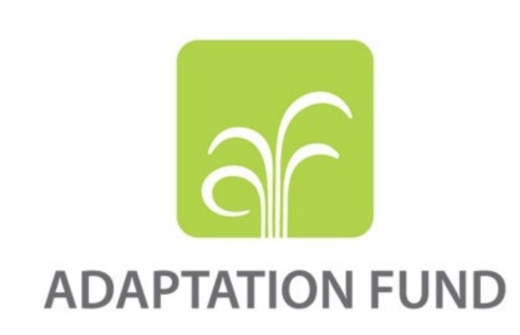
What is the CPDAE?
A global network integrated by National Implementing Entities (NIEs) of the Adaptation Fund (AF) and Direct Access Entities (DAEs) of the Green Climate Fund (GCF), involved in the programming of climate change adaptation and mitigation finance through the Direct Access Modality.
34 members
Best practice approach to enhance country ownership of climate projects
Notes:
The AF and the GCF have been promoting Direct Access Modality as a best practice approach to enhance country ownership of climate projects. In that regard, the AF’s National Implementing Entities (NIEs) and the GCF’s Direct Access Entities (DAEs) are important to understand national priorities and contributions towards low-emission and climate-resilient development pathways (GCF/B.20/17)

Slide 4
The Committee:
6 members representing the 3 Language Groups
French
English
Spanish
Ms. Aissata Sall (Vice-Chair) (CSE), Senegal
Ms. Shelia McDonald- Miller (PIOJ), Jamaica
Claudia Godfrey (Chair) (Profonanpe), Peru
Ms. Meryem Andaloussi (ADA), Morocco
Ms. Lisa Andon (MCT), Federated States of Micronesia
Rosa Montañez (Fundación Natura), Panama

Slide 5
Our expectations and Objectives: what do we want
Expectations
Develop a sustainable network strengthened with the constant support and interest of all – leading to an active community of practice and joint growth.
Enhance and develop in-house capacities of CPDAE members leading to increase the number of high-quality projects.
Strong DAs and NDAs that work closely with their NIEs/DAEs boosting country ownership of climate change adaptation and mitigation.
Support NIEs and DAEs to address country’s climate priorities and achieve long-term goals framed under the Nationally Determined Contributions (NDCs).
Objectives
Building in-house Capacity to enable successful re-accreditation/accreditation upgrade and submission of transformational projects.
Strengthen the community through communication and experience exchange mechanisms between the members of the CPDAE.
Support South-South cooperation between the members and their in-country partners for implementing climate finance projects.
Engage in a continuous dialogue with GCF and AF to improve efficiency of direct access to climate finance through DAEs and NIEs.

Slide 6
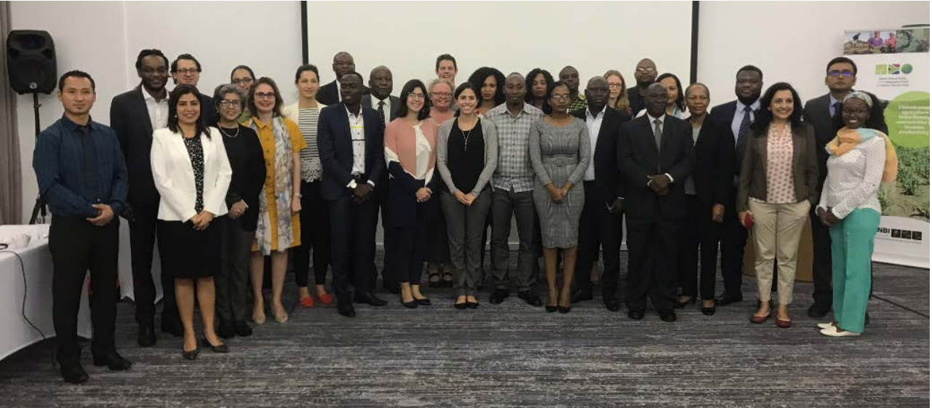
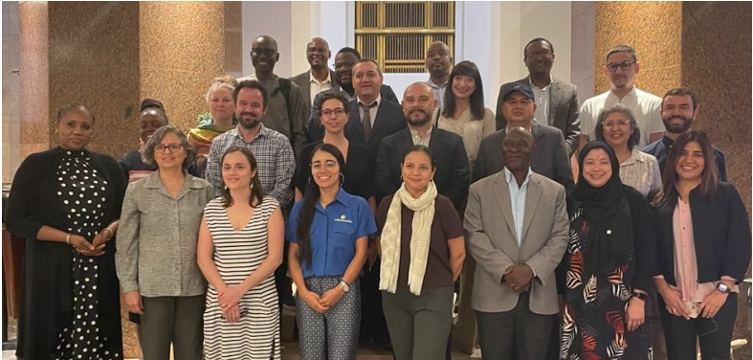
What the CPDAE is doing for its members
Design specific trainings to strengthen CPDAE members capacity on climate projects design and implementation,
Develop tools (rooster of experts, re-accreditation / accreditation upgrade self-assessment tool adapted to the CPDAE needs and challenges, materials focusing on lessons learned and experience sharing, etc.),
Facilitate peer-to-peer exchanges (virtually and during events of the funds),
Many more to come…
Community of Practice of Direct Access Entities
Members Meeting 5th - 7th June 2019
Durban, South Africa
Community of Practice of Direct Access Entities
Annual Meeting 2nd - 4th November 2022
Cairo, Egypt

Slide 7
Support to achieve key results
Put in place “building blocks” for an operational community thanks to the support of the African Development Bank, Adaptation Fund and the Green Climate Fund (Durban, 2019).
Side events on the margin of COP meetings 25, 26* and 27 thanks to the support of the GCF and the AF.
Facilitation and community building supported by GIZ.
Ongoing support from the GCF e.g., presentations of the CPDAE during key events of the fund, amongst others.
The AF has been providing ongoing support to the creation of the CPDAE since 2016, e.g., providing spaces during its Annual Seminars, hosting the CPDAE webpage on the official AF website, amongst others.
*Side Event on the margin of COP26 was also organized thanks to the support of Panama in the Panama Pavilion.
Notes:
- The meeting in Durban, 2019 resulted in 3 successful outcomes containing a Charter of Governance, Action Plan, and the 1st elected committee of the community.
- Side events aimed to present the community and enhance its network.
- Most recently at the GCF Regional Dialogue with Latin America and Workshop for Direct Access Entities in Latin America and the Caribbean in Uruguay, July 2023.
- Support from the AF also includes:
Part-time personnel to support the operations of the CPDAE.
Communication consultant to implement the CPDAE communications strategy.
2023 CPDAE Annual Meeting in Yerevan, Armenia, where among other, the New Committee will be elected. This activity is part of the Readiness Project.

Slide 8
What has been achieved at this moment?
CPDAE Side Event COP28
CPDAE Annual Meeting – Election of new Committee
CPDAE Side Event COP27
CPDAE Annual Meeting – CPDAE LOGO
Approved CPDAE Readiness Proposal by GCF
November 2023
September 2023
CPDAE Side Event COP26
November 2022
NDA Letters of Support and funds collected – CPDAE Readiness
November 2022
Engagement of GIZ: Delivery Partner – CPDAE Readiness
1st face-to-face meeting in Durban, South Africa
Engagement of Peru: Lead NDA – CPDAE Readiness
December 2021
November 2021
October 2021
Readiness begins in January 2022
February 2021
June 2019
November 2020

Slide 9
The Readiness GCF – AF – GIZ
GCF type of Support
Capacity building
Pipeline Development
Knowledge sharing and learning
Budget
GCF Funds allocated by NDAs:
Total Budget:
€ 1,235,950
Duration time: 24 months
Delivery Partner: GIZ
Lead NDA: MEF (Peru)
Direct Beneficiaries: 15 countries
(see next slide for more info on this)
Activities under the Readiness Project:
Online sessions with members to enhance the CPDAE’s Governance Structure
Roster of experts, re-accreditation / accreditation upgrade self-assessment tool adapted to the CPDAE needs and challenges.
Online trainings on Adaptation Fund and Green Climate Fund project development and implementation (see subsequent slide for more info on this).

Slide 10
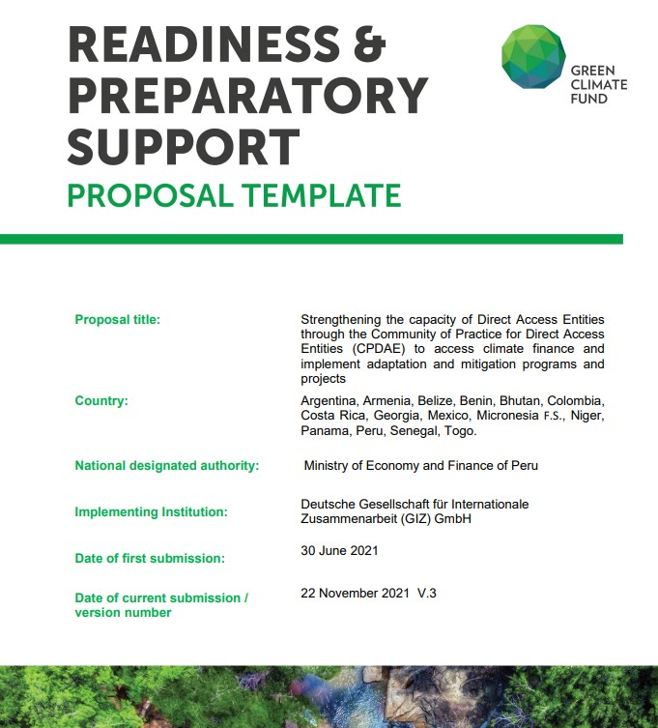
Readiness Direct Beneficiaries: countries (and entities) with Endorsement Letter
NDAs that allocated funds

Slide 11
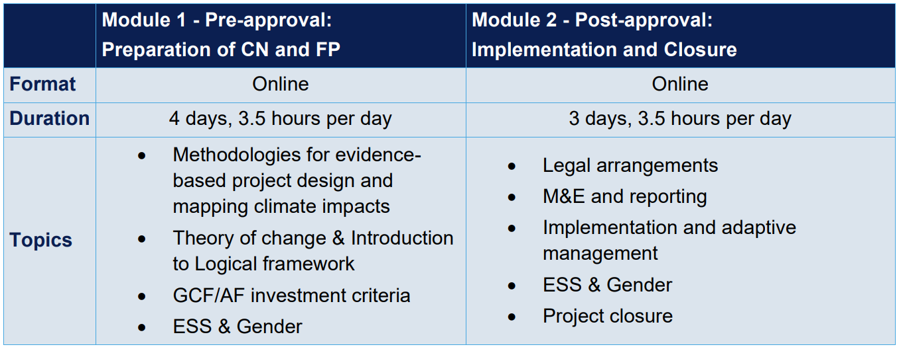
CPDAE trainings on AF and GCF project development and implementation
When are the trainings?
Date: 09–17 Oct 2023
Time: 11:00 – 14:30 CEST
Language: English with simultaneous translation to French*
* English with simultaneous translation to Spanish took place in August.
How to register?
Please send an email to Ms. Lisa Scholz (lisa.scholz@giz.de) with the list of participants asap. Registered persons will receive the meeting link in due time.
Who should join?
Ideally technical experts of your entity who are involved or will be involved in AF/GCF concept note/proposal preparation and implementation. You may nominate up to 2 representatives from your organization

Slide 12
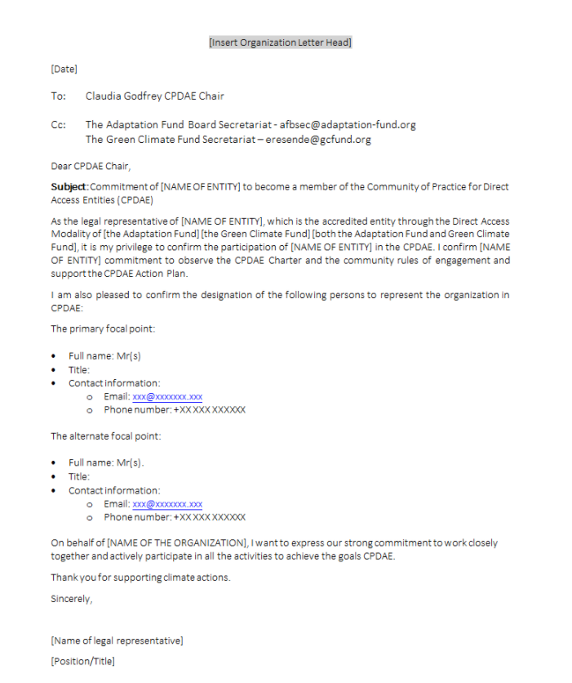
How to become a member
Join the community!
All National Implementing Entities of the Adaptation Fund and Direct Access Entities of the GCF are invited to become members.
The entity representative must send a letter to the CPDAE Chair and copy the Vice-Chair
The template can be found in the following link: Community of Practice - Adaptation Fund (adaptation-fund.org)
Template for membership letter:

Slide 13
Quick Quiz … are you ready?

Slide 14
What is the CPDAE?

Slide 15
And the Answer is…
A global network integrated by NIEs of the AF and DAEs of the GCF involved in the programming of climate change adaptation and mitigation finance through the Direct Access Modality

Slide 16
What are the OBJECTIVES of the CPDAE?

Slide 17
And the Answer is…
Building in-house Capacity to enable successful re-accreditation/accreditation upgrade and submission of transformational projects.
Strengthen the community through communication and experience exchange mechanisms between the members of the CPDAE.
Support South-South cooperation between the members and their in-country partners for implementing climate finance projects.
Engage in a continuous dialogue with GCF and AF to improve efficiency of direct access to climate finance through DAEs and NIEs.

Slide 18
How many members does the committee has?

Slide 19
And the Answer is…
Six members representing the 3 Language Groups

Slide 20
Last question… are you ready?
Who can be a member of the CPDAE?

Slide 21
And the Answer is…
All NIEs of the AF and DAEs of the GCF

Slide 22
Open moment to discuss and get to know each other
What would you like the CPDAE do for you/your entity
Ideas or feedback you would like to share?
Is your entity developing a project?
Notes:
Agregar apoyo financiado por el AF

Slide 23
Thank you.

