Slide 1
ADAPTATION FUND - OVERVIEW
NIE Seminar 2023
Santo Domingo, Dominican Republic

Slide 2
Introduction
Set up under the Kyoto Protocol of the UNFCCC (Fully operational in 2010)
Mandate: To finance concrete adaptation projects and programs in developing country Parties that are particularly vulnerable to the adverse effects of climate change
“The Adaptation Fund shall serve the Paris Agreement under the CMA with respect to all Paris Agreement matters, effective 1 January 2019.” – Decisions 13/CMA.1 and 1/CMP.14
The Adaptation Fund is one of several international funds in the multilateral climate finance landscape.

Slide 3
Governance & Institutional arrangements
Governance → Adaptation Fund Board (AFB):
Composed of 16 members and 16 alternate members, and meets at least twice a year in Bonn, Germany.
Has legal capacity in Germany
Institutional arrangements: The AFB reports to the CMP & CMA and is serviced by AFB Secretariat and the World Bank as a Trustee. Open-ended arrangement since CMP 15 (2019)
Functionally independent secretariat: Capacity of 23 Staff & Consultants
Functionally independent evaluation function: AF-TERG
CMP & CMA
AFB
Secretariat (hosted by GEF)
Trustee (World Bank)

Slide 4
Funding sources
Financed largely by government and private donors, and also from a 2% share of proceeds from the sales of Certified Emission Reductions (CERs) issued under the Protocol’s Clean Development Mechanism project. Decided to benefit from Paris Agreement, Article 6.4. Mechanism.
Pledges/Number of contributors (2015-2022):
Target year | Pledges, total | # of Contributors
2015 | US$ 74.1 M | 4
2016 | US$ 81.4 M | 7
2017 | US$ 95.9 M | 6
2018 | US$ 129.0 M | 9
2019 | US$ 90.0 M | 11
2020 | US$ 116.0 M | 6
2021 | US$ 349.0 M | 17
2022 | US$ 242 M | 17

Slide 5
Portfolio of implementing partners
57 IEs accredited to date
34 NIEs, 9 RIEs, and 14 MIEs
19 out of this are NIEs (about 54%)
35 IEs have been re-accredited (61%)
10 accredited NIEs from LDCs; 7 accredited NIEs from SIDS; and 17 accredited NIEs from other developing countries
Reinforces AF’s commitment to Direct access and the importance of country ownership and building national capacity in adaptation

Slide 6
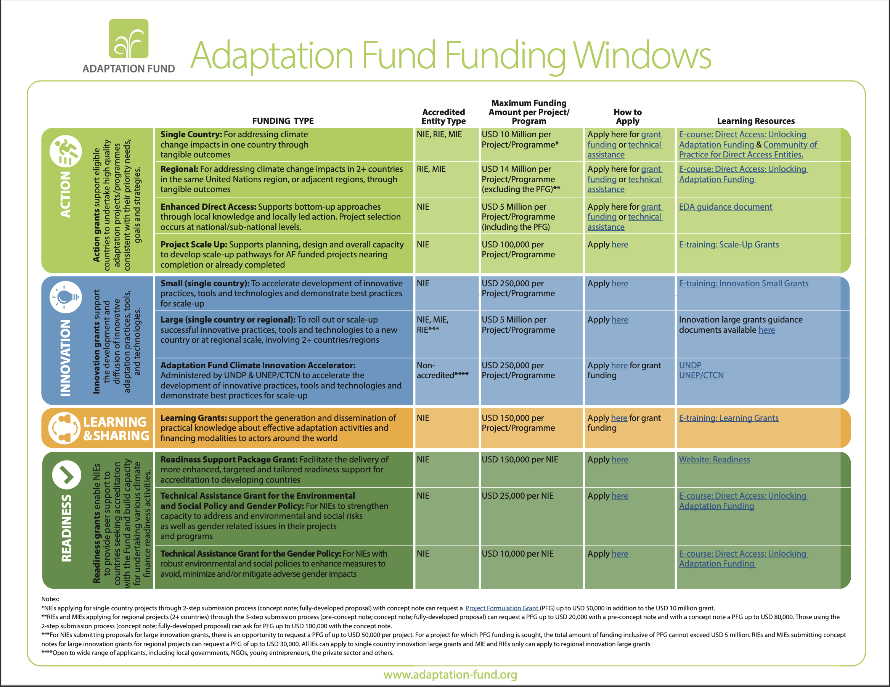
How to Access

Slide 7
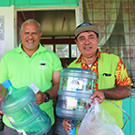
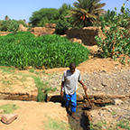
AF portfolio – Regional distribution to date
Eastern Europe
6 projects
$ 29.8 Million
Asia-Pacific
Multi
54 projects
2 projects
$322.8 Million
$10 Million
Africa
TOTAL
32 projects
53 projects
149 projects
Latin America & Caribbean
$419.4 Million
$271.1 Million
$1,053.2 Million

Slide 8
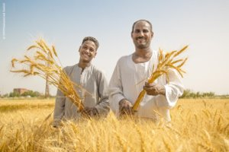
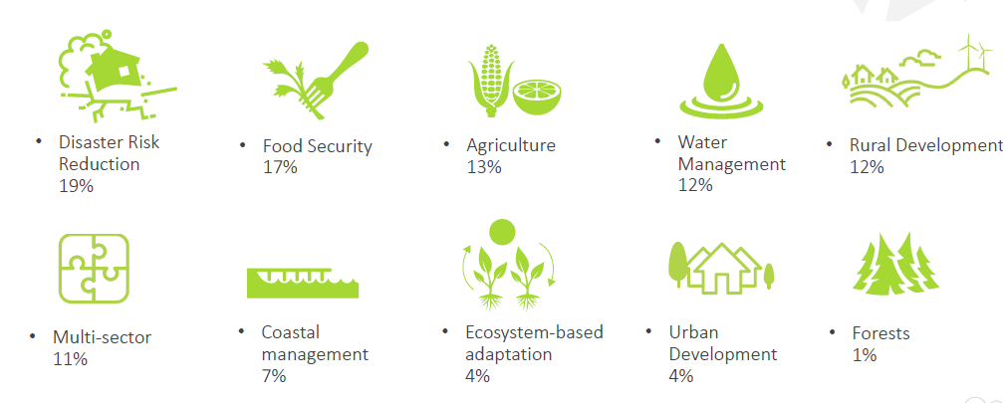
AF portfolio of projects – cont’d
Project portfolio across diversity of sectors
All projects tailored to local adaptation needs and country-driven

Slide 9
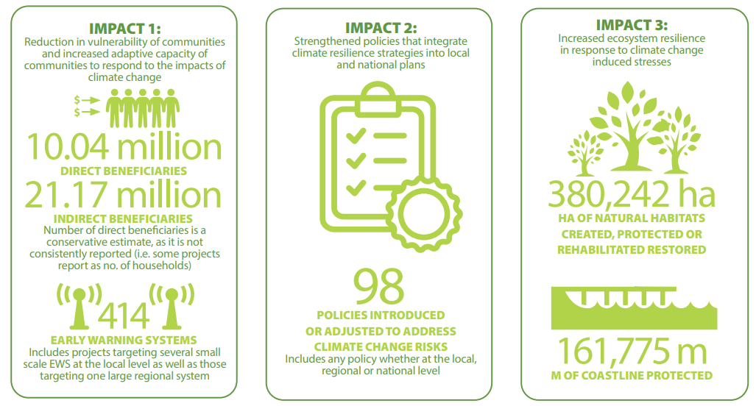
Tangible results
11.59
28.91
635,296
107
526
163,775

Slide 10
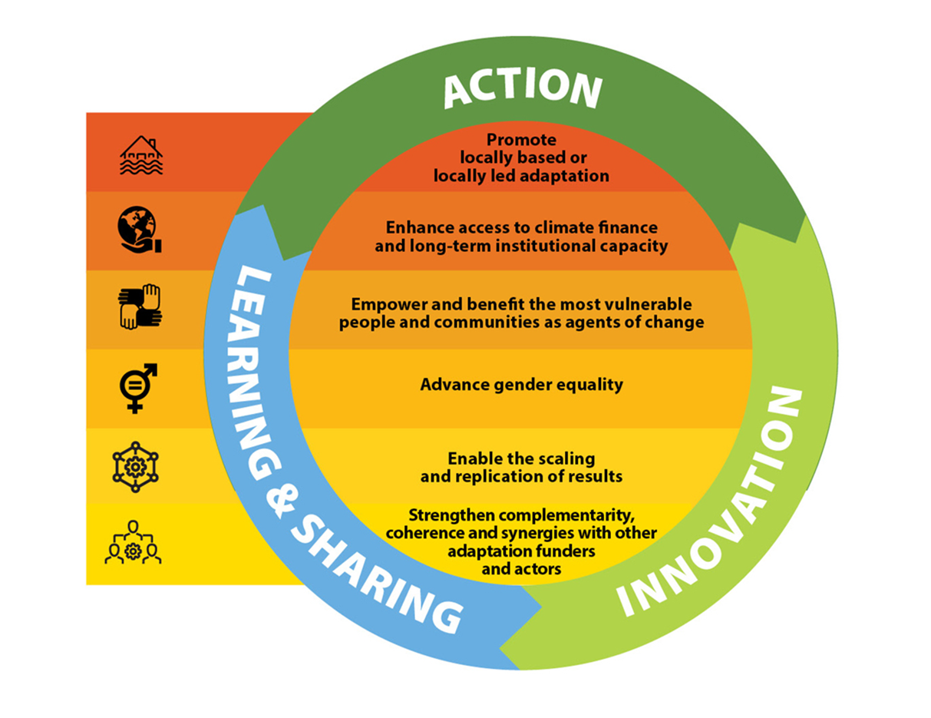
Medium Term Strategy 2023 to 2027
3 Strategic Pillars
6 Crosscutting Themes

Slide 11
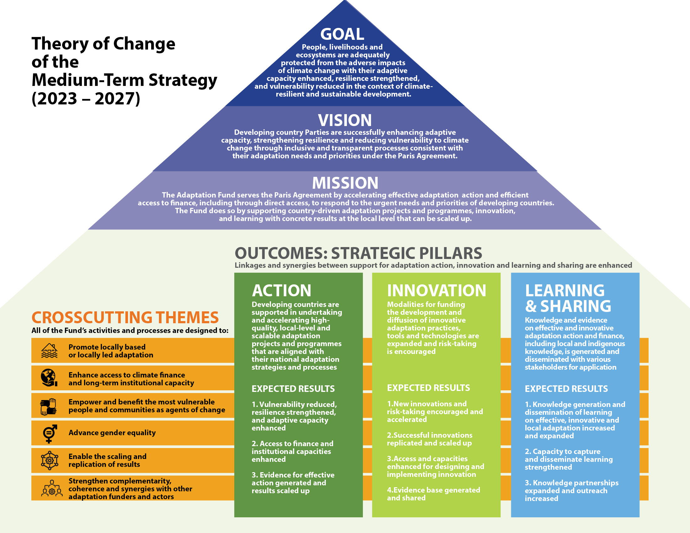

Slide 12
Proposed modalities for delivery & implementation in MTS-2
ACTION
Support and programme increasing number of concrete projects/ programmes aligned with NAPs, NDCs etc.
Expand Readiness Programme: more comprehensive and iterative, assessing needs and addressing gaps
Expand support to locally-based and locally-led adaptation through direct access, EDA, and further modalities
Expand engagement of local and vulnerable groups, incl. local private sector, in project cycle.
Incentivize scalability and replicability as part of project design and implementation
Identify ways to support related (novel or underrepresented) themes, sectors, and target groups with high relevance for/ synergies with effective adaptation
INNOVATION
Expand innovation facility & access to innovation grants, incl. by non-accredited actors
Enhance learning and sharing on innovation
Readiness & capacity-building for innovation
Modalities that target inclusion of youth, women, civil society, indigenous people, private sector etc.
Modalities that can create space for risk-taking
Partnerships for innovation in adaptation
Explore alignment and synergies with UNFCCC technology framework
LEARNING & SHARING
Expand learning grants
Capture synergies with action and innovation e.g. capture learning from innovation portfolio
Readiness and capacity-building for capturing learning
Develop new knowledge partnerships e.g. with research institutions
Further increase outreach and visibility of generated learning, incl. local and indigenous knowledge
Support communities of practice and local-level partnerships
Notes:
This is an illustrative, non comprehensive list of the main modalities that were approved as part of MTS-2. The secretariat used these as the basis for fleshing out proposals for concrete outputs and activities in the IP. Will not read all of them but the main point is that MTS-2 has on a general level already defined areas where the Fund’s ambition and impact can be increased under the three pillars and in line with the 6 crosscutting themes.
ACTION
Programming of increased number of projects and accreditation applications that are aligned with countries’ adaptation strategies (in line with increasing demand and Board decisions of increased country cap and up to 2 NIEs per country)
Enhanced, more comprehensive Readiness Programme (linked to theme of access to finance & long-term capacities)
Expand existing modalities for locally led adaptation and consider new ones
Further engage local and vulnerable groups in project cycle
Incentivize the scalability of AF projects by other actors in the project cycle
Identify ways to support novel or underrepresented themes, sectors, and target groups with high relevance for effective adaptation – (e.g. health, FCV, biodiversity, Indigenous Peoples’ issues) - the AF portfolio already touches many of those themes , with potential of further exploring these through a more targeted/ structured approach
INNOATION
Expand innovation facility and related grant modalities, and enhance access, capacities and partnerships for innovation funding
LEARNING & SHARING
- Expand learning grants and other KM activities to harness the Fund’s potential as a global leader and knowledge broker on effective adaptation

Slide 13
AF Funding Opportunities under Strategic Pillars
ACTION | INNOVATION | LEARNING & SHARING
Single country projects (<$10M) within cap of $20M per country NIEs, RIEs, MIEs & Project Formulation Grants: (<$50,000) for NIE only | Small grants (<US$250 k) to foster innovation practices in climate change adaptation (NIEs) | Learning grants (<US$150 K) to share best practices and lessons learned (NIEs)
Regional projects (multi-country): <up to $14M (RIEs, MIEs) & Project Formulation Grants | Small grants (<$ 250k) in innovation for non-accredited entities (AF Climate Innovation Accelerator through MIEs)
Enhanced Direct Access (EDA): <US$ 5 M per country (NIE) | Large grants (<US$5 M) to roll out innovative adaptation practices and tools Single country (NIE, RIE, MIE) or regional (RIE, MIE)
Project scale-up grants < US$100 k per project (NIE)

Slide 14
Proposed MTS-2 IP Delivery Methods & Activities
Single-Country Projects (within country cap) (NIEs/RIEs/MIEs)
Increased impact & delivery through direct access
Regional Projects/ Programmes (RIEs/MIEs)
Enhanced scope & effectiveness, incl. relevant sectors and themes
Modalities / Facility for
Locally Led Adaptation
ACTION
Existing EDA (NIEs)
New EDA type modality (MIE/RIE)
Global Aggregator
(Non-accredited entities through MIEs)
Options for caps/ maximum amount per project of various grants
Review and revise proposal templates, review criteria, and guidance documents
Develop modalities: funding amount, review criteria, templates etc.
Develop options for programmatic approaches through various funding windows for NAPs & NDC implementation
Small grants for innovation (NIEs)
Large grants for innovation (NIE/RIE/MIE)
AF Climate Innovation Accelerator (AFCIA)
Non-accredited entities through MIEs (LLA type)
INNOVATION
Simplify access & allow for bundling with other small grants
Develop options for enhanced risk-taking
Expand through existing & additional delivery partners
Readiness support for innovation, learning on innovation, partnerships and approach for scaling up innovation, consider co-financing/blended finance, Community of Practice for innovation in adaptation etc.
LEARNING & SHARING
Learning grants (NIEs)
Learning grants for RIEs/MIEs
Increase production, dissemination and visibility of Fund’s KM and learning products on emerging areas in adaptation, incl. innovation, gender, LLA etc.
Increase funding amount & scope to include learning within AF NIE portfolio
To develop joint studies with AF on best practices etc.
ENHANCED READINESS PROGRAMME
Incl. Readiness Package Grants, TA Grants for ESP & GP, Project scale up grants
Notes:
Non-exhaustive and non-comprehensive overview of proposed funding windows under 3 pillars (for comprehensive list, please refer to the tabular overviews in the draft IP document) – this is to provide a bird’s eye view of how the current landscape of available grants would evolve under this IP

Slide 15
Enhanced Readiness Programme: Proposed modalities for more comprehensive & iterative support
Enhanced support for accreditation of 2 NIEs per country & post-accreditation institutional capacity
Enhanced support for project development
Enhanced support to DAs for high-quality proposals/programmes that strengthen linkages with national adaptation processes
Readiness Package Grants
Increase outreach & uptake by increasing number of entities
Technical Assistance Grants for ESP & GP
Increase to up to
US$ 50,000
Project Formulation Grants
Increase by 50 – 100% for all project types
Project scale up grants
Increase to up to
US$ 300,000
Prepare options for supporting DAs through assistance provided regionally or globally
Broaden scope & eligibility:
For NIEs to access more than once depending on needs
For additional areas of technical expertise such as innovation, evaluation, EDA/LLA
Consider expanding to RIEs
Expand scope and eligibility to
include all AF projects incl. EDA/LLA & innovation
e.g. procurement
Consider options for institutional adjustments to enhance DA capacity (e.g. DA as institution + focal point as individual

Slide 16
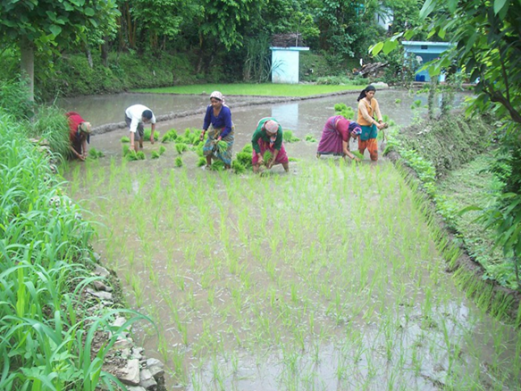
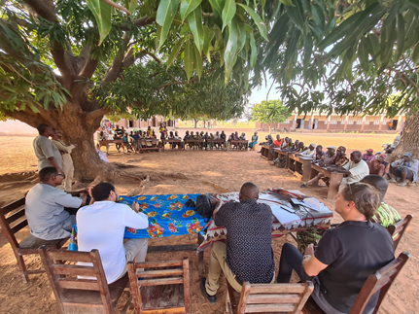
New strategic emphasis on promoting locally led action
AF was part of process for developing the Principles for Locally Led Adaptation Action & Board endorsed Principles for LLA in 2021
Refers to modalities for devolving decision making to the lowest appropriate level:
“Giving local institutions and communities more direct access to finance and decision-making power over how adaptation actions are defined, prioritized, designed, implemented; how progress is monitored; and how success is evaluated.”
(Source: Global Commission on Adaptation, 2021)
AF Board will consider funding modalities & other support for LLA at upcoming AFB.40 Board meeting in March 2023

Slide 17
Enhanced Complementarity & Coherence with Other Climate Funds
Strategic engagement at Funds’ secretariat and Board levels
AF/GEF secretariat collaboration on portfolio development matters
AF/GCF collaboration to enhance climate finance access
Direct Access: Joint support to Community of Practice of Direct Access Entities (CPDAE)
Joint Climate Funds Annual Dialogues & Roadmap (between AF/GCF/GEF/CIF)
GEF staff cross-support for AF portfolio quality at entry - GEF staff co-review of AF projects
Continuous engagement among the Funds on operational matters including project portfolio, collaboration platform on results management and reporting frameworks, support for resilient COVID-19 recovery, KM & communications, and scaling up projects
Project scale up: Pilot of Scaling-Up Approach between the AF and the GCF (nearly 10 projects so far)
Accreditation: AF and GCF fast-track accreditation and Re-accreditation
Joint activities and events at COPs to share knowledge on best practices
Synergies in implementing complementary projects (Honduras, Samoa, Tanzania) & projects that build on earlier GEF experiences (Antigua and Barbuda, Turkmenistan)

Slide 18
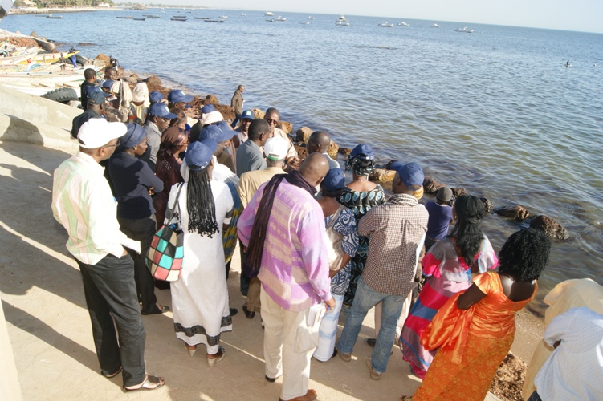
New emphasis on scaling up of results & strategic partnerships with other adaptation funders
More support, guidance and partnerships for incentivizing scalability and replicability of results as part of project design and implementation
Leverage partnerships and synergies with other adaptation actors and funders for more structured approaches to scaling up
Expand range of stakeholders & partnerships across operations to maximize support to developing countries (incl. projects, readiness, innovation, knowledge management etc.)

Slide 19
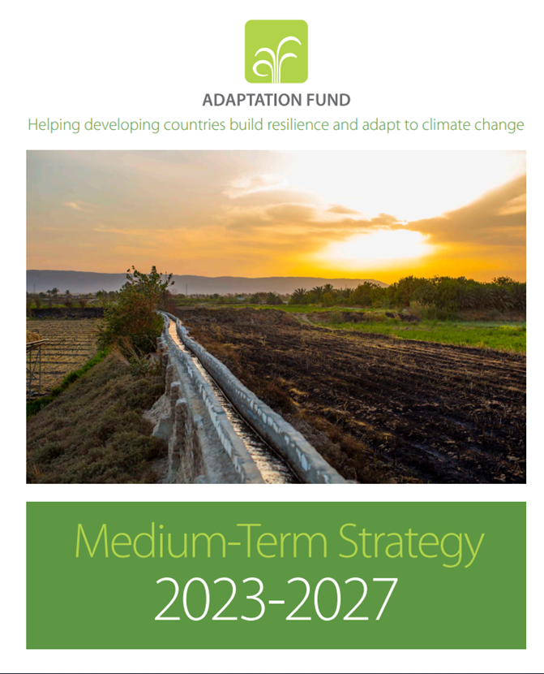
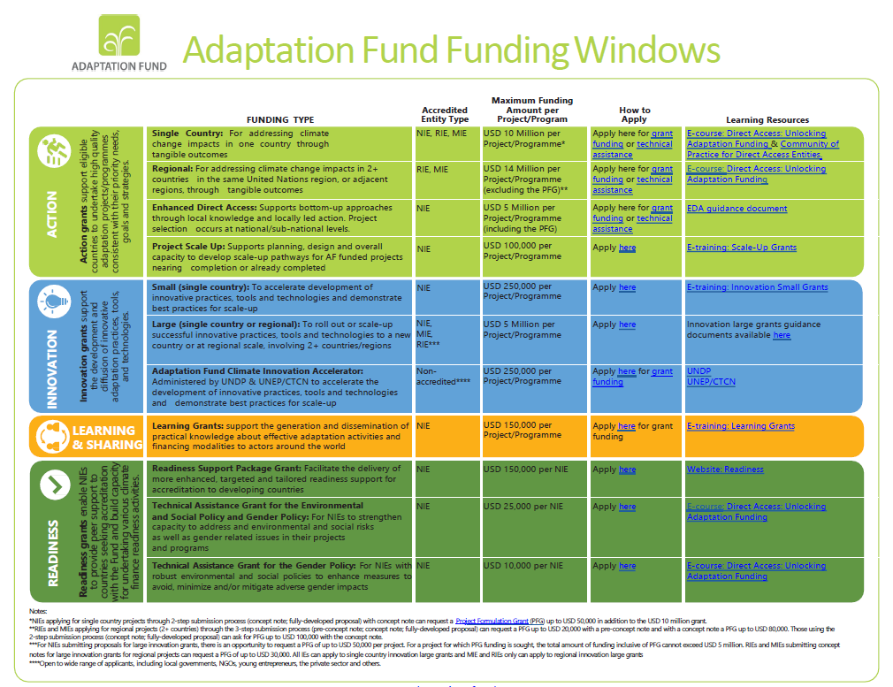
For further information
Overview of available funding opportunities & relevant links on AF website
Medium Term Strategy
available on AF website:
https://www.adaptation-fund.org/document/medium-term-strategy-2023-2027/

Slide 20
Thank you!
Notes:
With this I am ending my presentation, I thank you all for your attention.

