Slide 1
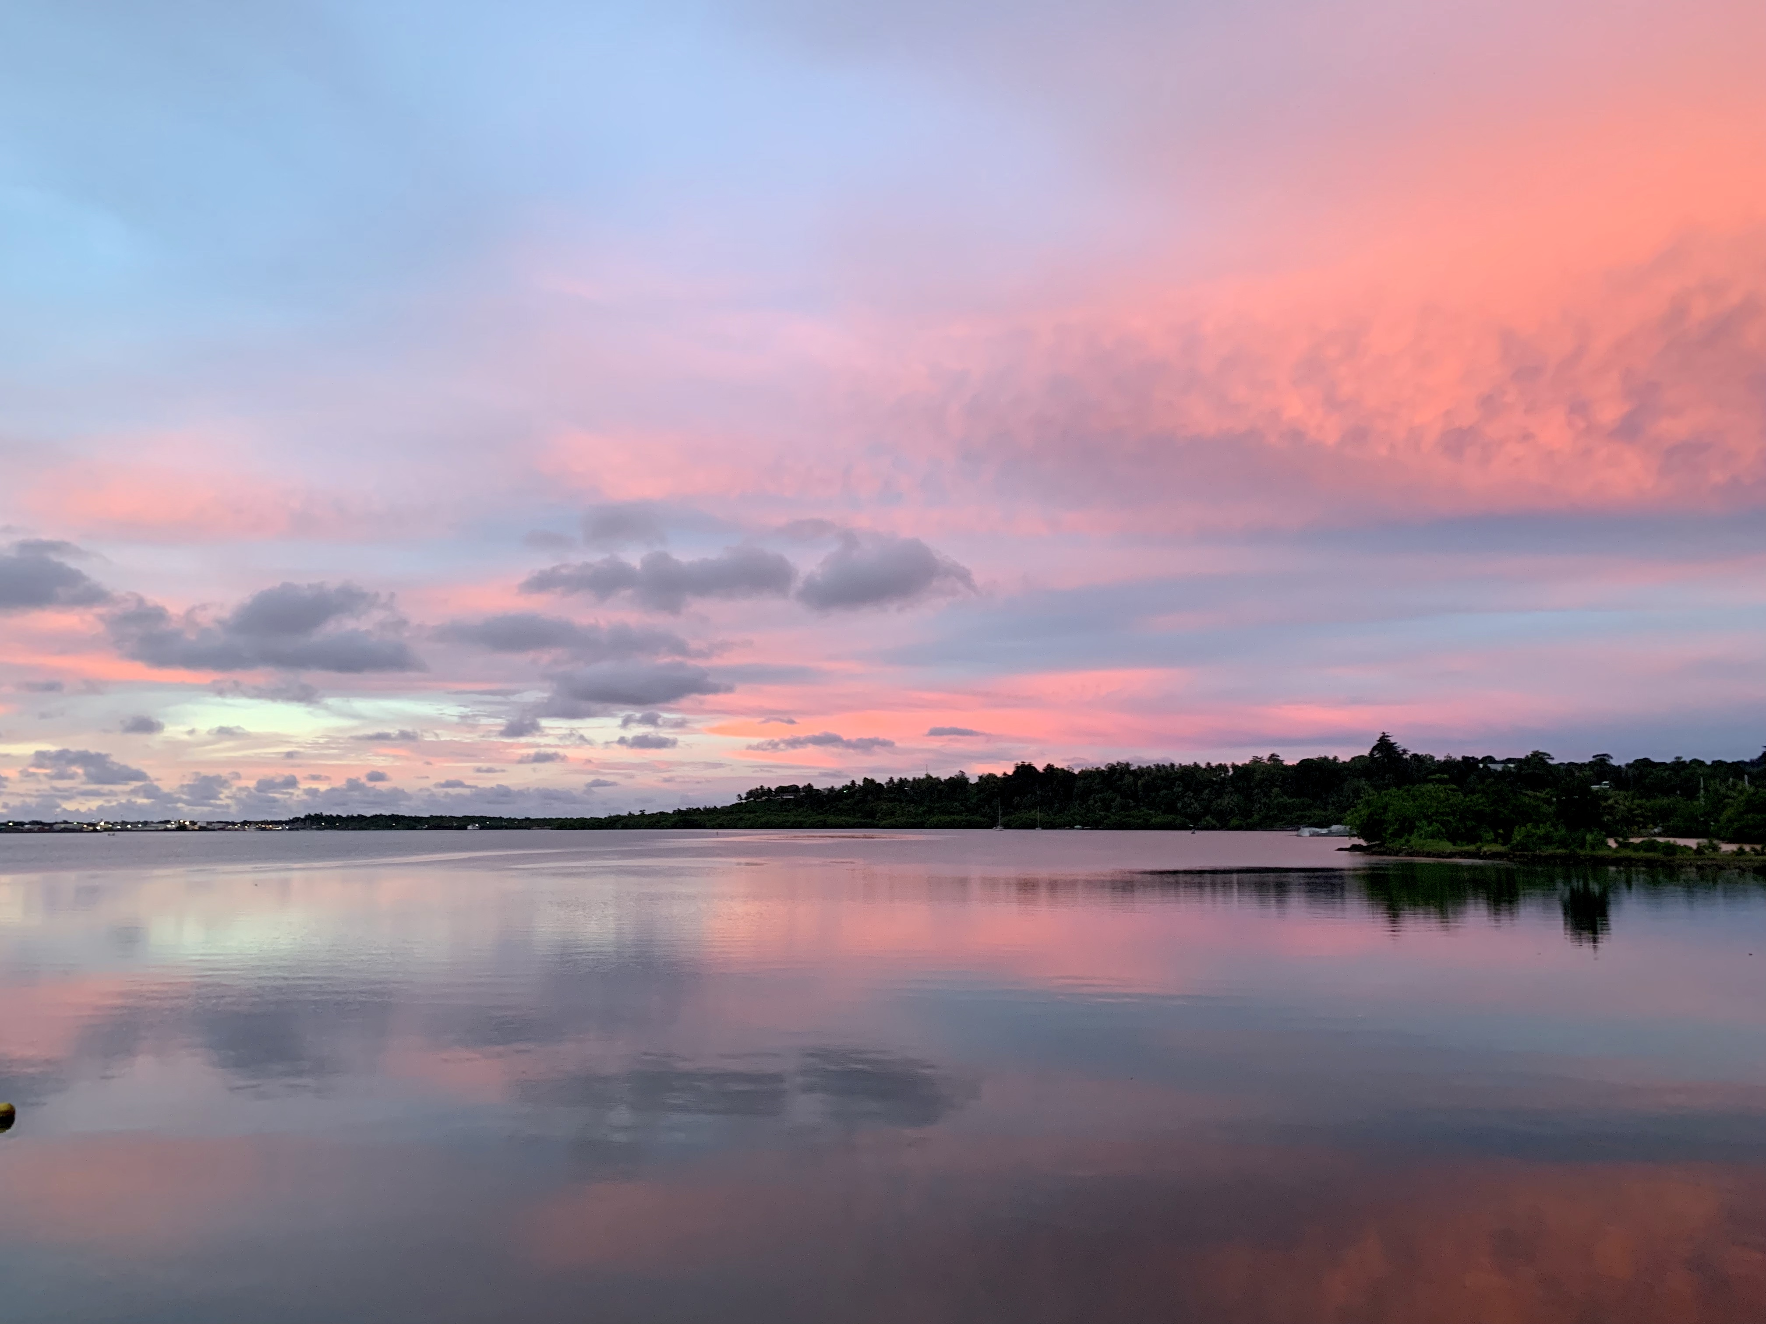



Practical Solutions for Reducing Community Vulnerability to Climate Change in the Federated States of Micronesia
National Implementing Entity , FSM
Notes:
Tam and Shirley representing MCT, FSM’s NIE
Project title: Practical Solutions for Reducing Community Vulnerability to Climate Change in the Federated States of Micronesia

Slide 2
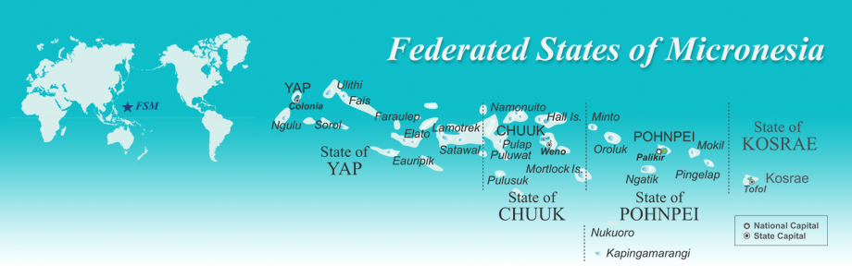
1,000,000 square miles of ocean/607 islands
112,000 people in 4 Island States: eclectic geography, ecology, language and cultures
More than 1,200 species of ferns and flowering plants, 1000 fish species,
350 coral species
More than 80% of communities in the FSM are vulnerable to sea-level rise and flooding: sea level rise has averaged 11 mm per year since 1993
Notes:
While MCT works across the region, this project is for the FSM – here are some specifics about the country.
Most important: Climate change is affecting the marine ecosystems that the people of FSM rely on for their protein and economic well being.

Slide 3
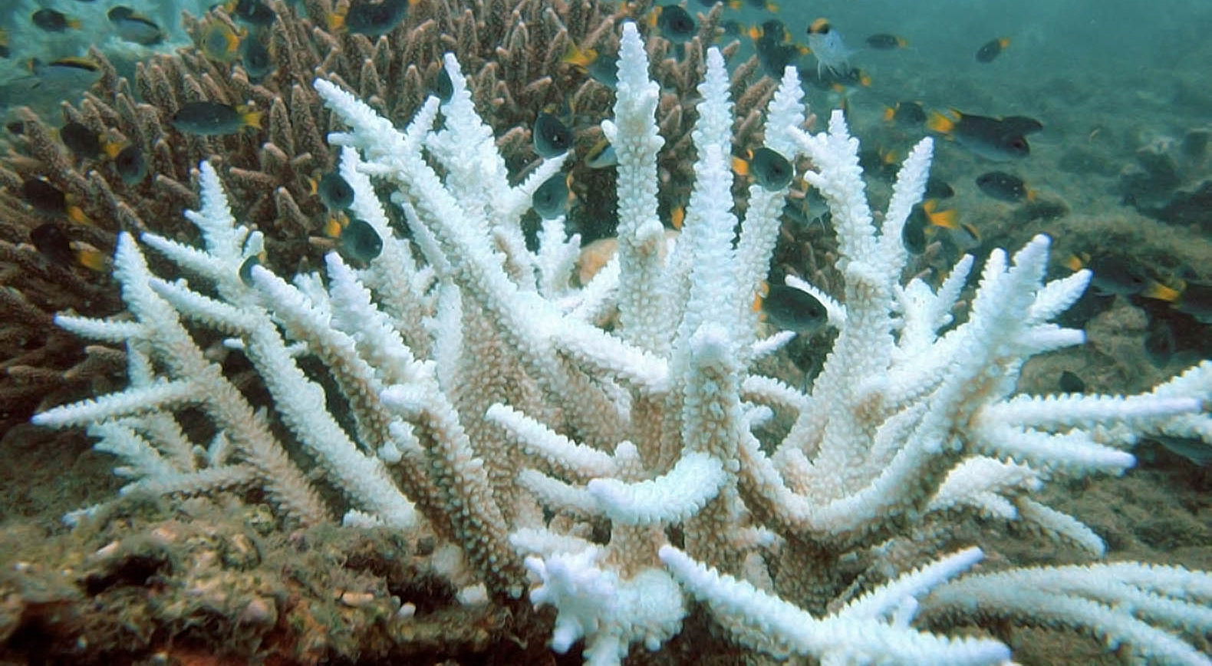
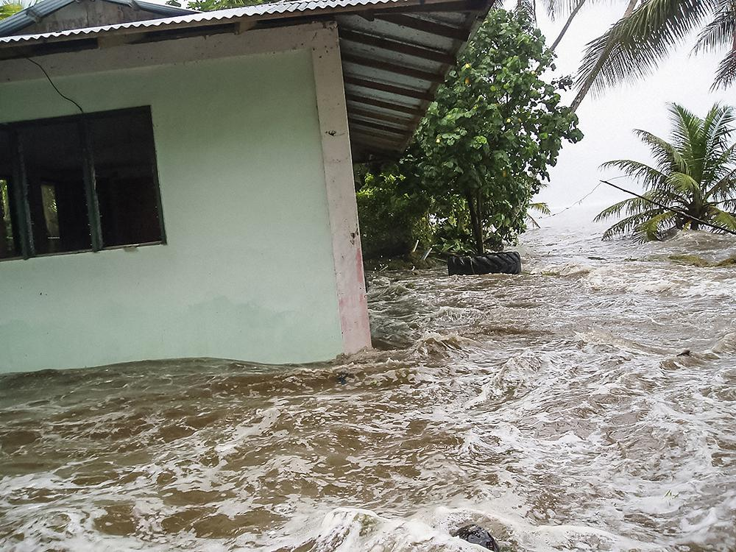
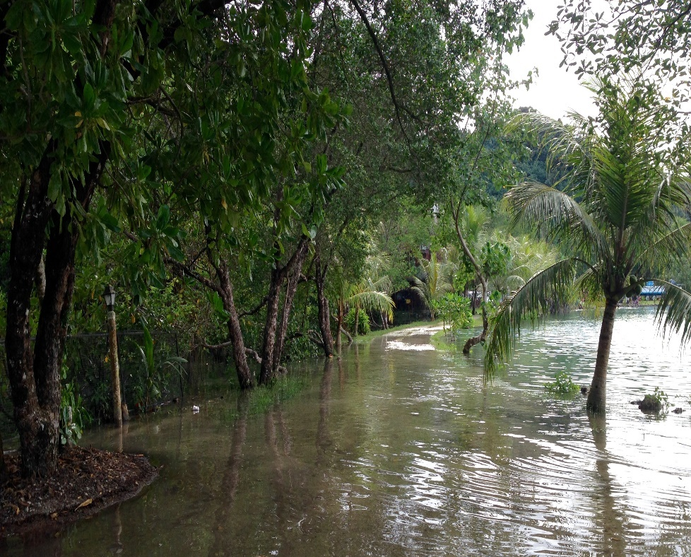
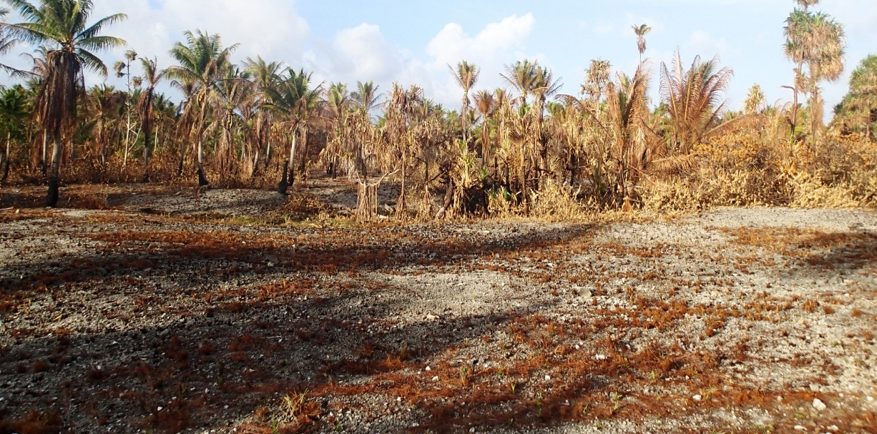
Notes:
This is to show the effects of climate change on the region and the FSM - in particular the top left, coral bleaching is one constant outcome of the rising temperatures in the region.
.

Slide 4
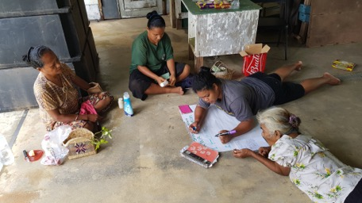
Community Empowerment
Locally Led Adaptation
Projects are in response to community planning, not dictated
Traditional/Local Leadership values locally led initiatives, closer to the problem
Local community empowerment to implement projects and in turn experience higher levels of social cohesion and capacity
Project support is greater, local-led = local buy in
Funds mostly remain in communities
Preservation of traditional values and pride in local culture, TK + science
Capacity building at the local level (planning, project mgmt., financial accountability)
Sustained funding and long term support to communities (long game)
Notes:
We relied heavily on unconventional data gathering and information and this took some time to gather through consultations and research.
Access and Trust
Indicative lists vs actual activities
Accreditation, due diligence
Costs of implementation, isolation
Donor Priorities (be flexible)
Acknowledge established mechanisms
Tangible activities
Ongoing support allowing projects to build off one another
Capacity development
Real transfer of knowledge, technical support mandates
Scholarships, fellowships, shadowing, formal certifications
No magic bullet (trust and patience)

Slide 5

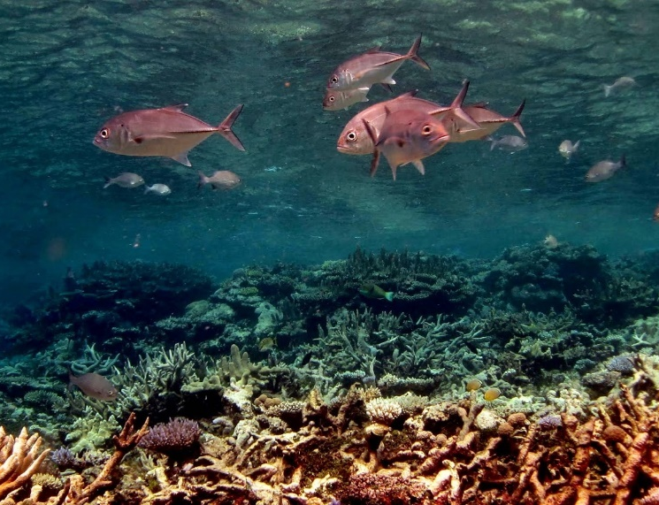
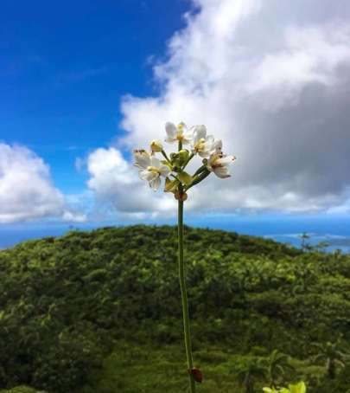
Small Grants Mechanism
Local community organizations, local governments
Identify their own projects priorities, budget, components
Priority to fund actions under already established plans
Nature based (NBS), Eco based solutions (EBA)
Fiscal sponsorship pairing if necessary
Capacity and Technical support from MCT and partners
Notes:
Justifying the climate adaptation rationale of supporting Marine Protected Areas: very unique
Project Outcomes Summary:
Resources for the sustainable finance of the marine ecosystem through protected areas networks
enforcement and policies
funding for small scale eco-system based adaptation projects in communities, positive impacts on health and nutrition
local community empowerment to implement projects and in turn experience higher levels of social cohesion and capacity
preservation of traditional values and pride in local culture
a reduction in the stressors of climate change on the marine ecosystem
Knowledge Management component sharing lessons learned

Slide 6
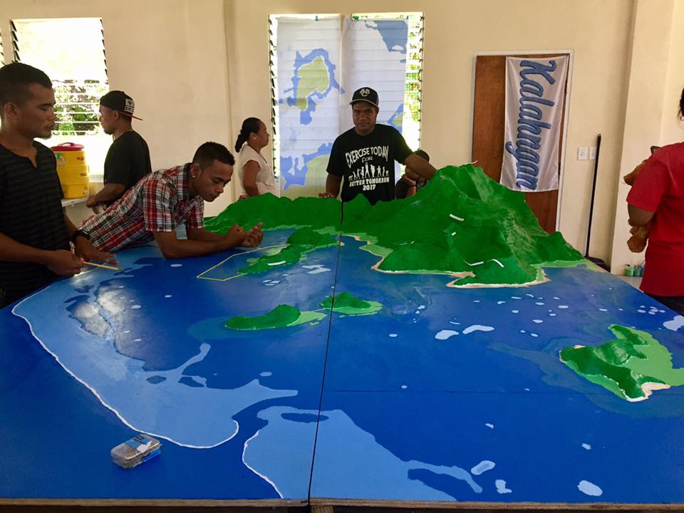
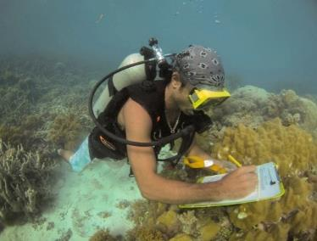
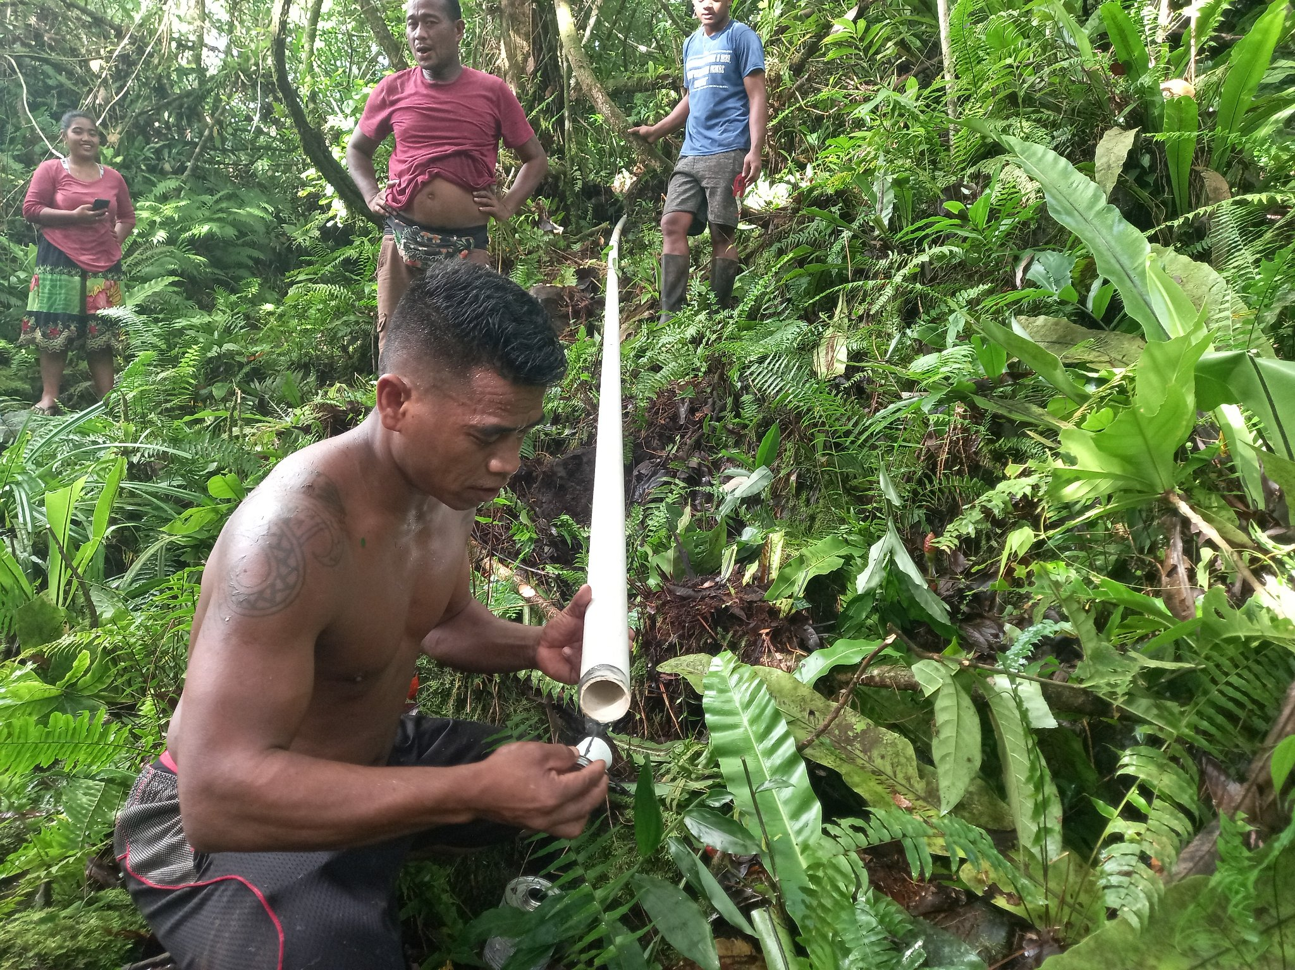
Examples of Small Grants Projects:
Agroforestry for Food Security: increasing nursery capacity to provide seedlings, gardens and livelihoods
Marine Ecosystem Health: Restoring sea cucumber resources
Mangrove Ecosystems: bringing together traditional leaders to design local policy on mangrove protection
Fisheries Regulations: supporting development of local spear-fishing ordinances
Protected Area Awareness: funding the development of locally produced media
Protected Area Development: official designation of marine protected area
Elementary Education: locally developed place-based lessons on conservation in schools
Notes:
Here’s some history on the AF and MCT and our grant
**took over a year to get the project approved, mostly because of questions about the climate rationale**

