Slide 1


“Adapting to Climate Change through Sustainable Integrated Watershed Governance in Indigenous People of Ammatoa Kajang Customary Area in Bulukumba Regency, South Sulawesi Province, Indonesia”
Laode M Syarif, Ph.D
Executive Director

Slide 2
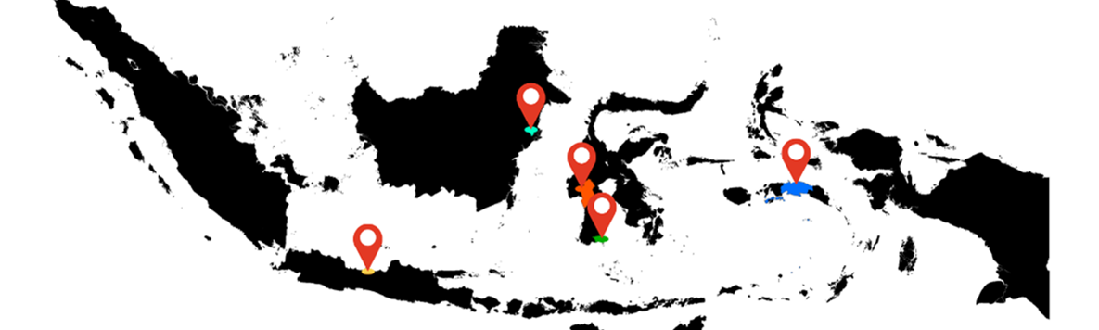
Project Location
Ammatoa
Kajang

Slide 3
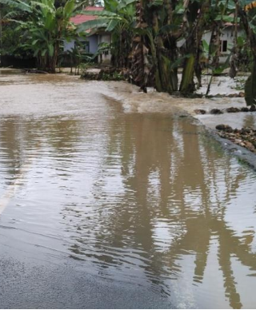
Overall Main Objective
To enhance climate resilience and build adaptive capacity toward climate change for vulnerable community through sustainable integrated watershed governance in Indigenous People of Ammatoa Kajang Customary Area in Bulukumba, South Sulawesi Province.

Slide 4
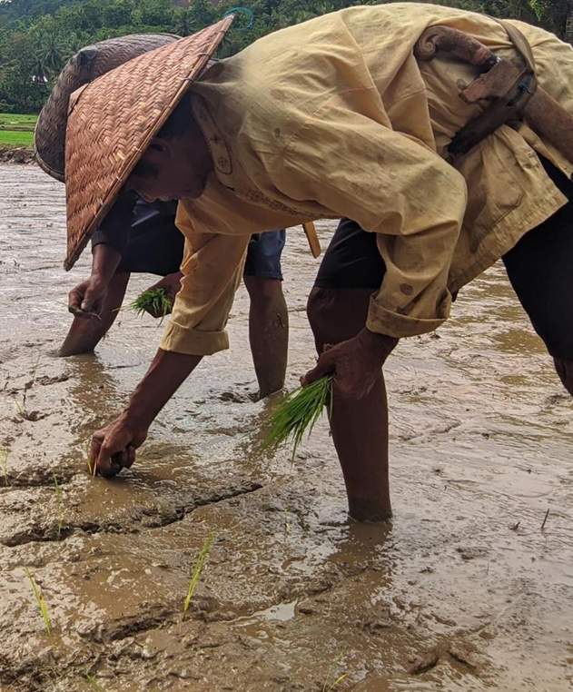
Intended Outcomes
Reduced climate change vulnerability and risk by improving management and governance of watersheds in Indigenous People of Ammatoa Kajang customary area in Bulukumba.
Enhanced resilience of people in Indigenous People of Ammatoa Kajang customary area with climate adaptive sustainable livelihood development and climate mitigation actions.
Advanced Sustainable Integrated Watershed Governance adaptive to Climate Change on regency development planning and development budgeting in Bulukumba regency;
Raising awareness and Increased knowledge of local people on the importance of watershed and climate change impact.

Slide 5
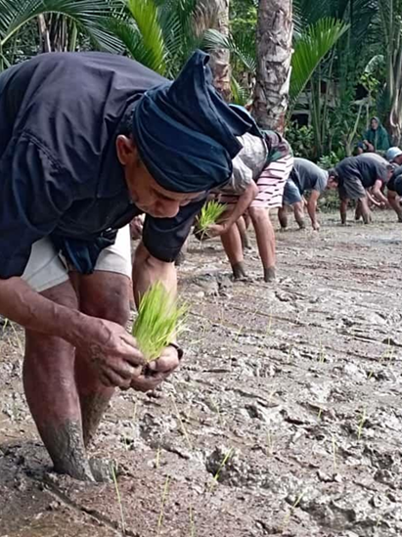
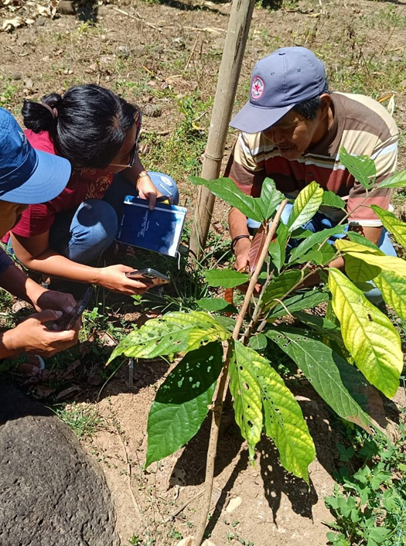
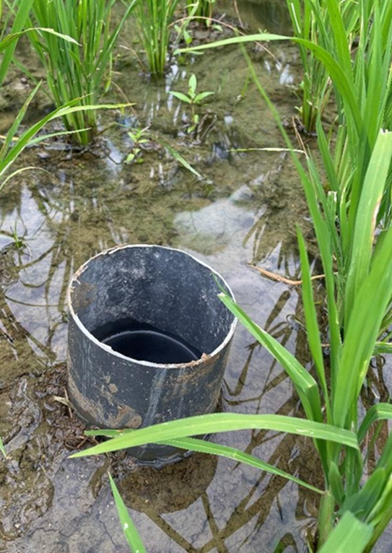
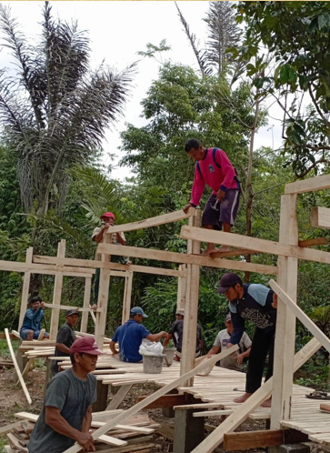
Introduction of the ‘New Innovation’
Intensive Rice Planting System and Water Measurement
Cross-Breeding: Top Grafting Technique of Cacao and Nutmeg to Indigenous Community.
Elevated Goat Pen
Sustainable Integrated Watershed Governance

Slide 6
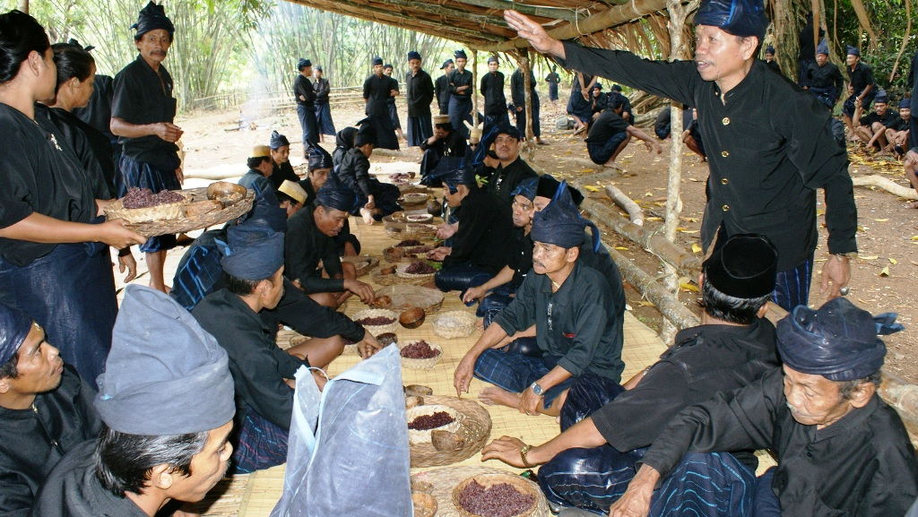
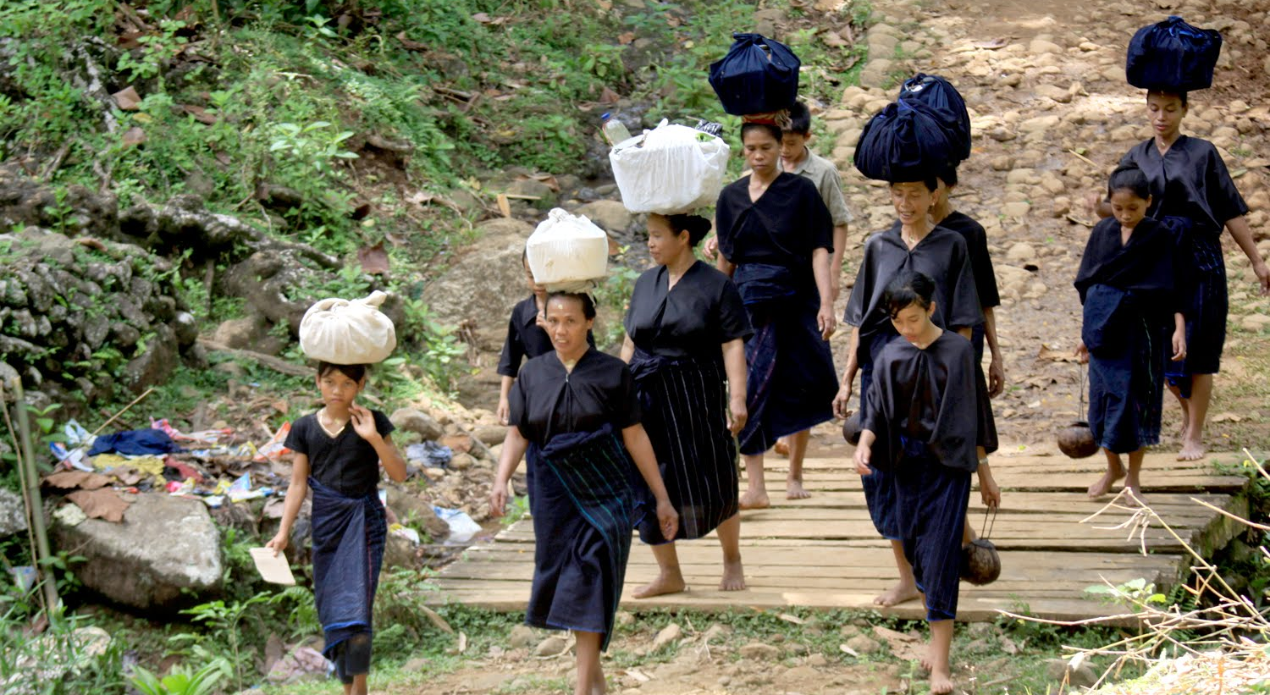
Innovation Challenges
Balancing the introduction of “Innovative Approach” and “Preserving Traditional Wisdom” of the Ammatoa Kajang Community.
Wining the heart of Indigenous people to accept new ‘technique & approach’
SPECIAL NOTE:
Kajang Tribe or Konjo People are inhabited a particular
area in the forest. Kajang was divided into two sub-groups called Konjo Pegunungan (Mountain Konjo) and Konjo Pesisir (Coastal Konjo) or inner .

Slide 7
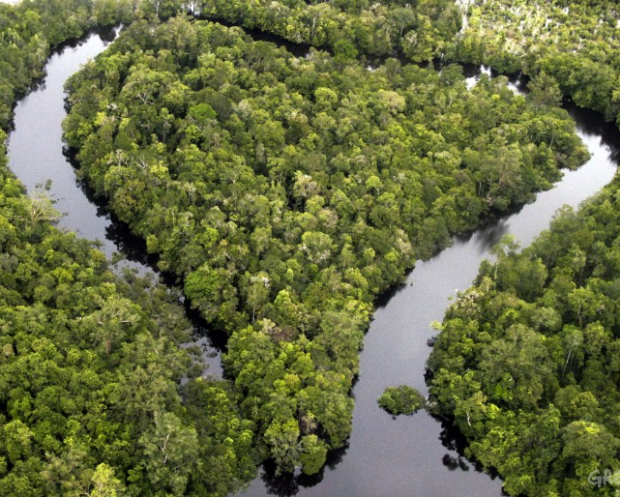
-TERIMA KASIH-
Twitter @LaodeMSyarif www.kemitraan.or.id

