Slide 1
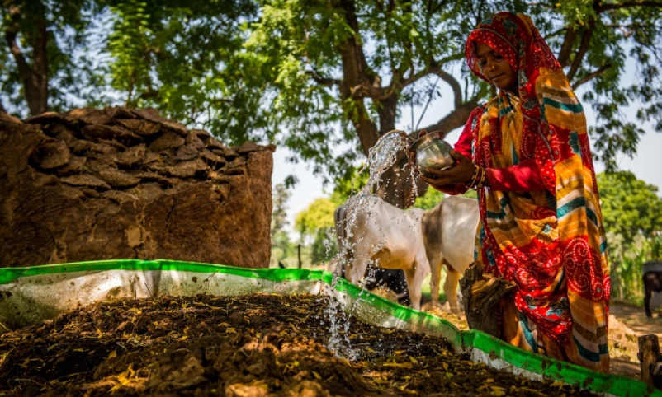


Empowering Local Communities & Integrating Indigenous Knowledge into Adaptation Strategy in India
Adaptation Futures 2023
Side Event | Oct 06; Montreal, Canada
CONTENT: -
About Development Alternatives
Adaptation Strategy of India
About the Evaluation
Learnings & Recommendations
Beyond Adaptation:
  Adaptation-Mitigation Strategies and Loss & Damage

Slide 2
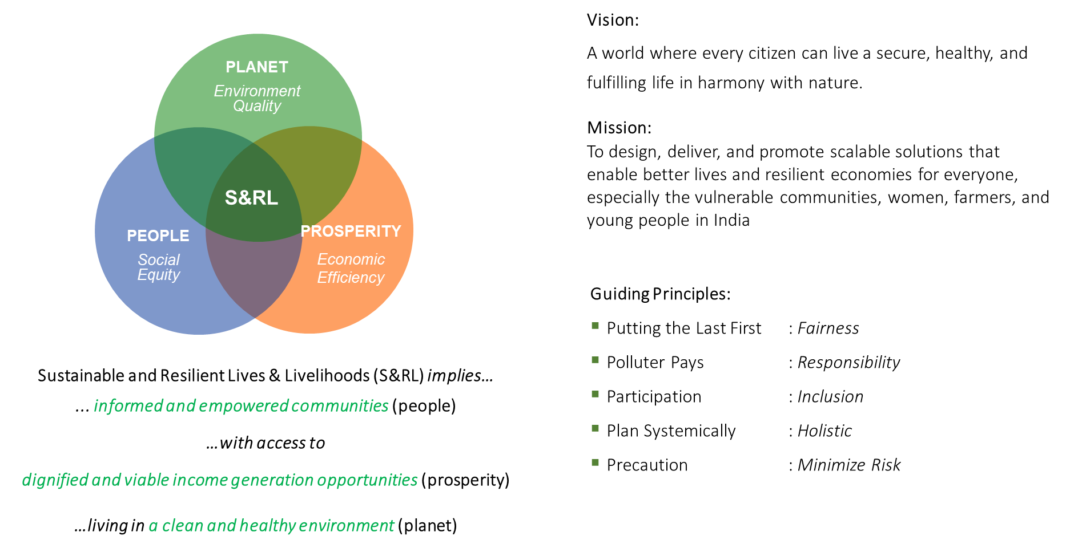
Adaptation Futures 2023
Side Event | Oct 06; Montreal, Canada
Development Alternatives Group
New Delhi, India

Slide 3
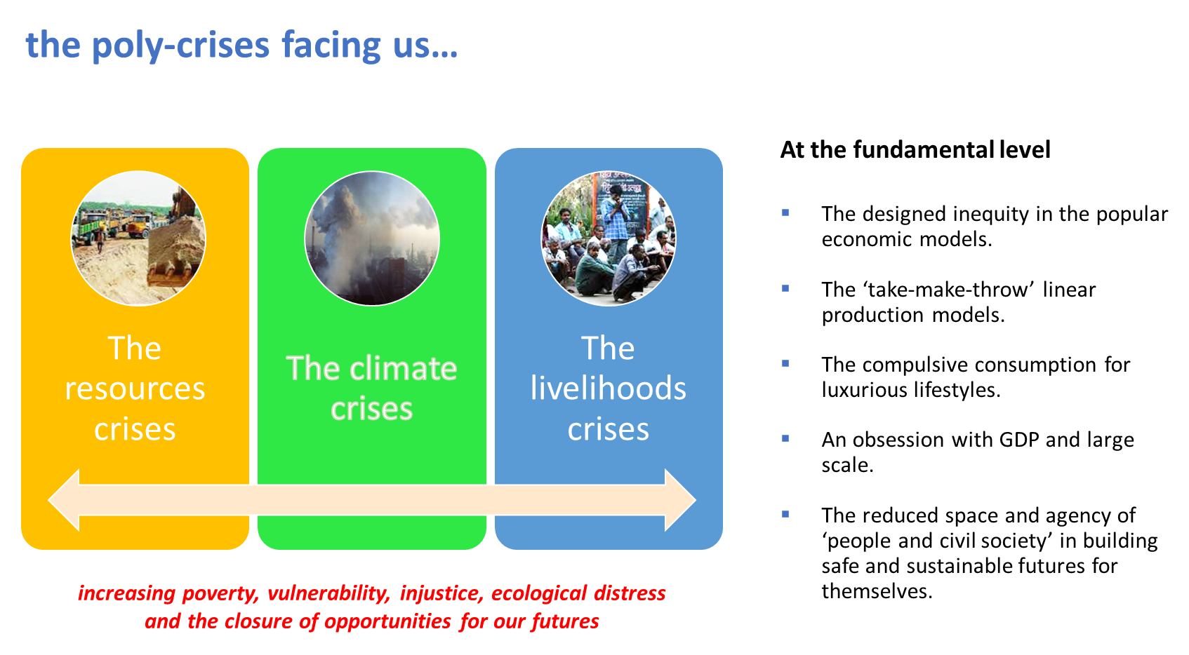
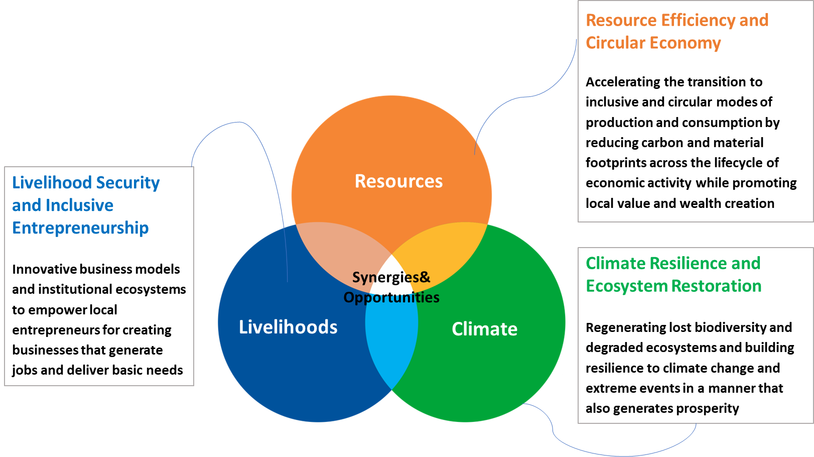
Adaptation Futures 2023
Side Event | Oct 06; Montreal, Canada

Slide 4









India’s Nationally Determined Contributions (NDCs) identify seven priority areas for adaptation and resilience building:-
India is the 7th most vulnerable country globally with:-
Adaptation Futures 2023
Side Event | Oct 06; Montreal, Canada
Coastal Regions and Islands
Agriculture
Water
Health
Disaster Risk Management
9 States
featuring among the top 50 vulnerable States across the world.
Biodiversity and Ecosystem
Rural Livelihoods & Security
These are reflected in the eight missions of the National Action Plan for Climate Change (NAPCC)* and are woven under national programmes such as:-
4-8% of GDP
Being lost to India on an annual average basis due to slow-onset calamities, extreme events and biological hazards.
1. The Mahatma Gandhi National Employment Guarantee Act (MGNREGA)
2. National Afforestation and Eco-Development Programme
3. Urban Rejuvenation Mission and Shyama Prasad Mukherji R-Urban Mission
Adaptation Fund in India
Total Sanctioned Grants to India: US$ 9,860,436
Total Projects: Six
Project Period: 2015 to 2020
1.6% of GDP
Or US$43.3 billion being the total climate adaptation cost required for cascading natural and biological hazards in India.
NABARD’s adaptation strategy to climate change emphasises on “enhancing livelihoods and quality of life of the rural community through improved resource access and peoples’ participation in their management.”
National Implementing Entity (NIE) for Adaptation Fund in India
Source: UNESCAP Risk & Resilience Portal and German Watch
* National Solar Mission, National Mission for Enhanced Energy Efficiency, National Water Mission, National Mission for Sustaining the Himalayan Ecosystem, National Mission for Green India, National Mission for Sustainable Agriculture, and National Mission on Strategic Knowledge for Climate Change.
Notes:
Introductory Slide:-
Climate vulnerability of India → What are the priorities identified to address it? → How is adaptation fund contributing to this?

Slide 5
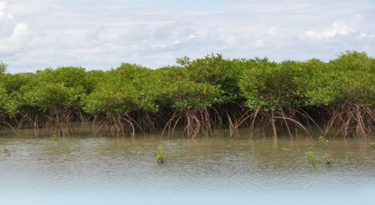
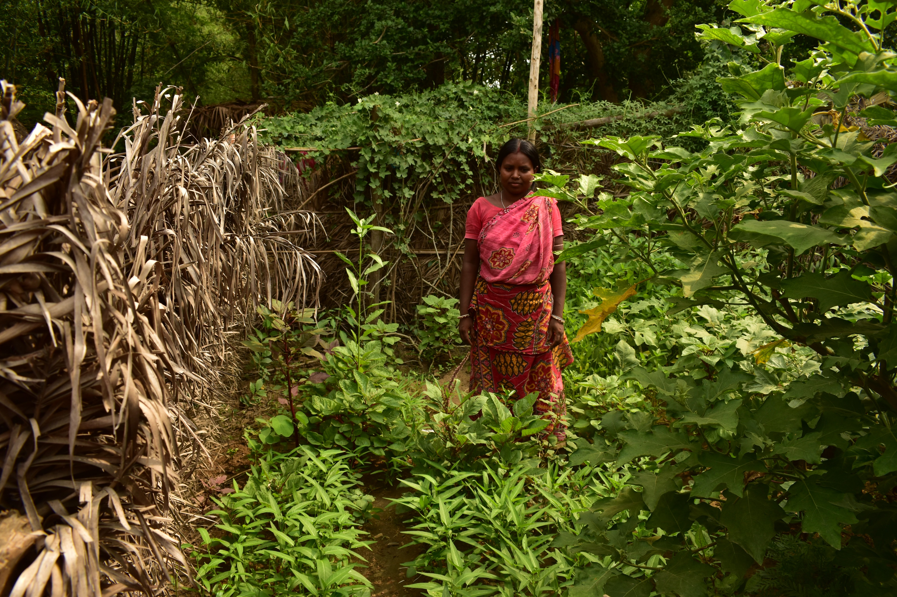
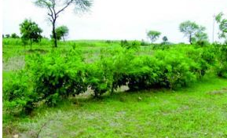
AF-Funded Projects in India
Evaluation by Development Alternatives with
Climate Action Network – South Asia (CANSA)
Adaptation Futures 2023
Side Event | Oct 06; Montreal, Canada
Coastal Ecosystem Management
1 Project in Andhra Pradesh
PROJECT SNAPSHOT
Project: Evaluation of AF-Funded Projects in India
Objective: Drawing recommendations to ensure that the interests of the most vulnerable are reflected in the AF project implementation.
Project Duration December 2018 – February 2020 (14 Months)
Project Location: AF-Funded Project Geographies
Methodology: Field visits, with data collection using the M&E Score Card developed by the Adaptation Fund NGO Network
Agriculture, Forestry & Livelihood
4 Projects in WB, MP & Uttarakhand
Inclusion at the Project Design Stage
Participation of vulnerable groups at the designing stage, communication of project progress to them, adoption of Gender Sensitive Approach, sustainable project outcomes, embedding in local policy
M&E Score Card
By Adaptation Fund NGO Network
Inclusion at Project Implementation Stage
Participation of vulnerable groups in the implementation stage, communication of project progress to them, the responsiveness of IA to feedback by local communities, timely delivery, financial accountability, adoption of a Gender-Sensitive Approach, and transparent implementation.
Water Resources Management
1 Combined Project in RJ & TN
Notes:
What did we do? Evaluating AF Funded Projects in India
Why did we evaluate? To check for and ensure representation of vulnerable communities in the AF-Funded Projects
Where did we evaluate? Project Locations
How did we evaluate? M&E Score Card by AF NGO Network

Slide 6
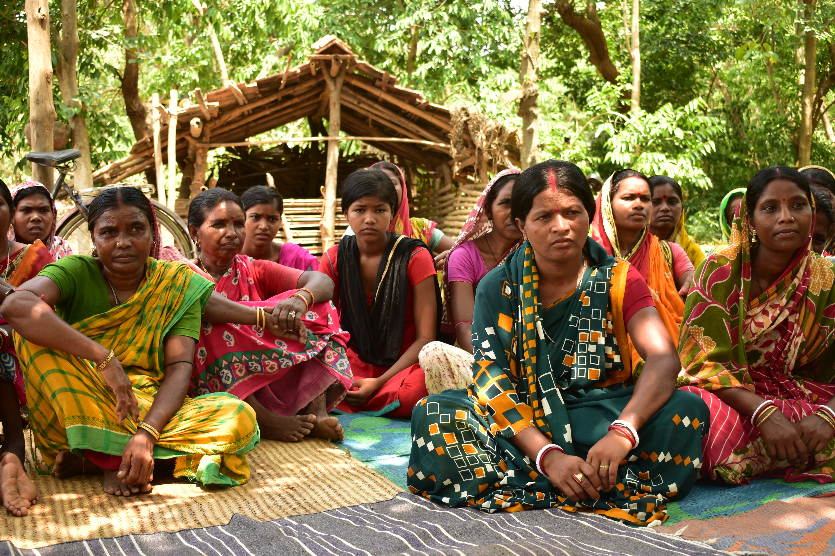
Findings from the Field for Community Empowerment and Integration of Indigenous Knowledge
Recommendations
for Improving Community Empowerment & Integration of Indigenous Knowledge in the AF-Funded Projects
Adaptation Futures 2023
Side Event | Oct 06; Montreal, Canada
DRIVERS: -
Community’s recognition of the urgency to act against climate change due to past losses of life and property;
Close-knit communities – efficacy of involvement of women as mobilisers for other women and vulnerable groups;
BARRIERS: -
Less than optimum involvement of local authorities in the intervention;
Data gaps, disabling pattern identification on local vulnerabilities for solution building;
RISKS: -
Undocumented indigenous knowledge and information loss;
IDENTIFIED BEST PRACTICES: -
Creation of Fisherfolk Committees for decision-making, with 1/3rd representation of women.
Setting up Community-based Grain Banks with 25 households to ensure food security during the shortage cycle, with youth and local women in charge.
Setting up Climate Advisory Services for timely information on weather-related changes/risks.
STRENGTHENING DRIVERS:-
Participatory Land Use/Cover Mapping: knowing your land and water​;
Provisions of Climate Advisory Services in local language;​
Starting the gender-inclusive conversation at the beginning, adopting a bottom-up approach​;
ADDRESSING BARRIERS:-
Involving policymakers right from the planning stage and communicating progress in a regular manner​;
Improving M&E through:-
  Defining ‘gender-sensitive’ and ‘vulnerable groups’ for removing subjectivity in the evaluation;
  Evaluating the inclusion of women not only as participants but also as decision-makers, including as a part of the supervising team from NIE & AF.
  Regularizing assessments and developing Data Banks/ Dashboards for monitoring by the AF, NIE and the local community themselves.
MANAGING RISKS:-
Developing Digital Libraries for documentation of indigenous knowledge and practices;

Slide 7
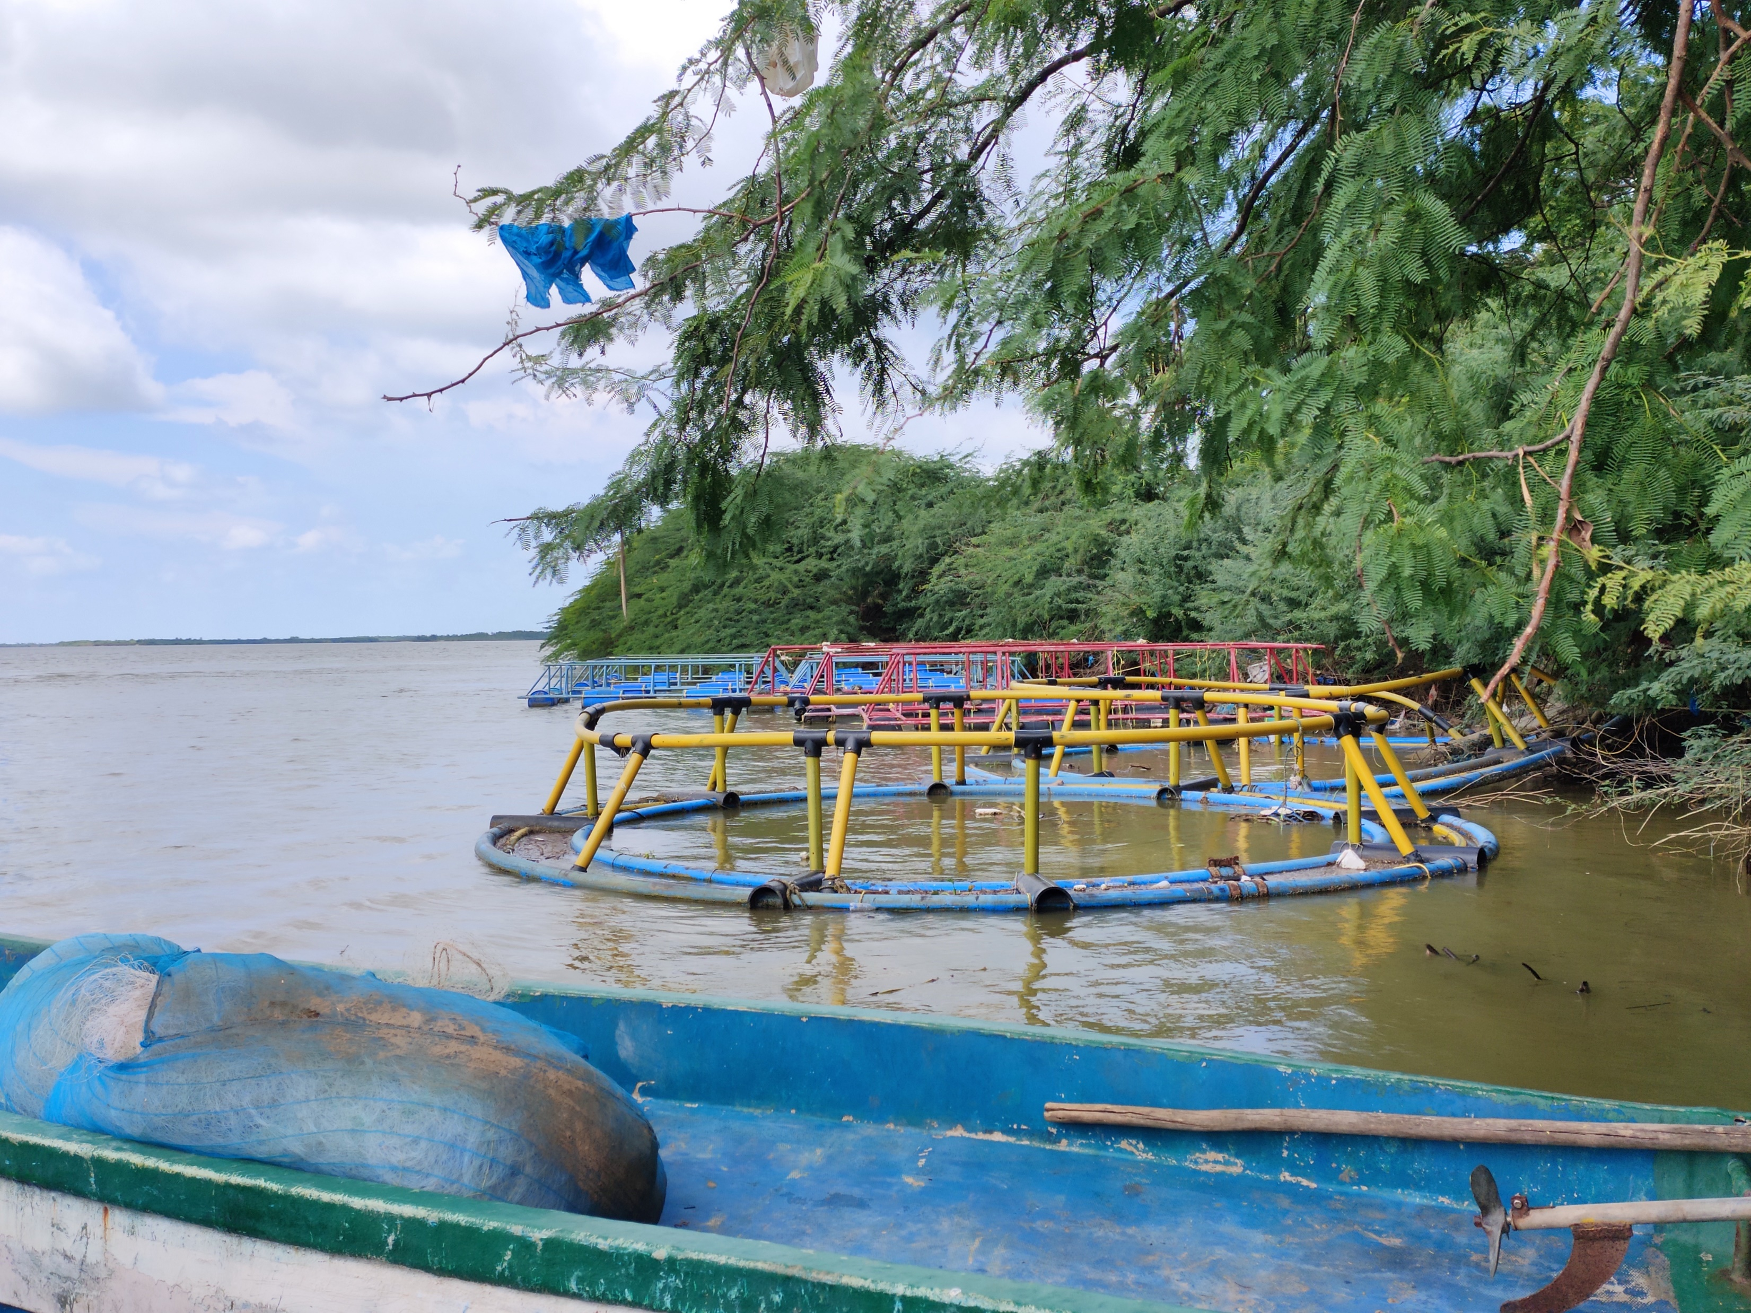
Beyond Adaptation:
Multiple Benefits – Ad-Mit. Strategies
Adaptation strategies offer tremendous scope for “greener development trajectories and therefore offer mitigation benefits.
Economic diversification based on renewable energy, low-input agriculture practices and restoration initiatives which bring in sequestration benefits can be aggregated for co-financing through carbon credits.
Adaptation Futures 2023
Side Event | Oct 06; Montreal, Canada
India’s development trajectory requires all interventions to be ‘climate resilient, greener, circular and inclusive – calling for ‘ad-mit’ strategies at community as well as industrial levels.
Managing Loss & Damage
Building adaptive capacity or reducing vulnerability is a slow and steady process.
Adaptation may be ineffective where the vulnerability needs immediate resolution – ex. coastal inundations.
The negative impact (economic and non-economic) of climate change that occurs despite or in the absence of adaptive or mitigation measures is Loss & Damage.
Knowledge and cultural practice loss is critical within non-economic or soft loss and damage.
T H A N K Y O U .
India’s adaptation strategy in general, and AF-funded projects in specific, offers a scope of incorporating loss and damage to make climate action inclusive and just.
Notes:
Concluding Slide -

