Slide 1
BTFEC’s Experiences Implementing Adaptation Fund (AF) Funded Projects (Knowledge Fair, Country Exchange Program, Tanzania (13-17 May 2024)
^{17th May 2024}

Slide 2
Presentation Outline
AF NIE in Bhutan: BTFEC
Relevant project pictures and videos
Lessons from the results of their interventions to address identified challenges
Purpose of the Project
Challenges faced in design & implementation and ways in which they were addressed

Slide 3
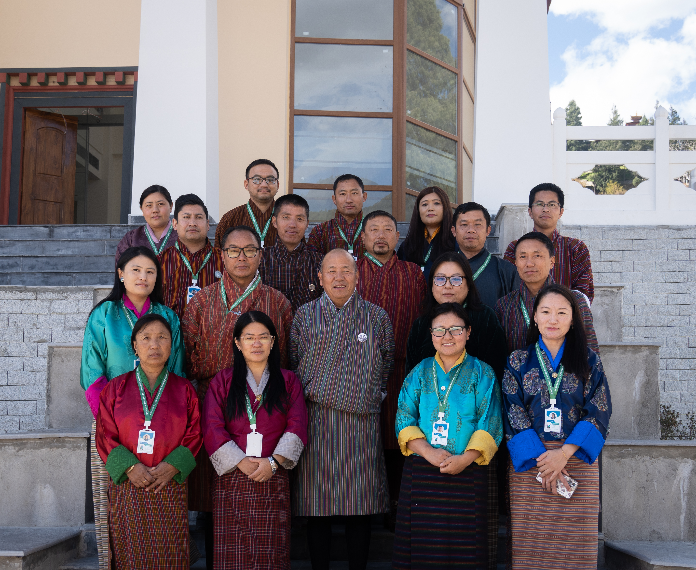
AF NIE in Bhutan: BTFEC
BTFEC established in 1991
Independent grant making organization
Incorporated under Royal Charter 1996 : Royal Charter 2021
Date of first accreditation: 25 January 2018
Date of first re-accreditation: 7th February 2024
Accreditation expiration date: 7th February 2029
Modality: Regular accreditation
Project size: Micro, up to USD 10 million
Projects/Proposals approved: 3

Slide 4
Purpose of the Project
Funding window | Project name | Year of approval | USD amount
Readiness grant | Technical Assistance Grant for ESP and Gender (TA-ESGP) | 2018 | USD 50,000
Regular project | Building Adaptive through Innovative Management of Pests/Disease and Invasive Alien Species (IAS) in Bhutan to Enhance Sustainable Agro-Biodiversity and Livelihoods (MB214Y22) | 2022 | USD 250,000
Regular project | Adaptation to Climate-Induced Water Stresses through Integrated Landscape Management in Bhutan | 2023 | USD 9.99 m

Slide 5
Challenges faced in design & implementation and ways in which they were addressed
Challenges
Inadequate capacity to develop proposal.
Covid 19 and the associated hinderances
Cost Escalation
Remote and scattered project site and beneficiaries
Measures
Outsourced to Experts.
Consultations at all levels
Instituted PSC to address the challenges & emerging issues
Used GIS for design and survey
Create new window for supplementary grants in AF

Slide 6
Lessons from the results of their interventions to address identified challenges
Inhouse capacity development necessary based on the project components.
Stakeholder consultation from designing to the project completion.
Engagement of project beneficiaries is crucial to empower and enhance sense of ownership.
Timely participatory monitoring (compliance/performance) of the project activities is crucial.
Knowledge & experience sharing amongst the project implementers is vital including engineers/supervisors & contractors.
Proper communications amongst stakeholders between NIE, NDA, executing entities & beneficiaries. (i.e social media group)

Slide 7
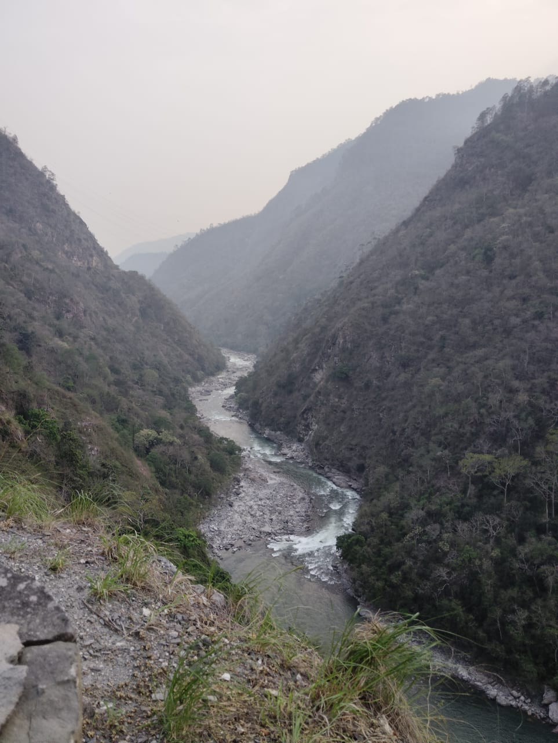
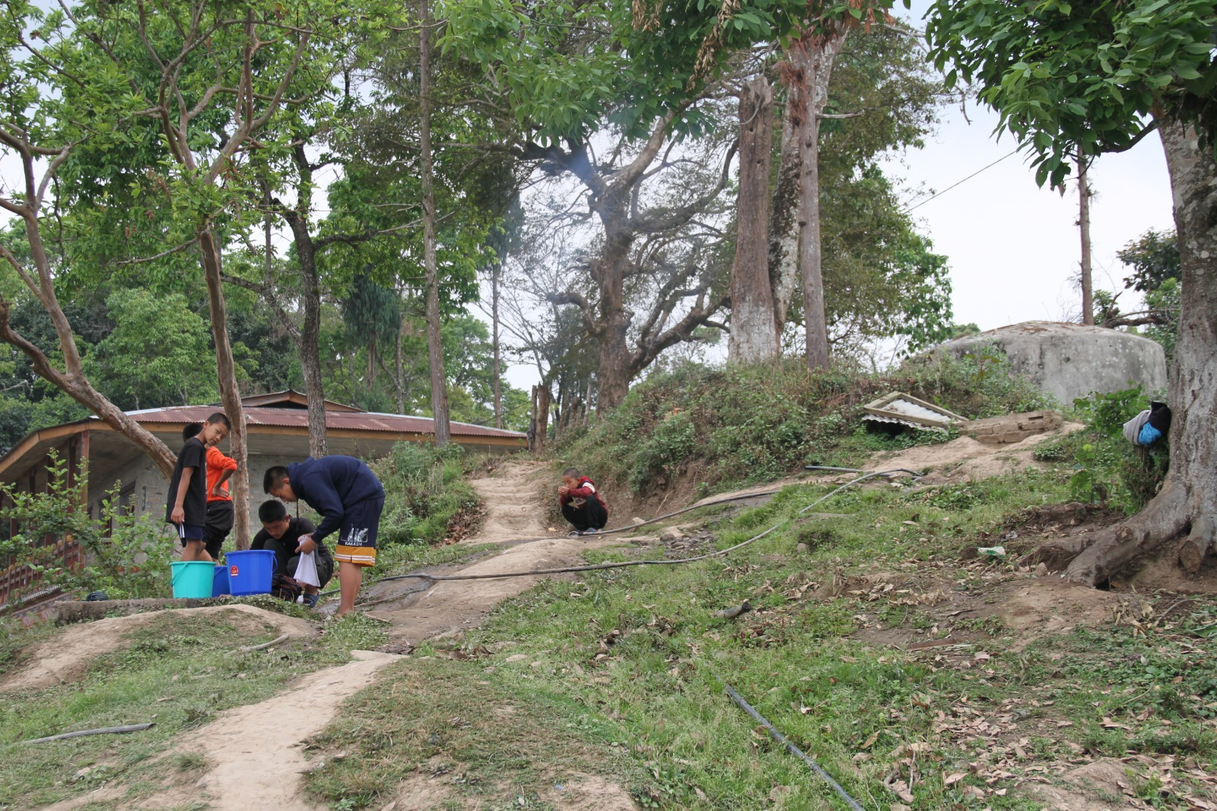
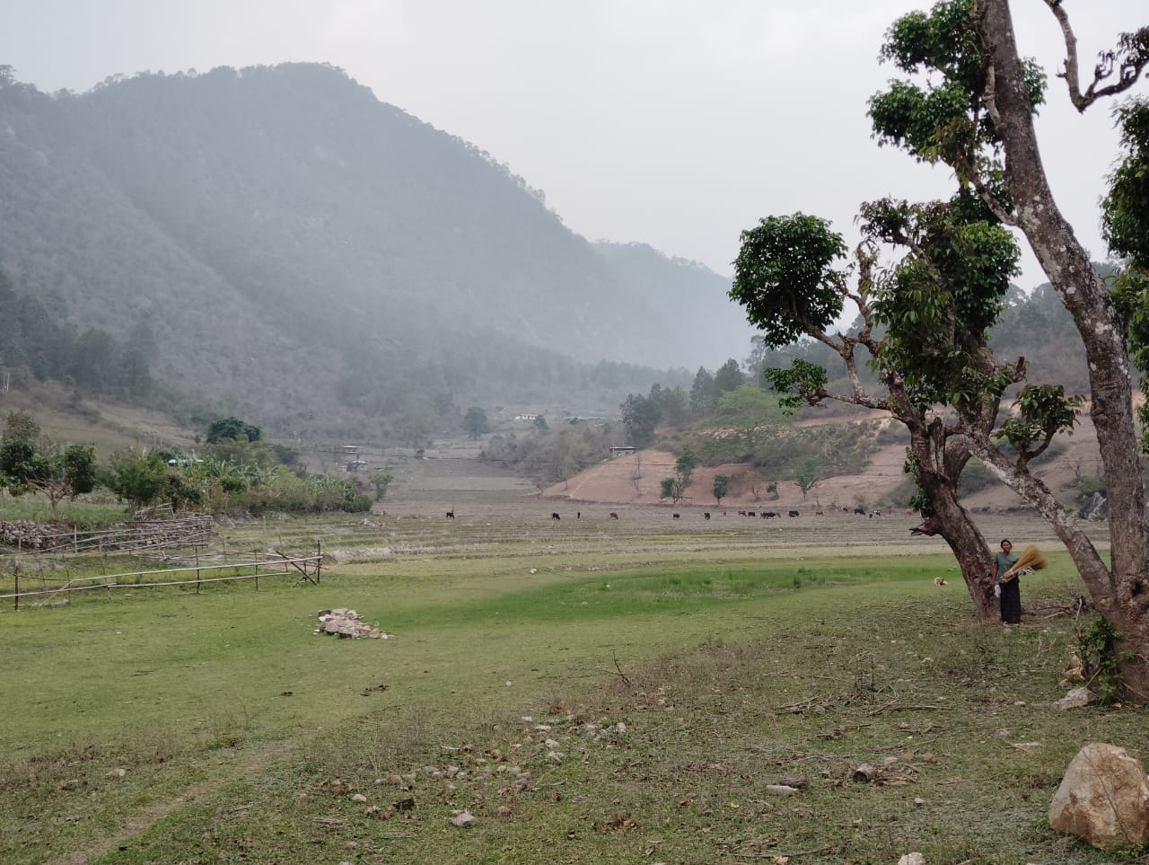
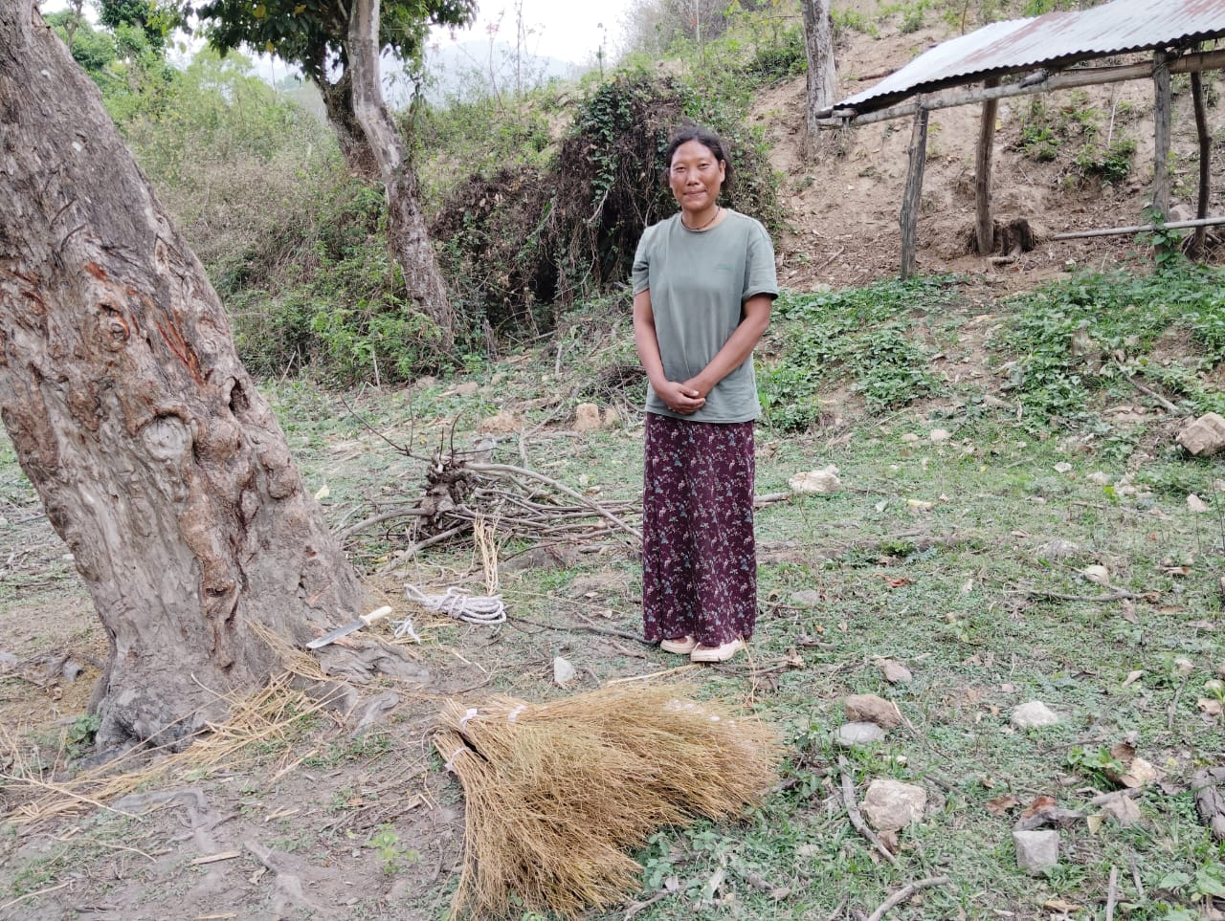
Relevant project pictures

Slide 8
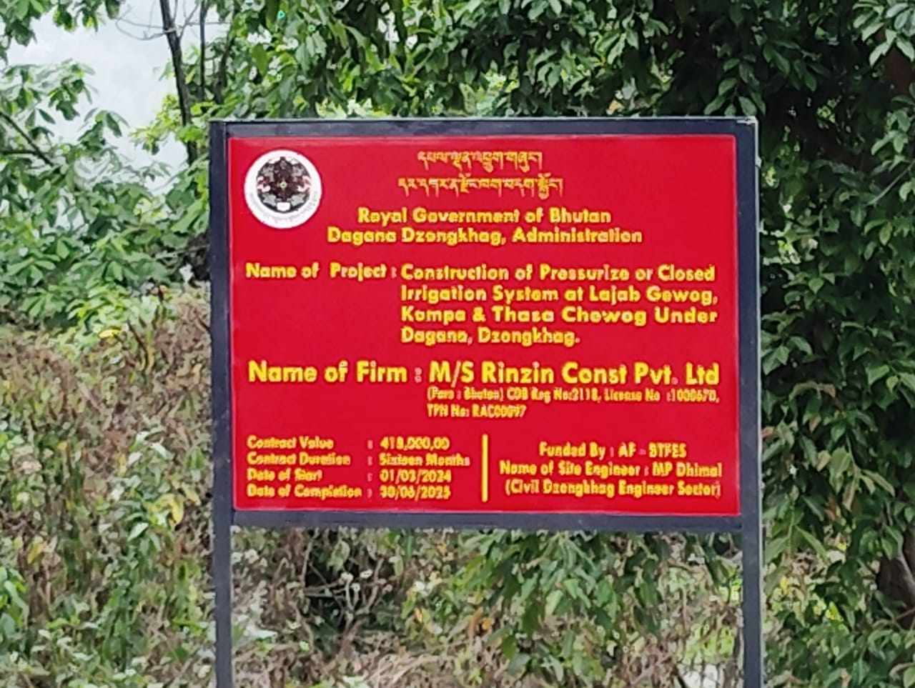
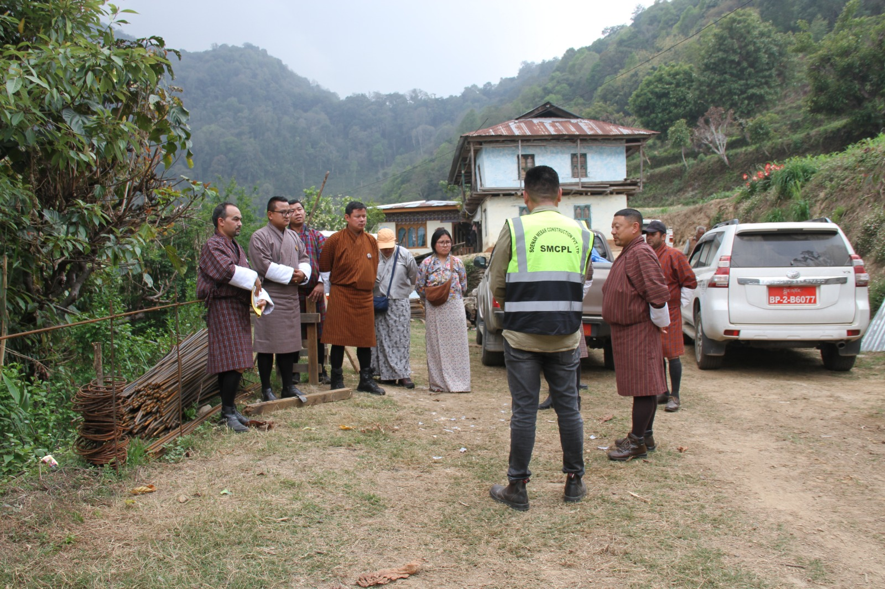
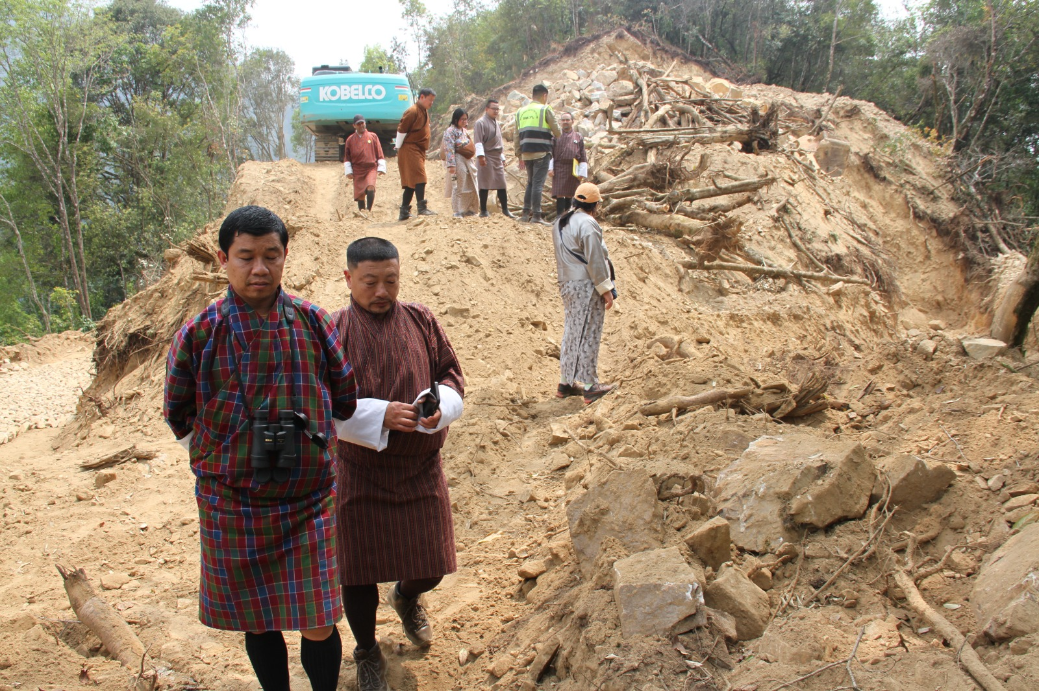
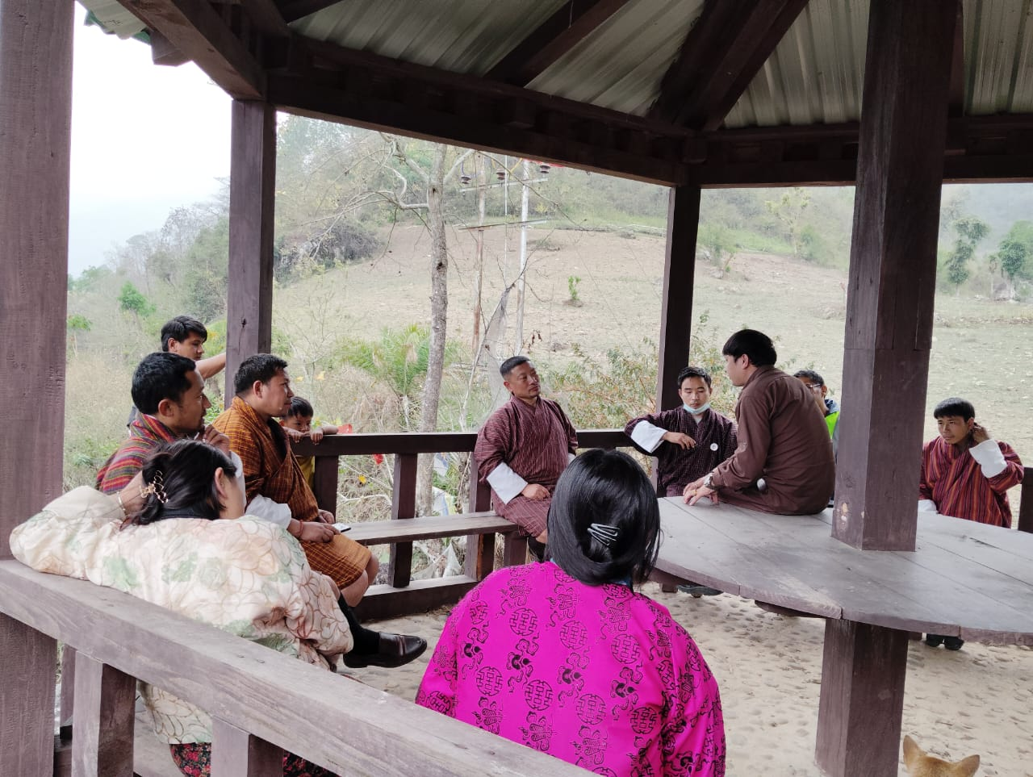
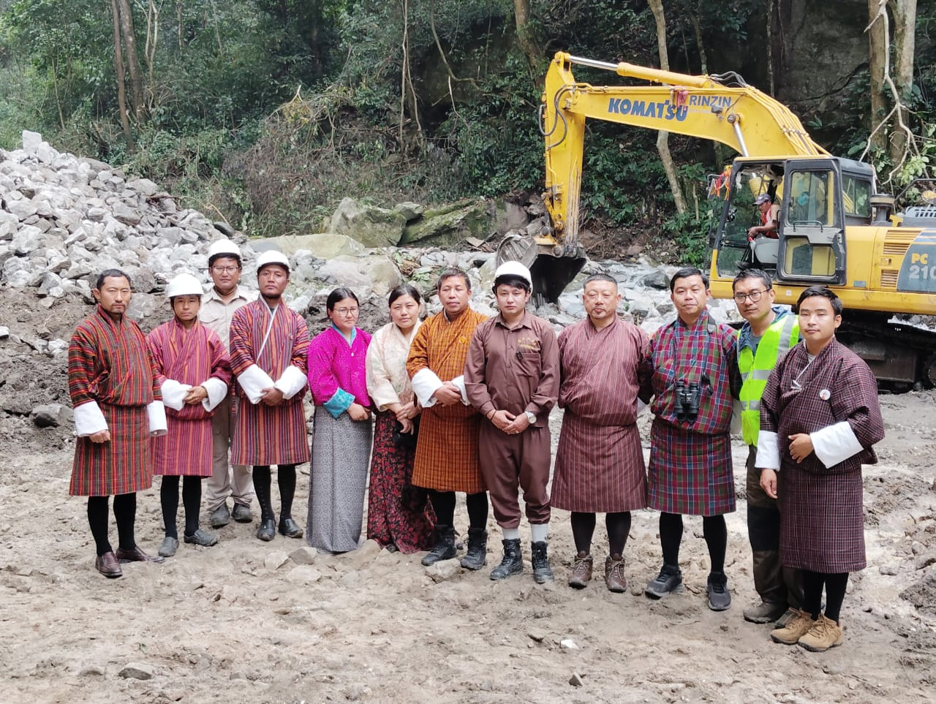
Relevant project pictures

Slide 9
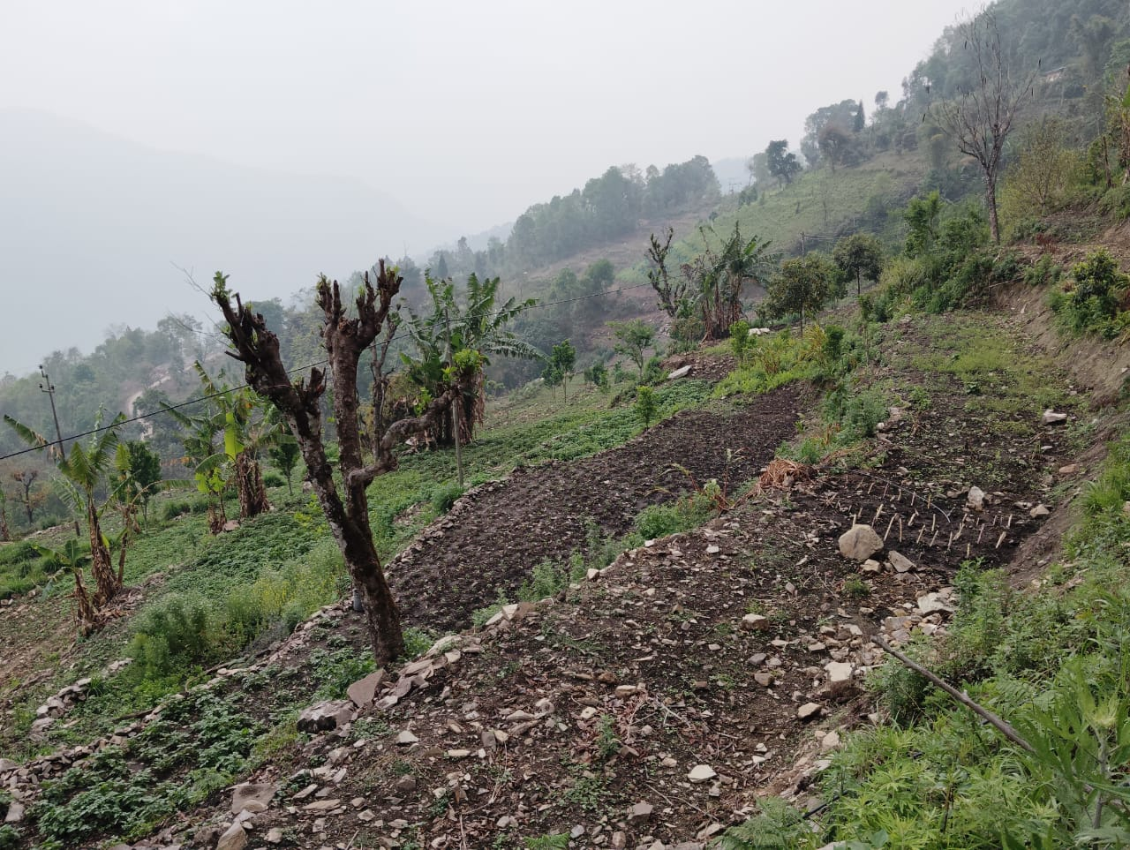
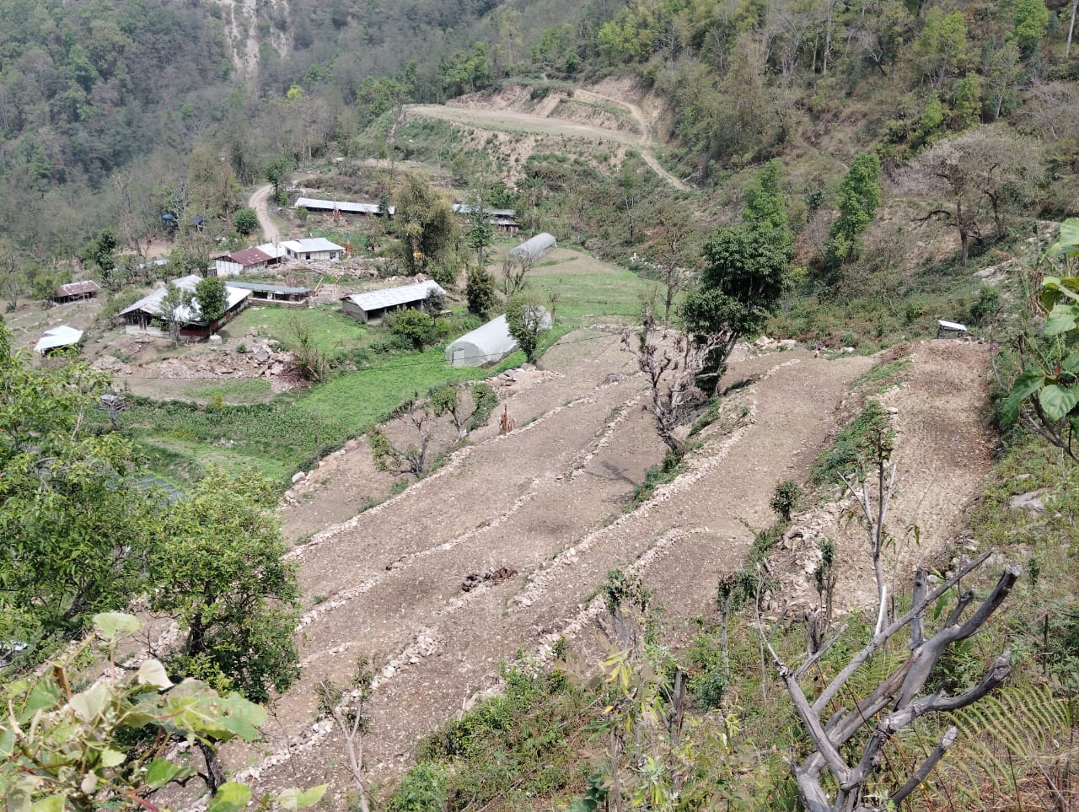
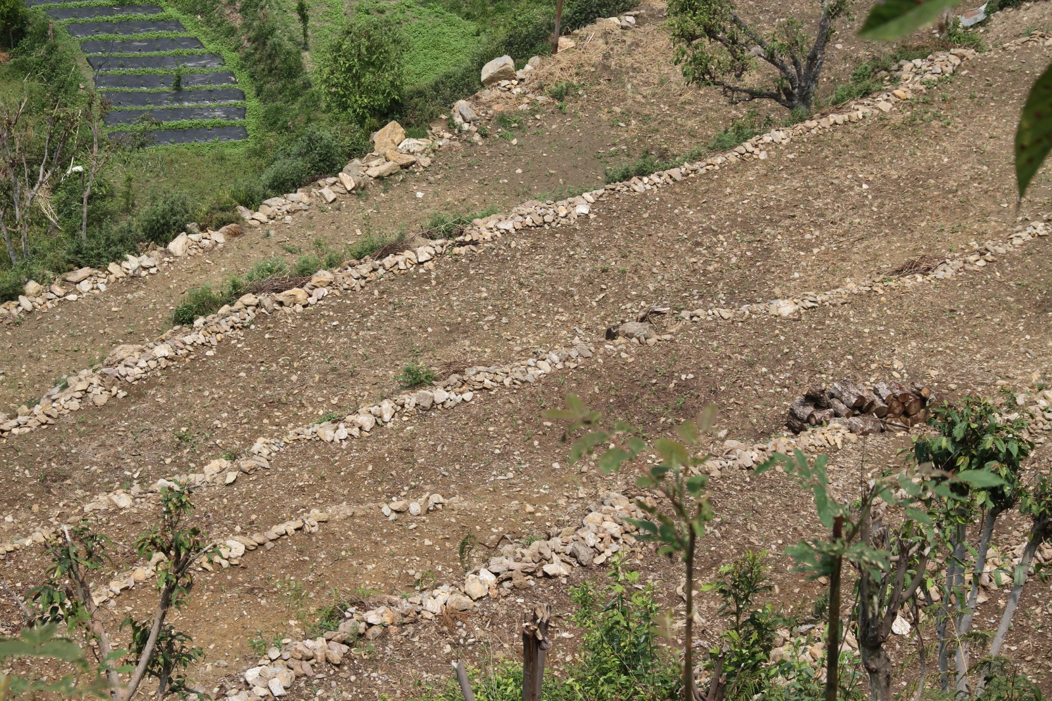
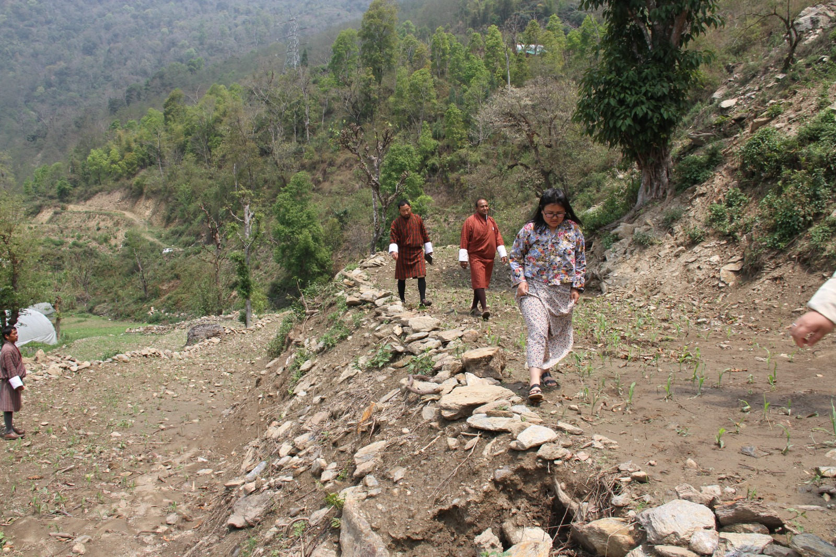
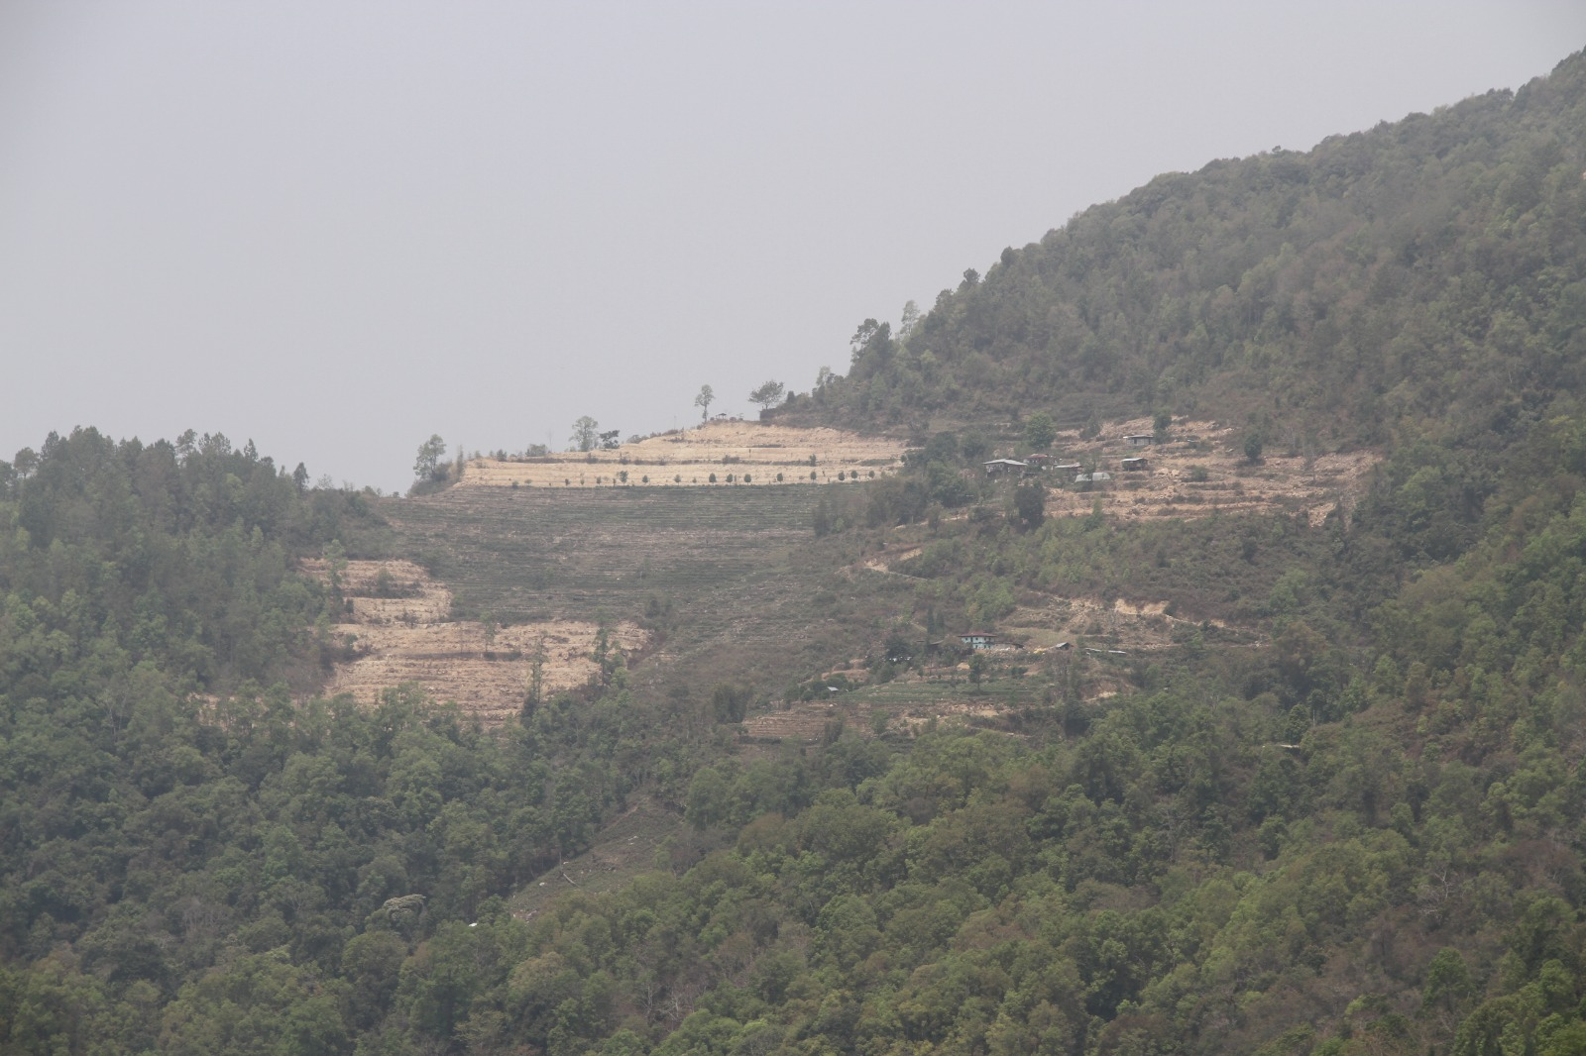
Relevant project pictures

Slide 10
Thank You!

