Slide 1
EDA Project
COUNTRY EXCHANGE IN IN TANZANIA_MAY 2024

Slide 2
The challenge that this proposal seeks to address key adaptation
Periodic drought
Increasing extreme rainfall &
water availability
Impacts on rural areas from
climate variability and change
The EDA will be focused on grants to sub-national government (district and local government) and civil society organizations (CSOs).
USD 5 million
The effects on agriculture &
livelihoods

Slide 3
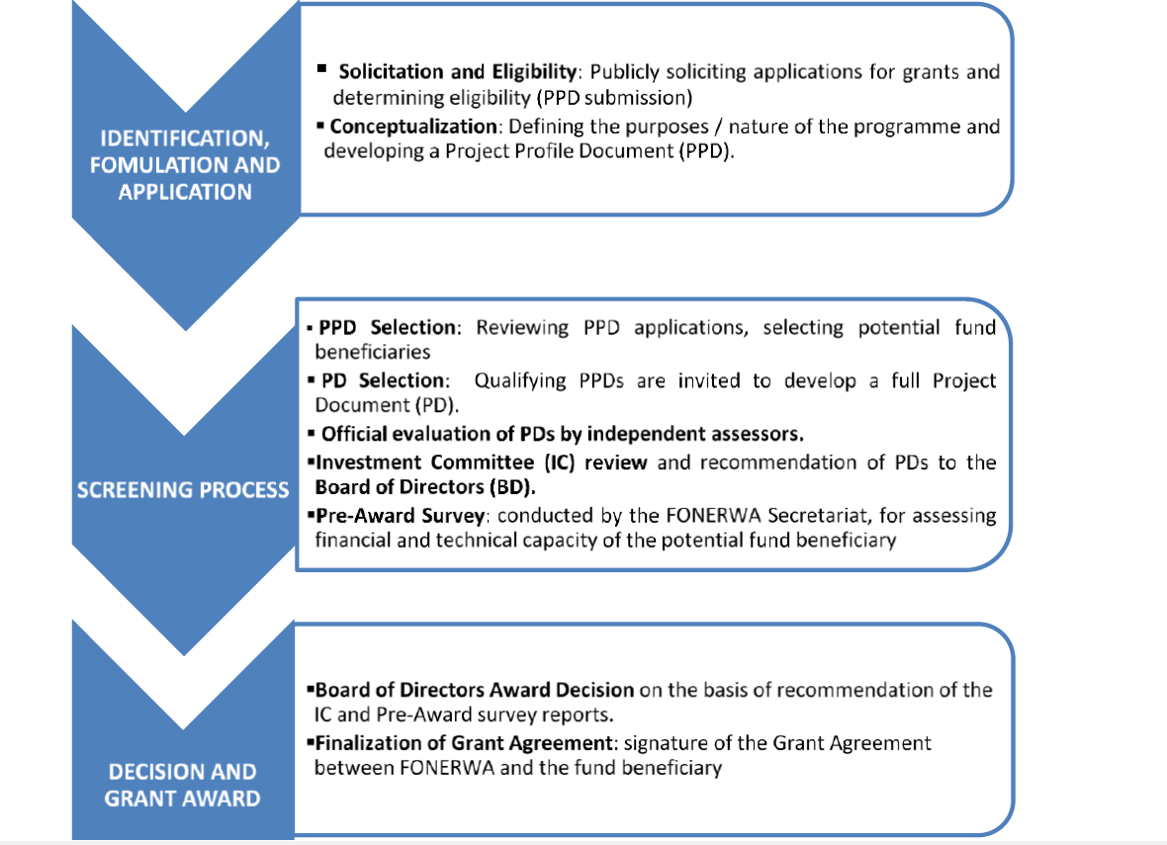

Slide 4
ROLE AND RESPONSIBILITIES
NIE (Ministry of Environment)
NEE( Rwanda Green Fund)
The overall management of the projects and programmes financed by the Adaptation Fund, and will bear all financial, monitoring, and reporting responsibilities
Execute adaptation projects and programmes supported by the Fund under the oversight of the Implementing Entities.

Slide 5
MURAKOZE

